Slide 1


WORKSHOP ON BRAIN-MACHINE INTERFACES
IEEE SMC 2026
October 4-7, 2026
Towards Enhanced Information Transfer Rates in SSVEP-Based BCIs Using
Conway's Game of Life as Visual Overlay
Atilla Cantürk and Ivan Volosyak
Faculty of Technology and Bionics
Rhine-Waal University of Applied Sciences, 47533 Kleve, Germany

Slide 2
Motivation
The Problem
Proposed Solution
High-contrast flickering targets cause visual fatigue and eye strain [1,2]
Reduced vigilance degrades SSVEP amplitude and classification accuracy
Repetitive tasks reduce attentional engagement during prolonged gaze fixation
Augment SSVEP targets with a dynamic visual overlay
Conway's Game of Life: complex evolving patterns from four simple rules
Phase-lock GoL dynamics to SSVEP flicker → no change to decoding
Hypothesis: richer visual context sustains attention while maintaining performance
For assistive end users who rely on a BCI daily,
comfort and engagement decide long-term acceptance.
[1] T. Cao, F. Wan, C. M. Wong, J. N. da Cruz, and Y. Hu, "Objective evaluation of fatigue by EEG spectral analysis in steady-state visual evoked potential-based brain-computer interfaces,“ BioMedical Engineering OnLine, vol. 13, no. 1, Mar. 2014.
[2] M. Azadi Moghadam and A. Maleki, "Fatigue factors and fatigue indices in SSVEP-based brain-computer interfaces: a systematic review and meta-analysis," Frontiers in Human Neuroscience, vol. 17, Nov. 2023.

Slide 3
Background
Chen et al. 2023;
Volosyak et al. 2011
Higher frequencies / lower contrast mitigate fatigue while largely preserving decoding performance
Fodor & Volosyak 2025
Imperceptible VEP (I-VEP): above critical fusion threshold
eliminates flicker perception, retains separability
Dehais et al. 2024
Gabor-based textured flickers maintain strong decoding and improve comfort (J Neural Engineering)
Gomel et al. 2025 (SMC)
StAR-Burst: random texture patches on flicker targets; modifying visual composition preserves performance and improves UX
Schrag et al. 2025
Textured SSVEP stimuli affect comfort in pediatric BCI
but clear gains in neural response are inconsistent
Gap: Application of a dynamic textured stimuli to improve SSVEP BCI
classification not yet tested.

Slide 4
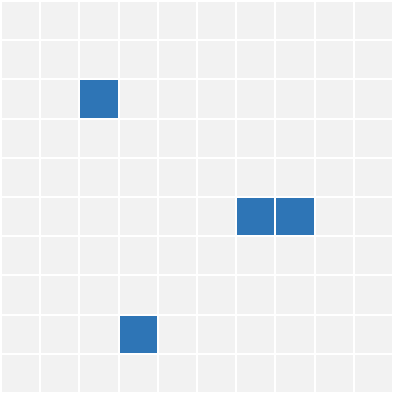
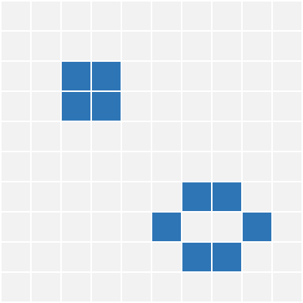
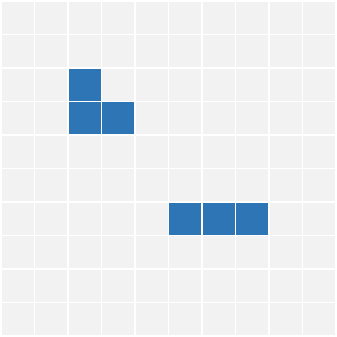
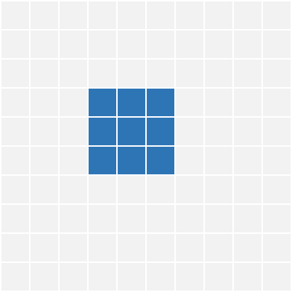
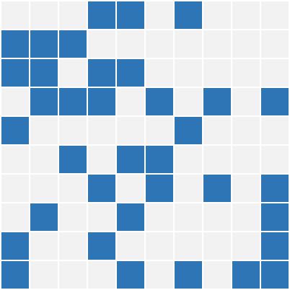
Conway's Game of Life
1
Underpopulation
Live cell with < 2 live neighbours → dies
Invented by John Conway (1970)
Grid of cells: alive or dead, evolving step by step
No player input → everything follows four simple rules
2
Survival
Live cell with 2 or 3 neighbours → lives
3
Reproduction
Dead cell with exactly 3 neighbours → born
4
Overpopulation
Live cell with > 3 neighbours → dies

Slide 5
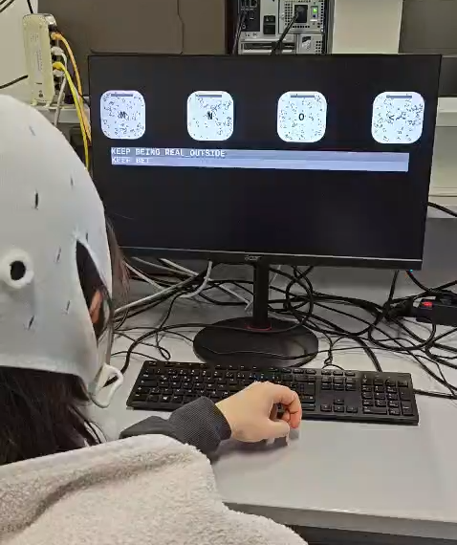
Hardware - Setup
PC
Dell Precision, Intel Core i9 (5.3 GHz), RTX-3070
OS
Windows 11 Education (24H2)
Monitor
Acer Nitro XV25Q F — 1920×1080, 240 Hz
EEG Amplifier
g.USBamp (Guger Technologies, Schiedlberg, Austria)
EEG Channels
PO7, PO3, POz, PO4, PO8, O1, Oz, O2 (10-10 system)
Reference / GND
Cz / AFz | Impedance < 5 kΩ (abrasive gel)
Sampling Rate
600 Hz

Slide 6
3-step SSVEP speller with GoL overlay
3-Step SSVEP Speller
Experimental Design
4 stimulus boxes (230×230 px) in 1×4 matrix
Frequencies: 6.67, 7.5, 8.57, 10 Hz
26 letters + underscore across 3 letter-group boxes
4th box: UNDO / backspace function
Audio + visual (green/red) feedback on selection
Within-subject design: Condition 1 (default) vs Condition 2 (GoL overlay)
Starting condition counterbalanced across participants
3 spelling tasks: RELAX, HAVE_FUN, KEEP_BEING_REAL_OUTSIDE
~15–20 min per condition + short rest break between
No classifier training required — training-free FBCCA

Slide 7
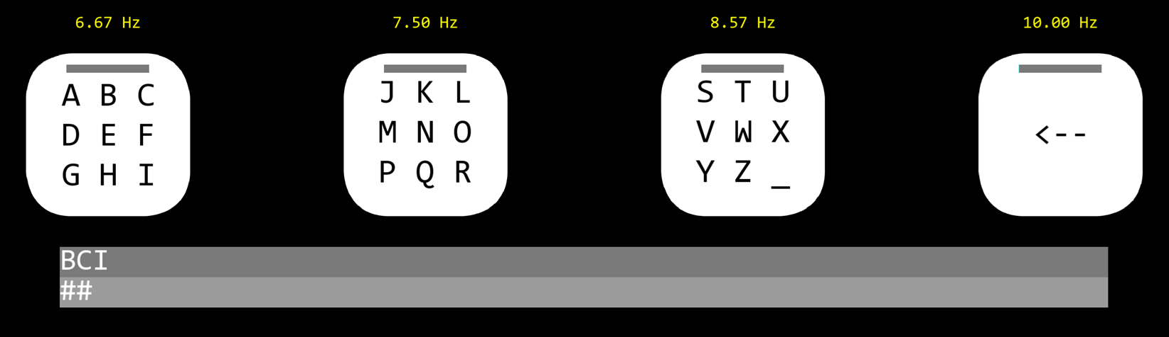
The GoL overlay
Condition 1 — Default Stimuli
Condition 2 — GoL Overlay
4 boxes, white ↔ black alternation at assigned frequency
Full contrast, no additional overlay
No GoL simulation running
Identical boxes and frequencies — only overlay added
128×128 cellular automaton grid per box
GoL state updated at every white↔black transition (phase-locked to flicker)
Active cells rendered at mid-contrast:
grey on white; invisible on black
Seed: sparse random (p ≤ 0.10) + predefined library patterns

Slide 8


Overlay Comparison
Default Stimuli
GoL Overlay
▶
▶
vs

Slide 9
Classification
Filter Bank Decomposition
Decision Criteria
5 sub-bands, 2nd-order Butterworth bandpass
FB₁: 6–60 Hz | FB₂: 14–60 Hz
FB₃: 22–60 Hz | FB₄: 30–60 Hz
FB₅: 38–60 Hz
Upper cut-off 60 Hz = g.USBamp maximum
Weights: wᵢ = (i+1)⁻¹·²⁵ + 0.25
emphasises lower-frequency sub-bands
Sliding 3.0 s window, updated every 50 ms (20 Hz update rate)
Classify if: ≥ 1.5 s elapsed AND
Δscore ≥ 0.15
1 s gaze-shift delay after each accepted classification
Reference signals: sine/cosine at fundamental + 5 harmonics per frequency
No subject-specific classifier training

Slide 10
Participants and Procedure
Participants (N = 6)
Procedure
5 male, 1 female; (22.83 ± 2.93 years)
3/6 prior BCI experience;
1/6 knew Conway's GoL
No neurological/psychiatric conditions (self-report)
Written consent (Declaration of Helsinki)
Ethics approval 24-11957-BO
No classifier training performed
Pre-questionnaire.
Calibration.
Condition A (~15–20 min):
  RELAX
  HAVE_FUN
  KEEP_BEING_REAL_OUTSIDE
Rest break between conditions
Condition B: alternate stimulus condition
Post-questionnaire

Slide 11
Performance - Accuracy
97.4%
95.6%
−1.8 pp
GoL Disabled
GoL Enabled
Difference
95% CI: [94.4, 100]
95% CI: [92.4, 98.8]
N=6 pilot — overlapping CIs

Slide 12
Performance - ITR
40.95
34.53
−6.42
bits/min
bits/min
bits/min
GoL Disabled
GoL Enabled
Difference
95% CI: [29.19, 52.70]
95% CI: [21.33, 47.73]
Wide overlapping CIs

Slide 13
Discussion
Questionnaire Results (n=6)
Discussion
Preference: 50% preferred default, 50% preferred GoL overlay
Fatigue: 2.33 ± 0.82 → 4.00 ± 1.26
(Δ = +1.67 Likert points)
Device control feasibility: median 2
(IQR 1–4); 66.7% agreement
Interesting: all participants preferring GoL showed lower accuracy + ITR under GoL
Accuracy remained high (97.4% vs 95.6%), GoL did not break SSVEP detection
ITR decrease likely due to increased visual complexity → reduced fixation stability, more eye-movement artifacts
Pilot (N=6): too small for definitive conclusions - effect directions, not significance
Results differ from Dehais 2024 textured flicker - different overlay dynamics, task design, metrics

Slide 14
Conclusion
Objective:
Evaluated a novel stimulus augmentation approach: embedding dynamic Conway's GoL overlay onto SSVEP flicker targets
Accuracy remained high in both conditions; ITR was lower with the overlay under the tested parameters
Future Goals:
Larger participant pool (N > 6) with novice BCI users
Systematically vary overlay density, contrast, and update coupling rate
Test GoL overlay with cVEP paradigm; explore GoL-driven SSMVEP
Separate analysis of decision time vs decoding accuracy to isolate the overlay's effect

Slide 15
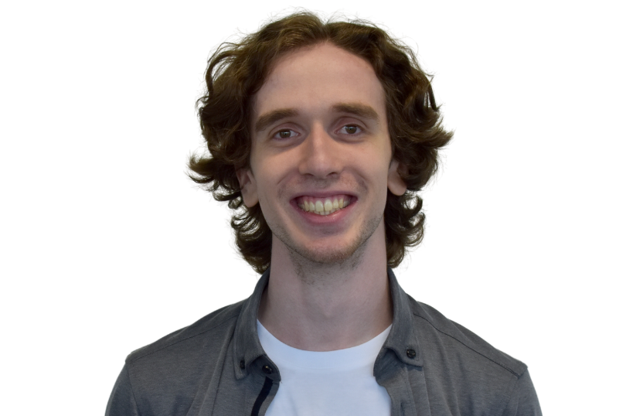
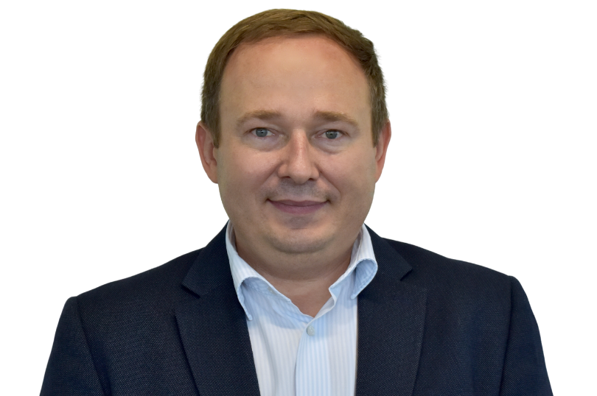
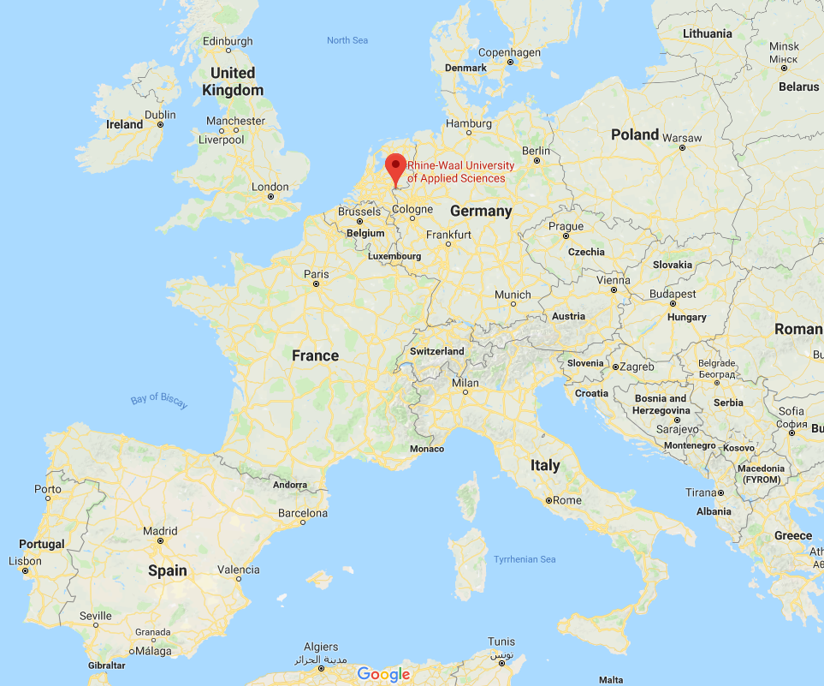


Thank You – Q & A
Atilla Cantürk Ivan Volosyak
Our Team
Projects
Tools
List of publications
Contacts
https://bci-lab.hochschule-rhein-waal.de

Slide 16
References
[1] J. R. Wolpaw et al., "Brain–computer interfaces for communication and control," Clin. Neurophysiol., vol. 113, no. 6, pp. 767–791, 2002.
[2] M. Nakanishi et al., "Enhancing detection of SSVEPs for a high-speed brain speller using task-related component analysis," IEEE TBME, vol. 65, no. 1, pp. 104–112, 2018.
[3] M. Azadi Moghadam and A. Maleki, "Fatigue factors and fatigue indices in SSVEP-based BCIs: a systematic review and meta-analysis," Front. Hum. Neurosci., vol. 17, 2023.
[4] T. Cao et al., "Objective evaluation of fatigue by EEG spectral analysis in SSVEP-based BCIs," BioMed. Eng. OnLine, vol. 13, no. 1, 2014.
[5] M. A. Fodor and I. Volosyak, "Towards visual-fatigue-free BCI with imperceptible visual evoked potentials (I-VEP)," IEEE SMC, pp. 3813–3818, 2025.
[6] X. Chen et al., "Optimizing stimulus frequency ranges for building a high-rate high frequency SSVEP-BCI," IEEE TNSRE, vol. 31, pp. 1277–1286, 2023.
[7] I. Volosyak et al., "BCI demographics II: how many (and what kinds of) people can use a high-frequency SSVEP BCI?," IEEE TNSRE, vol. 19, no. 3, pp. 232–239, 2011.
[8] P. Stawicki and I. Volosyak, "Comparison of modern highly interactive flicker-free SSMVEPs for practical BCIs," Brain Sci., vol. 10, no. 10, p. 686, 2020.
[9] V. Bravou and A. Drigas, "BCI-based games and ADHD," Res. Soc. Dev., vol. 10, no. 4, p. e52410413942, 2021.
[10] J. Gomel et al., "Pre-decision feedback in code-modulated visual evoked potentials BCI for an 11-class keypad typing task," IEEE SMC, pp. 3800–3805, 2025.
[11] F. Dehais et al., "Leveraging textured flickers: a leap toward practical, visually comfortable, and high-performance dry EEG code-VEP BCI," J. Neural Eng., vol. 21, no. 6, p. 066023, 2024.
[12] M. Gardner, "Mathematical games," Scientific American, vol. 223, no. 4, pp. 120–123, 1970.
[13] I. Volosyak et al., "Towards solving of the illiteracy phenomenon for VEP-based BCIs," Biomed. Phys. Eng. Express, vol. 6, no. 3, p. 035034, 2020.
[14] X. Chen et al., "Filter bank canonical correlation analysis for implementing a high-speed SSVEP-based BCI," J. Neural Eng., vol. 12, no. 4, p. 046008, 2015.
[15] E. Schrag et al., "An investigation into the comfort and neural response of textured visual stimuli in pediatric SSVEP-based BCI," Sci. Rep., vol. 15, no. 1, p. 26168, 2025.
[16] ConwayLife.com, "Conway's Game of Life pattern collection," conwaylife.com/patterns/, accessed 17 Feb. 2026.

