Slide 1

WORKSHOP ON BRAIN-MACHINE INTERFACES
IEEE SMC 2026 OCTOBER 4–7, 2026
MTCANet: A Multi-scale Fusion Temporal Convolution
and Multi-level Attention-based Network for
EEG-Based Motor Imagery Classification
Shangge Li, Yuan Yao and Ya Zhang
Motor Imagery EEG Classification · BCIC-IV-2a
Multi-scale convolution · Temporal modeling · Efficient attention
Academic Conference Presentation
IEEE SMC 2026

Slide 2
IEEE SMC 2026
Why motor-imagery EEG decoding remains difficult
01
02
03
Low SNR
Non-stationarity
Heterogeneity
Weak neural rhythms are easily masked by artifacts and background activity.
Signal statistics drift across trials, sessions and recording days.
Discriminative spatial-temporal patterns differ substantially across subjects.
Design objective: learn local rhythms, long-range temporal dependencies, and adaptive feature weights in one end-to-end model.
Motor imagery enables control without overt movement, making robust decoding relevant to neurorehabilitation and assistive BCIs.
MTCANet
2

Slide 3
IEEE SMC 2026
Research gap and contributions
LIMITATION OF EXISTING HYBRIDS
1
Multi-scale, scale-conditioned attention
1
Feature selection and fusion are often static, despite strong trial-to-trial variability in MI-EEG.
MHSA follows each temporal branch, refining dependencies at its own resolution.
2
Efficient channel-spatial recalibration
2
Static feature fusion
Adaptive multi-level fusion
ECBAM combines ECA-style channel gating with convolutional spatial attention.
MTCANet aligns feature extraction, temporal modeling and attention with the variability of MI-EEG.
3
Discriminative joint supervision
3
Cross-entropy and center loss jointly separate classes and compact embeddings.
MTCANet
3

Slide 4
IEEE SMC 2026
Dataset and subject-dependent evaluation protocol
9
22
250 Hz
288
4
Healthy participants
Ag/AgCl EEG channels
Sampling rate
Trials per session
MI classes
SESSION T
SESSION E
80% training
20% validation
separate days
Independent test session
Hyperparameter selection only
Never used for tuning or model selection
Left hand · Right hand · Both feet · Tongue | Window: [0, 4] s after cue
MTCANet
4

Slide 5
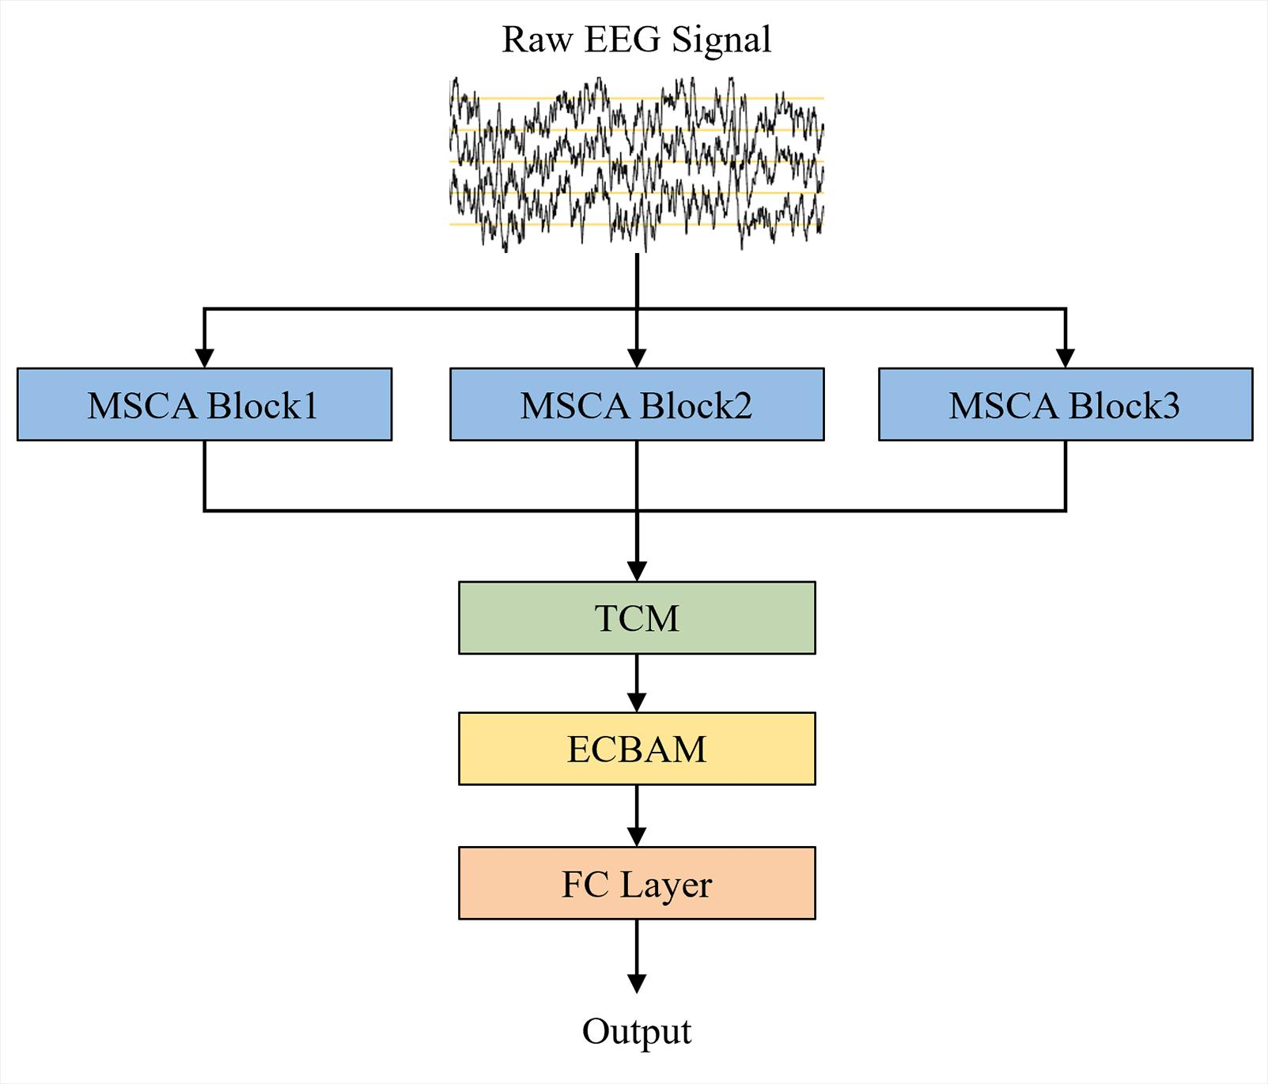
IEEE SMC 2026
MTCANet: end-to-end architecture
THREE COOPERATING STAGES
■ MSCA extracts temporal features at three scales and applies branch-wise MHSA.
■ TCM fuses branches and models short- and long-range temporal dependencies.
■ ECBAM recalibrates channel and spatial responses before classification.
Raw EEG → representation → 4-class output
MTCANet
5

Slide 6
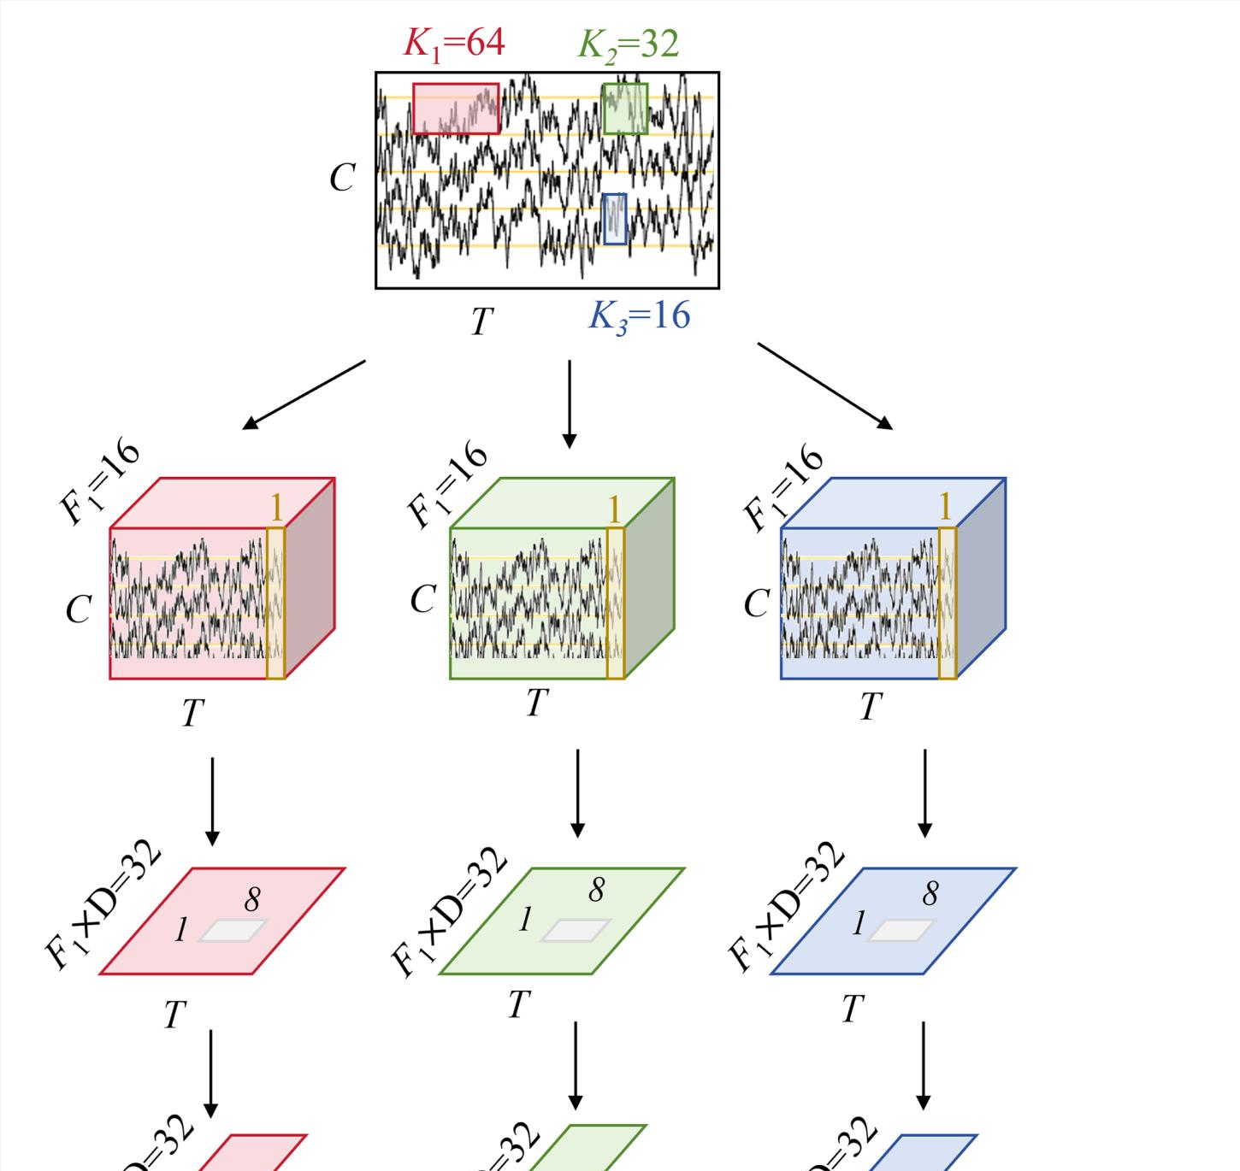
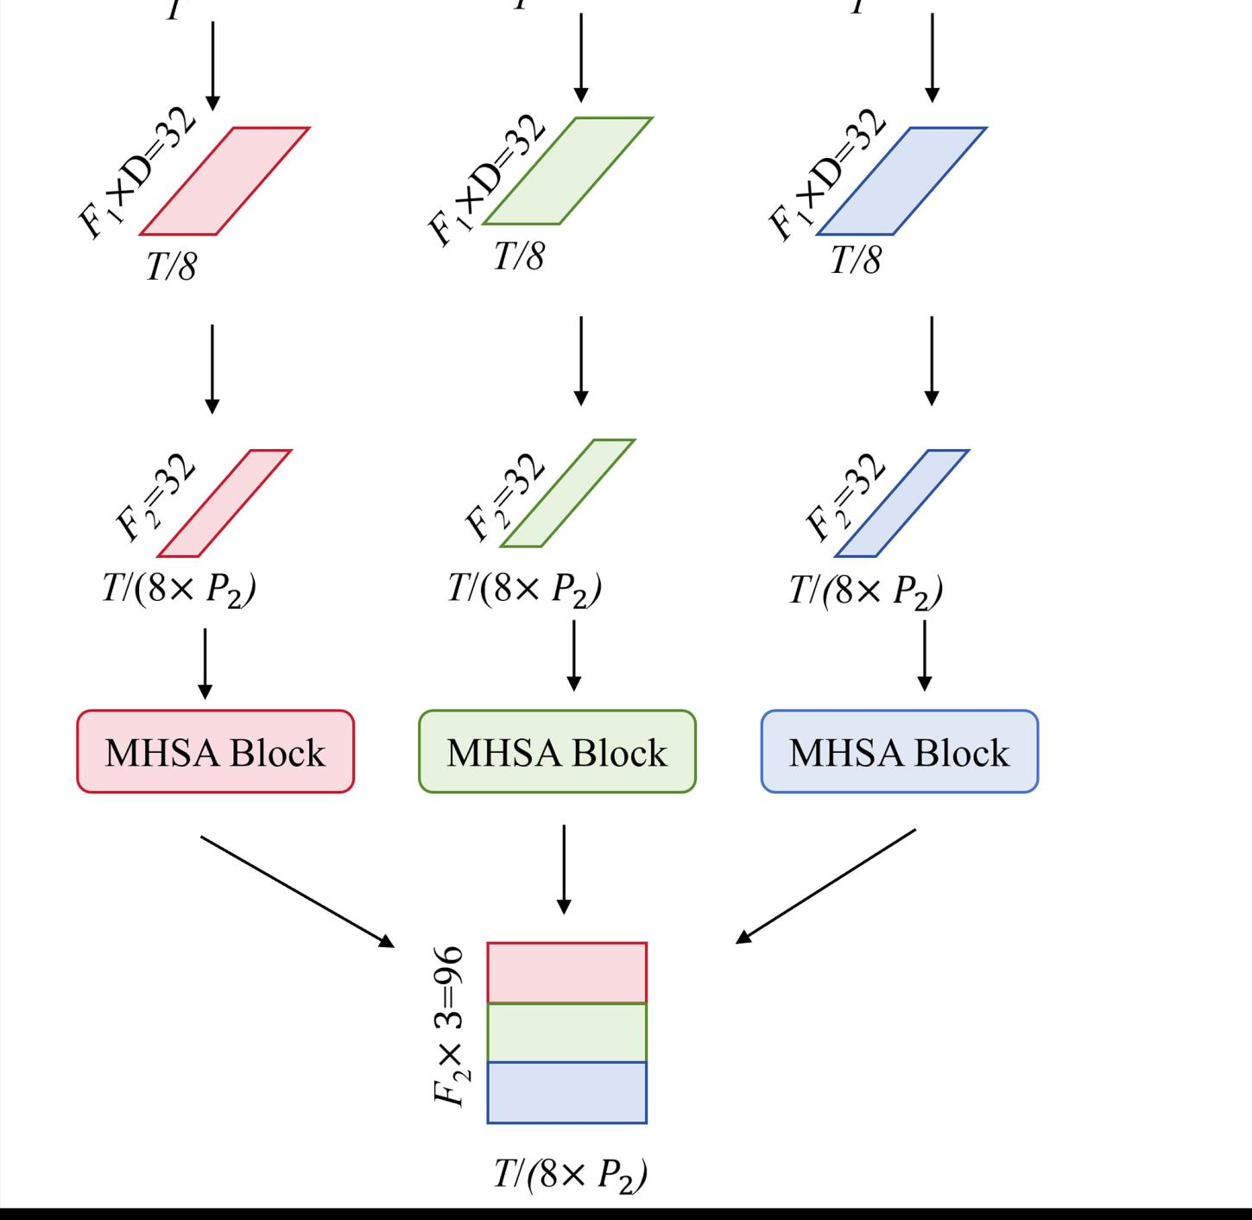
IEEE SMC 2026
MSCA: multi-scale convolution before fusion
WHY THREE SCALES?
■ Kernel sizes K = {16, 32, 64} probe distinct temporal resolutions.
■ Temporal convolution is followed by depthwise spatial filtering across EEG channels.
■ Separable convolution and pooling reduce dimensionality while preserving useful rhythms.
■ Outputs are concatenated only after branch-specific attention refinement.
F1 = 16 · D = 2 · F2 = 32 · P2 = 8
MTCANet
6

Slide 7
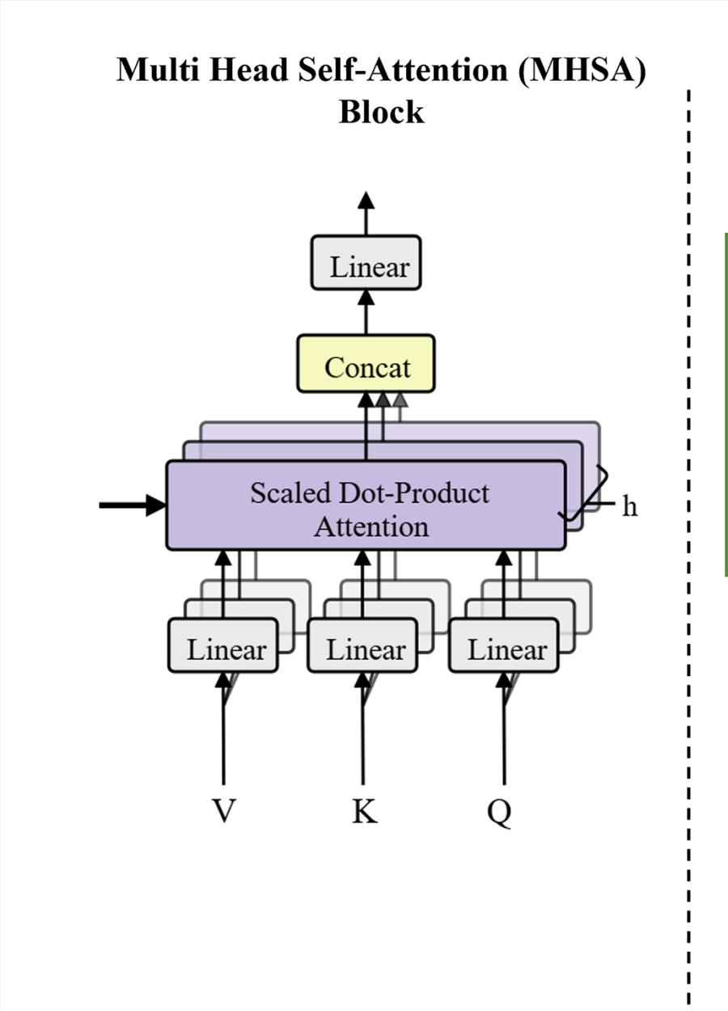
IEEE SMC 2026
MHSA: scale-conditioned global dependency modeling
BRANCH-WISE ATTENTION
Attention(Q,K,V) = softmax(QKᵀ / √dₖ)V
■ Two attention heads; depth = 1.
■ Short-scale branches can emphasize local rhythmic structure.
■ Long-scale branches can capture broader temporal context.
■ Attention is applied before branch concatenation, preserving scale specificity.
MTCANet
7

Slide 8
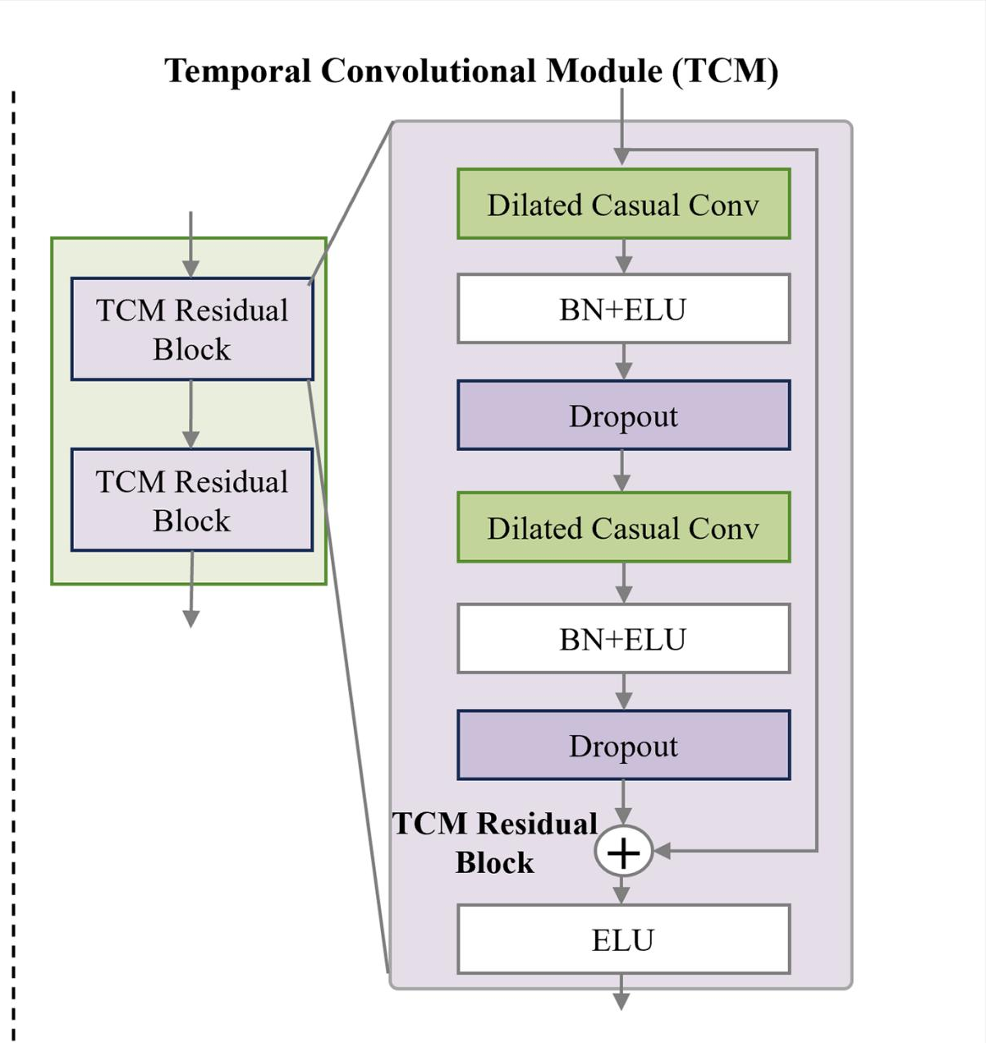
IEEE SMC 2026
TCM: temporal fusion with dilated causal convolutions
TEMPORAL MODELING AFTER FUSION
■ Two residual blocks, each containing two dilated causal convolutions.
■ Batch normalization and ELU stabilize optimization and nonlinear modeling.
■ Residual paths support gradient flow through the temporal stack.
■ Dilation expands the receptive field without recurrent computation.
L = 2 · Kₜ = 4 · Fₜ = 32 · dropout = 0.5
MTCANet
8

Slide 9
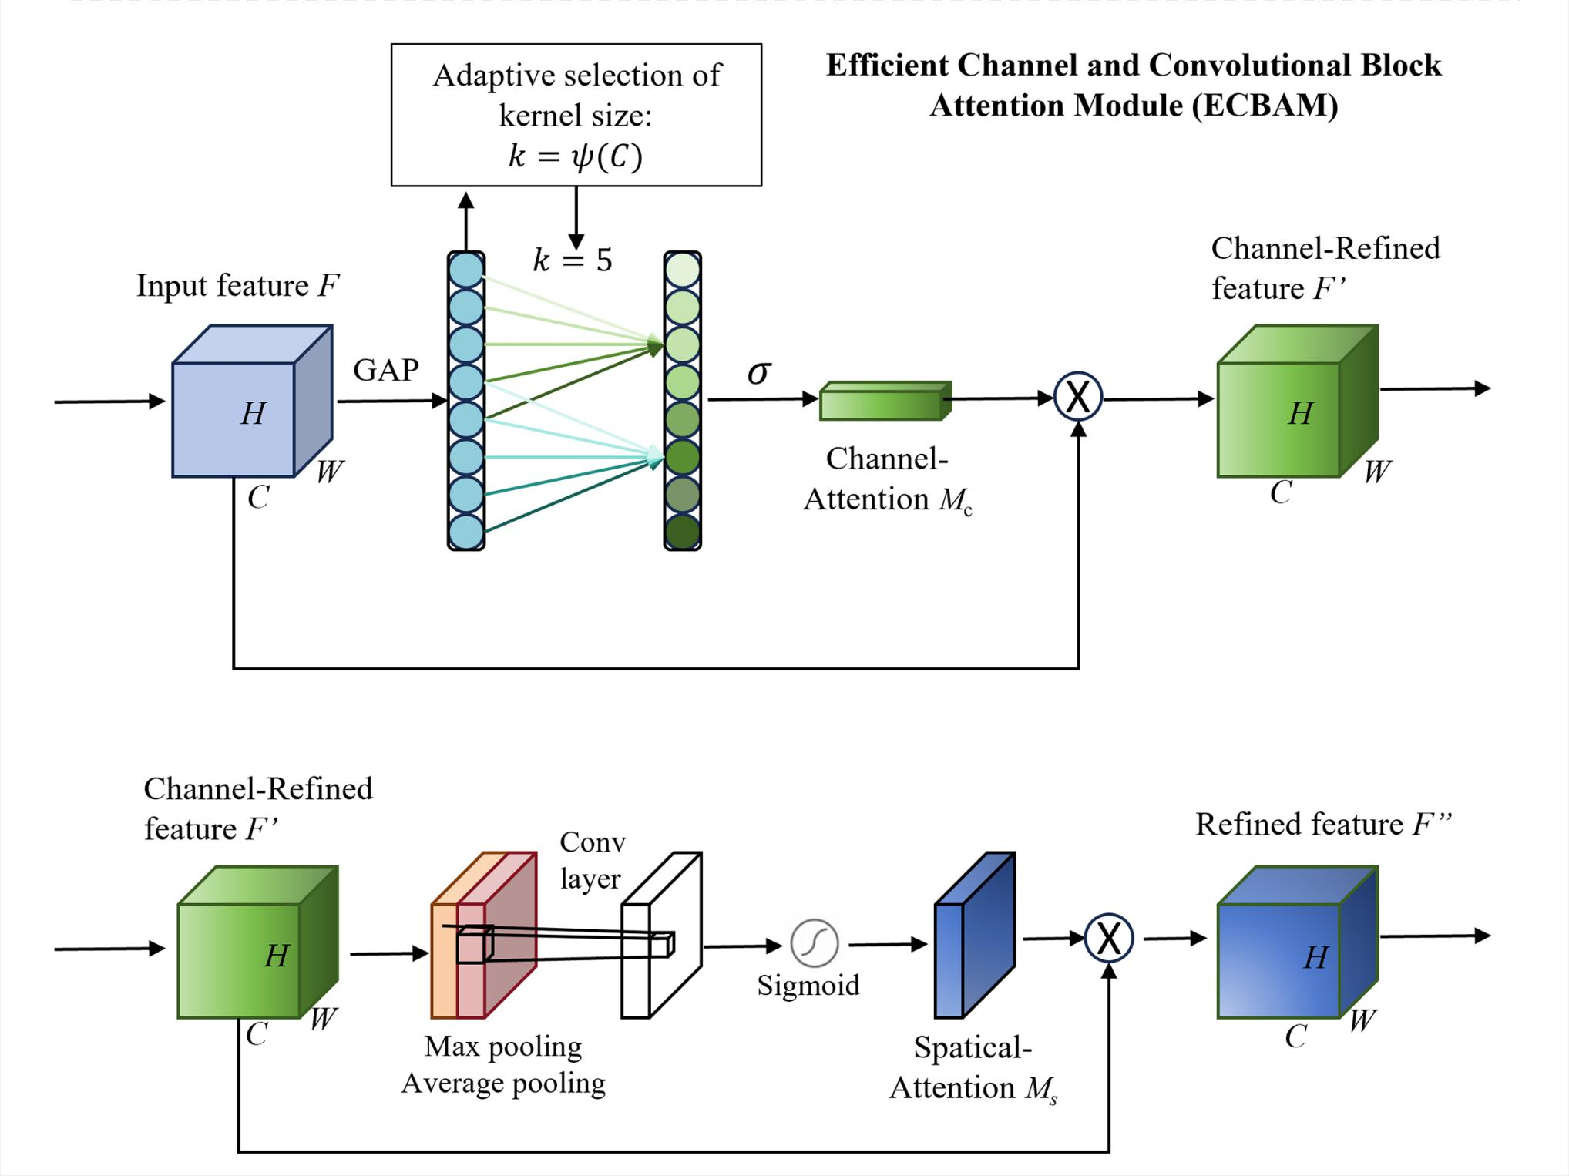
IEEE SMC 2026
ECBAM: efficient channel and spatial recalibration
TWO-STAGE RECALIBRATION
1
Channel attention
ECA-style 1D convolution learns efficient cross-channel weights.
2
Spatial attention
Pooled feature maps guide convolutional spatial weighting.
3
Refined output
Sequential weighting produces the discriminative feature F double-prime.
MTCANet
9

Slide 10
IEEE SMC 2026
Joint objective and temporal-segment augmentation
JOINT LOSS
SEGMENT-AND-RECOMBINE AUGMENTATION
L = LCE + λLC
Same-class trial pool
Segment position
A
1
2
3
4
5
6
7
8
Cross-entropy optimizes class decisions; center loss reduces intra-class feature dispersion.
B
1
2
3
4
5
6
7
8
C
1
2
3
4
5
6
7
8
Random selection at each temporal position
λ = 0.002
selected on validation performance
Augmented trial
1
2
3
4
5
6
7
8
Eight non-overlapping segments are recombined without changing trial length.
MTCANet

Slide 11
IEEE SMC 2026
Implementation details and evaluation metrics
2000
0.0009
1×10⁻⁴
Cosine
training epochs
initial learning rate
AdamW weight decay
annealing schedule
EVALUATION
Accuracy
Cohen’s κ
Observed proportion of correct four-class decisions
κ = (pₒ − pₑ) / (1 − pₑ), correcting for chance agreement
Framework: PyTorch · Hardware reported in paper: NVIDIA GeForce RTX 4080
MTCANet
11

Slide 12
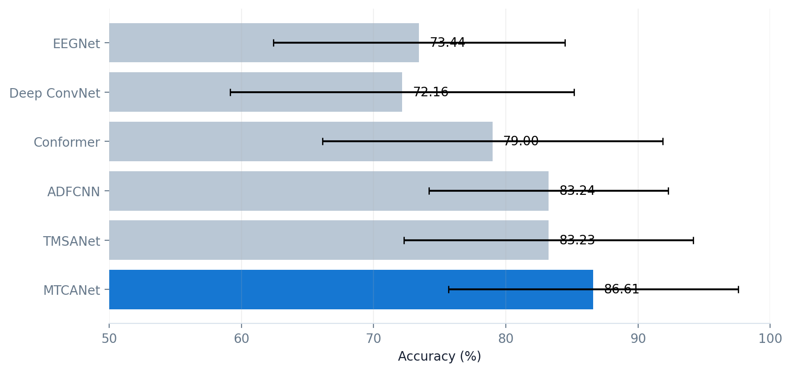
IEEE SMC 2026
Headline result: best overall performance
86.61%
mean classification accuracy
±10.96% across nine subjects
0.82
mean Cohen’s Kappa
+3.37 points over ADFCNN, the strongest baseline mean
MTCANet
12

Slide 13
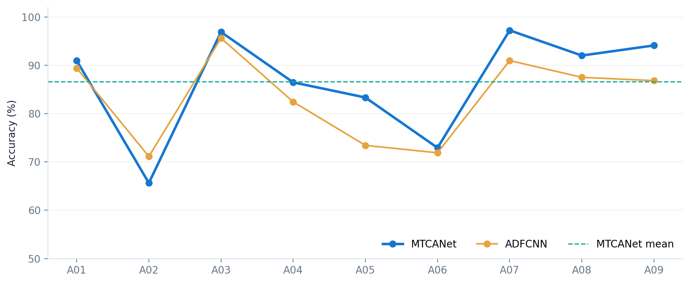
IEEE SMC 2026
Per-subject performance
SUBJECT VARIABILITY
97.22%
Best: A07
65.63%
Lowest: A02
MTCANet exceeds ADFCNN for 8 of 9 subjects; A02 remains the exception.
MTCANet
13

Slide 14
IEEE SMC 2026
Performance gains are statistically supported
χ²(5)=11.40
p = 0.044
p < 0.01
Kruskal–Wallis statistic
Overall model difference
Four post-hoc comparisons
REPORTED POST-HOC WILCOXON COMPARISONS
EEGNet
significant
Interpretation
Deep ConvNet
significant
The omnibus test confirms a model effect. MTCANet significantly outperforms four baselines; its advantage over ADFCNN is numerical but not significant.
Conformer
significant
TMSANet
significant
ADFCNN
not significant
MTCANet
14

Slide 15
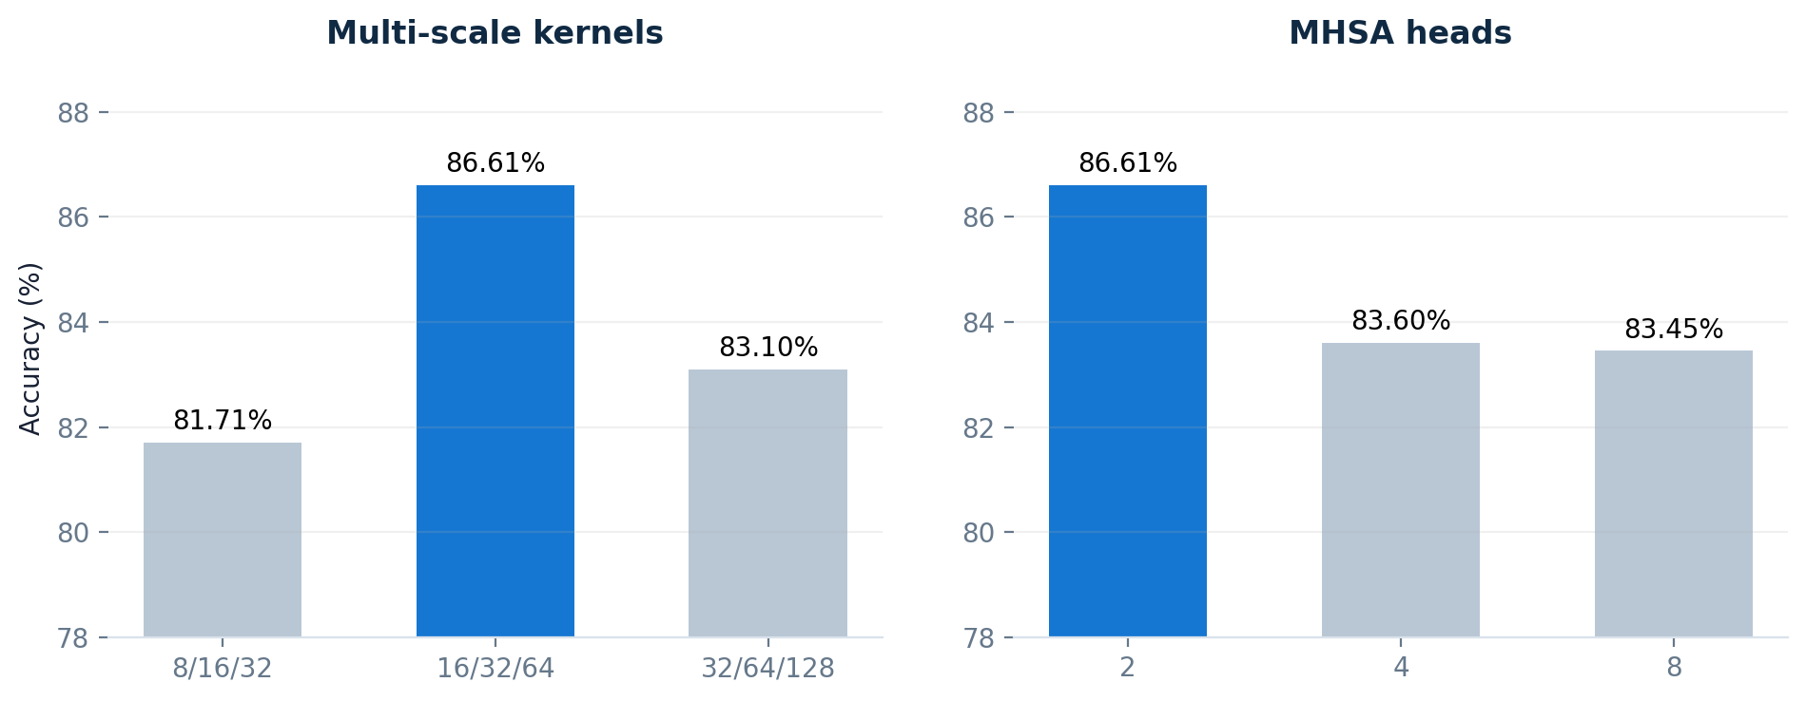
IEEE SMC 2026
Hyperparameter sensitivity
BEST CONFIGURATION
{16, 32, 64}
temporal kernels
2 heads
multi-head self-attention
Kernel scale matters more than increasing the head count.
MTCANet
15

Slide 16
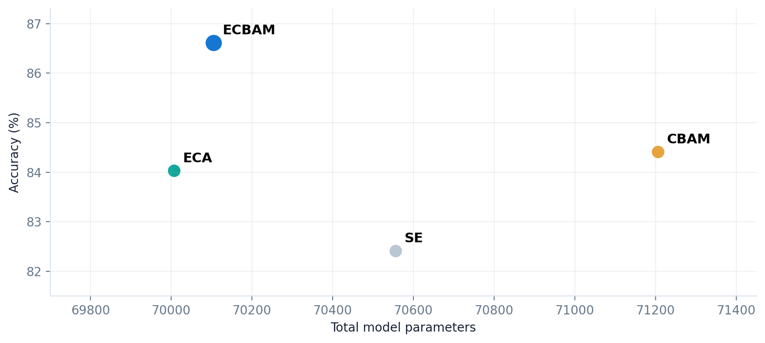
IEEE SMC 2026
ECBAM balances accuracy and parameter efficiency
ECBAM
86.61% accuracy
70,105 parameters
■ +2.20 points vs. CBAM
■ +2.58 points vs. ECA
■ 1,101 fewer parameters than CBAM
Best accuracy among tested attention modules
MTCANet
16

Slide 17
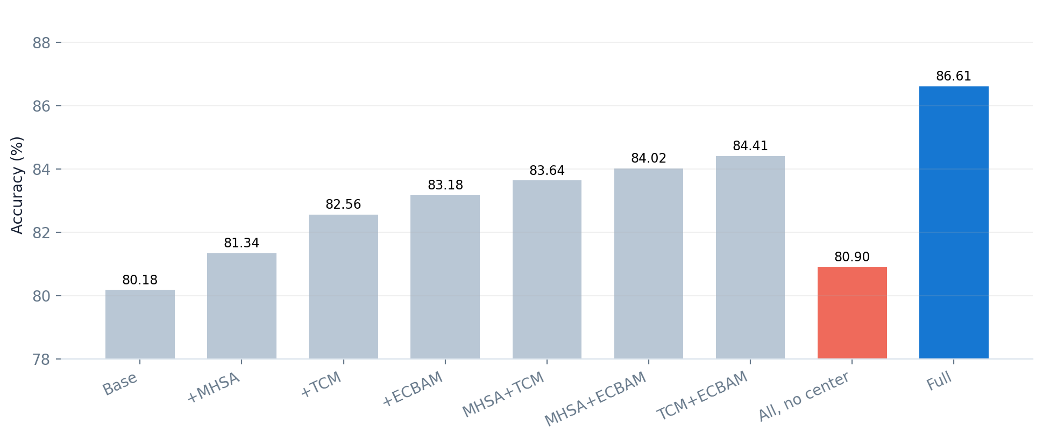
IEEE SMC 2026
Ablation: every component contributes
KEY OBSERVATION
+6.43
points over base model
Center loss is decisive in the reported full configuration:
80.90%
without center loss
86.61%
with center loss
Single-module and paired-module variants all improve over the 80.18% base model.
MTCANet
17

Slide 18
IEEE SMC 2026
Limitations and future work
LIMITATIONS
NEXT STEPS
■ One benchmark dataset: BCIC-IV-2a.
■ Subject-dependent evaluation only.
■ Offline results; real-time performance remains untested.
■ Larger and more diverse MI-EEG datasets.
■ Cross-subject and cross-session learning.
■ Online BCI deployment and evaluation.
Generalization to new users, devices and recording conditions remains open.
Robustness across EEG hardware and acquisition settings should be assessed.
MTCANet
18

Slide 19
IEEE SMC 2026
Conclusion
Multi-scale
Three temporal branches capture complementary MI-EEG patterns.
Multi-level attention
Branch-wise MHSA and ECBAM refine temporal, channel and spatial features.
Temporal fusion
Residual dilated causal convolutions model short- and long-range dependencies.
Strong result
86.61% accuracy and κ = 0.82 on BCIC-IV-2a.
MTCANet integrates complementary feature extraction and efficient attention in a unified MI-EEG decoder.
MTCANet
19

Slide 20
THANK YOU
SELECTED REFERENCES
Questions?
■ Lawhern et al., EEGNet, J. Neural Eng., 2018.
■ Ingolfsson et al., EEG-TCNet, IEEE SMC, 2020.
■ Vaswani et al., Attention Is All You Need, NeurIPS, 2017.
■ Wang et al., ECA-Net, CVPR, 2020.
■ Wen et al., Center Loss, ECCV, 2016.
■ Brunner et al., BCI Competition IV-2a, 2008.
MTCANet for EEG-based motor imagery classification
Shangge Li · Yuan Yao · Ya Zhang
20

