Slide 1

AsymHRF-Net
Physiologically Constrained Asymmetric Fusion of EEG and fNIRS
for Subject-Independent Brain–Computer Interfaces
Zhengyang Ding¹ Peicong Wu² Xiyao Tang³
¹ UESTC ² Yangtze Delta Region Institute (Quzhou), UESTC
³ Chongqing University
Paper 1361

Slide 2

EEG and fNIRS follow different timescales
EEG
fNIRS
Fast electrical activity
Delayed blood response
High temporal resolution
Sensitive to noise
Complementary information
Several seconds later
How should fusion handle this delay?
02 / 10

Slide 3
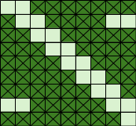
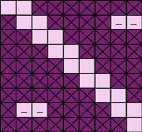
AsymHRF-Net
EEG provides the main path. fNIRS provides delayed guidance.
eeg_input:
C_{e} × T_{e}
Projector
1×T_{pe}×G ×G
Spatio Mix
1×T_{pe}×G ×G
EEG
Encoder
Envelope
C_{e}×T_{pe}
C_{e}
Modulate
Classifier
T_{e}
T_{pe}
T_{pe}
Dynamics Mask
…
fNIRS_input:
C_{f} × T_{f}
Projector
1×T_{pf}×G ×G
Spatio Mix
1×T_{pf}×G ×G
fNIRS
Encoder
Quality
Gate
fNIRS
Tokens
Envelope
C_{f}×T_{pf}
1×T_{pe}×G ×G
C_{e}
64
HBO
Proj
Multi-Head
Cross-Attention
(MHA)
Aligned
HBO
T_{e}
Branch
Pool
Renew Feat
T_{pe}
T_{pe}
HBR
Proj
Delay Mask
…
Aligned
HBR
T_{pe} × T_{f}
fusion:64
03 / 10

Slide 4
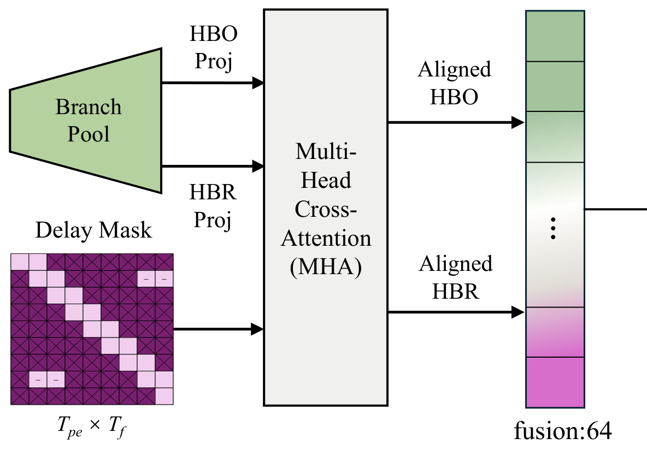
Attention follows a 3–8 s delay window
3–8 s
Fixed HRF delay prior
EEG queries
fNIRS keys and values
Learned attention
inside the allowed window
04 / 10

Slide 5
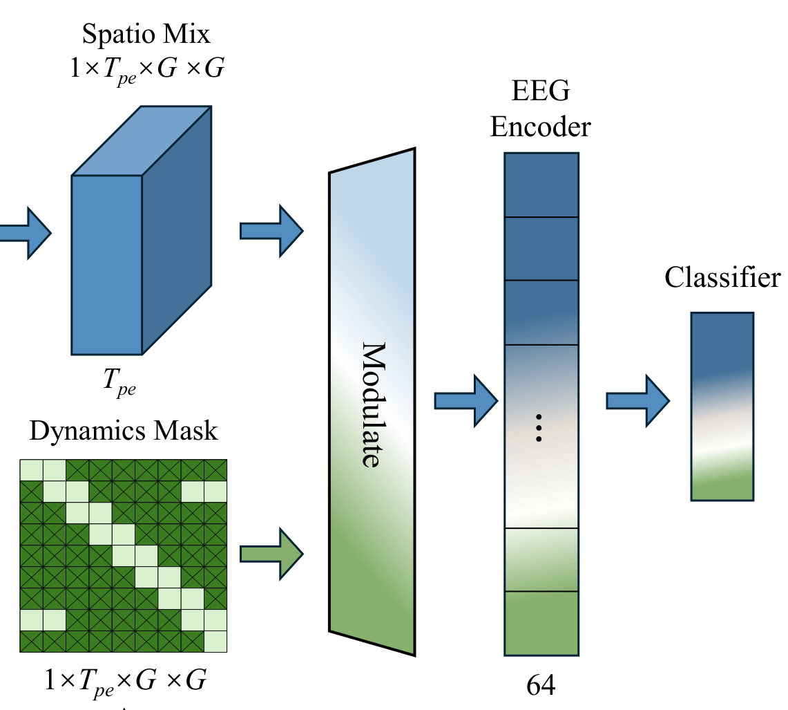
fNIRS guides the EEG features
Dynamic mask
Emphasize EEG features
Residual path
Preserve EEG features
Quality gate weights each trial in the training loss
05 / 10

Slide 6
Leave-one-subject-out evaluation
29 participants · Left- vs right-hand motor imagery
PARTICIPANTS
THE TASK
…
← →
01
02
03
…
29
Imagine hand movement
Fold 1
Test
Train
Train
…
Train
Fold 2
Train
Test
Train
…
Train
⋮
Fold 29
Train
Train
Train
…
Test
EEG + fNIRS
28 train + 1 unseen test → repeat for all 29
8 s windows · 1 s stride · Same protocol for all methods
Dataset: Shin et al., IEEE TNSRE, 2017
06 / 10

Slide 7
63.89% accuracy under the shared LOSO protocol
Accuracy (%) Results under our shared evaluation pipeline
07 / 10
Notes:
=

Slide 8
The full model improves over EEG alone
59.48%
63.89%
+4.41 pp
EEG-only
AsymHRF-Net
p = 0.0041
Accuracy (%) by participant Paired two-sided t-test, n = 29
08 / 10

Slide 9
From offline evidence to broader use
CURRENT SCOPE
One dataset · Binary motor imagery · Offline evaluation
01
02
03
A
B
C
BCI
3–8 s prior → adaptive
Test each module
Adapt the delay
Broaden evaluation
Separate contributions
Fit individual timing
More datasets + online use
NEXT STEPS
09 / 10

Slide 10
Physiology guides fusion
AsymHRF-Net
HRF-constrained
attention
fNIRS-guided
EEG features
Subject-independent
decoding
Thank you
Zhengyang Ding
2023150902014@std.uestc.edu.cn
10 / 10

Slide 11
Full benchmark results
Supplementary material
Method | Input | Acc. (%) | κ | Macro F1
LMDA | EEG | 53.39 | 0.13 | 0.528
EEG-only | EEG | 59.48 | 0.19 | 0.566
fNIRS-Trans. | fNIRS | 52.55 | 0.05 | 0.520
fNIRSNet | fNIRS | 56.92 | 0.14 | 0.562
FGANet | EEG + fNIRS | 59.60 | 0.21 | 0.572
BiMNC | EEG + fNIRS | 62.39 | 0.25 | 0.604
M2NN | EEG + fNIRS | 52.87 | 0.06 | 0.525
EFMLNet | EEG + fNIRS | 58.70 | 0.17 | 0.578
E-FNet | EEG + fNIRS | 54.56 | 0.09 | 0.516
AsymHRF-Net | EEG + fNIRS | 63.89 | 0.28 | 0.620
EEG-only uses the same backbone without the fNIRS fusion modules
Supplement 1

Slide 12
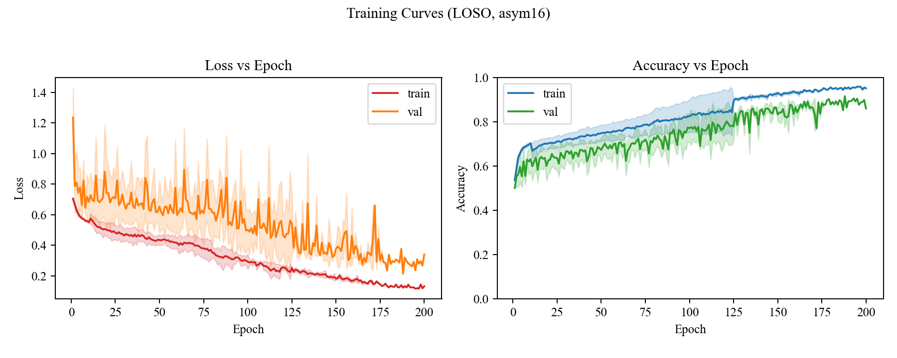
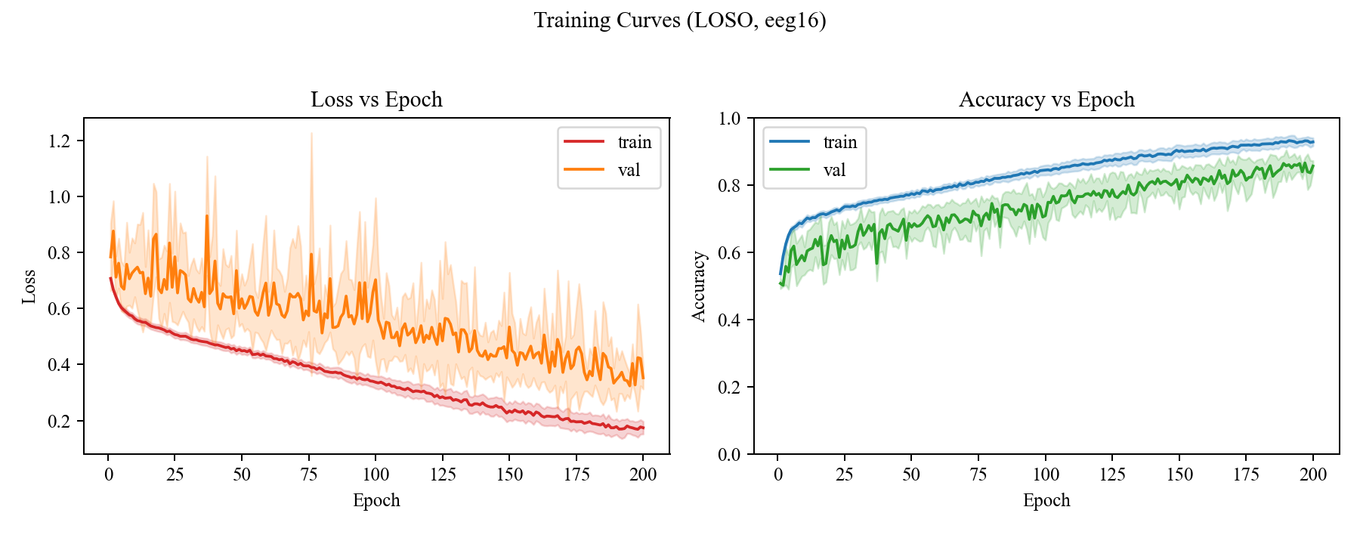
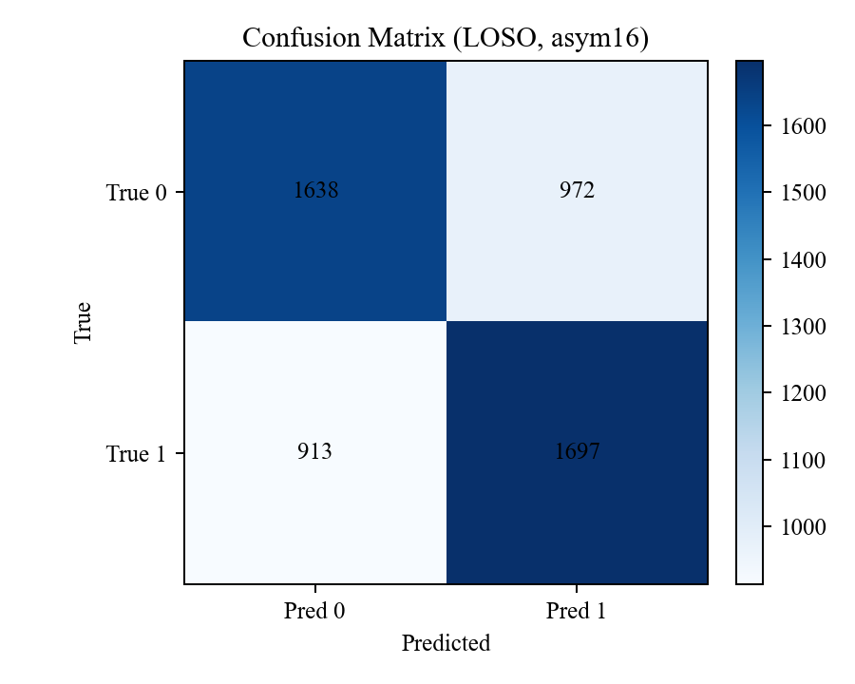

Original training curves and confusion matrices
Supplementary material
AsymHRF-Net
EEG-only
Supplement 2

