Slide 1





Towards simultaneous decoding of kinetic and kinematic movement parameters during grasp and lift task by non-invasive brain imaging
Parth G. Dangi and Yogesh Kumar Meena
Human-AI Interaction Lab, Dept. of Computer Science and Engineering

Slide 2
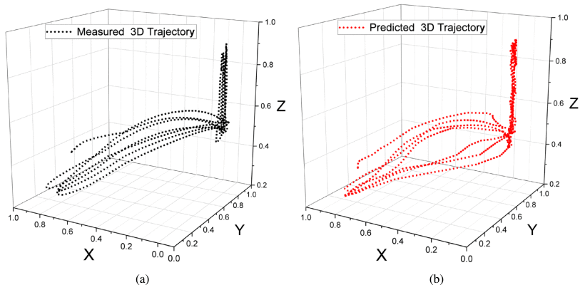
Problem & Motivation
Traditional motor planning-based BCIs essential for upper-limb reconstruction rarely utilize regression-based methods, relying instead on discrete signals and making continuous movement tracking limited.
Recent focus on regression-based BCIs is expanding, needing broader parameter integration, and complete upper-limb movement reconstruction remains unachieved due to narrow parameter targeting.
Example of decoding of single parameter type (Trajectory of the wrist) in prior studies¹
1. S. Pancholi and A. Giri, "NeuroKinect: A Deep Learning Framework for Hand Kinematics Reconstruction From EEG Signals," in IEEE Transactions on Medical Robotics and Bionics, vol. 8, no. 3, pp. 1349-1360, Aug. 2026, doi: 10.1109/TMRB.2026.3699211.

Slide 3
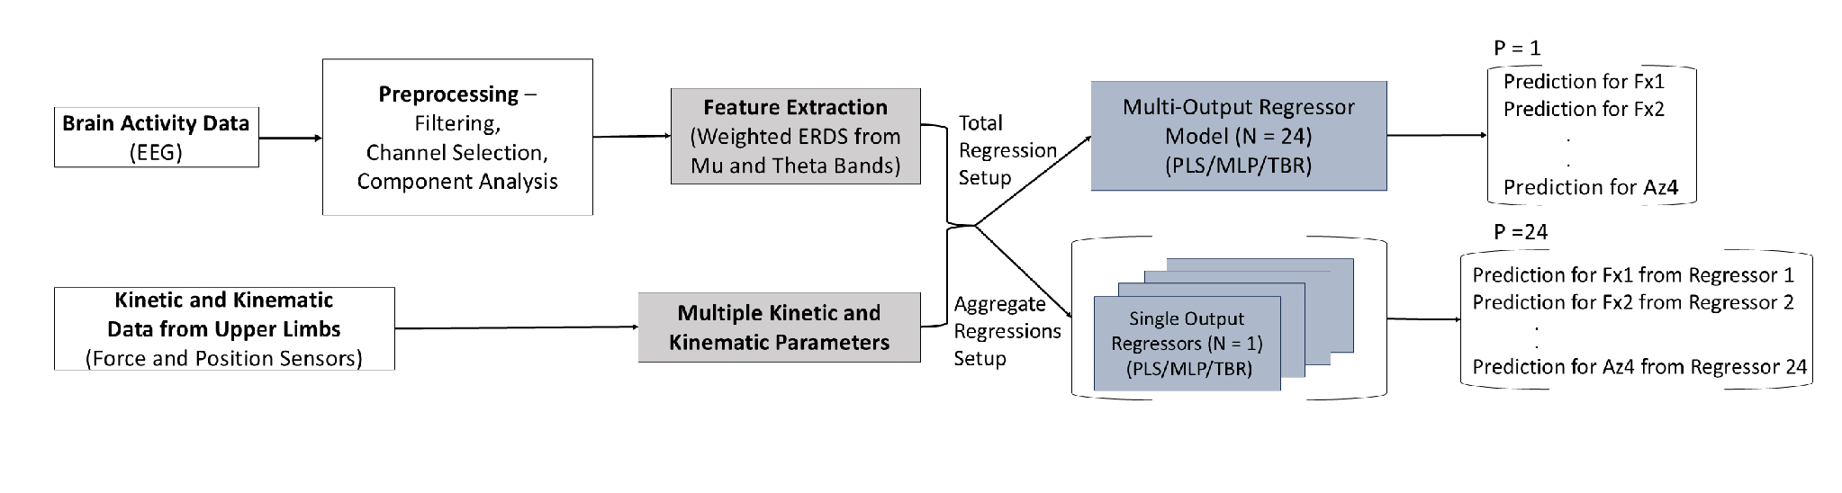
Research Gap
Existing regression-based BCI models focus only on decoding individual parameters
For reconstructing upper limb movements, multiple movement parameters need to be decoded simultaneously.
Modified EEGForceMap pipeline developed to decode multiple movement parameters simultaneously

Slide 4
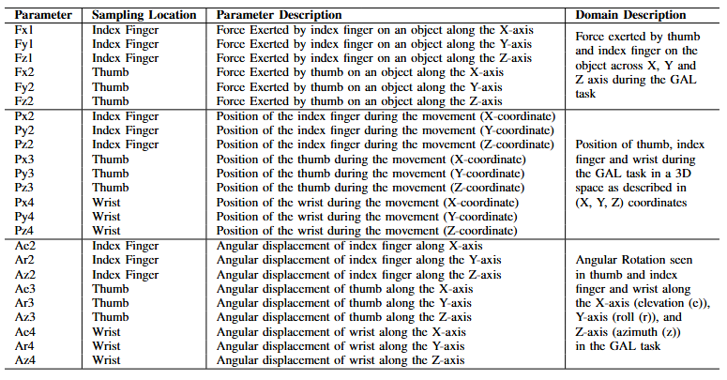
Contributions
Development the prior EEGForceMap preprocessing and feature extraction pipeline to analyze neural encoding patterns for simultaneous movement decoding.
Proposing the attention-based regression approach in decoding multiple movement parameters from the EEG signal by developing a transformer-based regressor.
Comprehensive benchmarking of the proposed attention-based regression approach with current state-of-the-art.
Table showing the parameters from WAY-EEG-GAL dataset selected for simultaneous decoding (GAL - Grasp and Lift)

Slide 5
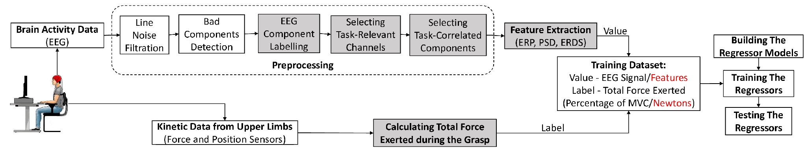
EEGForceMap Pipeline
Isolates EEG signals from nine premotor-parietal channels to extract weighted Event-Related Desynchronization/Synchronization features across Mu (9–11 Hz) and Theta (4–7 Hz) bands.
Capitalizes on underlying neural correlations present when motor networks simultaneously encode multiple kinetic and kinematic movement parameters.
Scaled up feature extraction to cover 24 movement parameters across kinetic force, 3D linear position, and 3D angular rotation domains simultaneously.
Original EEGForceMap pipeline for extracting relevant features from premotor parietal region

Slide 6
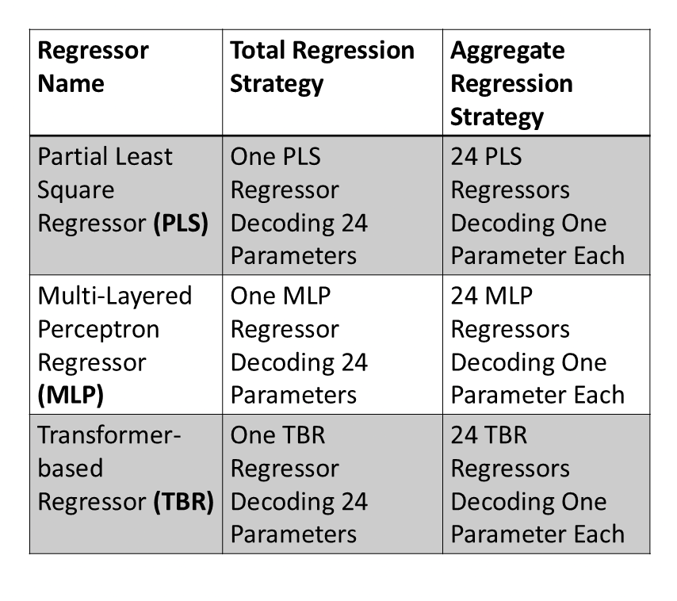
Proposed Regressor Models
Partial Least Squares Regressor (PLS): A traditional linear model optimized via adaptive hyper-parameter tuning and component selection, serving as a baseline to benchmark non-deep-learning parameter decoding.
Multi-Layered Perceptron (MLP): A deep network featuring three dense layers (512, 256, and 128 nodes) with 30% dropout, designed to model static non-linear features without temporal context
Transformer-Based Regressor (TBR): An attention-based network with a 4-layer encoder, 4 heads, and 50-token sequence length, designed to learn complex temporal dynamics and cross-parameter correlations.
Table describing the total and aggregate conditions in which the regressor models were tested

Slide 7
Method
Prior to testing the models, all the features were tested against multiple movement parameters for correlation between the features and movement parameters
Tested in pseudo-online conditions with a window size of 0.1 seconds and a step size 0.05 seconds
All models were tested in subject-specific and subject-independent conditions.
Benchmarked against the models prior integrated with EEGForceMap for
  Accuracy: Difference between predicted and actual trajectory; calculated using R² value
  Precision: Total error across the runs, calculated using mean squared error (MSE)
  Latency: Total time taken between acquiring EEG data and subsequent predicted movement parameters

Slide 8
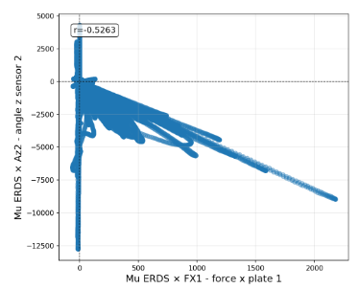

Results – Features and Parameters
A sample of scatter plots showing autocorrelation across different movement parameters' ERDS activity in mu band for between-group (left), and within-group (right) parameters (Az2: rotation of index finger along Z-axis; Fx1: force applied by the thumb along the X-axis; Fx2: force applied by the index finger along the X-axis)
Moderate correlations were found between ERDS features and movement parameters in Mu (r = 0.25) and Theta (r = 0.23) bands. Student's t-test confirmed no statistically significant difference between the two frequency bands (p = 0.49).
Overall, ERDS representations showed a high correlation (r = 0.89) across movement parameter values across frequency bands. This demonstrates strong shared neural activity captured from the targeted parietal-premotor region.
Within-group correlations (r = 0.96) were significantly higher than between-group correlations (r = 0.82) (t = 3.25, p = 0.002). This indicates tighter neural alignment among parameters within the same domain than across domains.

Slide 9
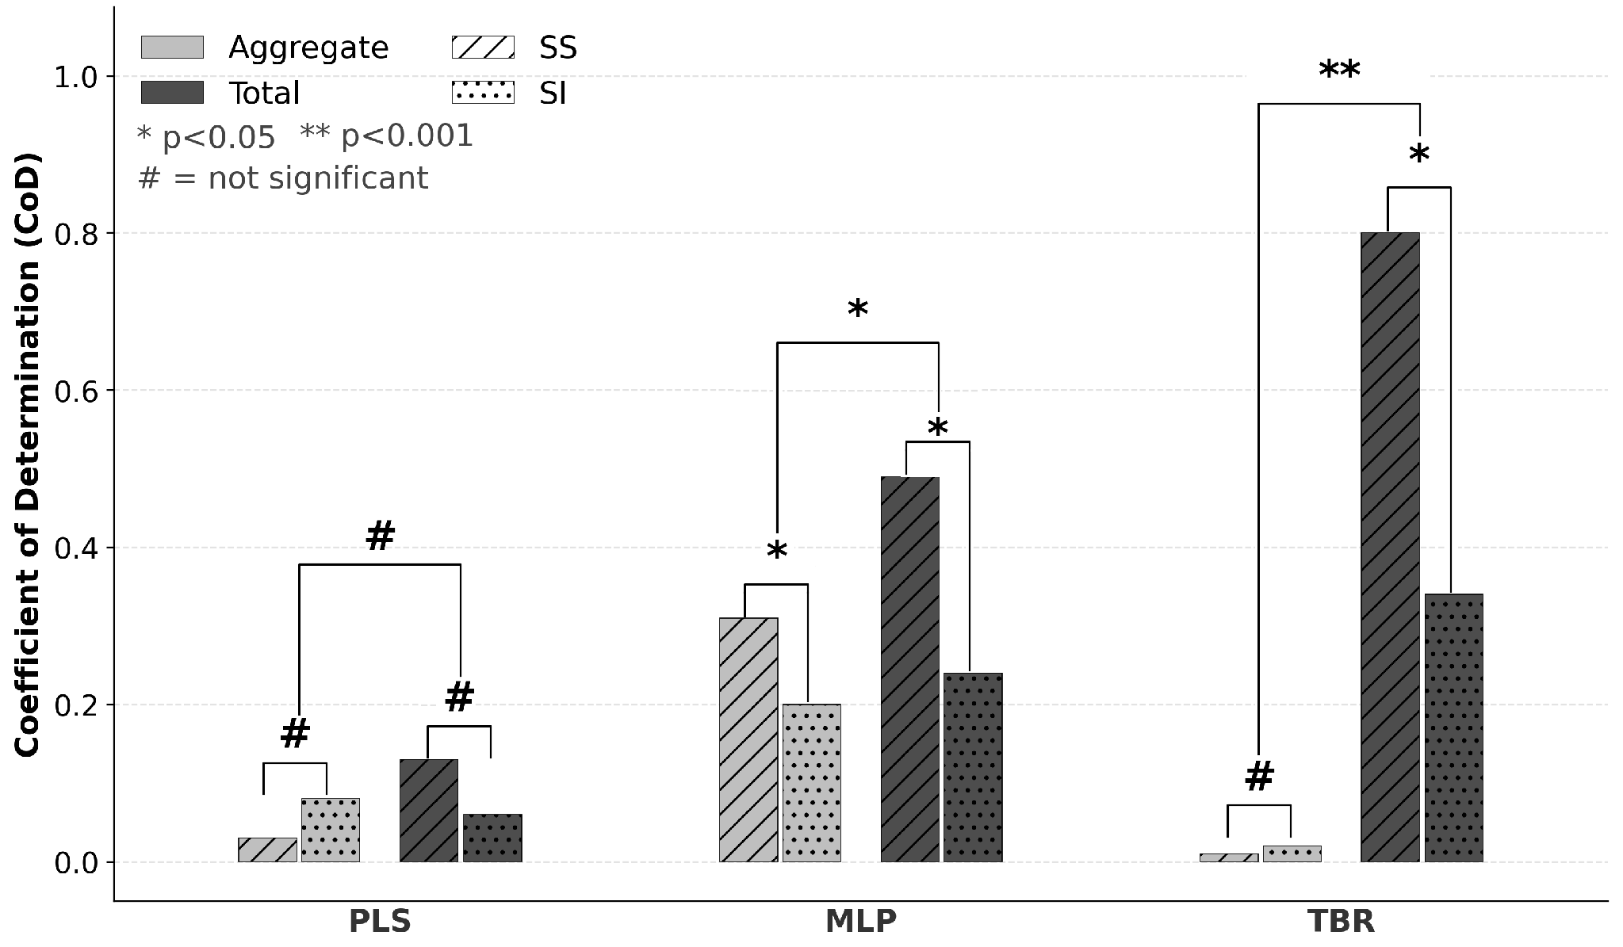
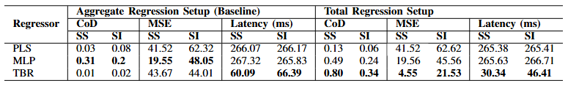
Results – Model Performance
Partial Least Squares regressor performed poorly (R² = 0.13, latency 265.4 ms), proving traditional linear models fail at real-time multi-output decoding.
Multi-Layered Perceptron yielded steady moderate accuracy (R² = 0.49) across setup strategies, accompanied by high latency (265.6 ms).
Transformer-Based Regressor achieved top performance (R² = 0.80, latency 30.3 ms) in total setup, but dropped (R² = 0.01) in isolated single-parameter decoding.

Slide 10
Discussion & Conclusion
Movement parameters are simultaneously encoded within parietal-premotor networks rather than independently. This neural correlation explains why traditional linear models like PLS failed in multi-output setups.
TBR achieved superior performance by using self-attention to exploit temporal context and cross-parameter autocorrelations. However, it struggles when predicting parameters in isolation.
MLP provided steady performance across setups but suffered lower accuracy than in single-parameter studies. This stems from its inability to model temporal dynamics in autocorrelated EEG signals.
Current limitations include the need to validate on external datasets and incorporate reaching task parameters. Future work must focus on testing these models in real-world closed-loop BMIs.

Slide 11


Acknowledgement
Thank you for your attention.
This study was supported by the IP/IITGN/CSE/YM/2324/05 project grant.
The details are available on GitHub: https://github.com/HAIx-Lab/EEG2GAL
Contact: yk.meena@iitgn.ac.in
Questions?

