Slide 1

IEEE SMC 2026 — BMI WORKSHOP
Paper ID #1406
Intra-Class Representation Regularization for
EEG Motor Imagery Classification
Roger Krishna B J · Amritavarshini S · Veena K
Sathyabama Institute of Science and Technology, Chennai, India
1

Slide 2
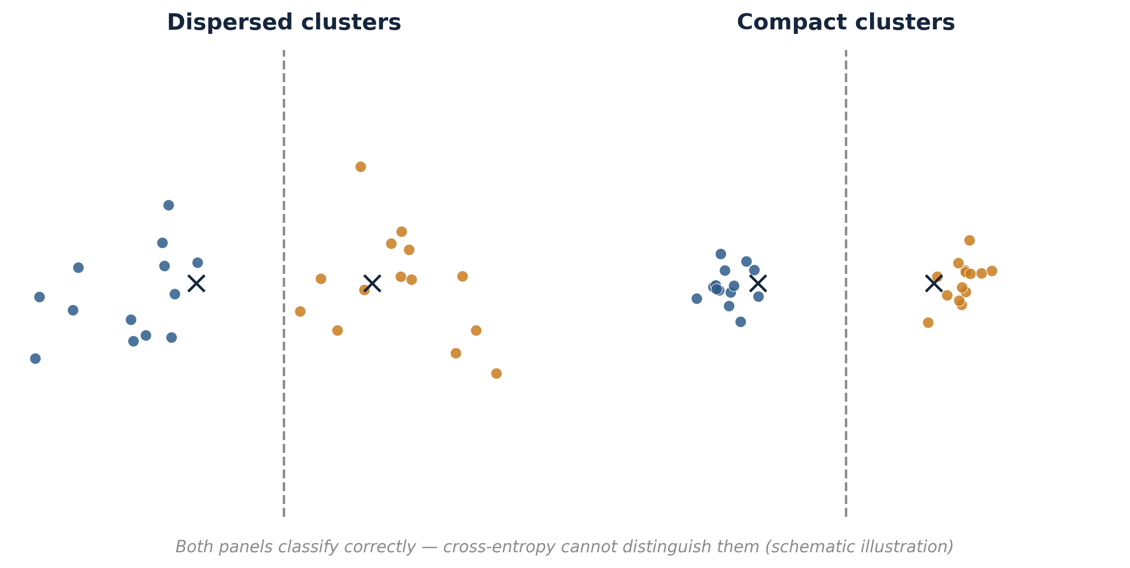
The Problem: Accuracy Without Geometry
Backbone trained end-to-end → judged on held-out accuracy [1]
Cross-entropy enforces separation, not compactness
Embedding geometry: unmeasured, uncontrolled
Both panels classify correctly. Cross-entropy is completely indifferent between them — it has no term that distinguishes a tight cluster from a dispersed one.
[1] F. Lotte et al., “A review of classification algorithms for EEG-based brain–computer interfaces: A 10 year update,” J. Neural Eng., vol. 15, no. 3, p. 031005, Jun. 2018.
2

Slide 3
The Gap Under Cross-Subject (LOSO) Evaluation
LOSO: generalize from a heterogeneous population → one held-out individual [2]
High-dimensional embeddings: large intra-class scatter, adequate accuracy
Boundary sits in a low-density region between dispersed same-class clouds
1
2
3
4
5
6
7
8
9
8 subjects — training
held
out
Repeated 9 times — every subject held out exactly once; no subject-specific fine-tuning.
Open question — and unanswerable without a loss function that controls intra-class compactness and a metric that measures it.
[2] P. Saha and M. Baumert, “Intra- and inter-subject variability in EEG-based sensorimotor brain computer interface: A review,” Front. Comput. Neurosci., vol. 14, p. 87, Feb. 2020.
3

Slide 4
Four Contributions
1
2
3
4
ICRR Loss
ESS
λ Selection
Empirical Result
Intra-class variance loss with exact gradient semantics
Evaluation metric precisely scoped to intra-class compactness
Data-driven — perpendicular distance from the efficiency diagonal
Geometry and accuracy shown to be independently optimizable
This paper contributes the loss, the metric, the selection rule, and the demonstration — as one coherent measurement framework.
IEEE SMC 2026 — BMI Workshop · Paper #1406
4

Slide 5
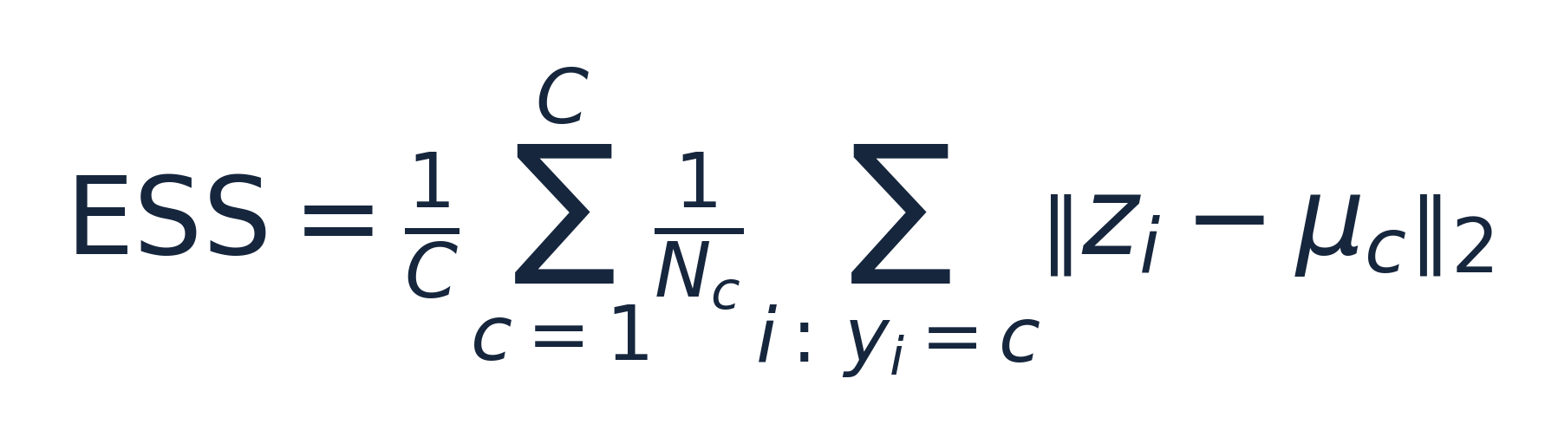
Embedding Stability Score (ESS)
Mean L2 distance from each embedding to its class centroid, averaged uniformly over classes
Lower ESS → tighter intra-class clusters
Deliberately excludes inter-class separation — by design
Not a claim that ESS is a superior general-purpose clustering measure — a claim that it is more precisely scoped to this research question than silhouette, Davies–Bouldin, or Calinski–Harabasz [13][14][15].
[13] P. J. Rousseeuw, “Silhouettes: A graphical aid to the interpretation and validation of cluster analysis,” J. Comput. Appl. Math., vol. 20, pp. 53–65, Nov. 1987.
[14] D. L. Davies and D. W. Bouldin, “A cluster separation measure,” IEEE Trans. Pattern Anal. Mach. Intell., vol. PAMI-1, no. 2, pp. 224–227, Apr. 1979.
[15] T. Caliński and J. Harabasz, “A dendrite method for cluster analysis,” Commun. Stat., vol. 3, no. 1, pp. 1–27, 1974.
5

Slide 6
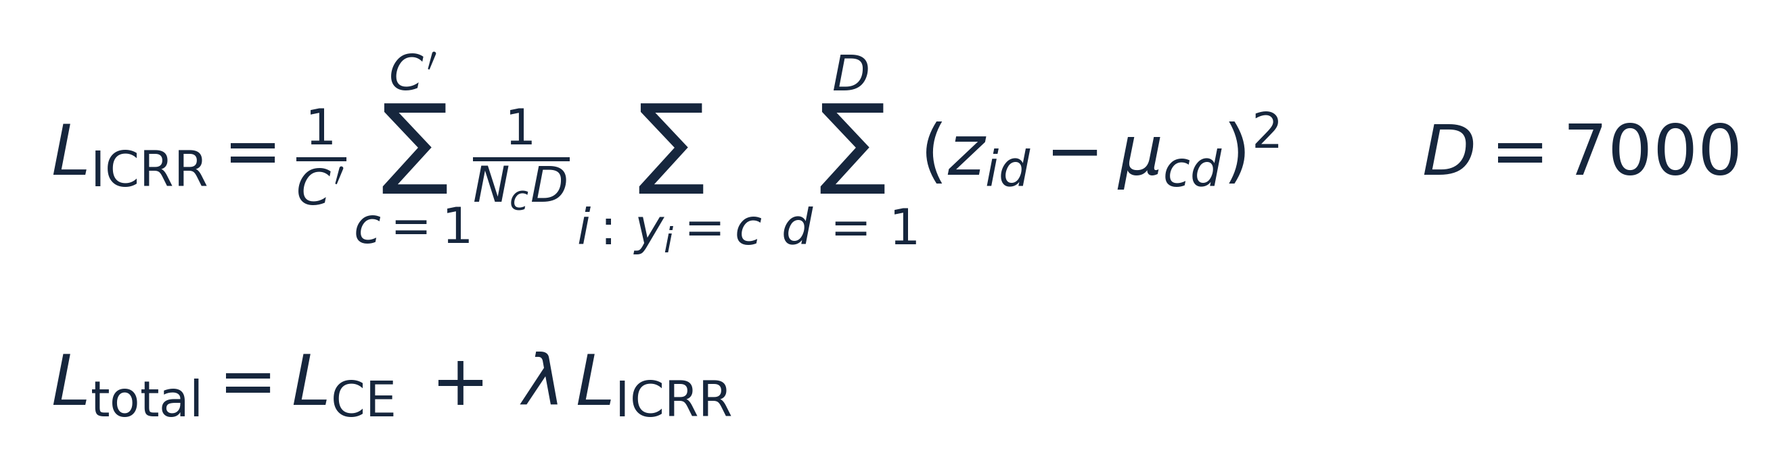
ICRR — A Squared Centroid-Deviation Term
vs. Center Loss [8]
 | ICRR | Center Loss
Centroids | current batch | global, learned (α)
Form | squared deviation | unsquared L2
Applied to | post-flatten z | projection space
No projection head: tested in pilot experiments and discarded — it caused ESS to increase by absorbing classification structure while leaving backbone geometry unregularized.
[8] Y. Wen, K. Zhang, Z. Li, and Y. Qiao, “A discriminative feature learning approach for deep face recognition,” in Proc. 14th Eur. Conf. Comput. Vis. (ECCV), 2016, pp. 499–515.
6

Slide 7
Experimental Setup
Dataset & Architecture
Protocol & Training
Dataset | BNCI 2014-001 — 4-class motor imagery [16]
Subjects / trials | 9 subjects · 576 trials each · 5,184 total
Channels / rate | 25 EEG channels @ 250 Hz
Chance level | 25%
Backbone | DeepConvNet — filters 25 / 50 / 100 / 200 [3]
Embedding | z ∈ ℝ⁷⁰⁰⁰ (post-flatten, sole latent space)
Evaluation | 9-fold LOSO — 8 train / 1 test, no fine-tuning [4]
Seed isolation | 42 + fold, before each instantiation
Optimizer | Adam, lr 10⁻³
Batch size | 64
Epochs | 50
Code | github.com/Roger1611/eeg_representation_geometry
Identical initialization across all experimental conditions within each fold — differences in results are attributable solely to the loss function.
[16] M. Tangermann et al., “Review of the BCI Competition IV,” Front. Neurosci., vol. 6, p. 55, 2012.
[3] R. T. Schirrmeister et al., “Deep learning with convolutional neural networks for EEG decoding and visualization,” Human Brain Mapping, vol. 38, no. 11, pp. 5391–5420, Nov. 2017.
[4] V. J. Lawhern, A. J. Solon, N. R. Waytowich, S. M. Gordon, C. P. Hung, and B. J. Lance, “EEGNet: A compact convolutional neural network for EEG-based brain–computer interfaces,” J. Neural Eng., vol. 15, no. 5, p. 056013, Oct. 2018.
7

Slide 8
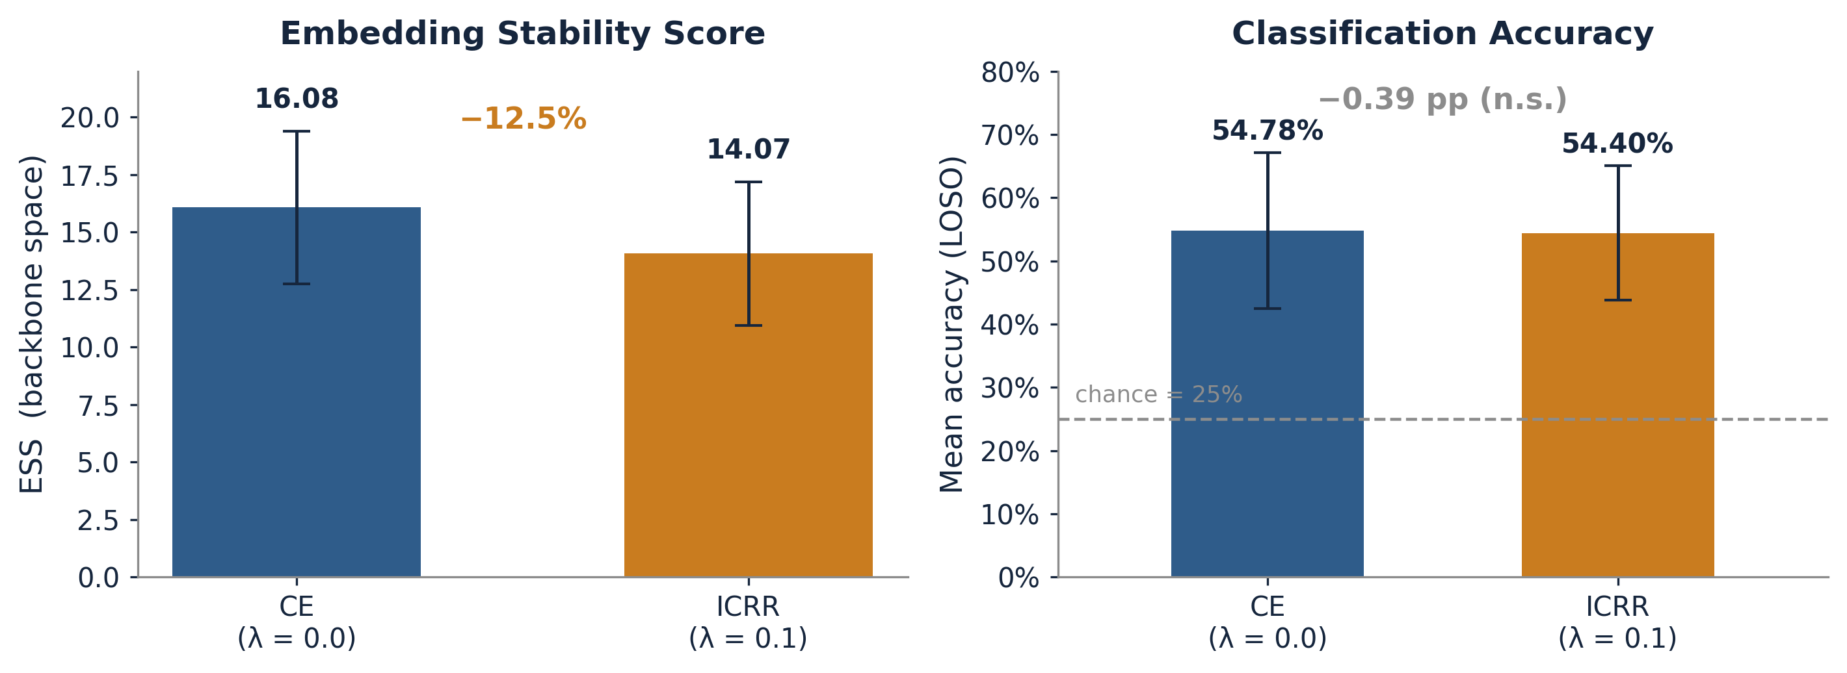
Proof of Concept: λ = 0.1
ESS: 16.08 ± 3.32 → 14.07 ± 3.12 (−12.5%), d = 2.353 [22], p = 0.0001 — all 9 subjects show the drop (sign test p = 0.0039). Accuracy Δ = −0.39 pp, p = 0.68, d = −0.144.
The geometric effect is large and directionally unanimous. The accuracy effect is statistically undetectable at any conventional threshold.
[22] J. Cohen, Statistical Power Analysis for the Behavioral Sciences, 2nd ed. Hillsdale, NJ: Lawrence Erlbaum Associates, 1988.
8

Slide 9
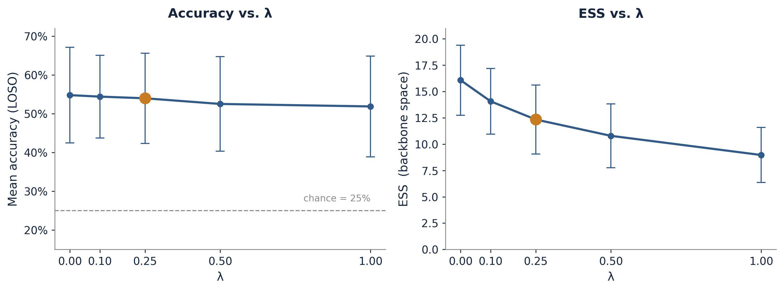
The Full λ Sweep
λ | Acc (mean ± sd) | ESS (mean ± sd) | p_acc | d_acc | p_ess | d_ess | ESS red.
0.0 | 0.5478 ± 0.1231 | 16.0759 ± 3.3245 | — | — | — | — | —
0.1 | 0.5440 ± 0.1065 | 14.0673 ± 3.1179 | 0.6775 | −0.144 | 0.0001 | 2.353 | 12.5%
0.25 † | 0.5397 ± 0.1161 | 12.3402 ± 3.2848 | 0.4897 | −0.241 | <0.0001 | 5.641 | 23.2%
0.5 | 0.5251 ± 0.1219 | 10.7915 ± 3.0392 | 0.0837 | −0.658 | <0.0001 | 5.165 | 32.9%
1.0 | 0.5187 ± 0.1300 | 8.9694 ± 2.6110 | 0.1394 | −0.547 | <0.0001 | 5.781 | 44.2%
Derived from Table I. d_ess ≥ 2.35 at every λ > 0; no p_acc crosses 0.05.
IEEE SMC 2026 — BMI Workshop · Paper #1406
9

Slide 10
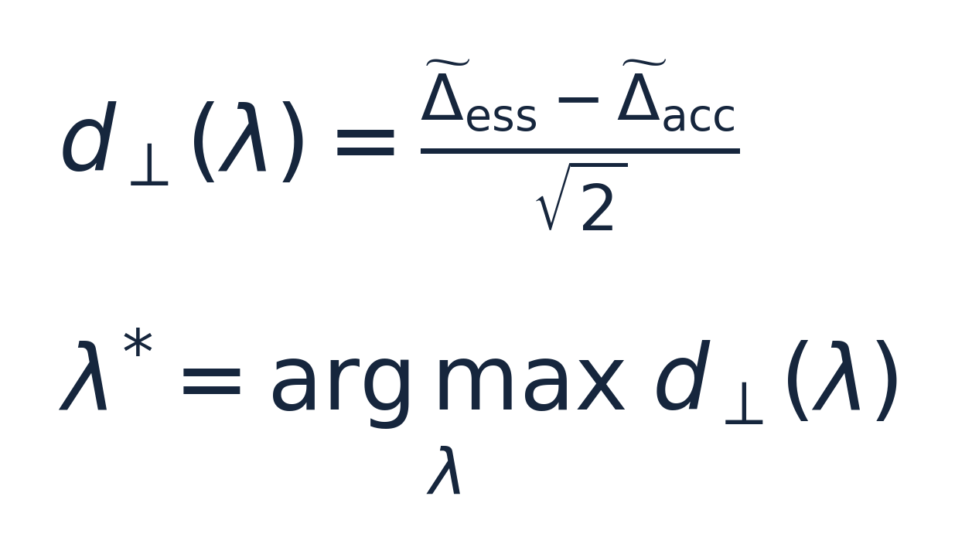
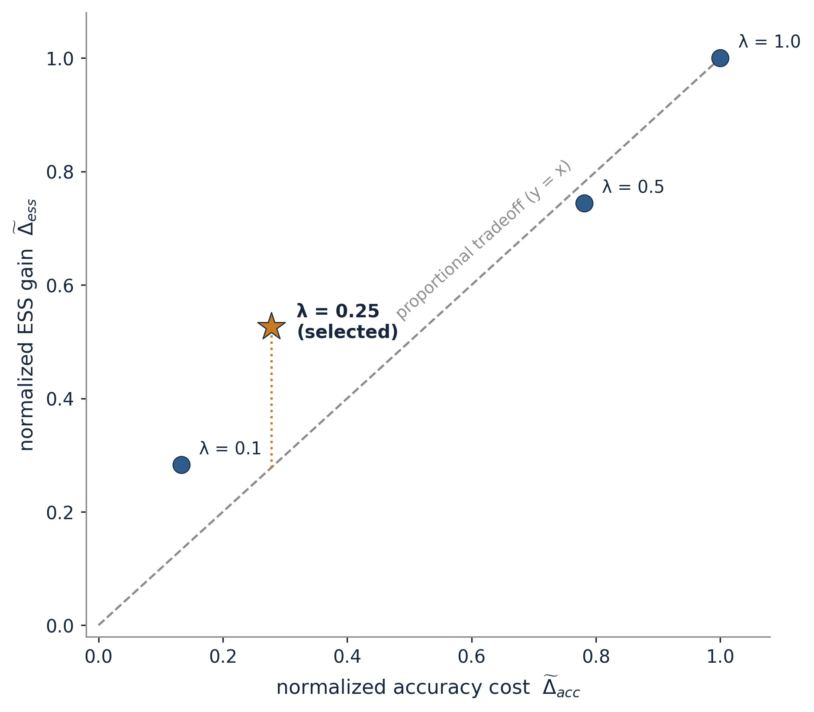
Selecting λ — The Tradeoff-Knee Algorithm
λ | Δacc (norm.) | Δess (norm.) | d⊥
0.1 | 0.133 | 0.283 | +0.106
0.25 † | 0.278 | 0.526 | +0.175
0.5 | 0.781 | 0.744 | −0.027
1.0 | 1.000 | 1.000 | 0.000
λ = 0.25 maximizes perpendicular distance from the proportional-tradeoff diagonal — no hardcoded thresholds; fully reproducible from Table I.
IEEE SMC 2026 — BMI Workshop · Paper #1406
10

Slide 11
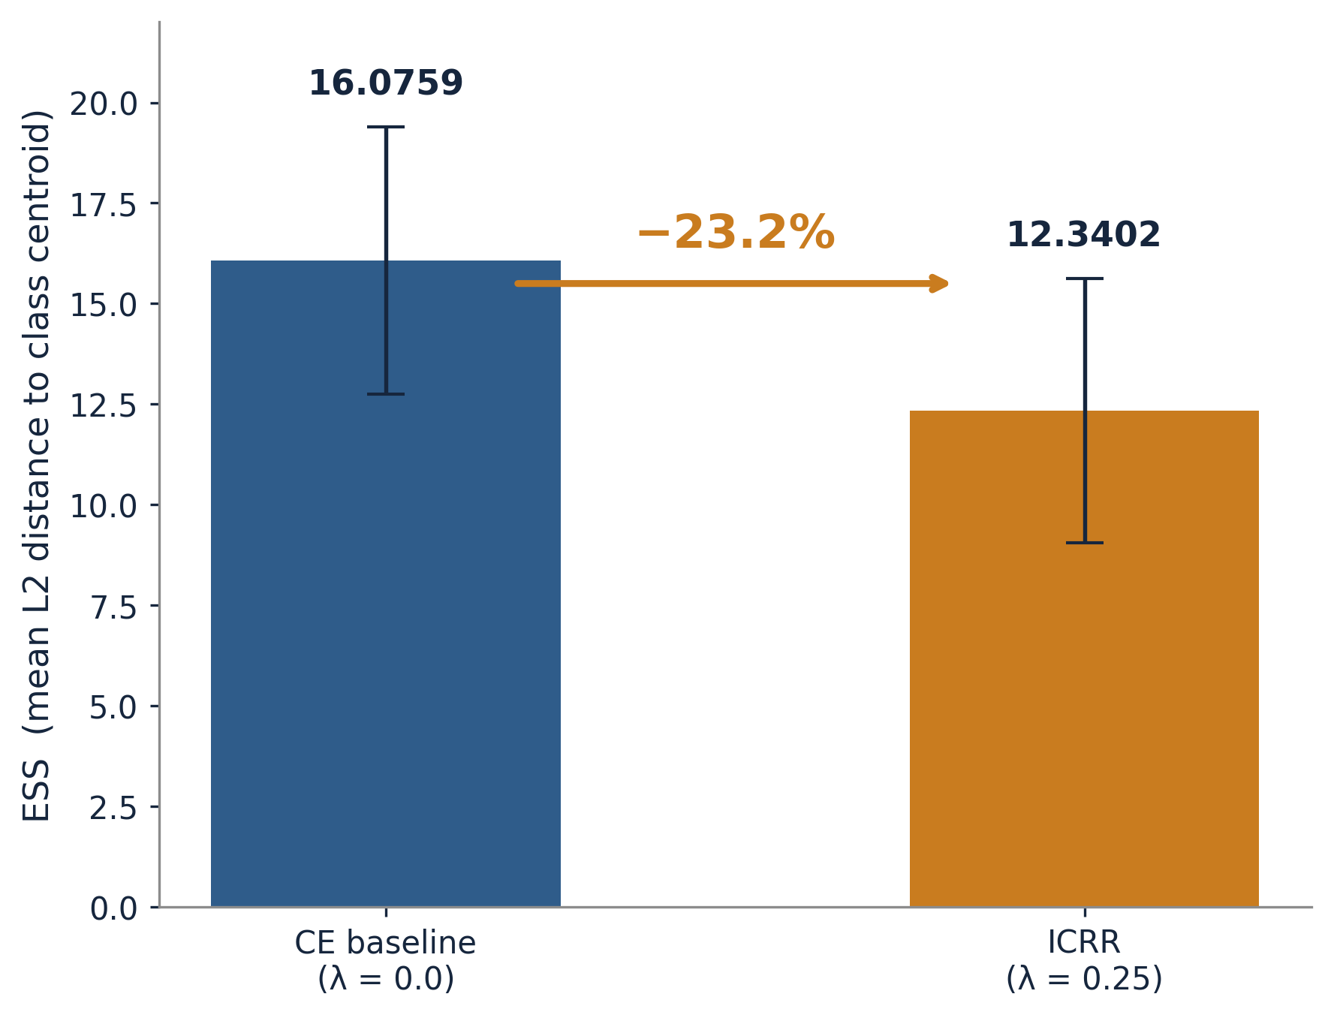
Headline Result at λ = 0.25
ESS ↓ 23.2%
16.0759 → 12.3402
d = 5.641 · p < 0.0001 · N = 9 · all 9 subjects
Accuracy Δ −0.81 pp
0.5478 → 0.5397
d = −0.241 · p = 0.490 · not significant
Additive loss preserves the CE gradient intact; the centroid-pulling term reshapes intra-class geometry separately. The two outcomes are structurally independent.
IEEE SMC 2026 — BMI Workshop · Paper #1406
11

Slide 12
Scope and Limitations
Results are scoped to DeepConvNet on BNCI 2014-001 under LOSO.
1
2
3
N = 9
λ selected on the sweep data
ESS not benchmarked
Adequate power for the geometric claims (dₑₛₛ ≥ 2.35) — not for definitive accuracy claims. The power limitation must be carried into any interpretation of the accuracy results.
No held-out validation fold confirms that λ = 0.25 generalizes to unseen data configurations — a data-driven criterion, not a validated hyperparameter.
Not yet compared against silhouette, Davies–Bouldin, or Calinski–Harabasz on EEG embeddings [13][14][15]. Generalization to other architectures and datasets remains to be investigated.
[13] P. J. Rousseeuw, “Silhouettes: A graphical aid to the interpretation and validation of cluster analysis,” J. Comput. Appl. Math., vol. 20, pp. 53–65, Nov. 1987.
[14] D. L. Davies and D. W. Bouldin, “A cluster separation measure,” IEEE Trans. Pattern Anal. Mach. Intell., vol. PAMI-1, no. 2, pp. 224–227, Apr. 1979.
[15] T. Caliński and J. Harabasz, “A dendrite method for cluster analysis,” Commun. Stat., vol. 3, no. 1, pp. 1–27, 1974.
12

Slide 13
Conclusion
23.2% ESS reduction at λ = 0.25 (d = 5.641, p < 0.0001), consistent across all 9 subjects
−0.81 pp accuracy (d = −0.241, p = 0.490) — no significant degradation at any tested λ
Geometry and accuracy: independently optimizable properties of the same model
Left open, deliberately:
Does tighter intra-class geometry help downstream — cross-subject transfer, noise robustness, adaptation efficiency? This work builds the measurement framework. It does not answer the question.
IEEE SMC 2026 — BMI Workshop · Paper #1406
13

Slide 14
Acknowledgments & References
Code
github.com/Roger1611/eeg_representation_geometry
References — as cited on the preceding slides
[1] Lotte et al., “A review of classification algorithms for EEG-based brain–computer interfaces: A 10 year update,” J. Neural Eng., 2018.
[2] Saha & Baumert, “Intra- and inter-subject variability in EEG-based sensorimotor brain computer interface: A review,” Front. Comput. Neurosci., 2020.
[3] Schirrmeister et al., “Deep learning with convolutional neural networks for EEG decoding and visualization,” Human Brain Mapping, 2017.
[4] Lawhern et al., “EEGNet: A compact convolutional neural network for EEG-based brain–computer interfaces,” J. Neural Eng., 2018.
[8] Wen et al., “A discriminative feature learning approach for deep face recognition,” ECCV, 2016.
[13] Rousseeuw, “Silhouettes: A graphical aid to the interpretation and validation of cluster analysis,” J. Comput. Appl. Math., 1987.
[14] Davies & Bouldin, “A cluster separation measure,” IEEE Trans. Pattern Anal. Mach. Intell., 1979.
[15] Caliński & Harabasz, “A dendrite method for cluster analysis,” Commun. Stat., 1974.
[16] Tangermann et al., “Review of the BCI Competition IV,” Front. Neurosci., 2012.
[22] Cohen, Statistical Power Analysis for the Behavioral Sciences, 2nd ed., 1988.
Thank you.
IEEE SMC 2026 — BMI Workshop · Paper #1406
14

