Slide 1
A Dyadic Neuroadaptive System for EEG-Based Affective State Fusion and Multimodal Generation
IEEE SMC 2026 · 16TH WORKSHOP ON BRAIN–MACHINE INTERFACE (BMI)
Tommaso Colafiglio · Angela Lombardi · Domenico Lofù · Paolo Sorino · Tommaso Di Noia
Dept. of Electrical and Information Engineering (DEI), Politecnico di Bari, Italy
Turning probabilistic emotional states, inferred from low-cost EEG, into shared visual and auditory artifacts through a language-mediated generative pipeline.

Slide 2
From EEG classification to meaningful experience
EEG-based affective computing has largely optimized classification accuracy or clinical interpretation.
Inferred emotions are typically reduced to discrete labels or numerical scores — hard to relate to subjective experience.
This leaves a gap between signal processing and user-centered, creative applications.
Generative AI (LLMs, text-to-image) can bridge this gap by turning abstract affect into rich multimodal artifacts.
1
EEG signal
Continuous, low-level, hard to interpret directly.
↓
2
Label / score
“Excited: 0.82” — accurate, but experientially flat.
↓ gap ↓
3
Meaningful artifact
Open question: how do we translate low-level neural signals into interpretable and expressive multimodal output — for more than one user at once?
Interpretable, engaging, shareable — this work's target.

Slide 3
Why a language-mediated, dyadic pipeline?
WHAT PRIOR WORK DOES
OUR CONTRIBUTIONS
EEG generative work (e.g., BrainDreamer, LoongX) aligns EEG with images via direct or predefined feature-to-output mappings.
EEG-driven biofeedback / art / music systems map neural features straight to output parameters.
LLM-based EEG interpretation (EEG Emotion Copilot, Thought2Text) stays mostly clinical or analytical.
Natural language as an interpretable intermediate layer — and multi-user fusion — remain largely unexplored.
End-to-end pipeline: EEG emotion recognition → text → image → sound.
Interpretable intermediate layer: natural-language description of affect between classifier and generator.
“Brain-mix”: a collaborative mechanism that fuses two users' affective profiles into one shared artifact.
Pilot study (n = 10) assessing usability and experiential quality.

Slide 4
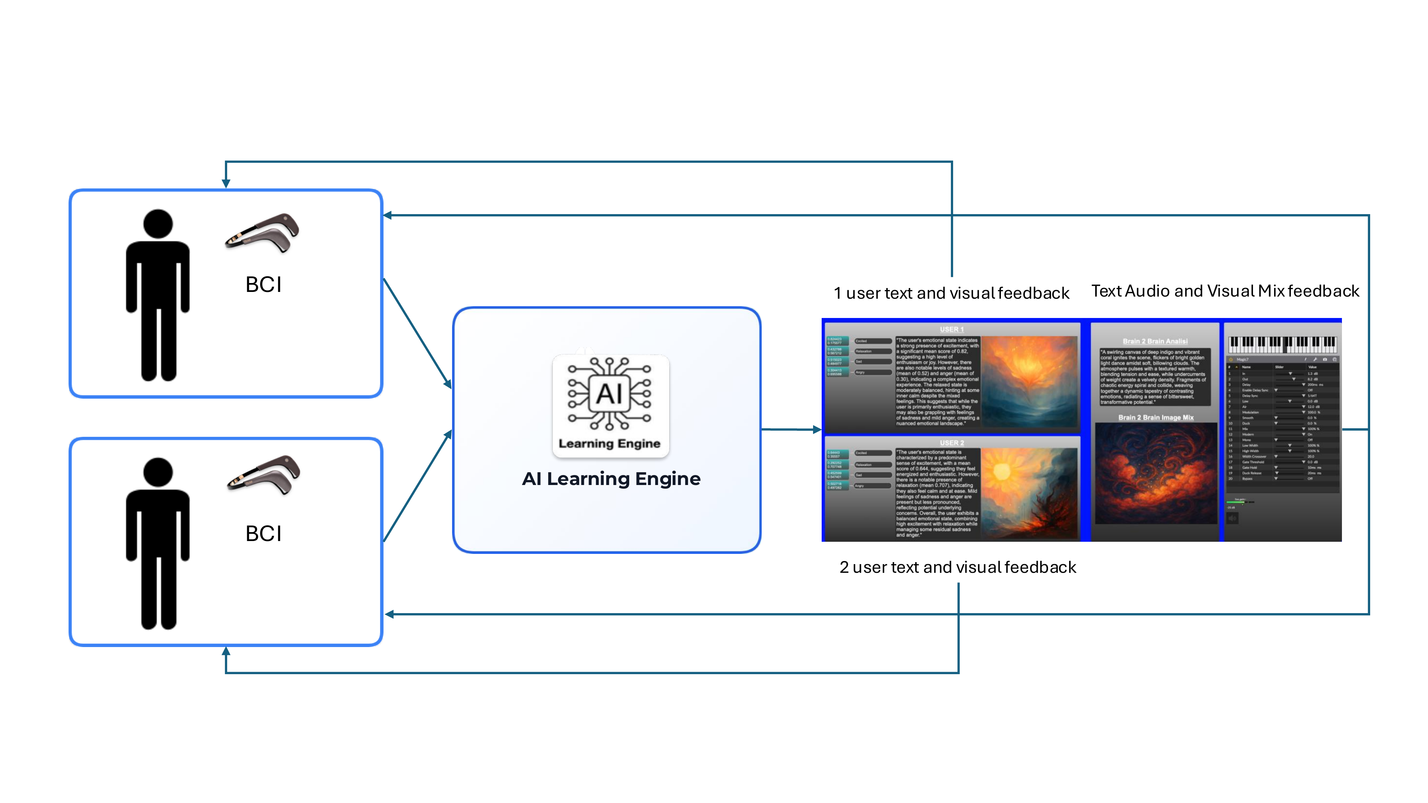
End-to-end neuroadaptive pipeline
TWO USERS, ONE LOOP
Each participant wears a Muse 2 BCI; EEG streams are processed independently and in real time.
SHARED AI ENGINE
Probabilistic affect → language description → image → brain-mix fusion → additive-synthesis sound.
CLOSED-LOOP FEEDBACK
Two Muse 2 devices acquire EEG from two users; probabilities are translated into text, then individual and merged (“brain-mix”) images.
Text, image, and audio are returned to both users, individually and as a merged dyadic output.

Slide 5
EEG preprocessing & affective-state inference
1
2
3
4
5
Acquisition
Filtering
Windowing
Artifact mitigation
Inference
Muse 2, 4 ch. (AF3, TP9, TP10, AF4), 256 Hz
FIR band-pass, 1–45 Hz, MNE-Python
5-s windows = 1280 samples / channel
kNN outlier detection (contam. 0.1) + interpolation
30 pre-trained NeuroSense classifiers / emotion, averaged
→
→
→
→
HARDWARE
SIGNAL
SIGNAL
CLEANING
ML MODEL
Only 4 channels → no spatial ICA / decomposition; artifacts are handled as statistical outliers in amplitude, then reconstructed by interpolation.
p = [ p_excited , p_relaxation , p_sad , p_angry ]

Slide 6
Emotion → text → image: a semantic intermediate layer
1
2
3
Probability vector p
gpt-4o-mini
gpt-image-1
4-dim affective estimate per user, per 5-s window
→
Structured prompt → 1–2 sentence affective description
→
Abstract, non-literal image conditioned on the description
LLM
DIFFUSION
“Create a highly creative, artistic, and suggestive image that expresses emotions through abstract visual metaphors, surreal atmosphere, color, light, texture, and composition. […] Emotion design guide: [affective description]. No text, no watermark.”
The LLM step makes the mapping interpretable: numerical probabilities become a human-readable description of mood, atmosphere, and intensity before conditioning the image model — rather than a black-box direct mapping.

Slide 7
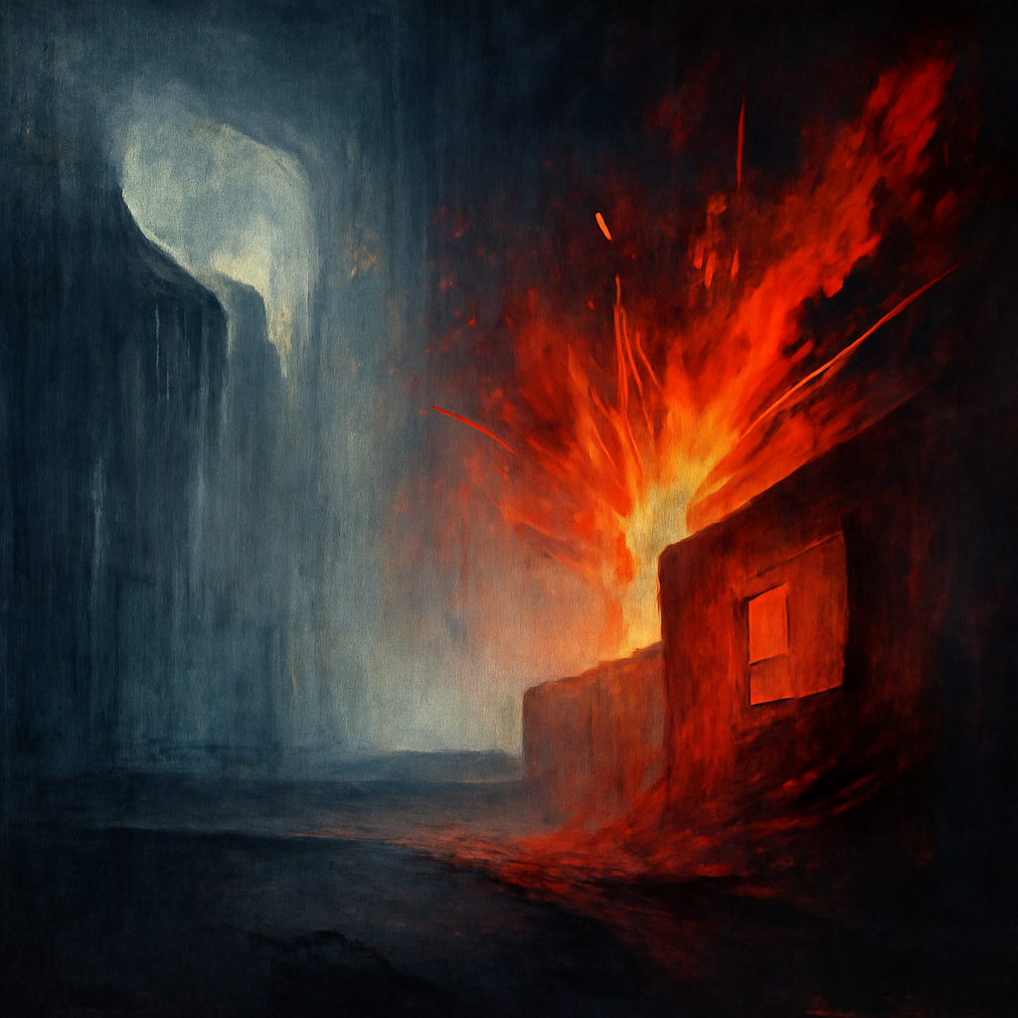
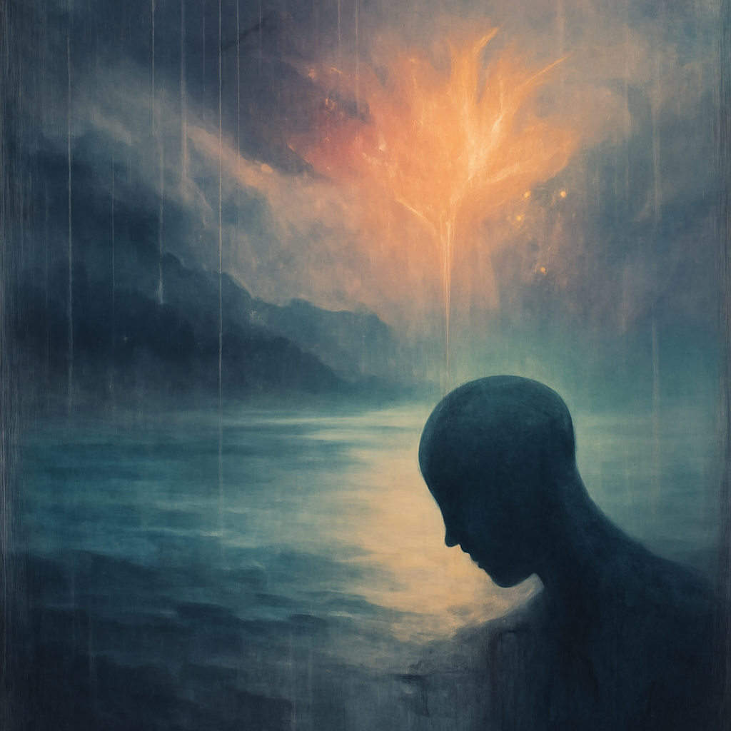
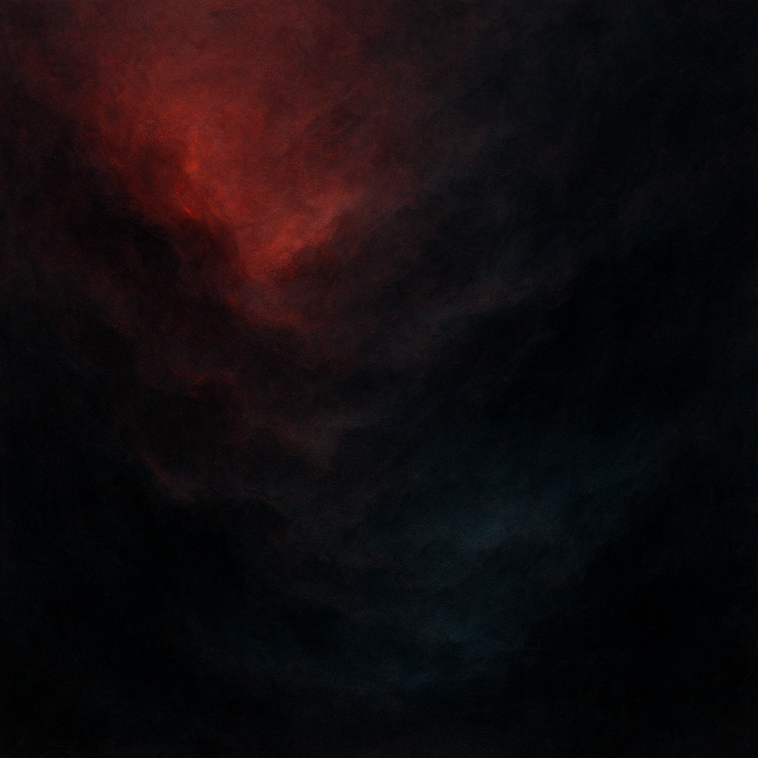
“Brain-mix”: fusing two affective profiles
User 1 — individual description → image
User 2 — individual description → image
Brain-mix — merged description → shared image
A second structured prompt asks the LLM to combine dominant and secondary traits from both descriptions — without discarding either — producing one coherent merged prompt for the shared image.

Slide 8
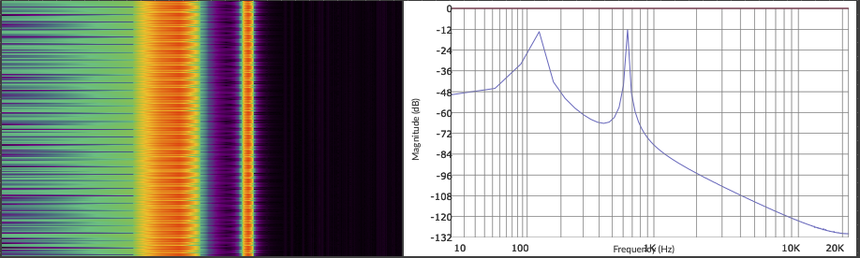
From image to sound: additive synthesis
1
2
3
RGBA extraction
MIDI + amplitude
Synthesis
Brain-mix image → normalized [0,1] channel values
12-TET quantization, duplicates removed
Sum of K partials + reverb (Max/MSP)
f(m) = 440 · 2^((m−69)/12)
s(t) = Σ(k=1→K) a_k · sin(2π f_k t)
Magnitude spectrum of the sound texture synthesized from the brain-mix image. Peaks are image-derived partials, not EEG frequency components.
The mapping from image color to sound spectrum is deterministic: different color distributions → different amplitude / pitch / harmonic combinations.

Slide 9
Pilot study: design
PARTICIPANTS & PROCEDURE
EVALUATION MEASURES
SAMPLE
n = 10, mean age 27, university-level education, no prior BCI experience
AttrakDiff
Creativity Support Index (CSI)
User Engagement Scale (UES)
SESSION
~10–15 min, individual, wearing Muse 2, real-time EEG
Plus direct ratings of liking and arousal for generated images and sounds, to assess perceptual meaningfulness of affect transmission.
CONDITIONS
Individual — own affective state → image
Dyadic — brain-mix, paired participants
Exploratory, descriptive analysis only (n = 10) — not powered for statistical inference.

Slide 10
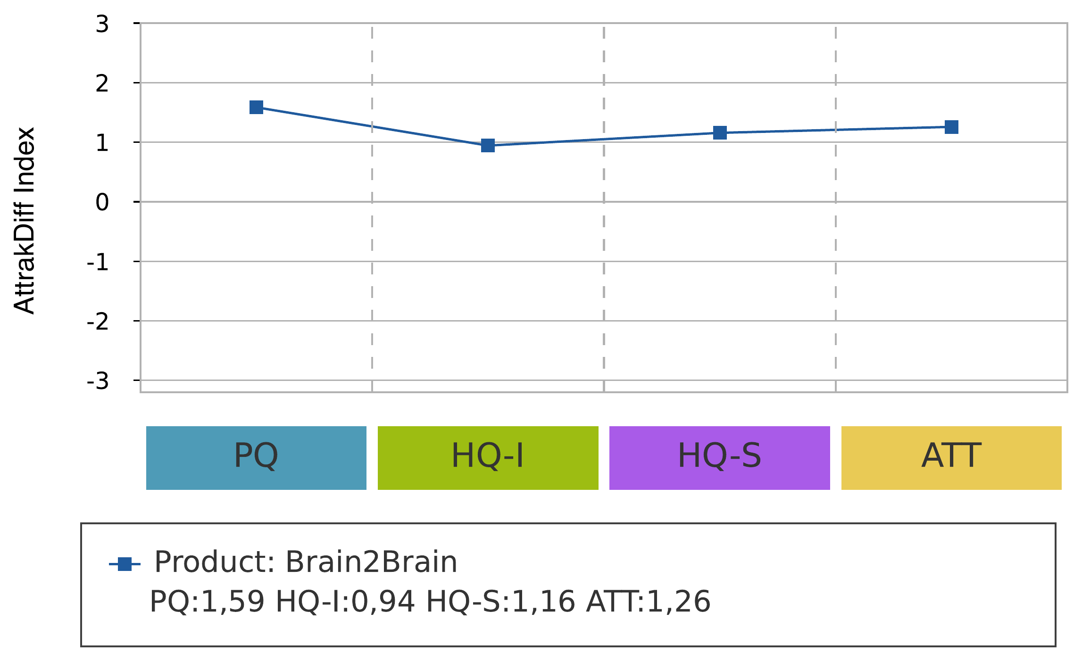
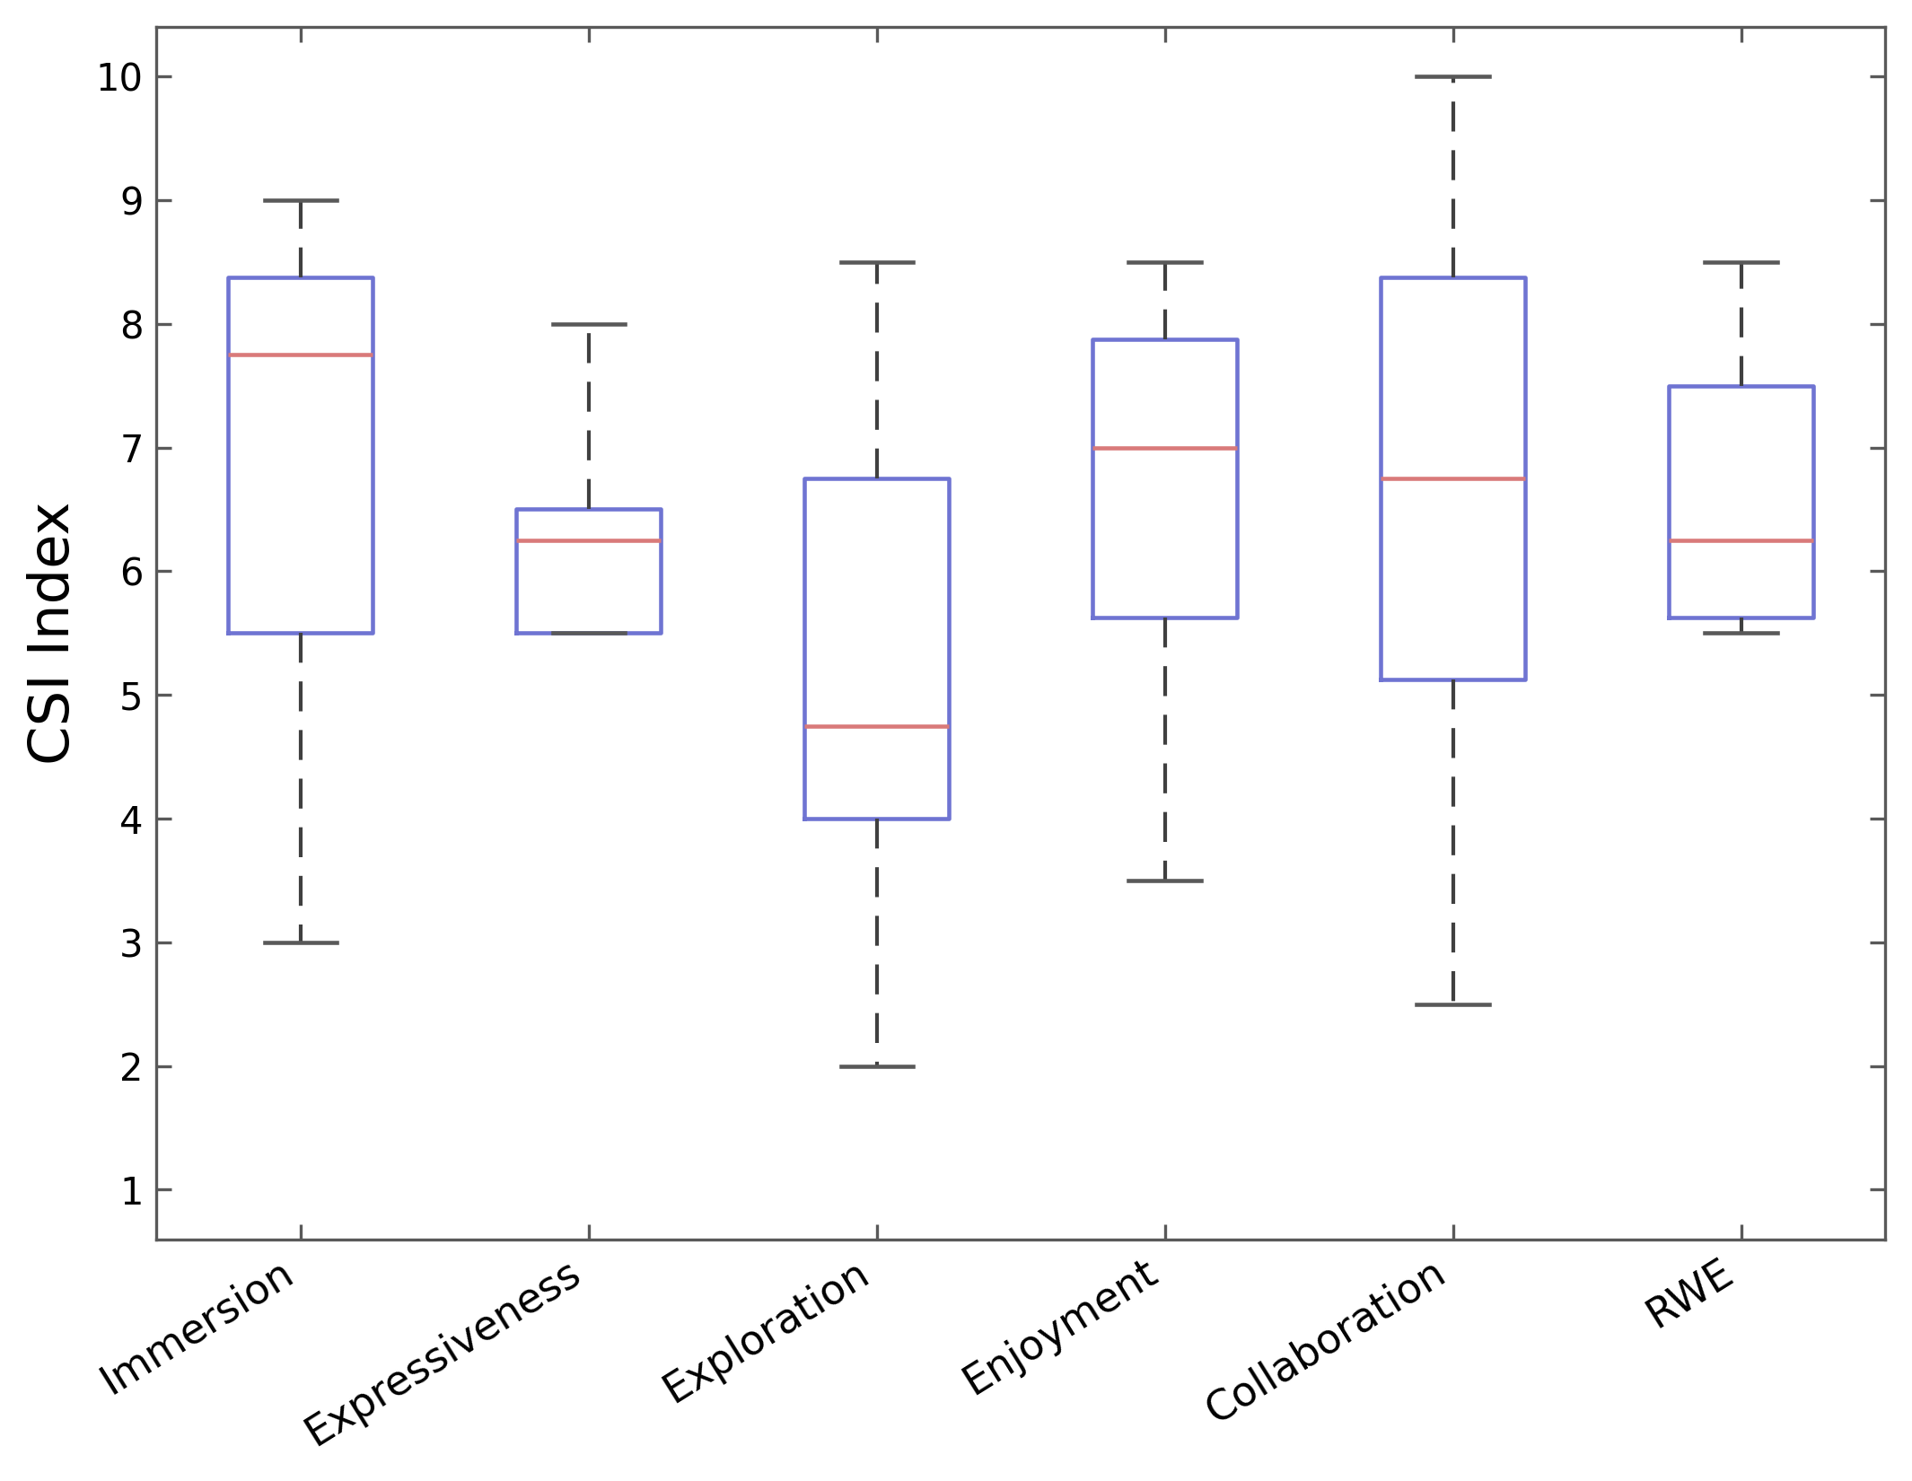
AttrakDiff & Creativity Support Index
PQ = 1.59 · HQ-I = 0.94 · HQ-S = 1.16 · ATT = 1.26
Median CSI scores by dimension (0–10 scale)
System perceived as functional and manageable (highest PQ); immersion, enjoyment, collaboration score higher than expressiveness and exploration — consistent with brain-mix driving shared engagement, but limited creative control.

Slide 11
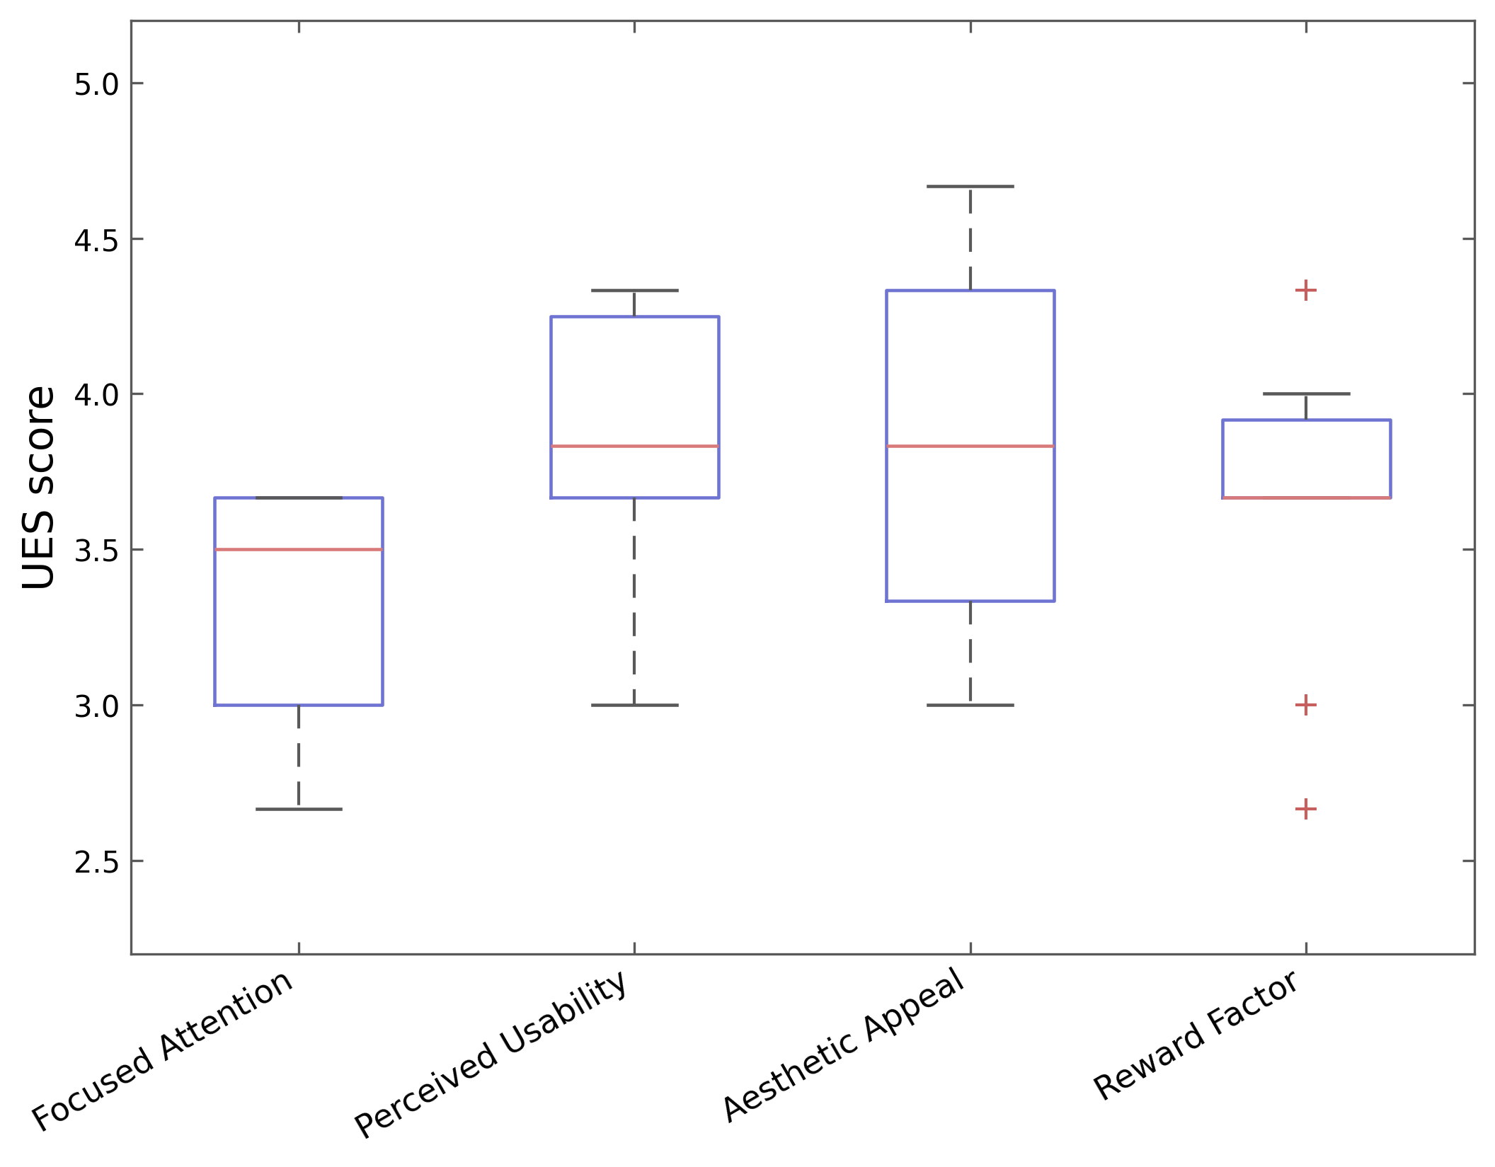
User Engagement Scale (UES)
3.83
PERCEIVED USABILITY (HIGHEST)
3.83
AESTHETIC APPEAL
3.60
REWARD FACTOR
3.50
FOCUSED ATTENTION (LOWEST)
Effective interaction and visually pleasing output, but limited sustained attentional immersion — echoing the lower expressiveness / exploration scores from CSI.

Slide 12
What worked — and current limitations
WHAT WORKED
LIMITATIONS
Perceived as functional, accessible, engaging.
Brain-mix supported a meaningful shared / collaborative experience.
High aesthetic appeal for generated visuals and sounds.
Lower expressiveness / exploration → limited perceived creative control.
Muse 2's 4-channel montage restricts neurophysiological resolution (traded off for portability & multi-user setup).
Small, homogeneous sample (n = 10) — descriptive only, no domain experts.

Slide 13
Language as a bridge between EEG and generative art
A language-mediated layer makes EEG-to-generation mappings more interpretable than direct signal-to-output pipelines.
Brain-mix introduces a novel form of collaborative neuroadaptive art, fusing two users' affective states into one artifact.
Pilot results support feasibility and usability, while pointing to expressiveness as the key open challenge.
NEXT STEPS
Larger, more diverse samples — including domain experts.
Alternative generation strategies giving users more control over semantic / visual / audio mappings.
Improve transparency, reproducibility, and creative autonomy.

Slide 14
Thank you tommaso.colafiglio@poliba.it

