Slide 1

WORKSHOP ON BRAIN-MACHINE INTERFACES
IEEE SMC 2026
October 4-7, 2026
BCI-Based Assessment of Ocular Response Time
Using Dynamic Time Warping & Leveraging an RDWT-Driven Deep Neural Framework
S. Sarkar¹, S. S. Gandavarapu², J. Feng³, S. Prasad¹, R. Khanbabaie⁴, & J. L. Contreras-Vidal¹
1 | 2 | 3 | 4
IUCRC BRAIN, ECE Department, Cullen College of Engineering, University of Houston, Houston, Texas, USA | Department of Data Science, Cullen College of Engineering, University of Houston, Houston, Texas, USA | IUCRC BRAIN, Dept. of Industrial Design, College of Arch. & Design, University of Houston Houston, Texas, USA | IUCRC BRAIN, Neuro-Technology & BCI, Cognixion Inc. Toronto, ON, Canada
Notes:
Hello everyone. I am Shantanu, and today I’ll be presenting our work “BCI-Based Assessment of Ocular Response Time Using Dynamic Time Warping and an RDWT-Driven Deep Neural Framework.” This project is a multidisciplinary collaborative work bringing together expertise in brain–computer interfaces, data science, industrial design, Machine Learning, and Signal Processing from the University of Houston and our industry partner “Cognixion”.

Slide 2

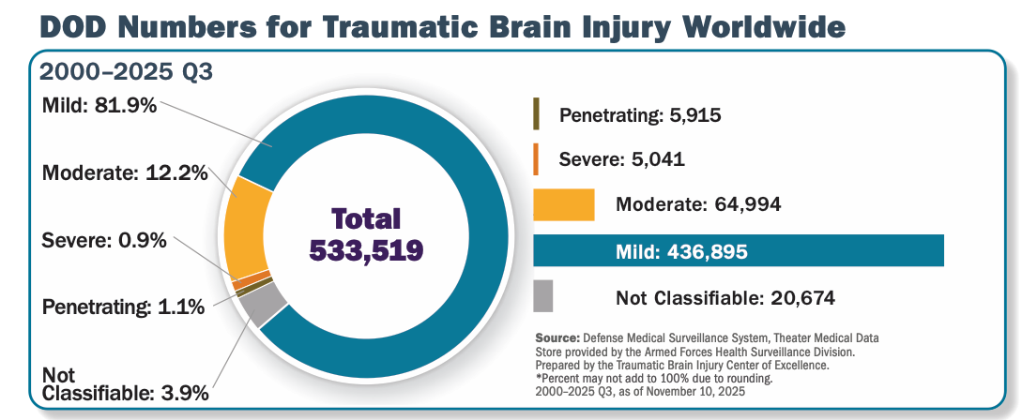
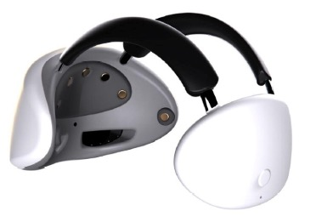



Motivation
Approximately 2.87 million cases of TBI occurred in the USA per year.
837,000 cases occurring among children and youth.
An estimated 13.5 million individuals live with a disability due to traumatic brain injury.
Estimated U.S. economic burden of TBI: ~$76.5 billion (2010 dollars).
No approved system integrates EEG with other measures for TBI assessment.
Develop a functional prototype of a novel system that integrates electroencephalography (EEG), Virtual Reality (VR), and Eye-tracking technologies to monitor mild Traumatic Brain Injury (mTBI) and explore other potential applications.
Why
How
What
Notes:
The broader motivation comes from the substantial burden of mild traumatic brain injury.
Since 2000, more than half a million brain injuries have been reported among U.S. service members, with the majority classified as mild TBI.
TBI also carries a substantial economic impact in the United States, with costs estimated in the tens of billions of dollars.
This motivated our goal - to develop a wearable multimodal platform integrating EEG, virtual reality, and eye tracking to monitor mild TBI.
This framework can also be extended to other applications using ocular response timing as an objective measure of neuro-ocular function.

Slide 3

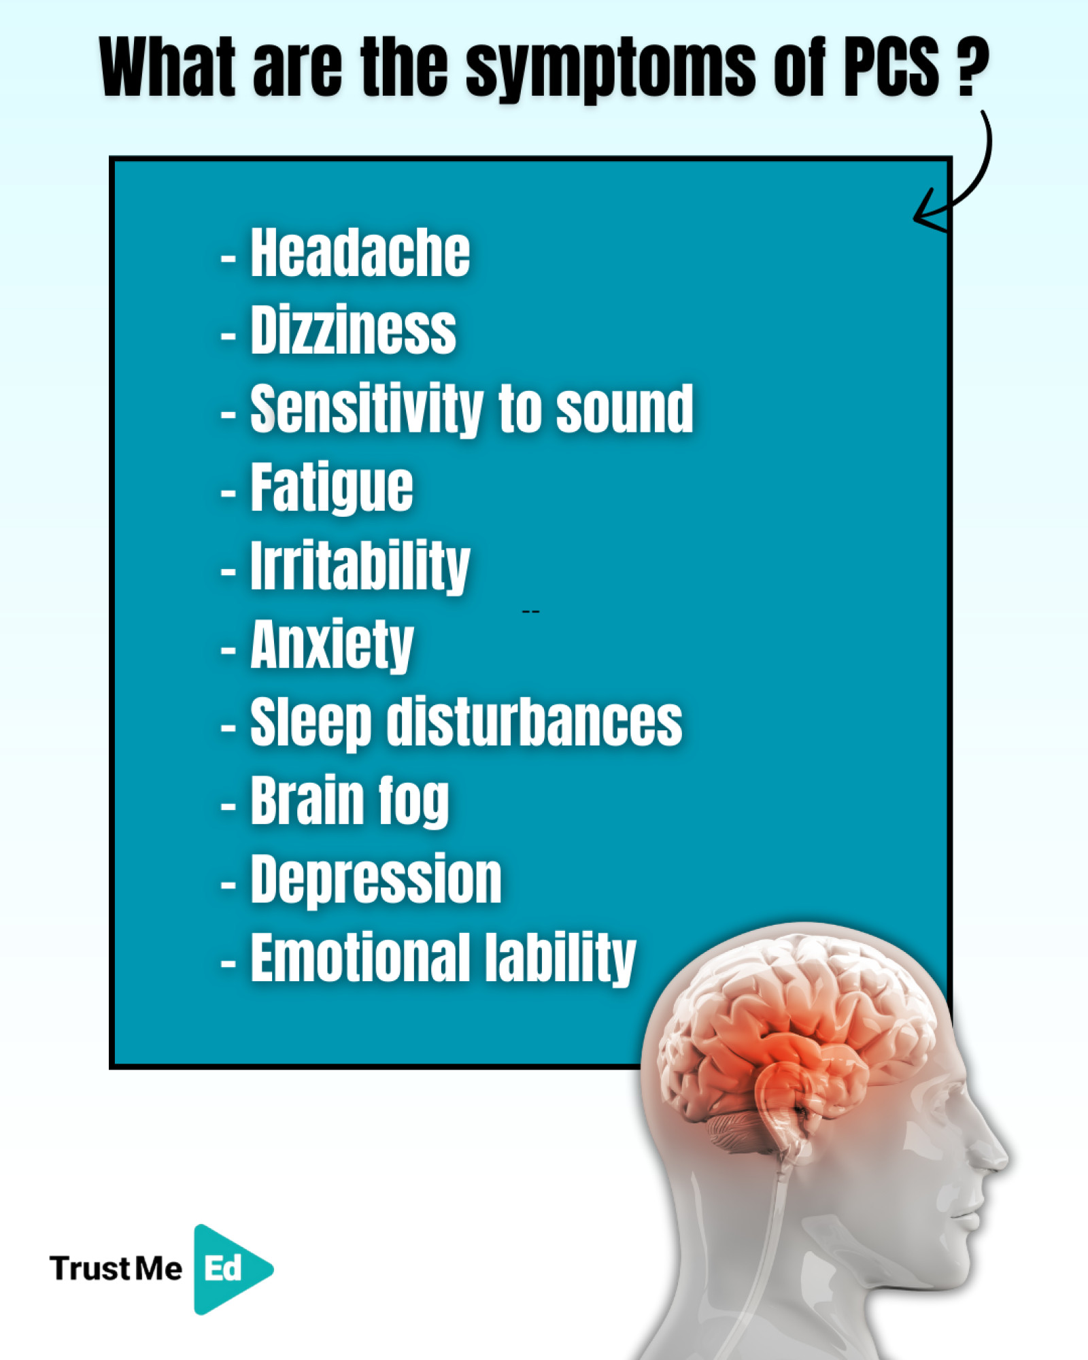
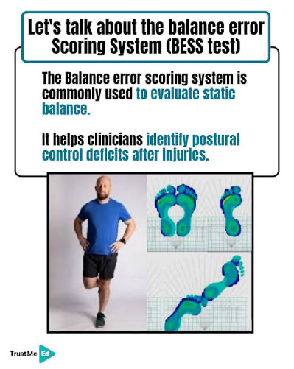




Current Solutions ➯Direction
ImPACT: Computerized cognitive test — Immediate Post-Concussion Assessment and Cognitive Testing.
PCSS: Symptom checklist — Post-Concussion Symptom Scale.
BESS: Clinical scoring system — Balance Error Scoring System.
BESS
Reliability Concerns:
Requires Baseline metrics.
Poor Test-Retest consistency.
Confounded by other Psychological & Physical conditions.
Oculomotor:
ImPACT shows moderate reliability only for visual-motor speed and reaction time.
Vestibular Oculomotor Motor Screening (VOMS) is validated for identifying concussion (Mucha et al., 2014).
No field-deployable rapid tool exists for time-sensitive mTBI evaluation or longitudinal tracking.
EEG/EOG capture brain and ocular dynamics but suffer from low SNR and artifacts, limiting clinical use.
Can a deep neural EEG-based BCI framework reliably assess ocular response time?
Why
How
What
Notes:
Current concussion assessment relies on tools such as ImPACT, Post-Concussion Symptom Scale, and Balance Error Scoring System.
These approaches rely on baseline measurements, raise concerns about test–retest reliability, and can be influenced by psychological or physical factors.
Oculomotor responses, including visual-motor speed and reaction time, have shown moderate reliability. The Vestibular/Ocular Motor Screening has demonstrated effectiveness in identifying concussion-related oculomotor dysfunction.
There is still a need for a rapid, field-deployable tool for time-sensitive mTBI evaluation. So, here is our question: Can an EEG-based deep neural BCI framework reliably assess ocular response time while addressing the fundamental challenge of low SNR in EEG?

Slide 4


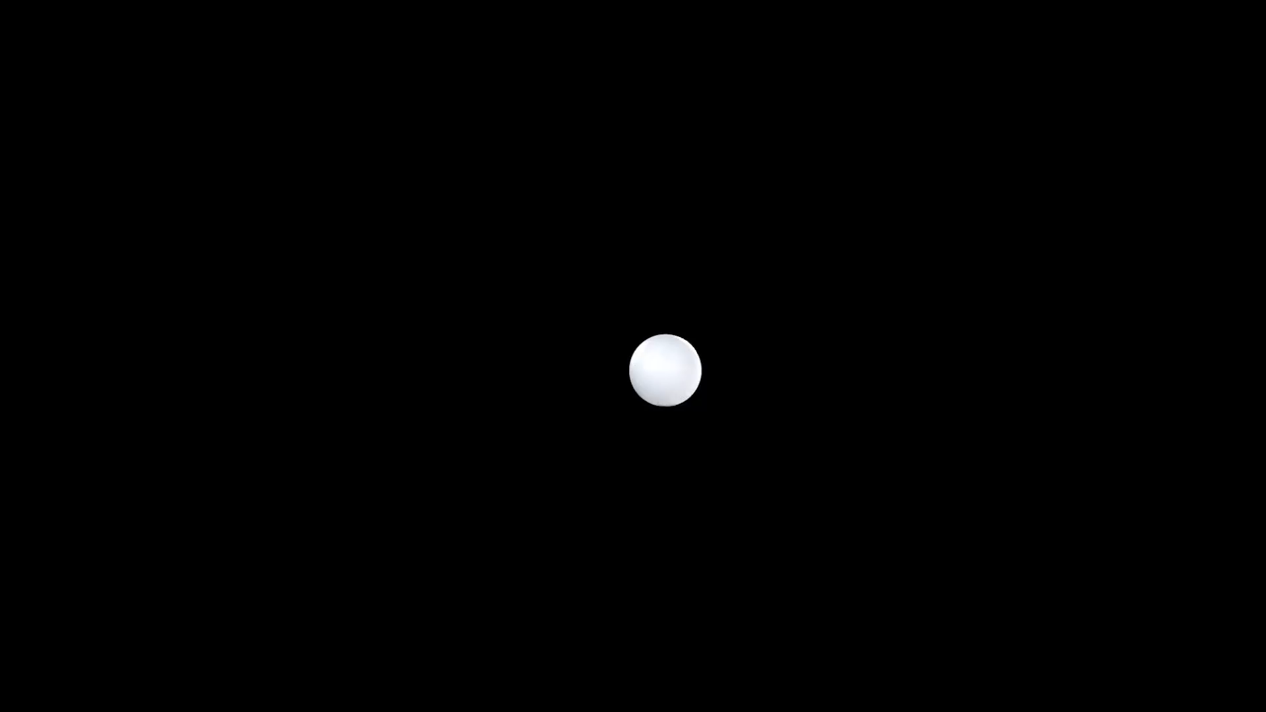





Experimental Design
Two Control Participants with:
No known history of mild traumatic brain injury (mTBI).
No confounding neurological conditions and no visual impairments.
Subject | Sex | Age
S1 | M | 55 Yr.
S2 | M | 23 Yr.
Four Vestibular/Ocular Motor Screening (VOMS) tasks
Horizontal Saccade: 7 left–right complete cycles (14 s)
Horizontal Pursuit: ∼4.7 alternating right/left excursions (15 s)
Vertical Saccade: 7 top–bottom complete cycles (14 s)
Vertical Pursuit: ∼4.7 alternating top/bottom excursions (15 s)
Horizontal Saccade
Horizontal Pursuit
Vertical Saccade
Vertical Pursuit
$$y$$
$$x$$
$$z$$
Why
How
What
Notes:
We conducted a proof-of-concept study with two control participants.
For this POC, we selected four VOMS tasks based on horizontal and vertical saccades and pursuits.
The saccade tasks consisted of seven complete cycles over 14 seconds, while the pursuit tasks contained approximately 4.7 alternating excursions over 15 seconds.
Both participants performed the VOMS tasks in the same sequence: horizontal saccade followed by horizontal pursuit and then vertical saccade and finally vertical pursuit.

Slide 5
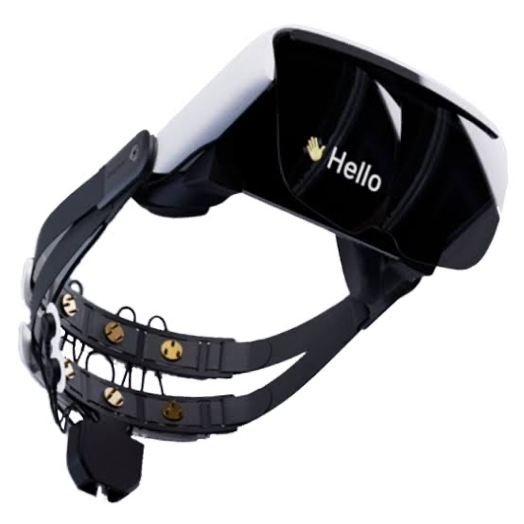
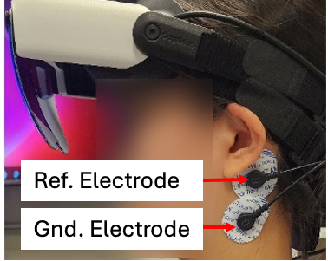
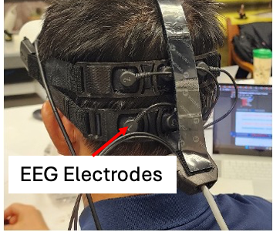
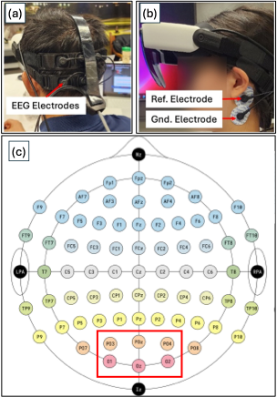
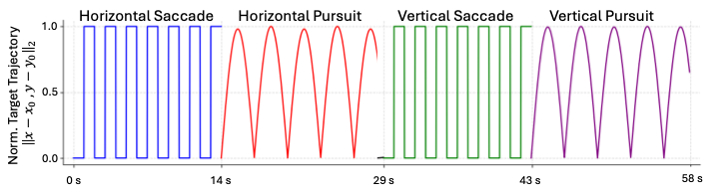
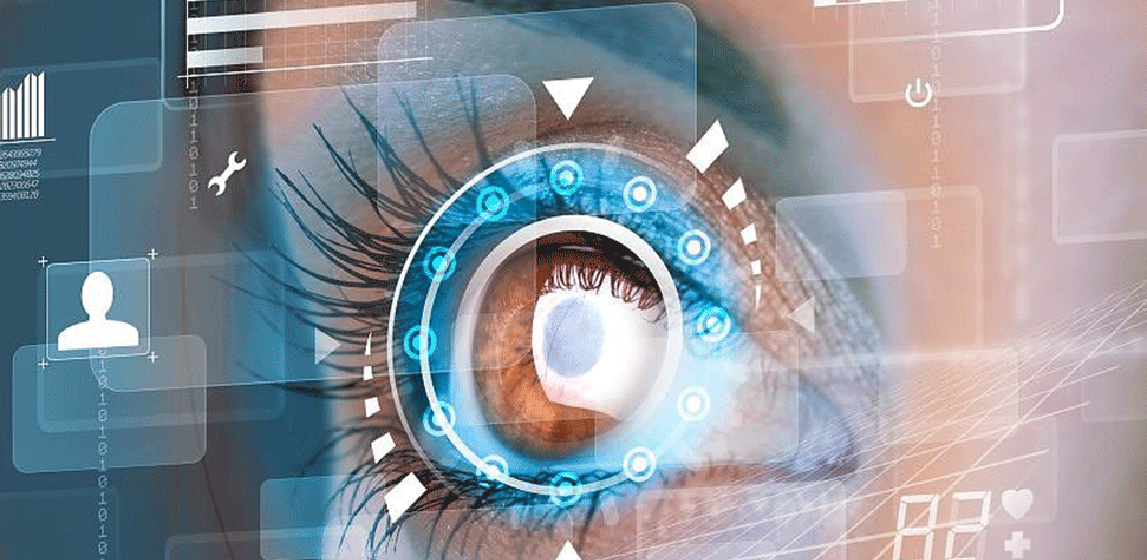

Experimental Setup
► Cognixion Axon-R Device ► 6 Electrodes - Occipital and Parietal-Occipital region ►Impedance ≤ 20 KΩ
► 5 Trials (60 s) $×$10 Session ≃ 3000 s Data / Participant
Visual Validation of Signal
Initial 2 s
Why
How
What
Notes:
We captured EEG using the Axon-R device with six electrodes capturing occipital and parietal-occipital regions
At the start, we made sure electrode impedance was below 20 kilo-ohms.
Each participant completed 10 sessions, with five 60-second trials per session.
Within each trial, we used the first two seconds for visual signal-quality validation, asking participants to relax, clench, or blink their eyes.

Slide 6
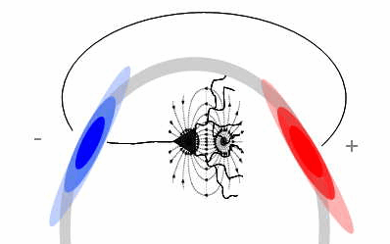
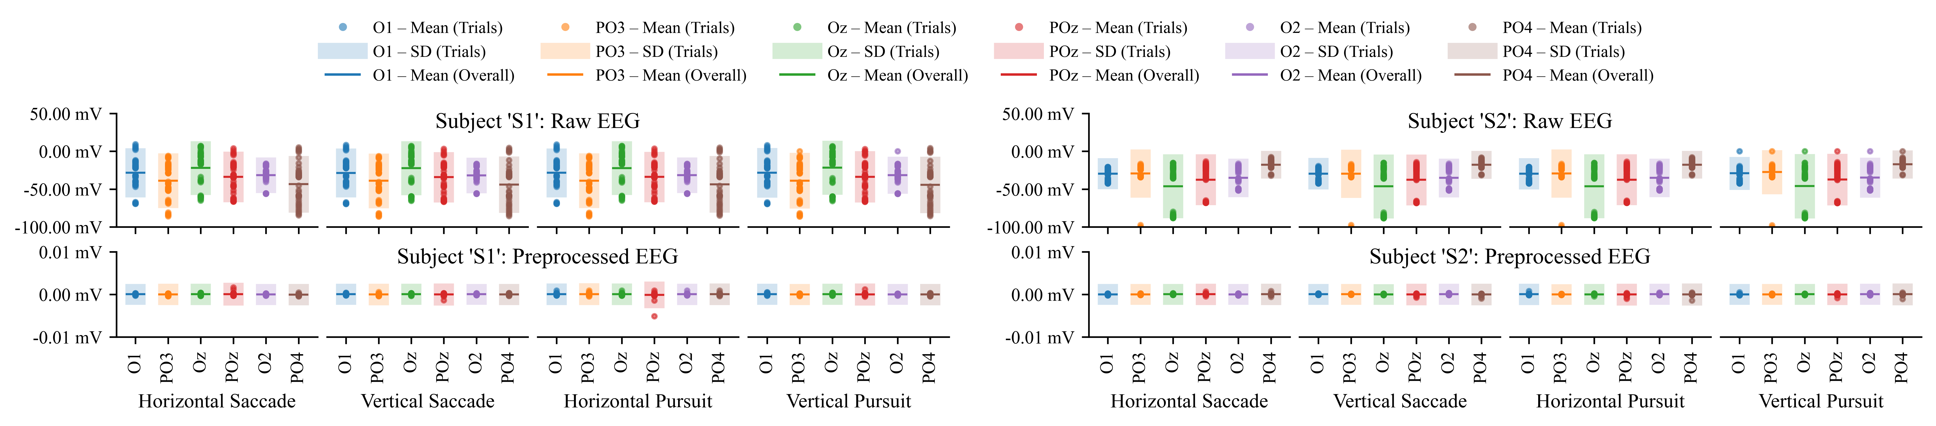
EEG Pre-Processing
Raw EEG
FS = 250 Hz
Resampling
Freq. = 100 Hz
Zero-Phase BPF
4th-order Butterworth
f_{c}(Hi): 0.5 Hz
f_{c} (Lo): 30 Hz
Re-Referencing
Why
How
What
Notes:
We sampled the raw EEG at 250 Hz and then resampled it to 100 Hz.
We applied a zero-phase fourth-order Butterworth band-pass filter (Cutoff frequencies 0.5 to 30 Hz), followed by average re-referencing.
The bottom plots show that preprocessing substantially reduced the variability and DC shift.

Slide 7
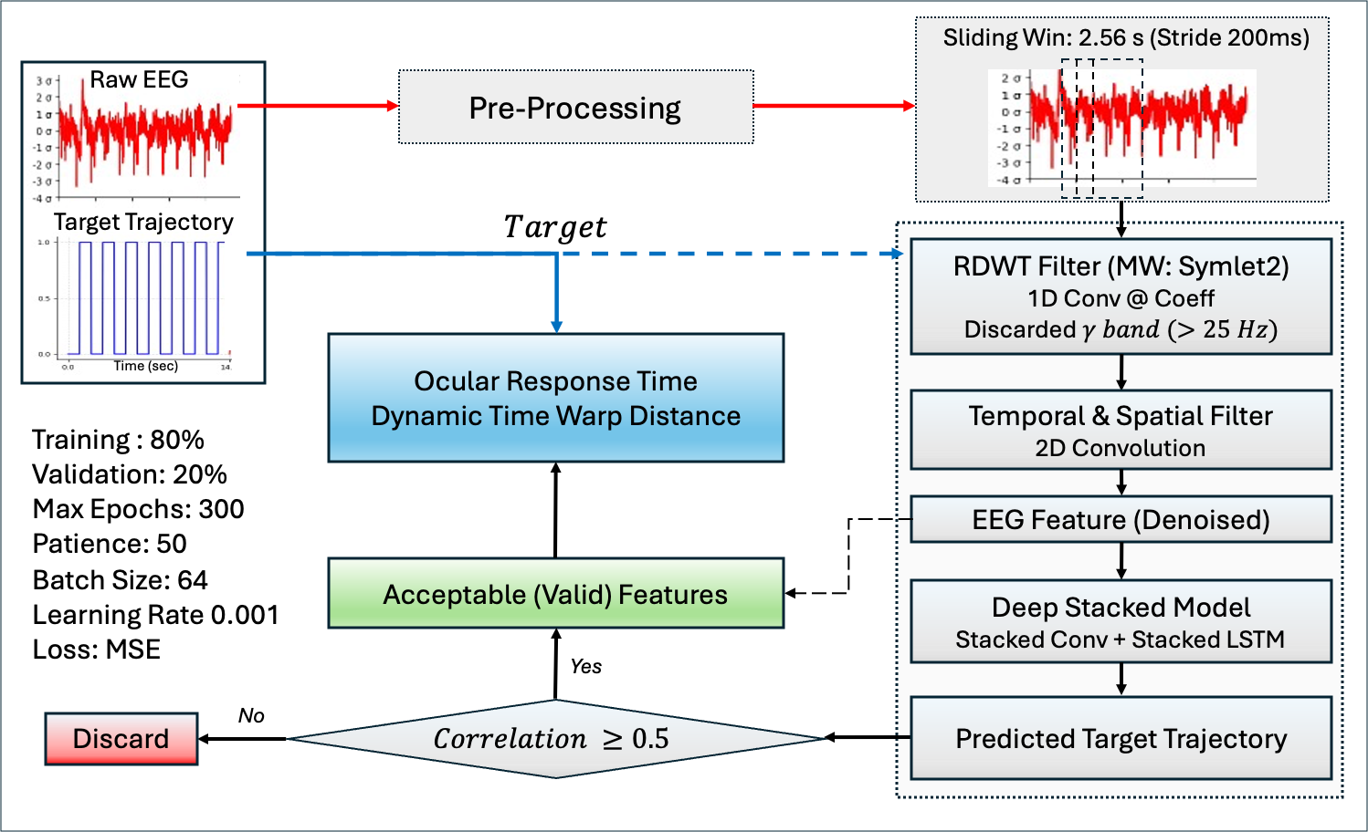
Feature Extraction Via RDWT-Driven DL-Framework
Why
How
What
Notes:
Here comes the core of our approach.
We segmented the preprocessed EEG into 2.56-second windows with a 200-millisecond stride.
Each window was passed through our Redundant Discrete Wavelet-driven framework.
The signal was decomposed using Symlet-2 and the wavelet coefficients were filtered via learned weights
The gamma band above 25 Hz was masked to reduce EMG contamination.
Temporal and spatial convolution then produced a compact denoised EEG feature, which was passed through the stacked convolutional and LSTM network to predict the visual-target trajectory.
The predicted trajectory served as our validation step. For windows with correlation greater than the threshold, we extracted the corresponding EEG feature from the model and used it for subsequent analysis.

Slide 8
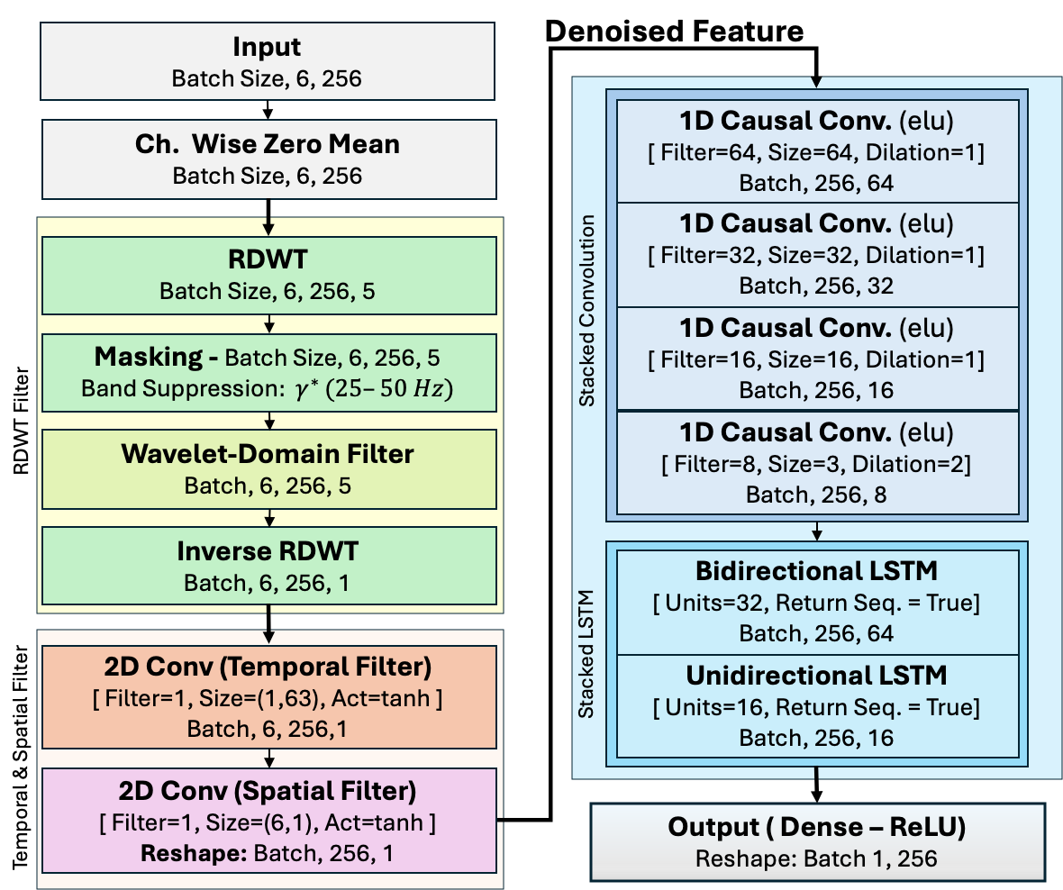
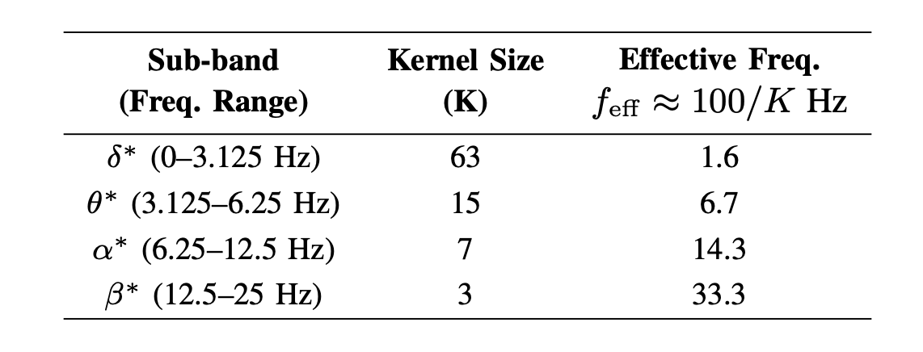
RDWT-Driven Deep Neural Framework
Why
How
What
Notes:
Here is the architecture in a little more detail.
Each EEG window contains six channels and 256 sample points.
After channel-wise normalization, we apply a four-level Redundant Discrete Wavelet Transform to decompose the EEG into frequency-specific bands.
We suppress the gamma band and apply learnable convolutional filters directly to the wavelet coefficients.
For each band, we select the kernel size based on its effective frequency. The inverse RDWT then reconstructs the filtered EEG.
Next, temporal convolution acts as a secondary filter. And finally, spatial convolution extracts a compact EEG feature across six channels.
This feature is then passed through stacked causal convolutions and LSTMs to predict the corresponding visual-target trajectory.

Slide 9
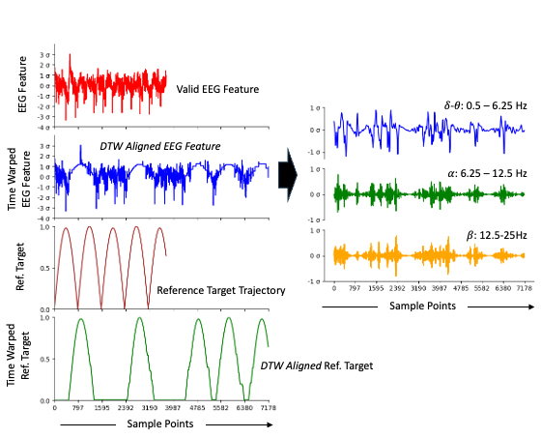
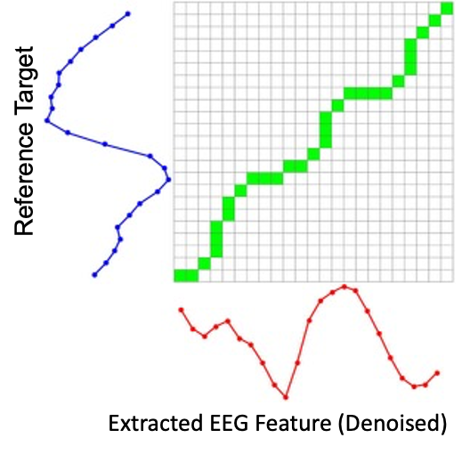
Dynamic Time Warping (DTW) Distance
DTW (Dynamic Time Warping):
An algorithm that aligns two time series of different lengths/speeds by nonlinearly stretching the time axis to find their optimal similarity match.
Constrained Alignment Window
50 samples (±500 ms)
Why
How
What
Notes:
To quantify ocular response timing, we used Dynamic Time Warping
Dynamic Time Warping algorithm aligns two time series by nonlinearly stretching the time axis to find their optimal similarity match.
Here, we aligned the valid EEG-derived feature with the corresponding target trajectory using a constrained temporal window of 50 samples, that is 500 ms.
The right-side plot illustrates a typical example of the DTW-aligned EEG feature and target trajectory, along with insights into the corresponding frequency-band activity.

Slide 10
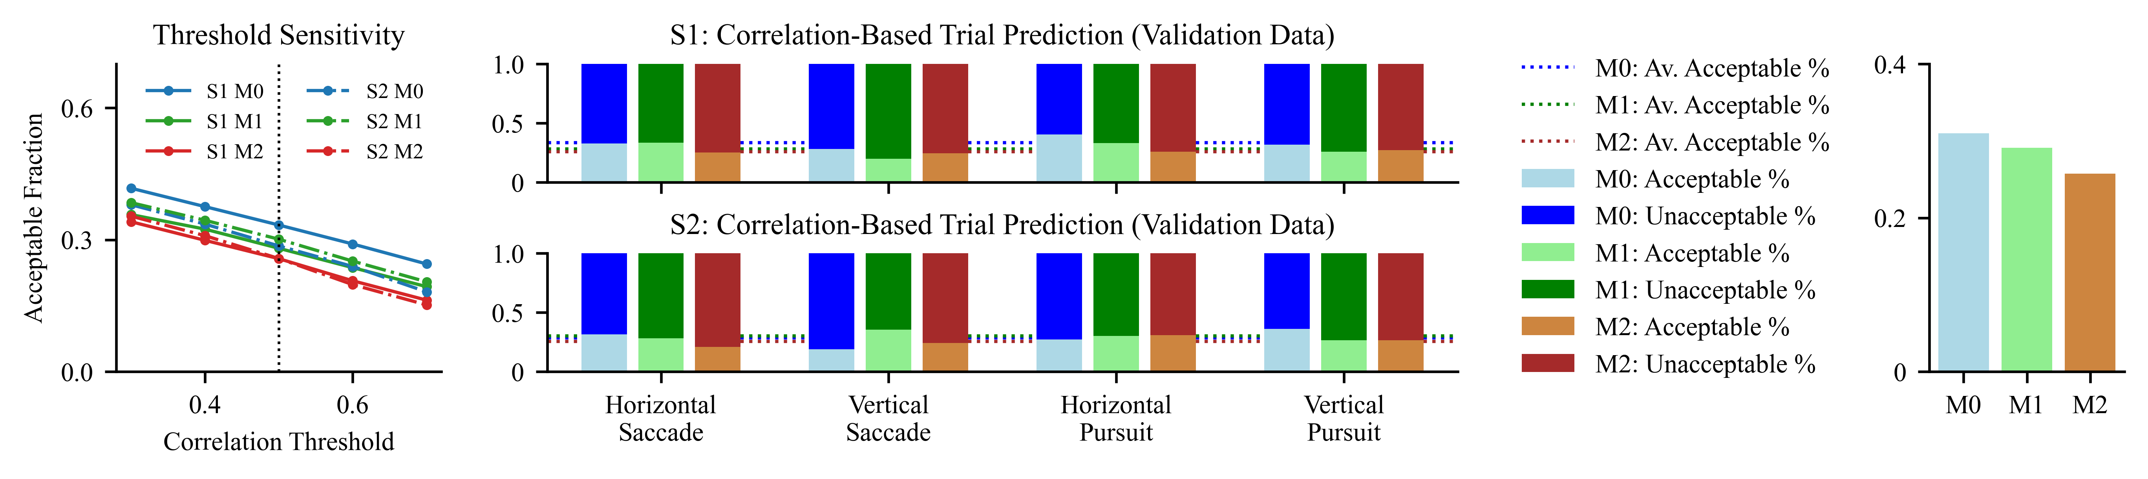
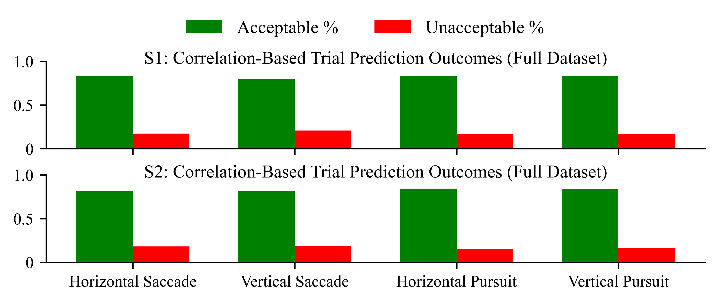
Ablation Results
Overall Average
Threshold-sensitivity validation: $r=0.3$ to 0.7
Complete Data – M0 – Threshold: 0.5
Model | Description
M0 | Full RDWT pipeline with wavelet-domain filtering.
M1 | Without the wavelet-domain filtering layer
M2 | Stripped out all RDWT-related components
Why
How
What
Notes:
Before analyzing the extracted EEG features, we first validated the contribution of the RDWT-based filtering through an ablation study.
M-Zero represents the complete framework, M1 removes only the learnable wavelet-domain filtering, and M2 removes all RDWT-related components.
Across both participants and all four VOMS tasks, the complete M-Zero model consistently outperformed.
Importantly, the same ordering—M-Zero, followed by M1, then M2—was preserved as we varied the correlation threshold from 0.3 to 0.7.

Slide 11
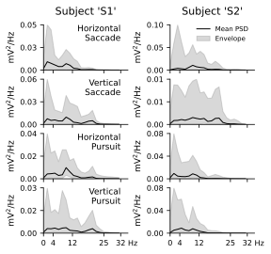
PSD of Extracted Features (Valid Windows)
Horizontal Saccades
Dominated by low-frequency components, with most power concentrated below ∼ 10 Hz.
Vertical Saccades
Strong low-frequency dominance, but with a more pronounced contribution in the β-band.
Horizontal
Vertical Pursuit
Broader spectral distribution, with elevated power extending from low frequencies into the α band.
*Additional β-band contributions were observed particularly for participant S1.
Why
How
What
Notes:
We analyzed the Power Spectral density of the extracted EEG features.
For both participants, the saccade tasks were predominantly characterized by low-frequency activity, with most power below approximately 10 hertz.
Vertical saccades also showed a comparatively greater beta-band contribution.
In contrast, the pursuit tasks showed a broader spectral distribution, extending from the lower frequencies into the alpha band.
Additional β-band contributions were observed particularly for participant S1.

Slide 12
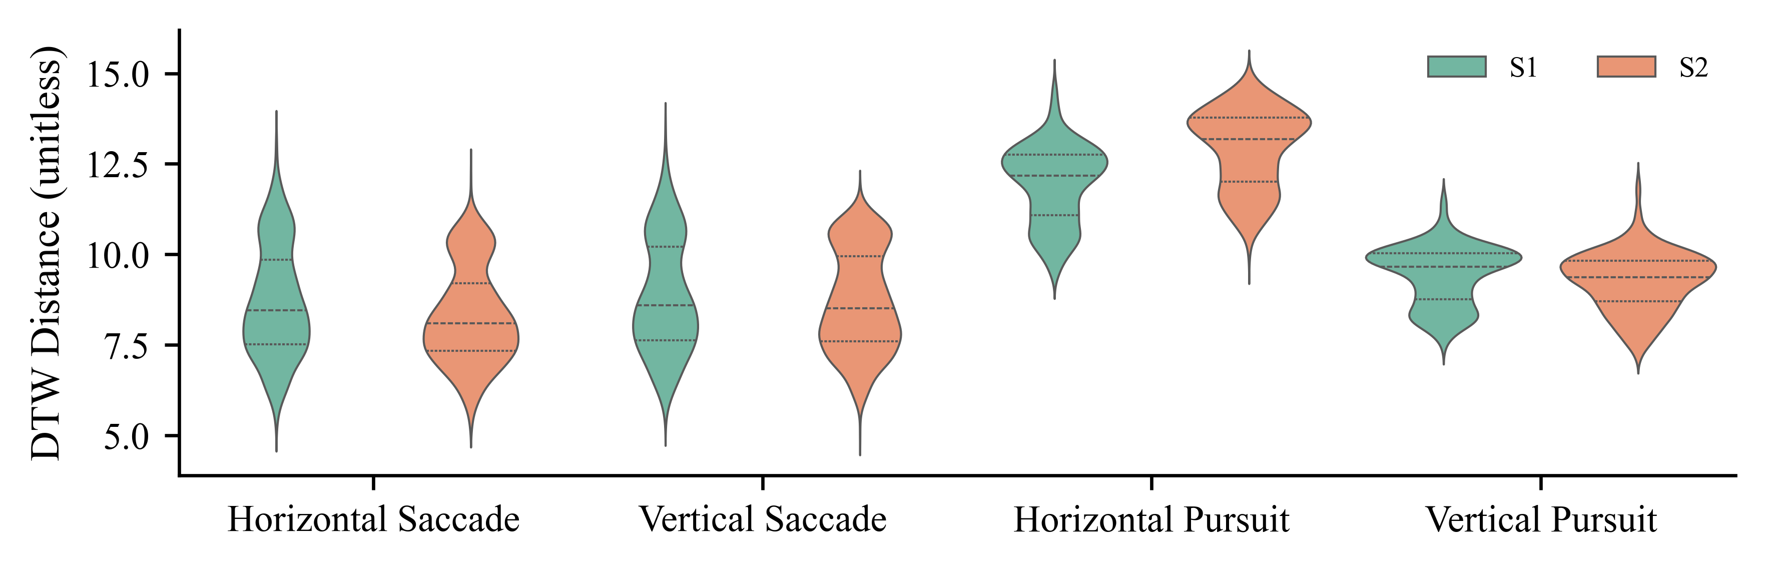
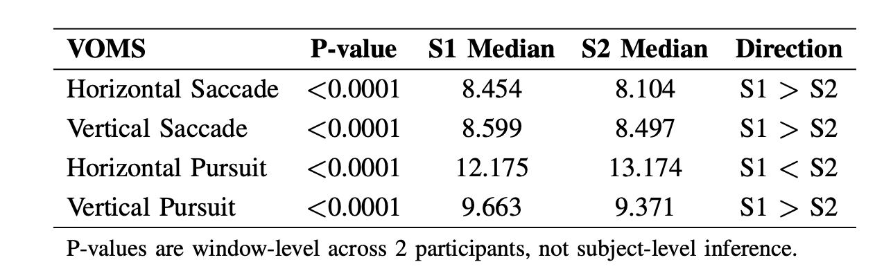
Window Level DTW Distance
Mann Whitney U Test – Across Subjects (S1/S2) – Across VOMS
Why
How
What
Notes:
Here, the violin plots show window-level DTW-distance distributions across VOMs and participants.
Horizontal pursuit produced the highest DTW distances, while the other tasks showed comparatively lower values.
To quantify the differences between S1 and S2, we used the Mann–Whitney test. All four VOMS tasks showed significant window-level differences.
S1 had a higher median DTW distance for horizontal and vertical saccades and vertical pursuit, whereas S2 had a higher median for horizontal pursuit.

Slide 13
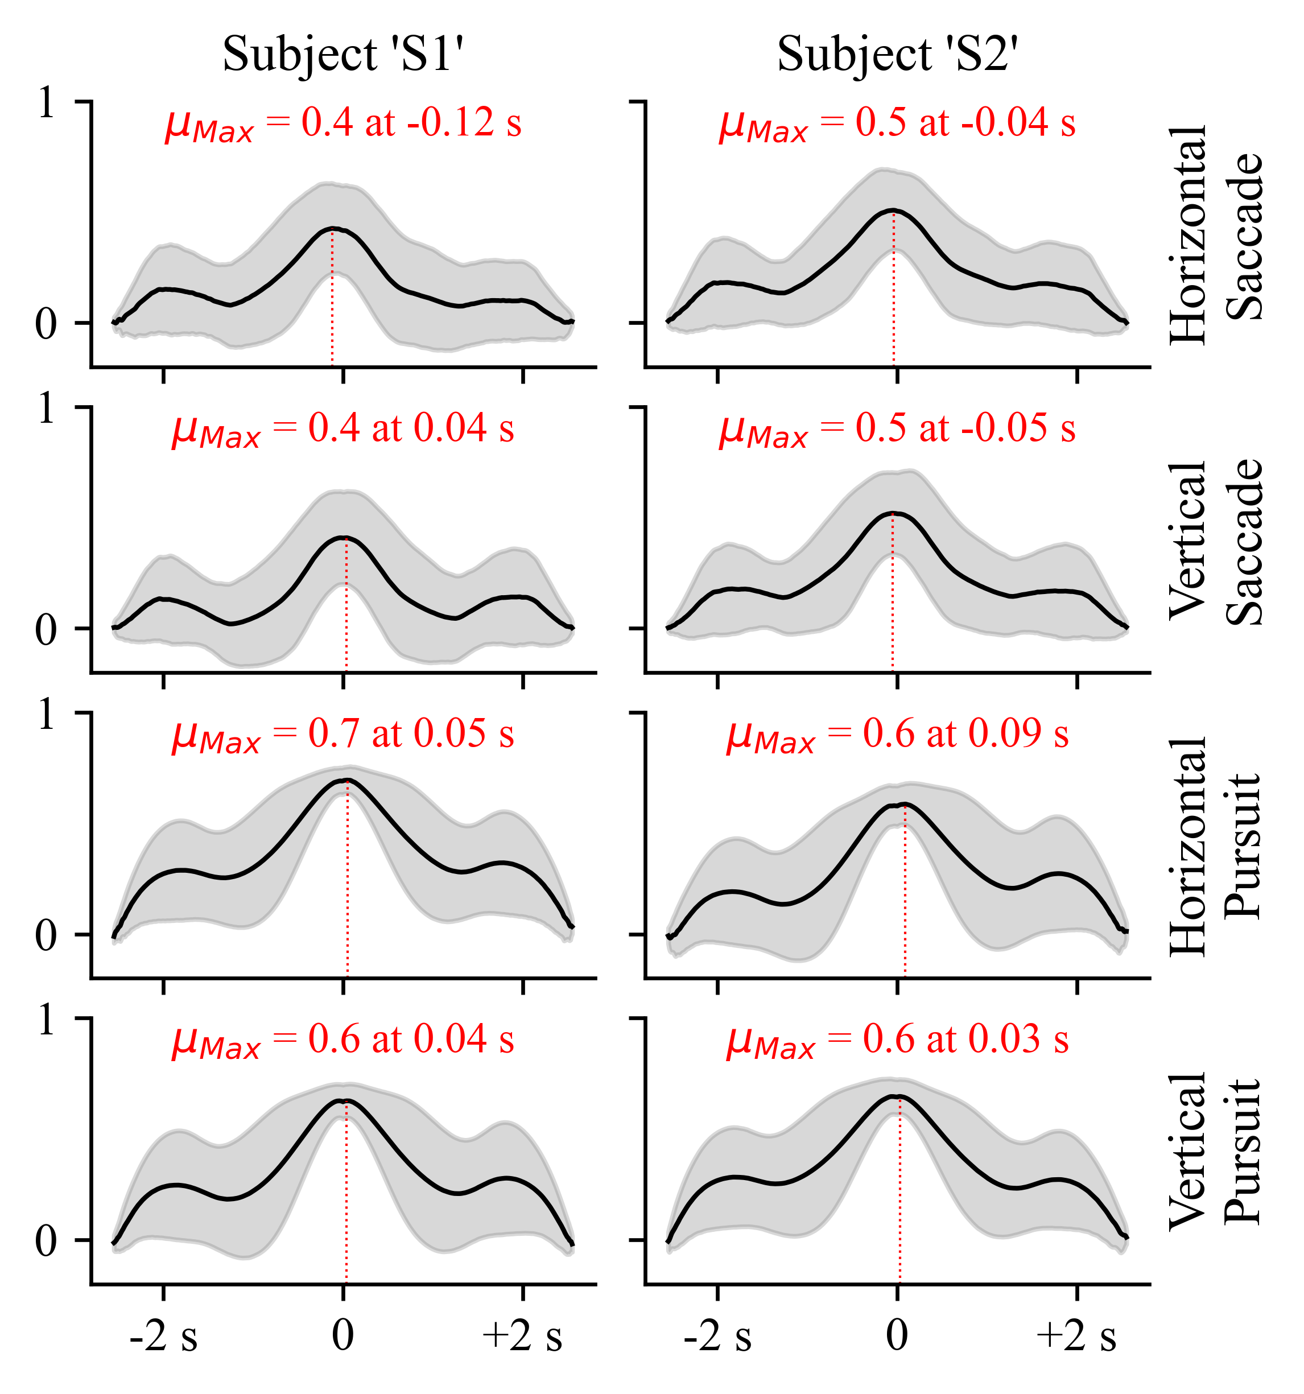
Cross-Correlation Dynamics
Horizontal Saccades
EEG features lead the target (S1: −120 ms | S2: −40 ms).
Vertical Saccades
S1: EEG features lead the target slightly (+40 ms).
Horizontal
Pursuit
EEG features lag the target (S1: 50 ms | S2: 90 ms).
S2: The EEG features lead the target (-50 ms).
Vertical
Pursuit
EEG features lag the target (S1: 40 ms | S2: 30 ms).
Pursuit: Stronger correlation (~0.6–0.7) and Consistent EEG lag → Reactive Response.
Why
How
What
Notes:
Finally, we used cross-correlation to examine the temporal relationship between the EEG-derived features and the visual target.
Here, a negative lag indicates that the EEG feature leads the target, while a positive lag indicates that the EEG feature follows the target.
For the saccade tasks, the response was predominantly anticipatory, with the EEG feature generally leading the target.
In contrast, both horizontal and vertical pursuit showed a consistent positive lag across both participants—approximately 30 to 90 milliseconds—indicating a reactive response.
Importantly, the pursuit tasks also showed stronger peak correlations, around 0.6 to 0.7, compared with approximately 0.4 to 0.5 for saccades.
So, in this proof-of-concept, pursuit provided stronger and more consistent EEG–target temporal coupling.

Slide 14
Conclusion
RDWT−Filter
Trainable RDWT-filtering improved EEG-based ocular-trajectory prediction (M0 outperformed).
DTW−Metrics
Supporting its use as a quantitative temporal metric.
Pursuit
Stronger correlation (~0.6–0.7) and Consistent EEG lag → Reactive Response.
Framework
Provides a proof-of-concept EEG-based approach for objective neuro-ocular assessment.
Future Goals:
1
Integrate EEG, eye tracking, and visual-target data to validate ocular response timing.
2
Incorporate improved ocular-artifact handling, including H∞-based filtering.
3
Validate the framework in a larger and more diverse cohort, including participants with mTBI.
4
Evaluate EEG/DTW metrics as potential mTBI biomarkers.
Notes:
Here we conclude
Trainable RDWT filtering improved trajectory prediction, while DTW captured task- and subject-dependent response dynamics.
Pursuit tasks showed stronger EEG–target coupling and consistent reactive lags.
Overall, our results support the feasibility of this EEG-based framework for objective neuro-ocular assessment.
Going forward, we plan to integrate eye tracking for direct validation of ocular response timing, improve ocular-artifact handling, and validate the framework in a larger and more diverse cohort, including participants with mTBI. Ultimately, we aim to evaluate these EEG- and DTW-derived metrics as potential biomarkers for mTBI assessment.

Slide 15
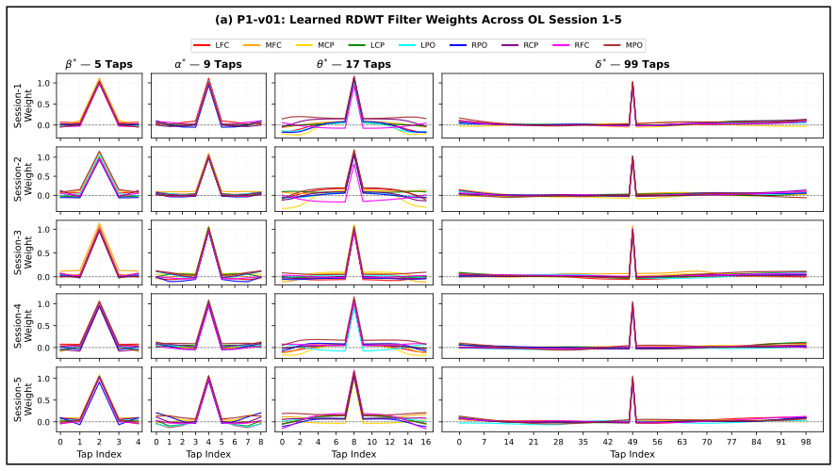
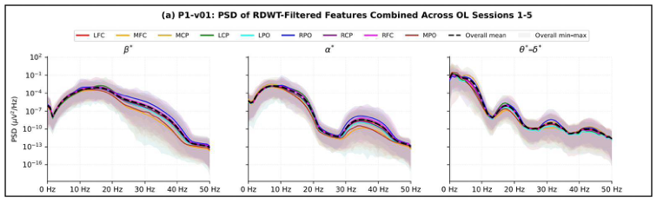
Annexure - Learned RDWT Filter Weights and Resulting Spectral Characteristics
S. Sarkar et al., “A 2-Block Architecture for Real-Time EEG Gait Decoding: A Pilot Study,” arXiv:2608.02083, 2026.(IEEE MLSP 2026)
The learnable RDWT-based filter layer was independently validated in a separate real-time gait-phase decoding BCI study.
P1- Learned RDWT Filter Weights Across OL Sessions 1-5
P1 - PSD of RDWT-Filtered Features Combined Across OL Sessions 1-5
Notes:
As additional validation, the learnable RDWT-based filtering approach was also evaluated independently in our separate real-time EEG gait-decoding study.
The plots show the learned subband-specific filter weights across sessions and ROIs, together with their resulting spectral characteristics.
This provides additional evidence that the RDWT filtering layer can learn structured, frequency-dependent transformations rather than acting simply as a fixed filter.

Slide 16
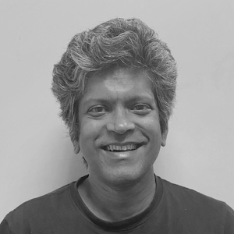




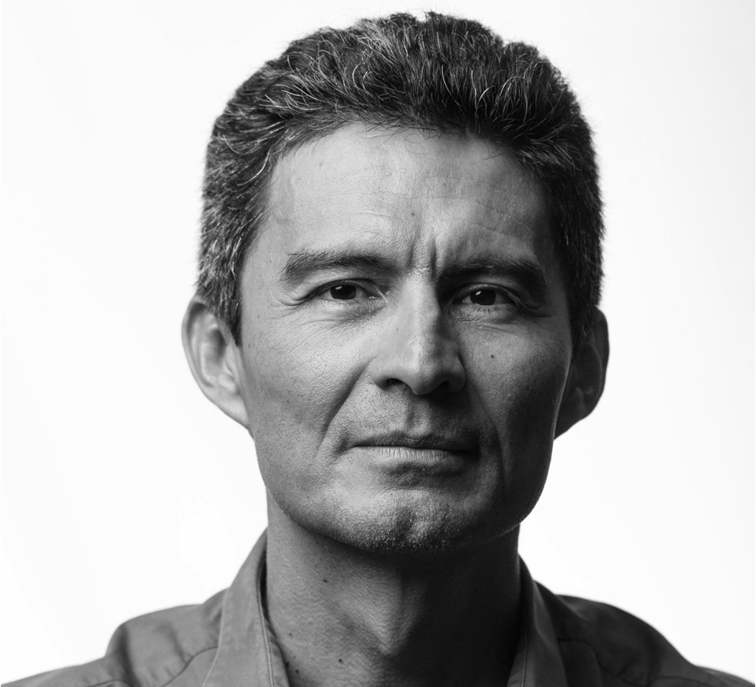





Thank You – Q & A
Shantanu Sarkar
PhD Candidate
University of Houston
Sai S. Gandavarapu
Graduate Student
University of Houston
Jeff Feng
Professor, Ind. Design
University of Houston
Saurabh Prasad
Professor, ECE
University of Houston
Reza Khanbabaie
Lead Neuroscientist
Cognixion
J. L. Contreras-Vidal
Professor, ECE
University of Houston
Axon-R
Notes:
And finally, here is our team. I’d like to thank all of my co-authors for their contributions, as well as the students and other team members who helped with data collection and different aspects of this work. Thank you all for your attention. I’ll be happy to take any questions.”

Slide 17
References
[1] CDC, “Traumatic Brain Injury & Concussion: Facts About TBI,” 2025.
[2] DoD, “DoD TBI Worldwide Numbers,” Military Health System, 2026.
[3] A. C. McKee and M. E. Robinson, “Military-related traumatic brain injury and neurodegeneration,” Alzheimer’s & Dementia, 2014.
[4] T. Covassin et al., “Immediate post-concussion assessment and cognitive testing (ImPACT) practices,” J. Athletic Training, 2009.
[5] P. Langevin et al., “Responsiveness of the post-concussion symptom scale to monitor clinical recovery,” Orthop. J. Sports Med., 2022.
[6] D. R. Bell et al., “Systematic review of the balance error scoring system,” Sports Health, 2011.
[7] J. L. Farnsworth et al., “Reliability of computerized neurocognitive tests for concussion assessment,” J. Athletic Training, 2017.
[8] J. Resch et al., “ImPACT test–retest reliability: Reliably unreliable?” J. Athletic Training, 2013.
[9] S. J. Mason et al., “Temporal stability of ImPACT scores among collegiate athletes,” Arch. Clin. Neuropsychol., 2020.
[10] J. A. Urigüen and B. Garcia-Zapirain, “EEG artifact removal: State-of-the-art and guidelines,” J. Neural Eng., 2015.
[11] A. Craik et al., “Design and validation of a low-cost mobile EEG-based BCI,” Sensors, 2023.
[12] J. S. Kutcher and C. C. Giza, “Sports concussion diagnosis and management,” Continuum, 2014.
[13] T. T. K. Munia et al., “EEG spectral analysis of brain function alteration in athletes with concussion history,” Sci. Rep., 2017.
[14] J. K. Yue et al., “The role of blood biomarkers for MRI diagnosis of traumatic brain injury,” Medicina, 2020.
[15] A. Mucha et al., “A brief Vestibular/Ocular Motor Screening (VOMS) assessment to evaluate concussions,” Am. J. Sports Med., 2014.
[16] K. Toda et al., “P300 and reaction time in Parkinson’s disease,” J. Geriatr. Psychiatry Neurol., 1993.
[17] J. N. van der Geest et al., “Eye movements, visual attention, and autism,” Biol. Psychiatry, 2001.
[18] S. A. Wylie et al., “The effect of Parkinson’s disease on interference control during action selection,” Neuropsychologia, 2009.
[19] J. Zhang et al., “Decision deficits and response inhibition in PSP and Parkinson’s disease,” Brain, 2016.
[20] X. Xie et al., “Visualizing autism spectrum disorder biomarker insights,” Heliyon, 2024.
[21] K. J. Pope et al., “Managing EMG contamination in scalp recordings,” Brain Behav., 2022.
[22] S. Sarkar and J. L. Contreras-Vidal, “Optimal discrete mother wavelet selection for EEG motor imagery decoding,” CCIS, Springer, 2025.
[23] T. Giorgino, “Computing and visualizing dynamic time warping alignments in R,” J. Stat. Softw., 2009.
[24] A. R. Nikolaev et al., “Combining EEG and eye movement recording in free viewing,” Brain Cogn., 2016.
[25] N. W. Churchill et al., “Brain function associated with reaction time after sport-related concussion,” Brain Imaging Behav., 2021.
[26] B. A. Christensen et al., “Interhemispheric transfer time and concussion in adolescents,” Front. Hum. Neurosci., 2023.
[27] S. J. Mullen et al., “Saccadic eye movements in mild traumatic brain injury,” Can. J. Neurol. Sci., 2014.
[28] J. L. Stubbs et al., “Diagnostic performance of smooth pursuit eye movement in mild traumatic brain injury,” Sci. Rep., 2019.

