Slide 1





A Multi-Objective Optimisation Framework for Corticomuscular EEG-EMG Pair Selection in Hybrid BCI
Dekka Muni Kumar, Yogesh Kumar Meena
Human-AI Interaction (HAIx) Lab, IIT Gandhinagar, India

Slide 2
Problem & Motivation
Existing CBPT-based hybrid EEG-EMG BCIs rely on manually predefined EEG-EMG channel pairs, which may not capture the most informative corticomuscular interactions across subjects.
Develop an automatic, domain knowledge-guided EEG-EMG pair selection framework to improve corticomuscular interaction analysis and motor imagery classification performance.

Slide 3
Research Gap
Existing hybrid EEG-EMG BCIs rely on manually predefined EEG-EMG channel pairs.
EEG-EMG pair selection is not formulated as a systematic optimization problem.
Neurophysiological spatial information from motor cortex regions is not incorporated into pair selection.
Existing methods do not adapt channel pair selection to subject-specific corticomuscular connectivity patterns.

Slide 4
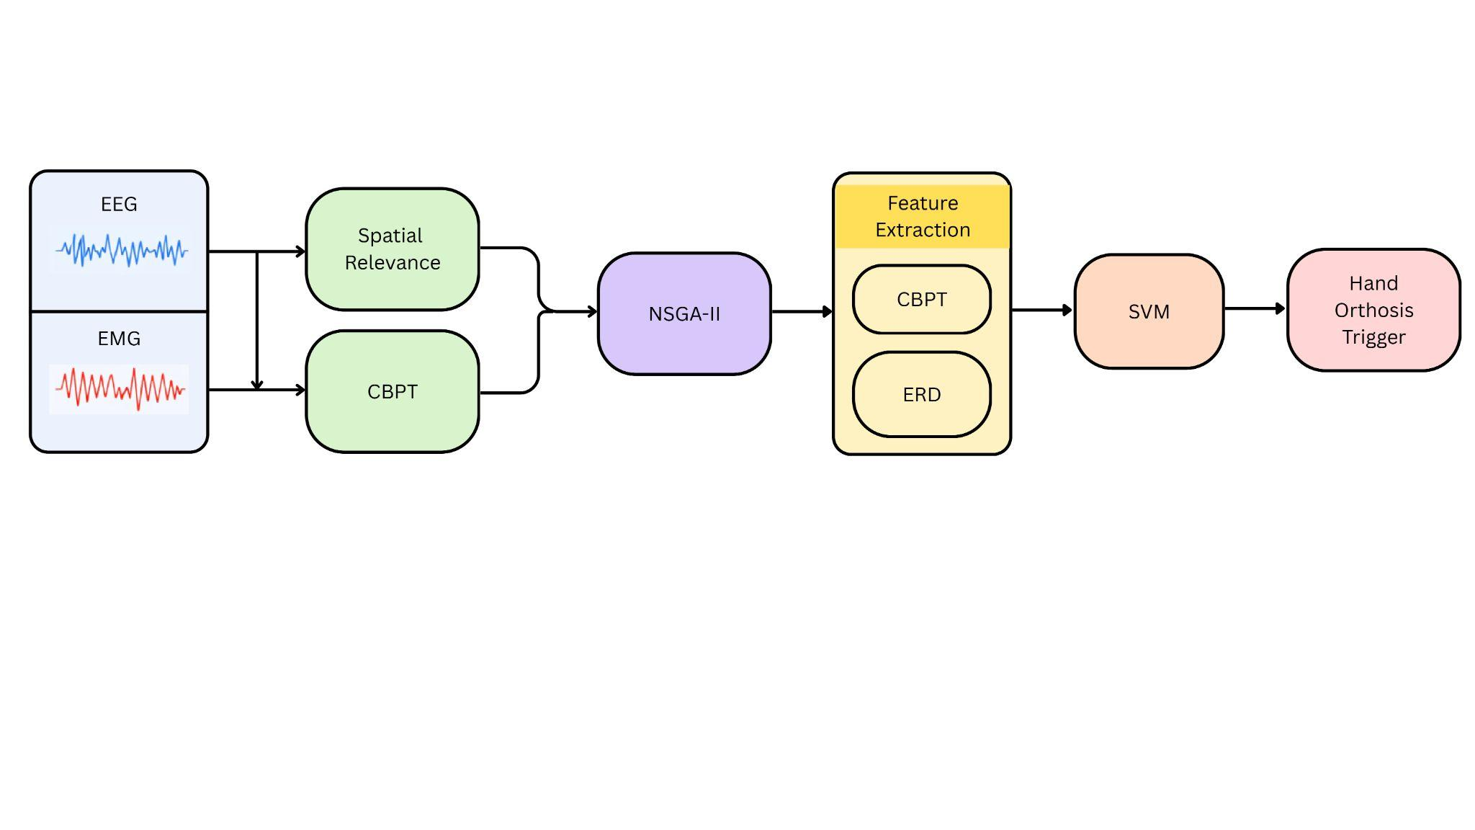
Contributions
Bi-objective EEG–EMG pair selection using a constrained optimization framework.
Domain knowledge-guided optimization combining Gaussian spatial relevance and CBPT-based corticomuscular interaction with NSGA-II.
Hybrid CBPT + ERD feature extraction with SVM classification for robust motor imagery detection.
Proposed hybrid EEG–EMG BCI framework with NSGA-II-based pair selection, CBPT/ERD feature extraction, SVM classification, and hand orthosis control.

Slide 5
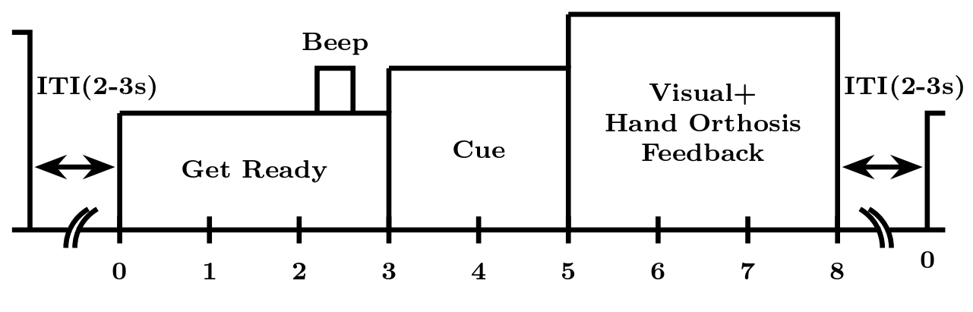
Dataset Acquisition
EEG-EMG dataset collected from 8 stroke patients performing left- and right-hand MI tasks [1].
EEG acquired using 7 bipolar channels from the standard 10–20 system for sensorimotor activity analysis.
EMG recorded from two forearm muscles: FDSR and FDSL.
Experimental protocol consists of:
  Offline training phase
  Online feedback phase
Each trial includes a visual cue followed by a motor imagery period, with real-time feedback provided during online testing.
Fig: Timing diagram of single-trial dataset recorded
[1] Anirban Chowdhury et al. ,An EEG-EMG correlation-based brain-computer interface for hand orthosis supported neuro-rehabilitation, Journal of Neuroscience Methods,Volume 312,2019,

Slide 6
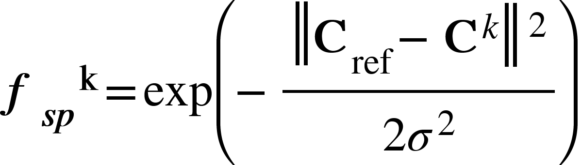
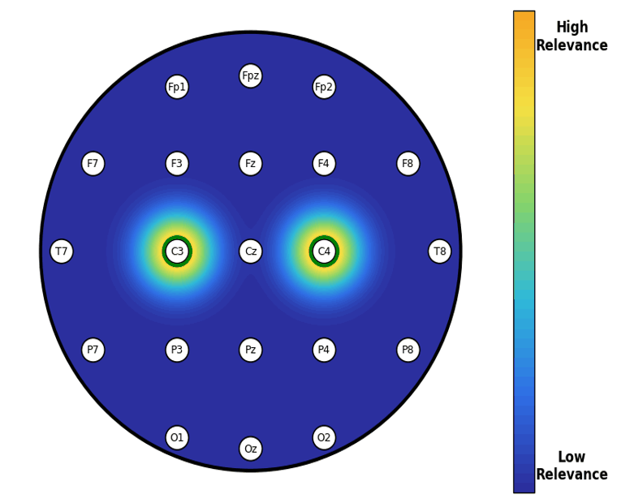


Method used for Pair Selection
Objective 1: Spatial Relevance
Prioritize the channels that are close the reference channels (C3 and C4) over sensorimotor cortex.
Gaussian Kernel is used to give higher weights to channels that are closer to reference channels.
Where:
: Reference channel position (C3 or C4)
: Position of the k-th EEG channel
σ : Gaussian kernel radius controlling neighbourhood spread

Slide 7

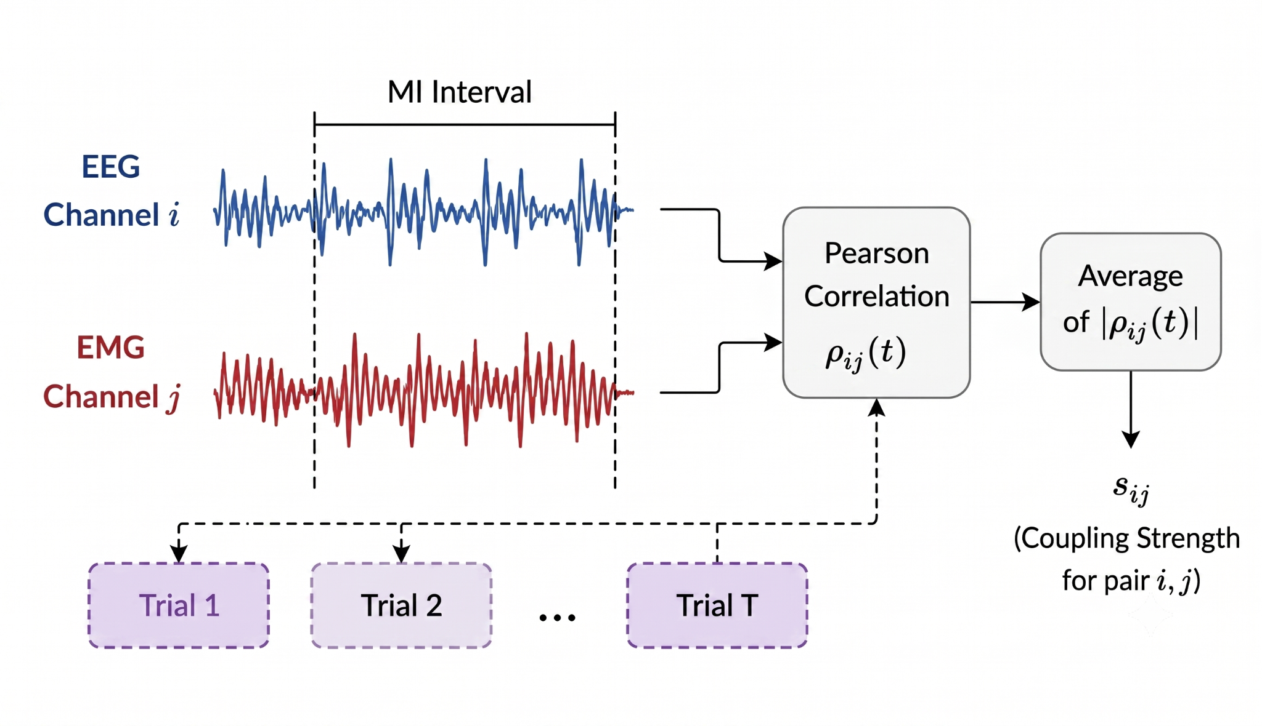
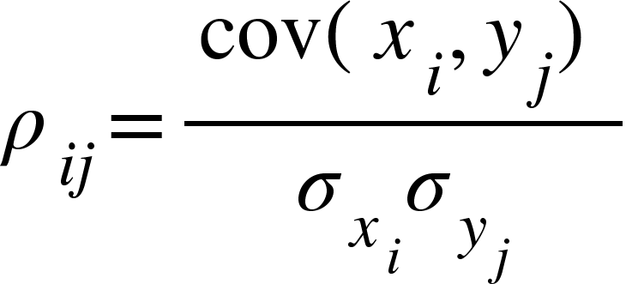
Method used for Pair Selection
Objective 2: Corticomuscular Coupling Strength
Objective aims to maximise corticomuscular coupling between EEG and EMG signals during motor imagery.
Strong EEG-EMG coupling reflects meaningful interactions between cortical activity and muscle responses .
Pearson correlation coefficient is used to measure coupling between EEG and EMG channels.
Absolute correlation values are averaged across all trials to obtain robust coupling estimates and reduce trial variability

Slide 8
Results
Patient | Acc (%) | Selected Channel Pairs
P1 | 100.0 | FC3-FDSR, C3-FDSR, CP3-FDSR, Cz-FDSR
P2 | 85.0 | CP3-FDSR, Cz-FDSR, C4-FDSL, CP4-FDSL
P3 | 90.0 | CP3-FDSR, FC4-FDSL, C4-FDSL, CP4-FDSL
P4 | 92.5 | CP3-FDSR, FC4-FDSL, C4-FDSL, CP4-FDSL
P5 | 100.0 | CP3-FDSR, Cz-FDSR, Cz-FDSL, CP4-FDSL
P6 | 85.0 | C3-FDSR, CP3-FDSR, Cz-FDSR, Cz-FDSL
P7 | 82.5 | CP3-FDSR, FC4-FDSL, C4-FDSL, CP4-FDSL
P8 | 82.5 | FC3-FDSR, C3-FDSR, CP3-FDSR, Cz-FDSL
Mean | 89.6
Table: Motor imagery classification accuracy and the corresponding optimal EEG–EMG channel pairs selected by the proposed NSGA-II-based pair selection framework for each patient.

Slide 9
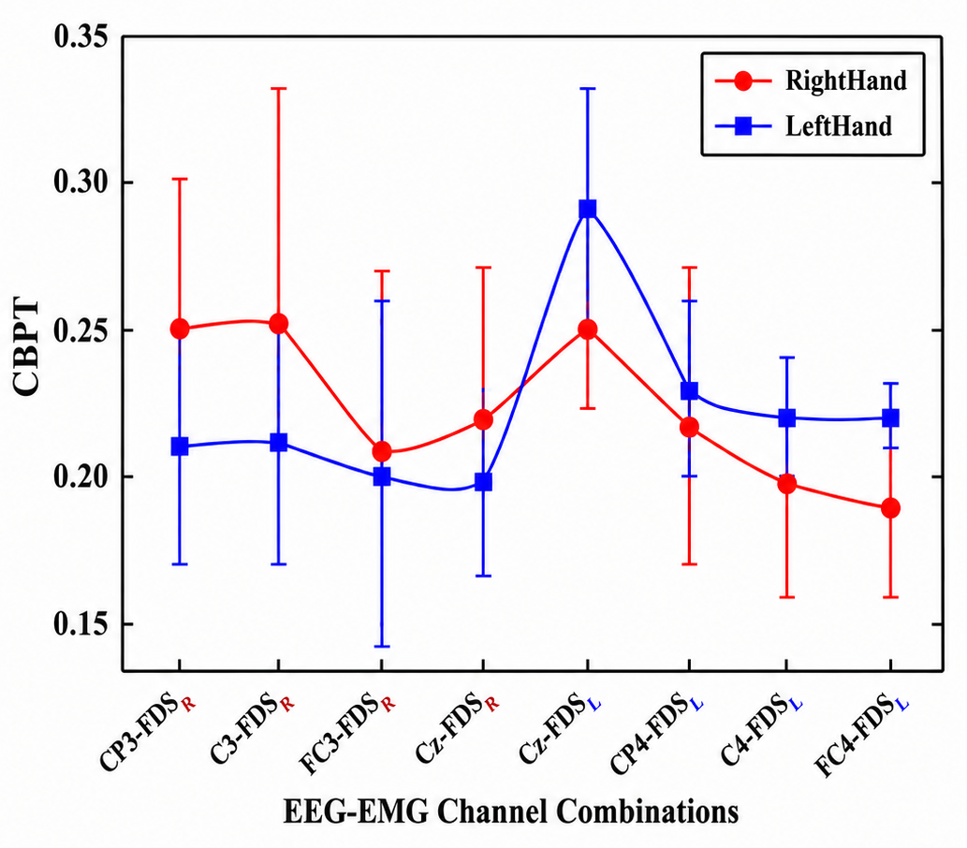
Results
EEG-EMG Pair | Left Hand | Right Hand
CP3-FDSR | 0.21 ± 0.04 | 0.25 ± 0.05
C3-FDSR | 0.21 ± 0.04 | 0.25 ± 0.08
FC3-FDSR | 0.20 ± 0.06 | 0.21 ± 0.06
Cz-FDSR | 0.20 ± 0.03 | 0.22 ± 0.05
Cz-FDSL | 0.29 ± 0.04 | 0.25 ± 0.01
CP4-FDSL | 0.23 ± 0.03 | 0.22 ± 0.05
C4-FDSL | 0.22 ± 0.02 | 0.20 ± 0.04
FC4-FDSL | 0.22 ± 0.01 | 0.19 ± 0.03
Fig: Average CBPT feature distribution across EEG-EMG channel pairs arranged to reflect spatial progression from left to right sensorimotor cortex.
Table: Average EEG-EMG correlation values for each channel pair.

Slide 10
Discussion & Conclusion
Adaptive EEG–EMG pair selection improved motor imagery classification accuracy compared with fixed CBPT channel pairs.
Selected pairs were concentrated around sensorimotor regions (C3, CP3, Cz, and C4), supporting physiological relevance.
The framework captured both consistent contralateral corticomuscular interactions and subject-specific connectivity patterns.
A compact set of four EEG–EMG pairs provided an interpretable and computationally efficient solution for hybrid BCI systems.

Slide 11

Acknowledgement
Thank you for your attention.
This study was supported by the IP/IITGN/CSE/YM/2324/05 project grant.
The details are available on GitHub: https://github.com/HAIx-Lab/EEG-EMG-Pair-Selection-Framework
Contact: yk.meena@iitgn.ac.in
Questions?

