Slide 1






Title: EEGForceFusion: Joint Tokenised–Continuous Representation Learning for Subject-Independent Grasp Force Decoding
Sankalp Sunil Turankar, Yogesh Kumar Meena
Human-AI Interaction (HAIx) Lab, IIT Gandhinagar, India

Slide 2
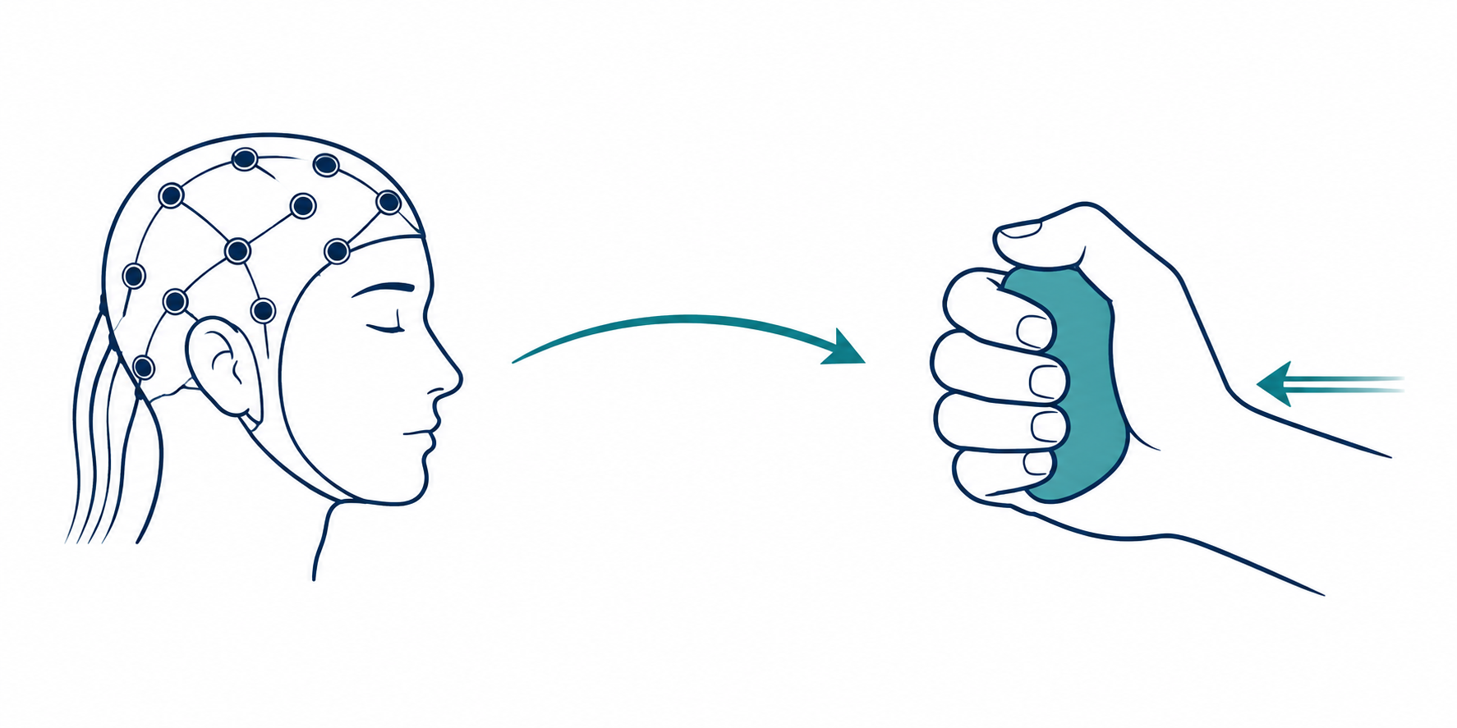
Problem & Motivation
Brain-machine interfaces decode neural activity into control signals. Strong progress on kinematic decoding (movement trajectory, velocity)
Kinetic variables, specifically continuous grasp force, remain hard to decode
Why: Complex temporal dynamics, high inter-subject variability, distributed cortical generators (parietal-premotor network), low signal-to-noise ratio
Fig.1: Illustration of the brain–machine interface paradigm.

Slide 3
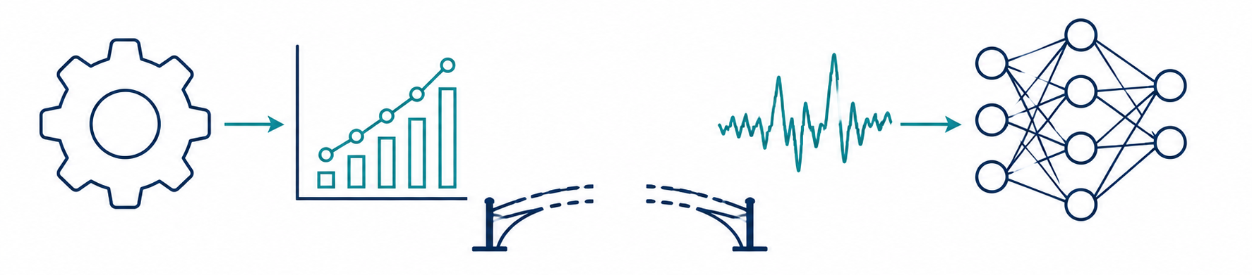
Research Gap
Feature-engineering pipelines : Handcrafted time-frequency features + regression; effective but limited by predefined features and doesn't generalise across subjects.
Deep learning approaches: Learn directly from raw EEG, but struggle to capture fine-grained local structure and long-range temporal dependencies jointly
The actual gap: Nothing bridges continuous (fine-grained) representations with structure that supports long-range temporal modelling
Handcrafted features
Deep learning
Fig. 2: Illustration of the research gap.

Slide 4
Contributions
A tokenisation-based EEG representation framework enabling transformer-based temporal modelling without handcrafted features
A unified architecture combining continuous embeddings and tokenised representations
Discrete tokens fused with continuous embeddings → compact, frozen representation for real-time force prediction, while preserving decoding accuracy
Evaluated under strict LOSO and simulated real-time conditions on WAY-EEG-GAL

Slide 5
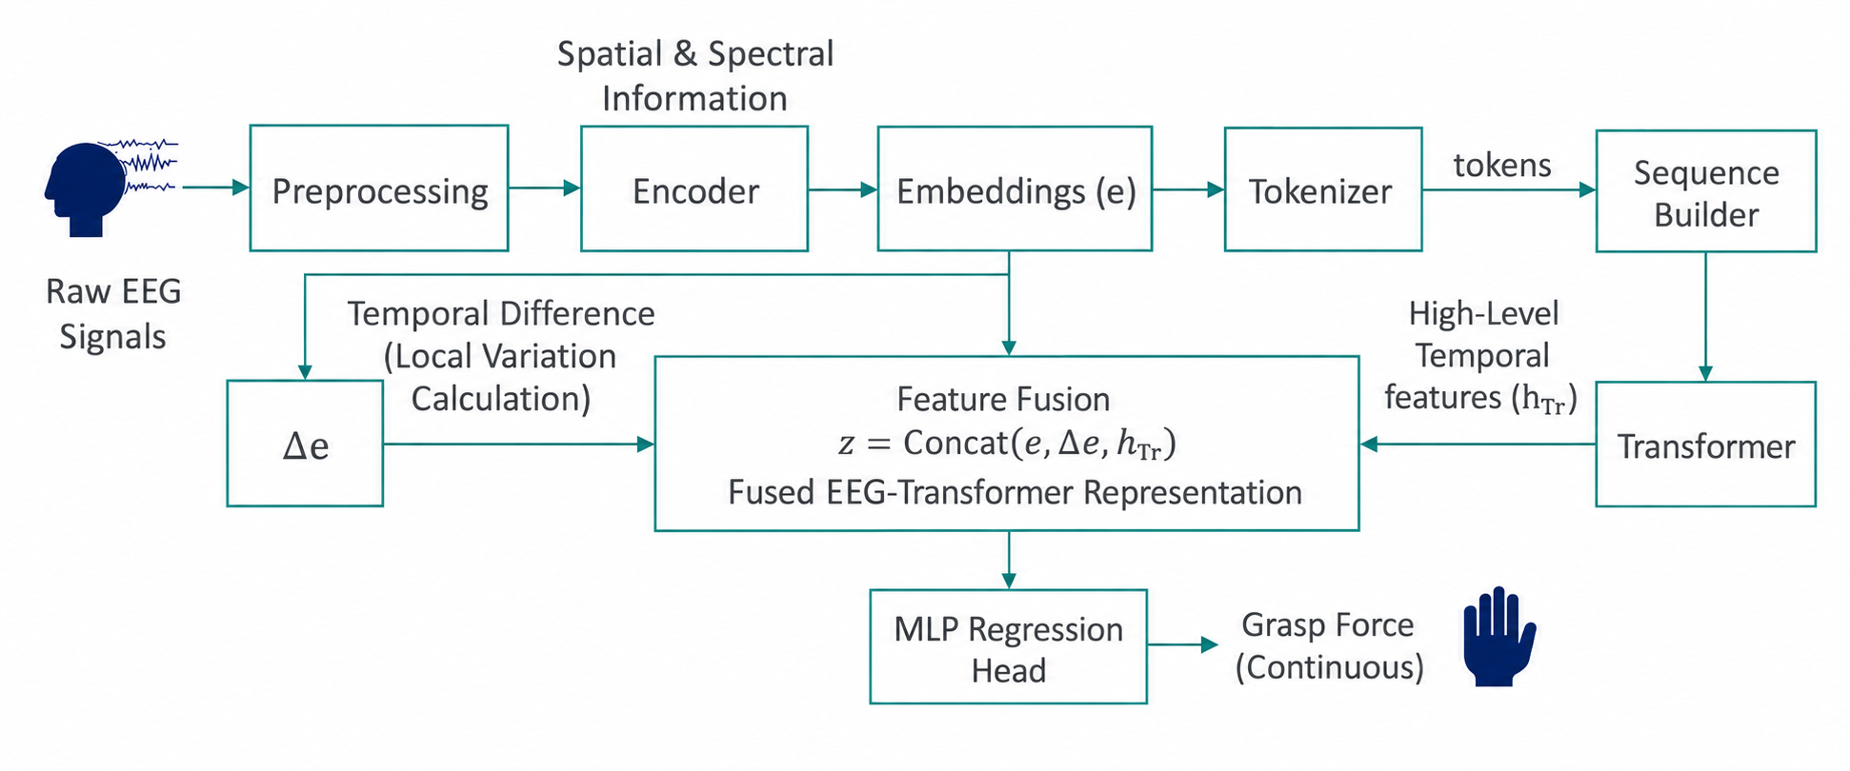
Method: Architecture
Fig. 3: Proposed EEG-to-grasp-force regression framework

Slide 6
Evaluation Protocol
Pipeline is evaluated on WAY-EEG-GAL [1] dataset
Strict leave-one-subject-out (LOSO): train on 11 subjects, test on the 12th, repeat across all 12
Two settings: offline (full temporal window, bidirectional) vs. simulated real-time (causal, sliding buffer, T=32)
Honesty disclosure, stated plainly: encoder is trained on all 12 subjects; the transformer+fusion stages are held out per fold (EEGForceMap convention) → reported scores are an upper-bound estimate, not fully subject-independent
[1] M. D. Luciw, E. Jarocka, and B. B. Edin, “Multi-channel EEG recordings during grasp and lift trials,” Scientific Data, vol. 1, 2014.

Slide 7
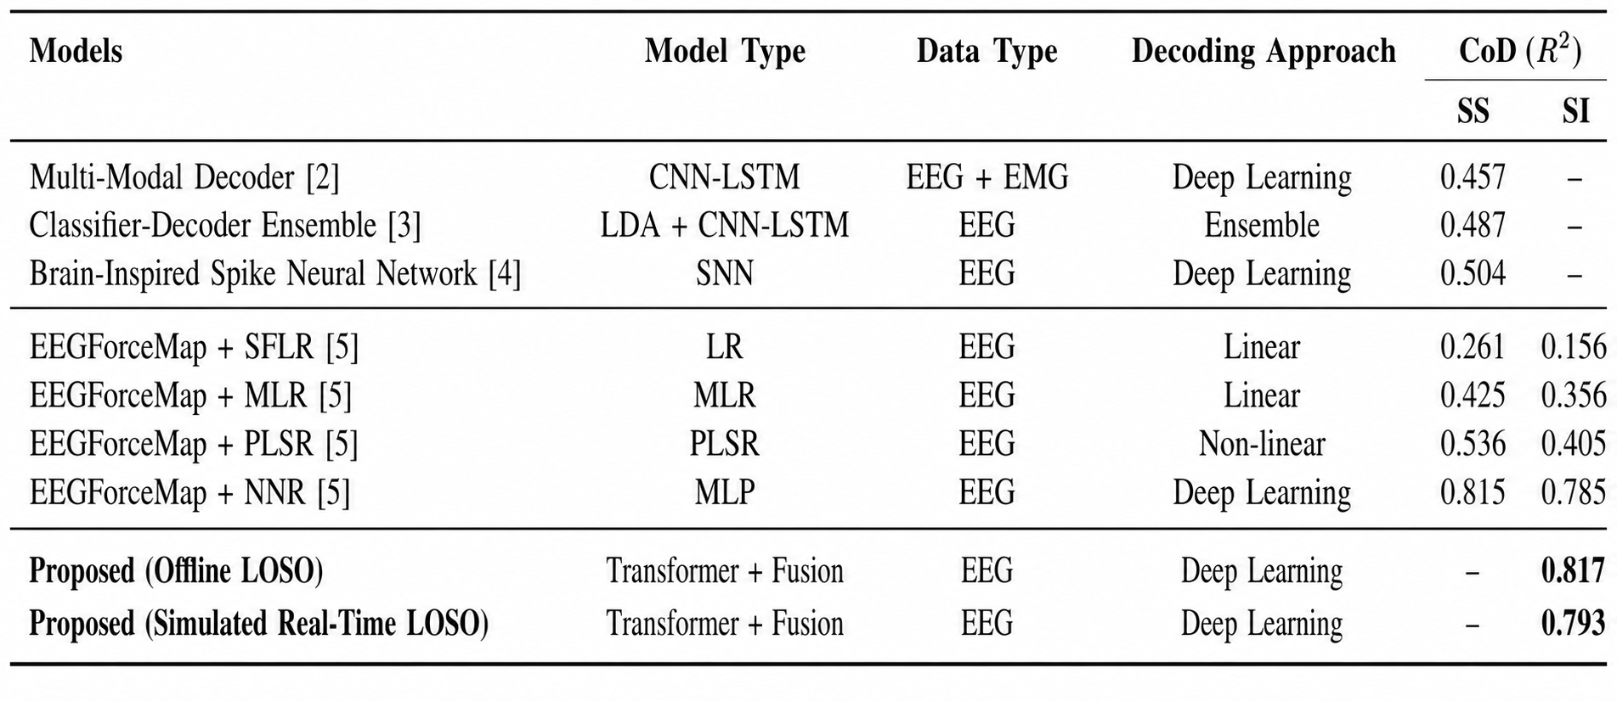
Results: Headline Numbers
Table 1: Comparison with prior works
[2] L. Fu, H. Li, H. Ji, and J. Li, “EEG-EMG analysis method in hybrid BCI for hand rehabilitation,” Computing and Informatics, vol. 42, no. 3, pp. 741–761, 2023.
[3] A. Y. Paek, A. Gailey, P. J. Parikh, M. Santello, and J. L. Contreras-Vidal, “Regression-based reconstruction of human grip force trajectories with EEG,” Journal of Neural Engineering, vol. 16, no. 6, 2019.
[4] K. Kumarasinghe, N. Kasabov, and D. Taylor, “Brain-inspired spiking neural networks for EEG-based decoding of muscle activity and kinematics,” Scientific Reports, vol. 11, 2021.
[5] P. G. Dangi and Y. K. Meena, “Improving continuous grasp force decoding from EEG with time-frequency regressors,” in Proc. IEEE SMC, pp. 6014–6020, 2025.

Slide 8
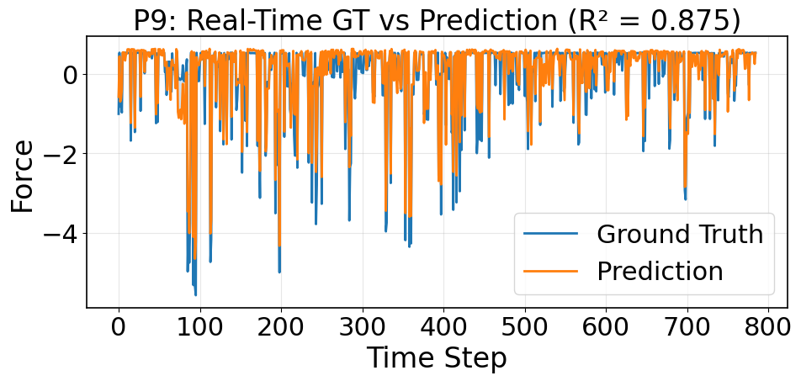
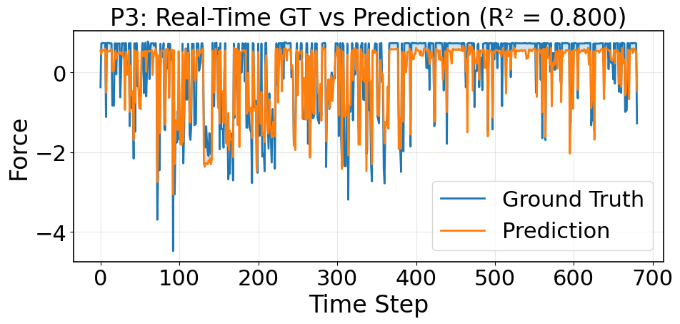
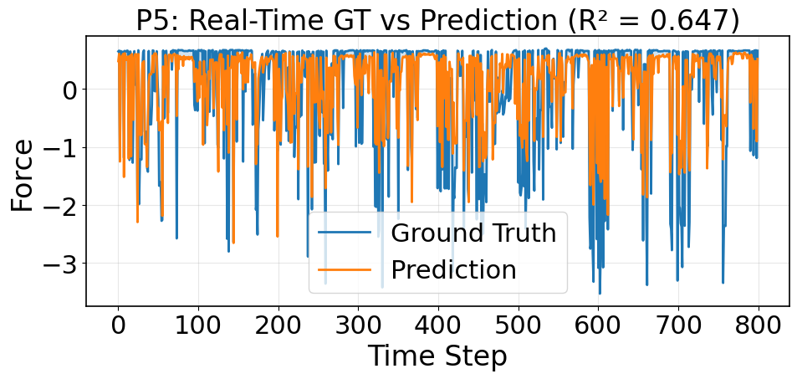
Results: Qualitative & Per-Subject
Predictions track ground truth closely; force onset, sustain, and release all captured accurately
Best case: P9, R² = 0.875 and middle case: P3, R² = 0.80
Worst case: P5, R² = 0.647; reflects BCI illiteracy, not a systematic model failure; every other subject clears R² ≥ 0.75
Fig. 4: Qualitative analysis per subject

Slide 9
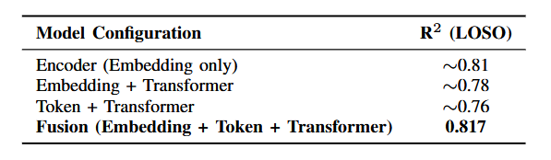
Ablation Study: The Key Finding
Encoder alone already captures rich, force-relevant structure
A transformer over one representation type overfits under LOSO; it doesn't generalize better
Fusion matches, not beats, the encoder: tokenisation buys deployability, not extra accuracy
Table 2: Ablation study

Slide 10
Discussion
Why tokenisation: A finite FSQ codebook gives a subject-invariant token space; the causal transformer is pretrained once, self-supervised, then frozen — produces temporal context in ~2ms/window, no per-subject retraining
Analogy: Like a fixed sub-word vocabulary underpinning a pretrained language model; reusable, not rebuilt per input
Limitations, Stated briefly: single dataset (WAY-EEG-GAL); reported scores are an upper bound, the encoder was trained on all subjects. real-time evaluation is a simulated buffer, not true closed-loop deployment

Slide 11
Conclusion & Future Work
Restate: 0.817 offline, 0.793 real-time, 3.2% margin over strongest baseline, 1.6–2ms latency
Ablation shows tokenisation buys a frozen, reusable backbone without sacrificing accuracy
Future work: fully subject-independent encoder training; richer tokenisation (learned VQ / hierarchical codebooks); scaling to larger EEG corpora (foundation-model framing)

Slide 12


Acknowledgement
Thank you for your attention.
Funding: This study was supported by the IIT Gandhinagar startup grant (IP/IITGN/CSE/YM/2324/05) and the IndiaAI Fellowship (PG251215005117)
GitHub:github.com/HAIx-Lab/EEGForceFusion
Contact: yk.meena@iitgn.ac.in

