Slide 1

IEEE SMC 2026
Characterization of Speech Imagery in Scalp EEG and Comparison with Motor Imagery
Bob Van Dyck, Liuyin Yang, Qiang Sun, Ang Li, Marc M. Van Hulle
Laboratory for Neuro- & Psychophysiology, KU Leuven
Does speech imagery resemble motor imagery?

Slide 2
CONCEPTUAL CONTEXT
A closer look at speech imagery
Why speech imagery matters
A variety of speech modes, and targets
Endogenous, intrinsically linguistic and covert
— an attractive basis for communication BCIs.
Perception → Production
Silent → Imagined → Inner speech — Schultz et al. (2017)
Phoneme → Syllable → Word → Sentence
This study
Participants imagined speaking a word, by focusing on articulatory movements
Clear instruction grounded in speech production
Promote consistent task interpretation and execution
Enable a focused comparison with finger motor imagery
Schultz et al. (2017). Biosignal-based spoken communication: A survey. IEEE/ACM
KU Leuven · 02

Slide 3
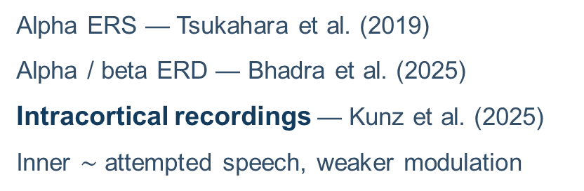
MOTIVATION
The physiology of imagined speech remains unclear
What decoding has not resolved
Clues from prior studies
Many studies find that imagined speech can be decoded from EEG — but no consensus on physiology, or complete spatiotemporal characterization.
Alpha ERS — Tsukahara et al. (2019)
Alpha / beta ERD — Bhadra et al. (2025)
Intracortical recordings — Kunz et al. (2025)
Inner $\sim$ attempted speech, weaker modulation
This study
Compare speech and finger motor imagery under identical timing
Contrast both tasks with matched no-task trials
Does imagined articulation show motor-related alpha/beta ERD?
Tsukahara et al. (2019). Analysis of EEG frequency components and an examination of electrode localization during speech imagery. EMBC.
Bhadra et al. (2025). Learning to operate an imagined speech brain-computer interface involves the spatial and frequency tuning of neural activity. Communications Biology.
Kunz et al. (2025). Inner speech in motor cortex and implications for speech neuroprostheses. Cell.
KU Leuven · 03

Slide 4
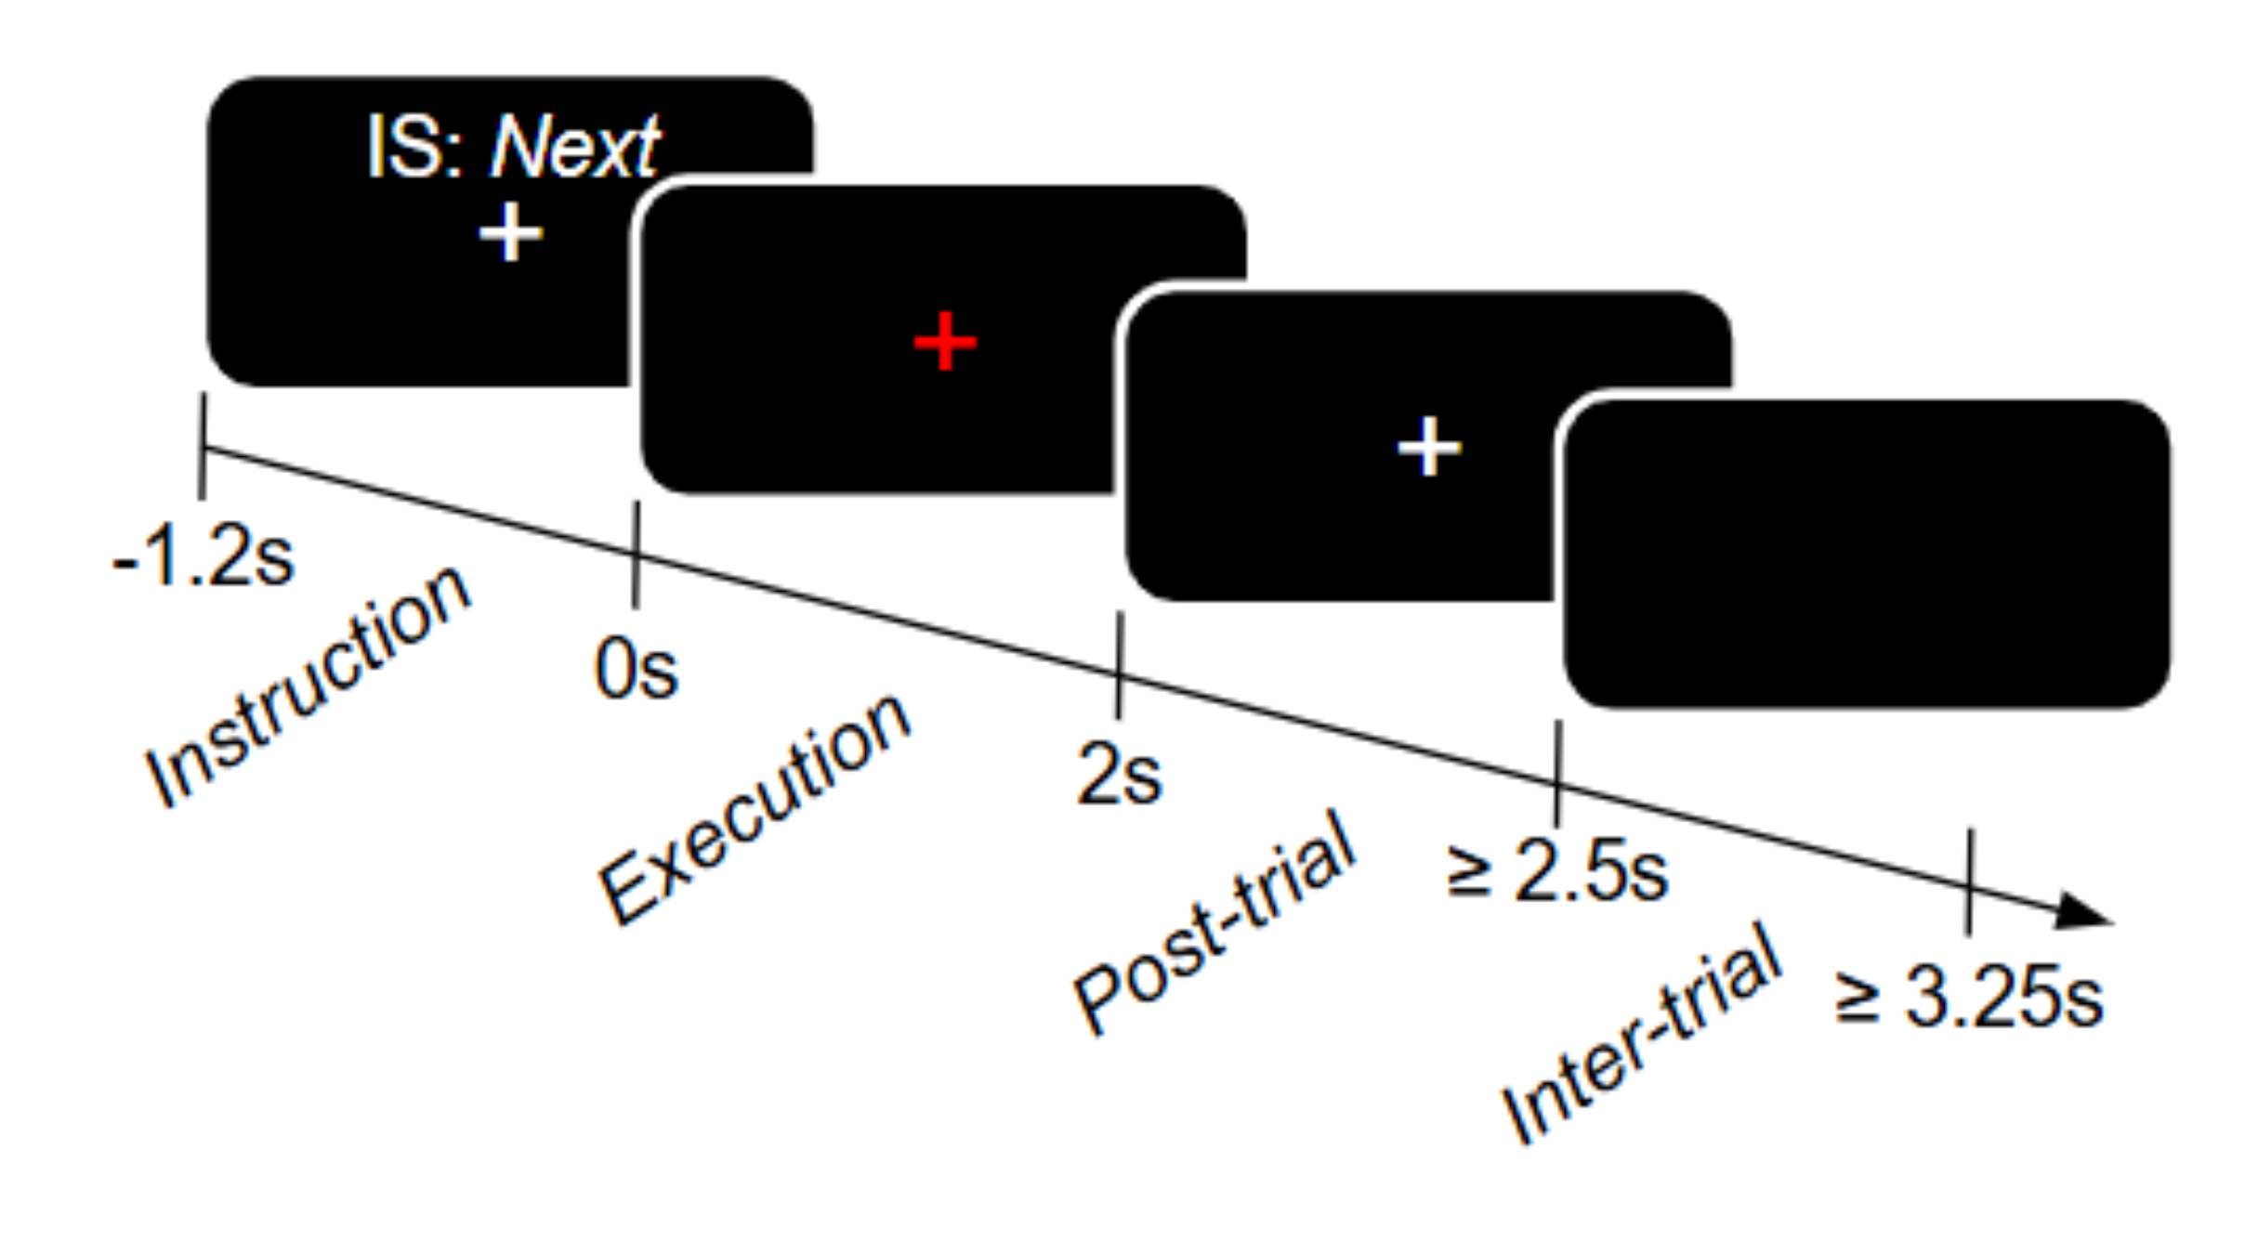
WITHIN-PARTICIPANT COMPARISON
Experiment design
34 healthy right-handed adults completed speech and finger motor imagery, and matched no-task trials.
One common trial structure
60 trials per target, four targets per task.
Speech imagery: Next, Back, Select, — (no task)
Motor imagery: Thumb, Index, Point, — (no task)
64-channel EEG at 500 Hz, downsampled to 200 Hz.
No-task contrast allows isolation of task-related activity from cue- and trial-related effects.
KU Leuven · 05
²

Slide 5
ANALYSIS
Two complementary analyses
We characterize group-level physiology and participant-level detectability,
then ask whether targets separate and what distinguishes the best performing participants.
Group-level physiology
Participant decoding
+ Follow-ups
Spatiotemporal cluster-permutation analysis across 7 frequency bands.
Task — no-task
FB-CSP plus shrinkage LDA for task versus no-task, with 5-fold cross-validation and balanced accuracy.
Target-specific maps and pairwise target decoding,
leave-one-band-out ablation, and best performers.
KU Leuven · 06
²

Slide 6
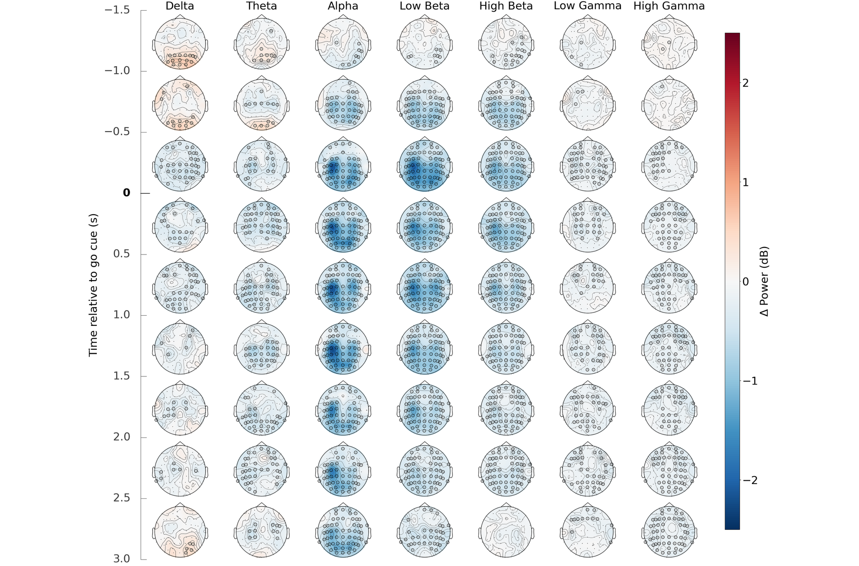
REFERENCE PATTERN
Finger motor imagery shows canonical motor pattern
Canonical motor pattern
Sustained contralateral alpha/beta ERD Focal left sensorimotor power decrease Before, during and after finger imagery
No target-specific separation
Pairwise decoding at chance-level
No target-dependent clusters
No target effect on cluster strength
KU Leuven · 07
²

Slide 7
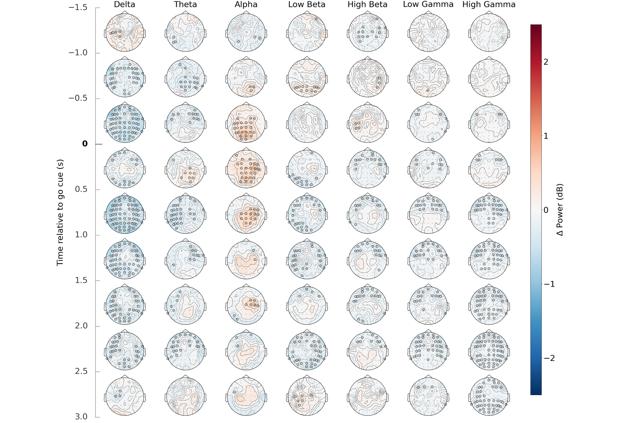
MAIN RESULT
Speech imagery shows weak, distributed alpha synchronization
No canonical motor pattern
Transient, distributed alpha ERS Strongest near execution onset
Not sustained across the full trial
No target-specific separation
Pairwise decoding at chance-level
No target-dependent clusters
No target effect on cluster strength
KU Leuven · 08
²

Slide 8
MAIN RESULT
Speech imagery shows weak, distributed alpha synchronization
No canonical motor pattern
Transient, distributed alpha ERS Strongest near execution onset
Not sustained across the full trial
Possible interpretation
ERD → cortical activation
ERS → inhibition / attentional control
KU Leuven · 08
²

Slide 9
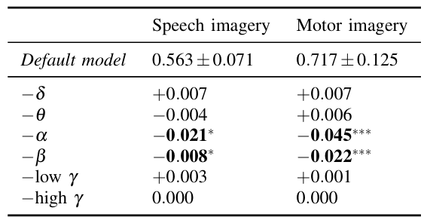
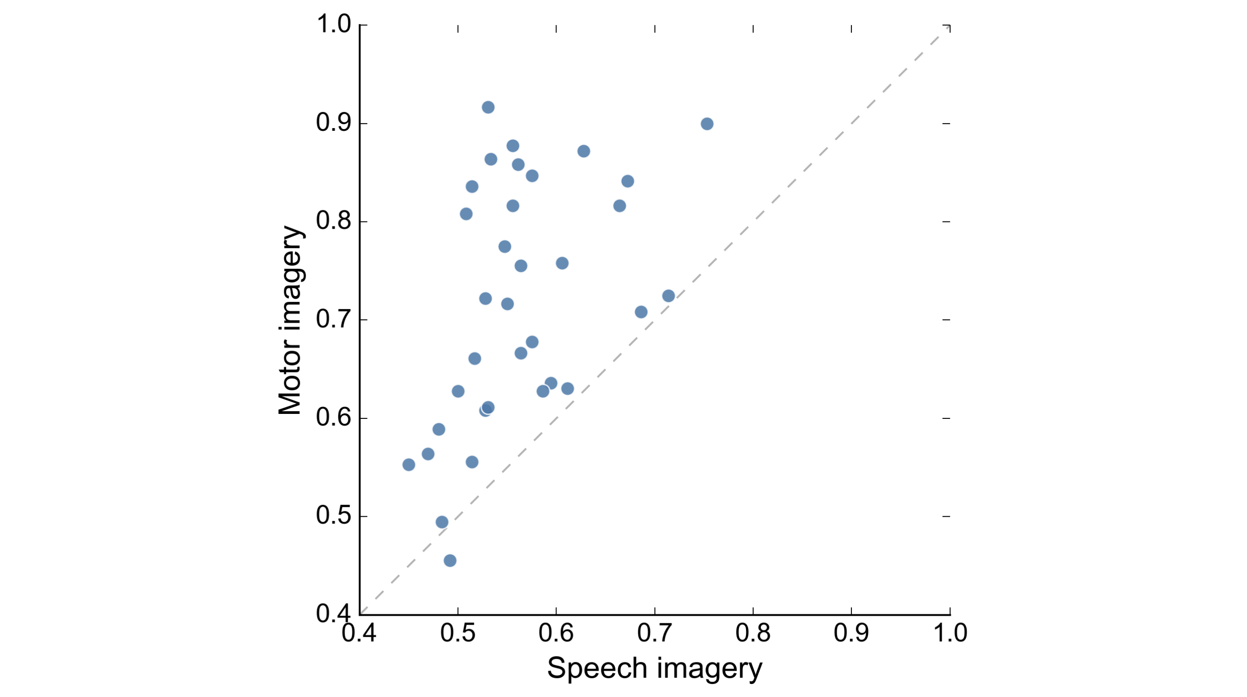
DETECTION AND CORRELATION
Detection varies across participants but correlates across tasks
FB-CSP detection
Motor imagery: 0.717 ± 0.125
Speech imagery: 0.563 ± 0.071
Spearman’s ρ = 0.520, p = 0.00164, n = 34
Correlation may reflect consistency, engagement, EEG quality, or broader BCI literacy.
KU Leuven · 09
²

Slide 10
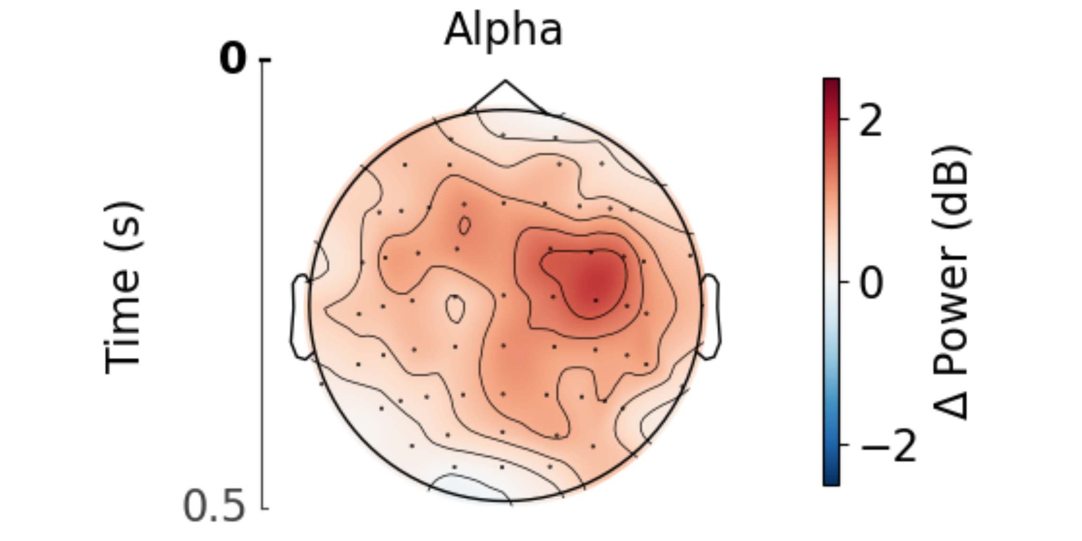
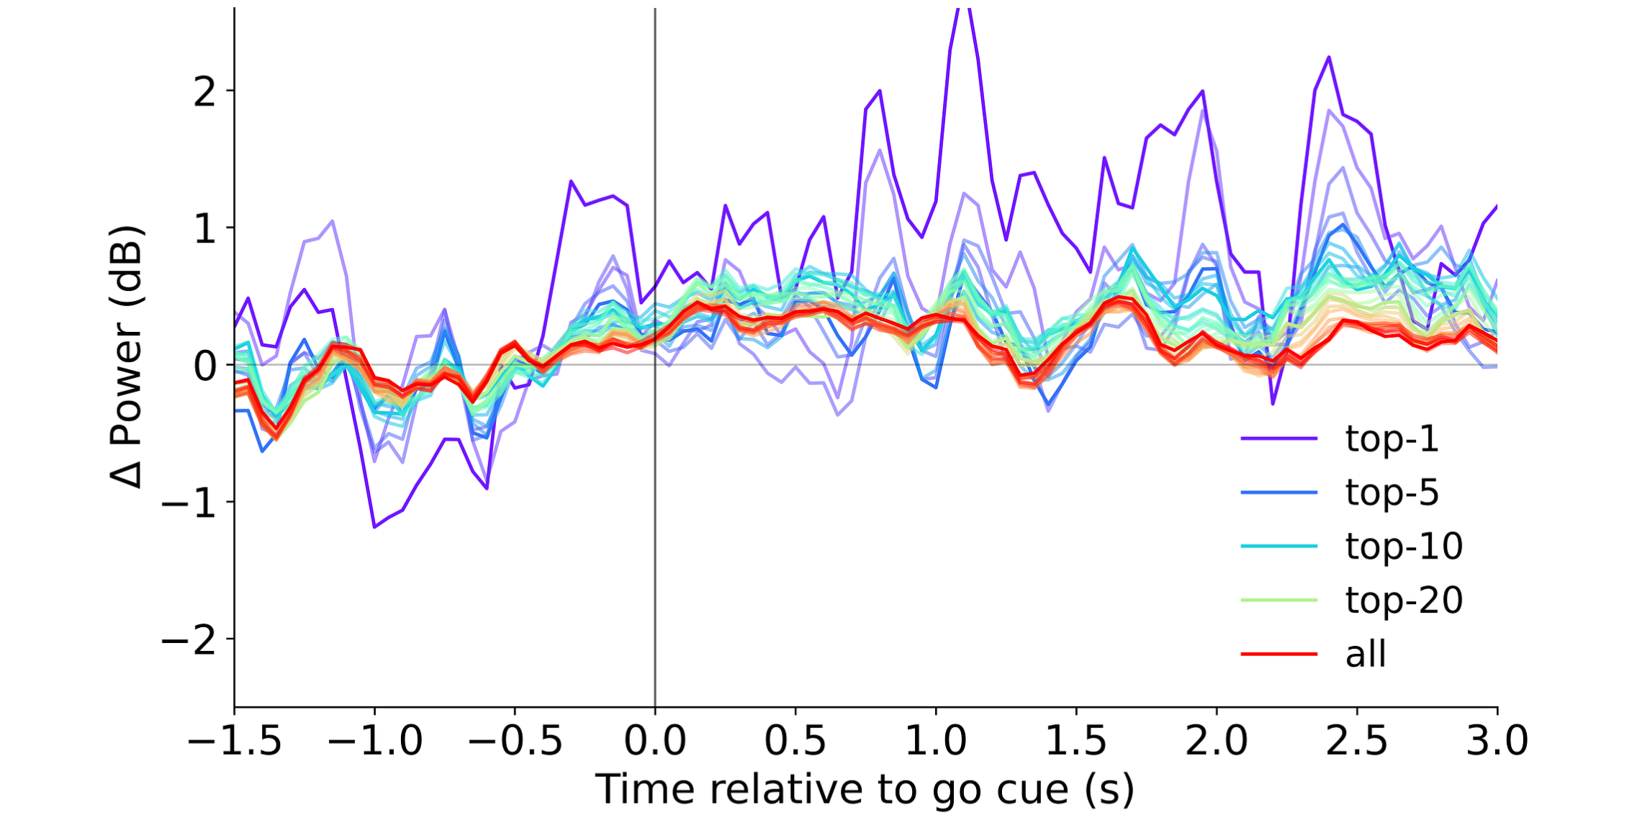
EXPLORATORY FOLLOW-UP
Right-frontocentral alpha synchronization in best performers
6 of 34 participants exceeded the uncorrected binomial threshold (balanced accuracy > 0.617).
More pronounced right-frontocentral alpha synchronization centered on FC4.
KU Leuven · 10
²

Slide 11
INTERPRETATION
Making sense of the results
Alpha synchronization, no ERD
Imagining articulation may be difficult: internal and coordinated
Broader task-related processes, such as attentional control
Bhadra et al. (2025) found ERD with repeated syllable imagery
No detectable target-specific effects in either task
Both rely on small, finely controlled muscles
Scalp EEG may lack sufficient spatial resolution
Leave-one-band-out ablation
Descriptive baseline-normalized comparison
KU Leuven · 11

Slide 12
CONCLUSION
Where this leaves imagined speech decoding
Gap addressed
Band-wise spatiotemporal characterization of speech imagery
Comparison with finger imagery using matched no-task contrasts
Mechanism remains unresolved
What produces the alpha response remains unclear
Weaker motor effects may be obscured by broader task activity
Open questions
What do successful classifiers of imagined words actually detect?
Could peripheral EMG be a better basis for communication interfaces?
Thank you
KU Leuven · 12

Slide 13
INTERPRETATION
Making sense of the results
Alpha synchronization, no ERD
Imagining articulation may be difficult: internal and coordinated
Broader task-related processes, such as attentional control
Bhadra et al. (2025) found ERD with repeated syllable imagery
No detectable target-specific effects in either task
Both rely on small, finely controlled muscles
Scalp EEG may lack sufficient spatial resolution
Open questions
What do successful classifiers of imagined words actually detect?
Could peripheral EMG be a better basis for communication interfaces?
Thank you
KU Leuven · 11

