Slide 1



October 4 - 7, 2026
EU-TTR: A Framework for Epistemic Uncertainty and Test-Time Reliability Assessment for
EEG based Deep Learning Models
Bhavesh Kapil¹, Elisabeth Wetzer², Sneha Singh¹, Arnav Bhavsar¹
1 Indian Institute of Technology Mandi, India
2 UiT The Arctic University of Norway, Tromsø, Norway

Slide 2


Motivation
Why accuracy alone is not enough
Why EEG reliability is challenging
EEG signals are noisy, artifact prone, and highly heterogeneous across sessions and subjects.
Aggregate accuracy alone is insufficient to assess whether individual predictions can be trusted.
Predictive confidence may remain unreliable even when classification accuracy appears high.
Can we assess reliability for each unseen EEG sample?
EEG is non-stationary and vulnerable to noise and artifacts.
There is substantial variability both within and across subjects.
Poorly represented regions of the training data increase epistemic uncertainty.
What is needed?
Estimate model uncertainty at test time, not only classification accuracy.
Separate reliable predictions from highly uncertain predictions.
Reject high-uncertainty samples to control the accuracy–coverage trade-off.

Slide 3
Uncertainty in EEG Deep Learning
Predictive uncertainty has two conceptually different sources:
Aleatoric Uncertainty
Uncertainty in the data
• Comes from intrinsic randomness or ambiguity in EEG.
• Examples: sensor noise, artifacts, overlapping class
patterns, and label ambiguity.
• Remains even when the model has sufficient training data.
• Mainly reduced by improving data acquisition,
denoising, repeated measurements, or labeling.
Epistemic Uncertainty
Uncertainty in the model
• Comes from lack of model knowledge.
• Caused by limited or non-representative training data
and poorly covered input regions.
• Can become important for unfamiliar EEG patterns
or unseen subjects.
• Reducible with more diverse data, improved model
design, or active learning.
Focus of this work: Epistemic uncertainty at test time
Goal: Identify predictions the model does not know enough to trust.

Slide 4
Key Contribution
Reliability Beyond Classification Accuracy
Model comparison can be carried out based on uncertainty in addition to accuracy.
We validate the framework across five EEG deep learning architectures, under both subject-dependent and subject-independent settings.
Test-Time Reliability Framework for EEG
EU-TTR estimates sample-level epistemic uncertainty for EEG prediction using MC Dropout
MI-Based Selective Prediction
High-uncertainty predictions are rejected to improve accuracy on retained samples, based on EU thresholds.

Slide 5
EU-TTR: Test-Time Reliability Framework
①
②
③
④
⑤
Reliability
Decision
Unseen EEG
MC Dropout
Predictive Mean
Uncertainty
Motor-imagery EEG
sample x
T stochastic forward passes
Average class probabilities
Predictive entropy Expected entropy
Mutual information
Low EU → Accept High EU → Reject
Key idea: Use epistemic uncertainty as a filtering criterion at inference time.
Reject highly uncertain predictions retain a more reliable subset of EEG decisions.
Training architecture remains unchanged;
dropout is activated only during test-time inference.

Slide 6




Mathematical Foundation of UQ
Mathematical Foundation of Uncertainty Quantification
In supervised deep learning, we observe a dataset:
A deterministic model gives only a prediction; UQ requires a predictive distribution.
Deterministic Prediction:
The model gives one output for one fixed parameter setting.
What is the prediction?
Probabilistic Prediction
The model gives a distribution over possible outputs.
How reliable is the prediction?
Bayesian Predictive Distribution:
In uncertainty quantification, we do not treat the neural network as one fixed model.
Instead, we assume there can be many possible model parameters that explain the training data.
means the probability distribution over model parameters after seeing the training data.
Prior over Parameters (Model)
Predictive
Likelihood
(Data)

Slide 7

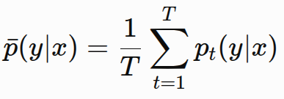
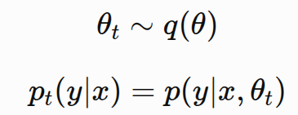
Monte Carlo Dropout
Main Problem:
We want multiple plausible models:
but training many full models is very expensive.
Solution:
MC Dropout gives an approximate ensemble from one trained network. During inference, dropout remains active:
Each dropout mask creates a slightly different subnetwork.
Advantage:
MC Dropout allows us to estimate uncertainty without training many separate models.
Therefore, MC Dropout is a practical bridge between deterministic neural networks and Bayesian uncertainty estimation.

Slide 8

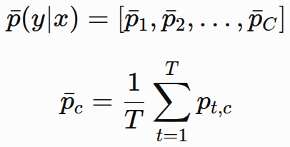
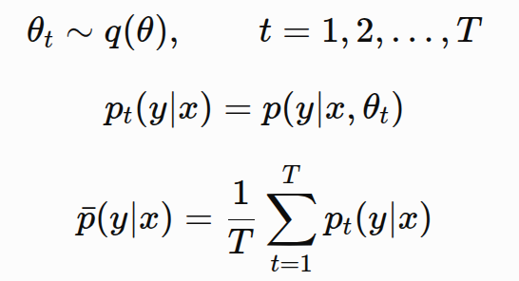
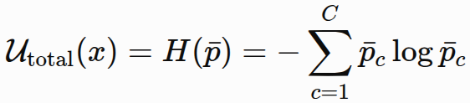
Uncertainty Estimation
The exact Bayesian predictive distribution is usually intractable for deep neural networks.
Therefore, the integral is approximated using stochastic forward passes.
MC Dropout, Deep Ensembles and BNNs generate multiple predictive samples.
Total Predictive Uncertainty
For classification of C classes, the predictive distribution is categorical:
Total uncertainty is commonly measured using predictive entropy.
Predictive entropy is high when probability mass is spread across classes.

Slide 9
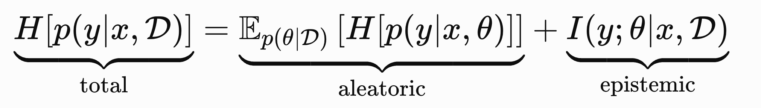
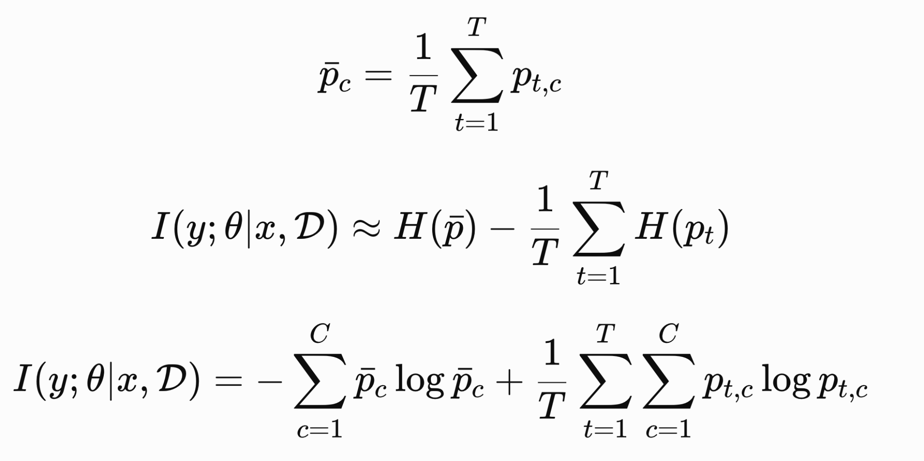
Uncertainty Decomposition:
Classification uncertainty decomposition is information-theoretic:
Equivalently,
Monte Carlo Estimator:

Slide 10
Deep learning Models and Dataset
Model | Architecture | Purpose in Comparison | Accuracy(%) | Precision (%) | Recall (%) | F1 (%)
EEGNet | Compact CNN | Lightweight EEG baseline | 78.51 | 79.37 | 78.51 | 78.42
ShallowConvNet | Shallow CNN | Classical EEG CNN | 76.00 | 78.10 | 76.00 | 75.85
DeepConvNet | Deep CNN | Deeper convolutional model | 78.09 | 80.53 | 78.09 | 77.85
Conformer | CNN + Transformer | Local + global feature modeling | 79.13 | 79.82 | 79.13 | 78.96
CTNet | Conv. + Transformer | Transformer-based EEG model | 82.45 | 83.54 | 82.45 | 82.33
Dataset: BCI Competition IV-2a
9 subjects
4 motor-imagery classes: Left Hand, Right Hand, Feet, and Tongue
22 EEG channels
Sampling rate: 250 Hz
Widely used benchmark for motor-imagery EEG classification.

Slide 11
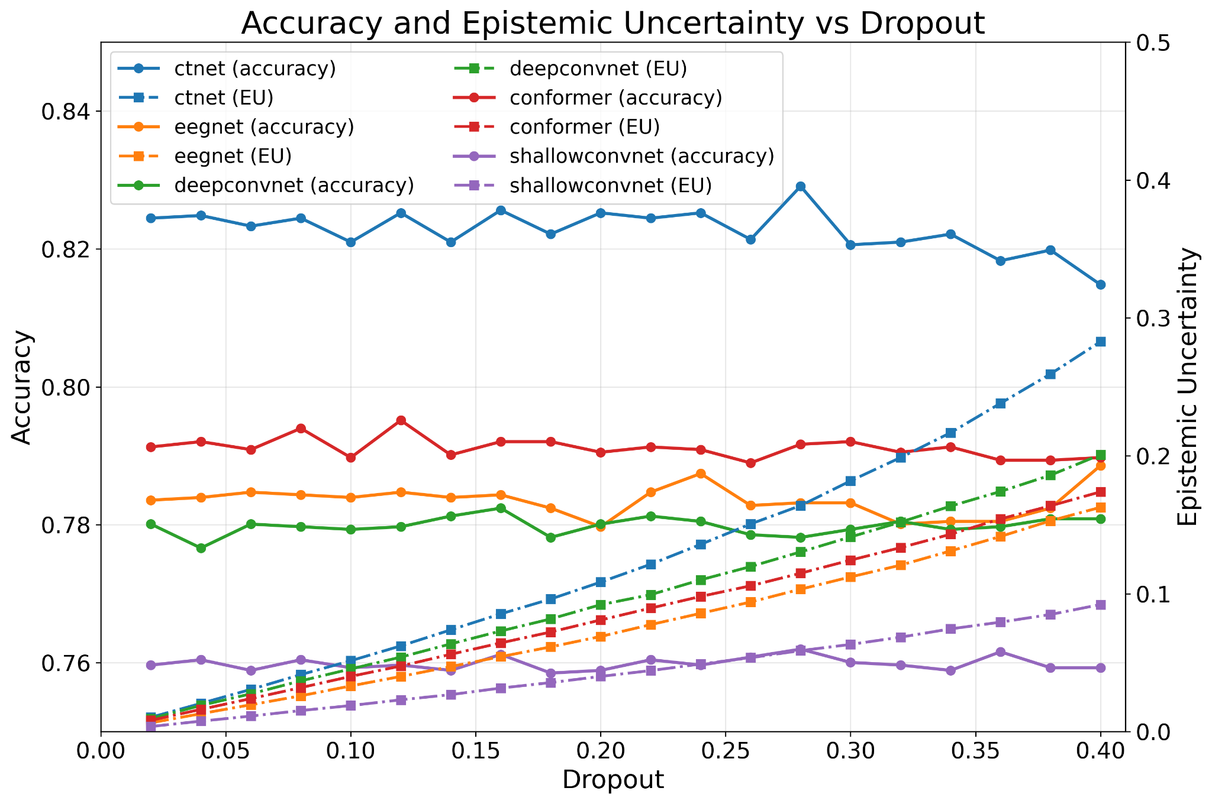
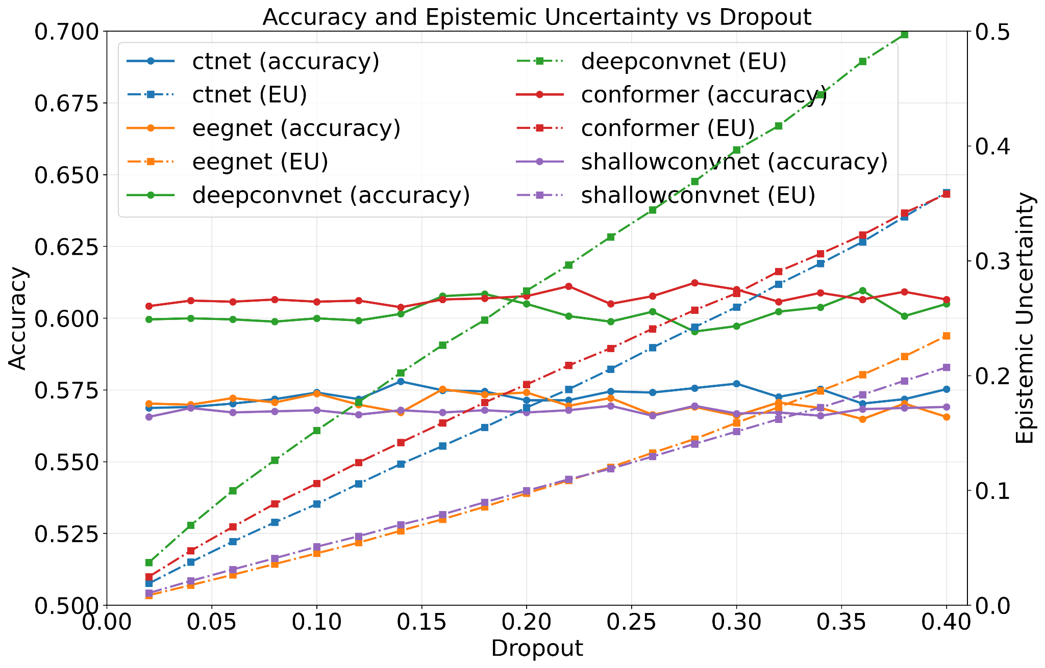
Epistemic Uncertainty Analysis of models on BCI-dataset
Subject dependent
(b) Subject independent
Accuracy and epistemic uncertainty trends across dropout rates for
CTNet, EEGNet, DeepConvNet, Conformer, and ShallowConvNet.

Slide 12
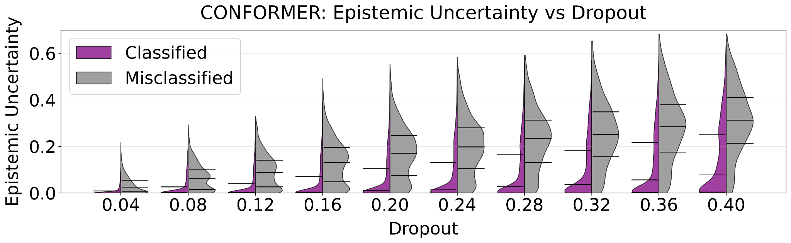
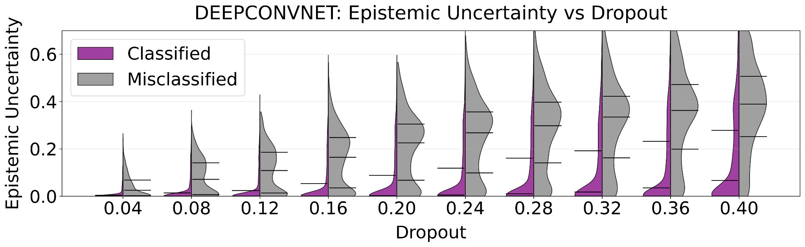
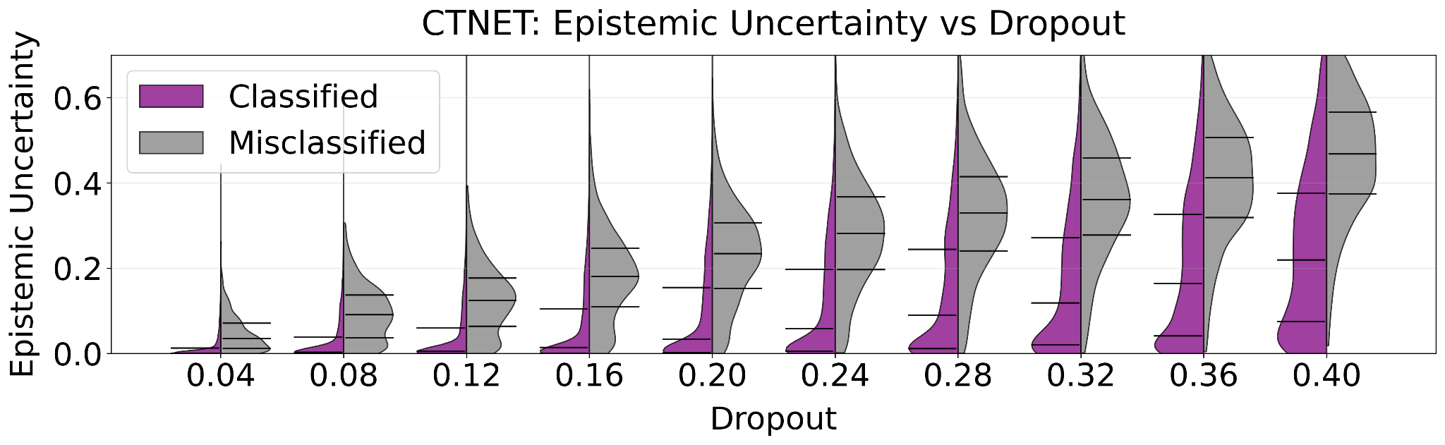
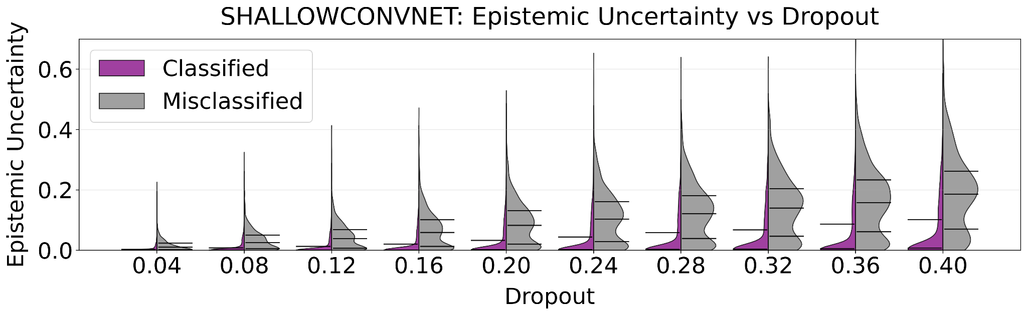
Epistemic Uncertainty Analysis of models on BCI-dataset
Epistemic uncertainty across dropout rates in the subject-dependent setting.
Violin plots of epistemic uncertainty for correctly classified and misclassified samples

Slide 13
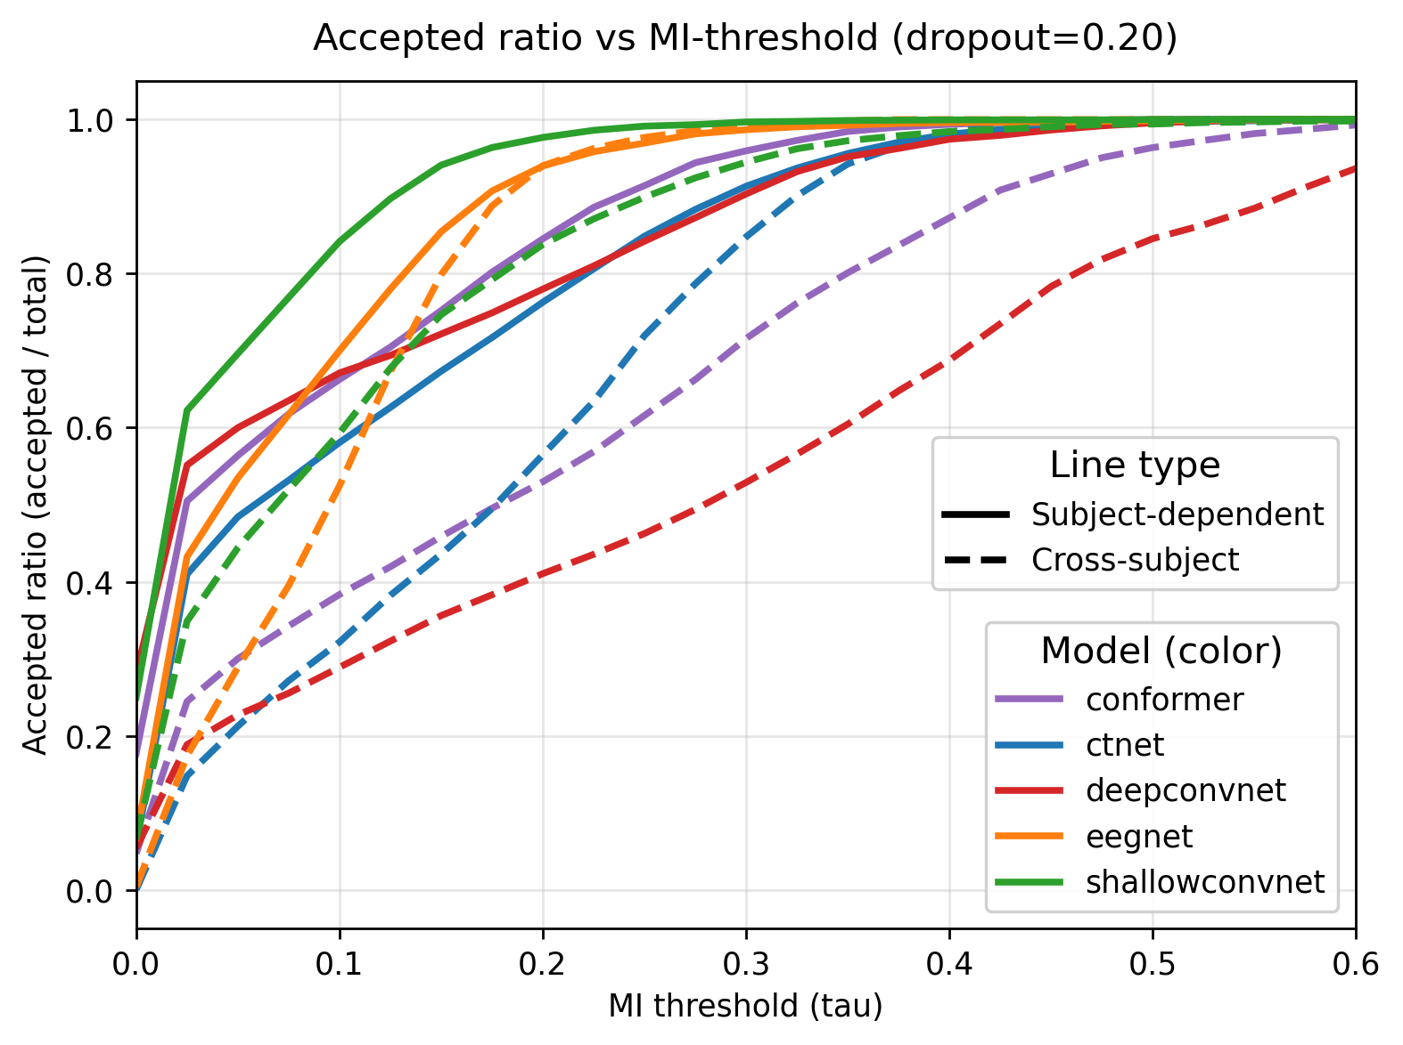
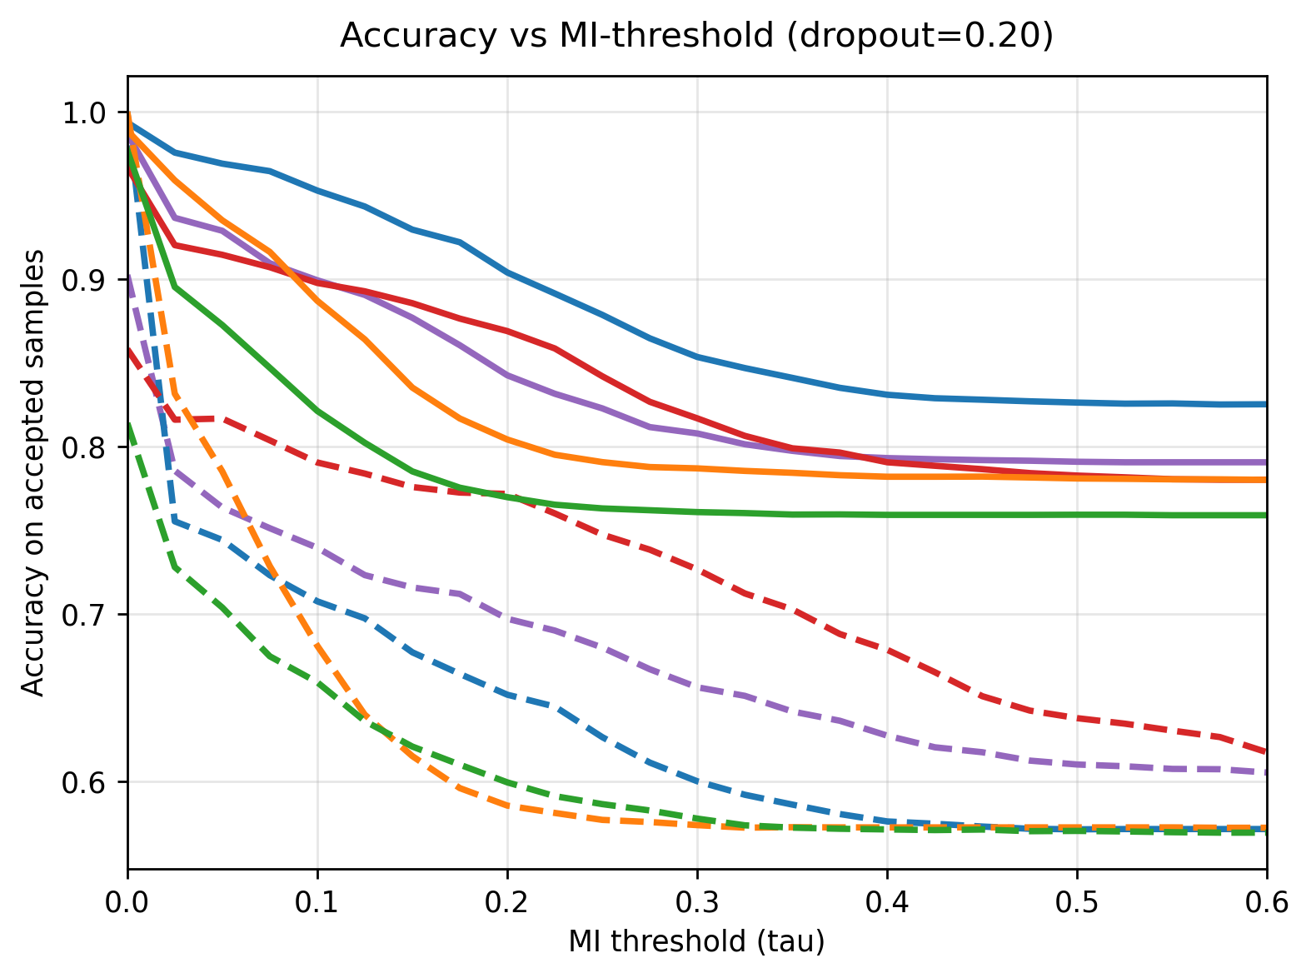
Epistemic Uncertainty Analysis of models on BCI-dataset
Subject dependent
Threshold-based reliability analysis of EEG models on the BCI Competition IV-2a dataset.
(a) Accepted ratio versus MI threshold. (b) Accuracy on accepted samples versus MI threshold

Slide 14
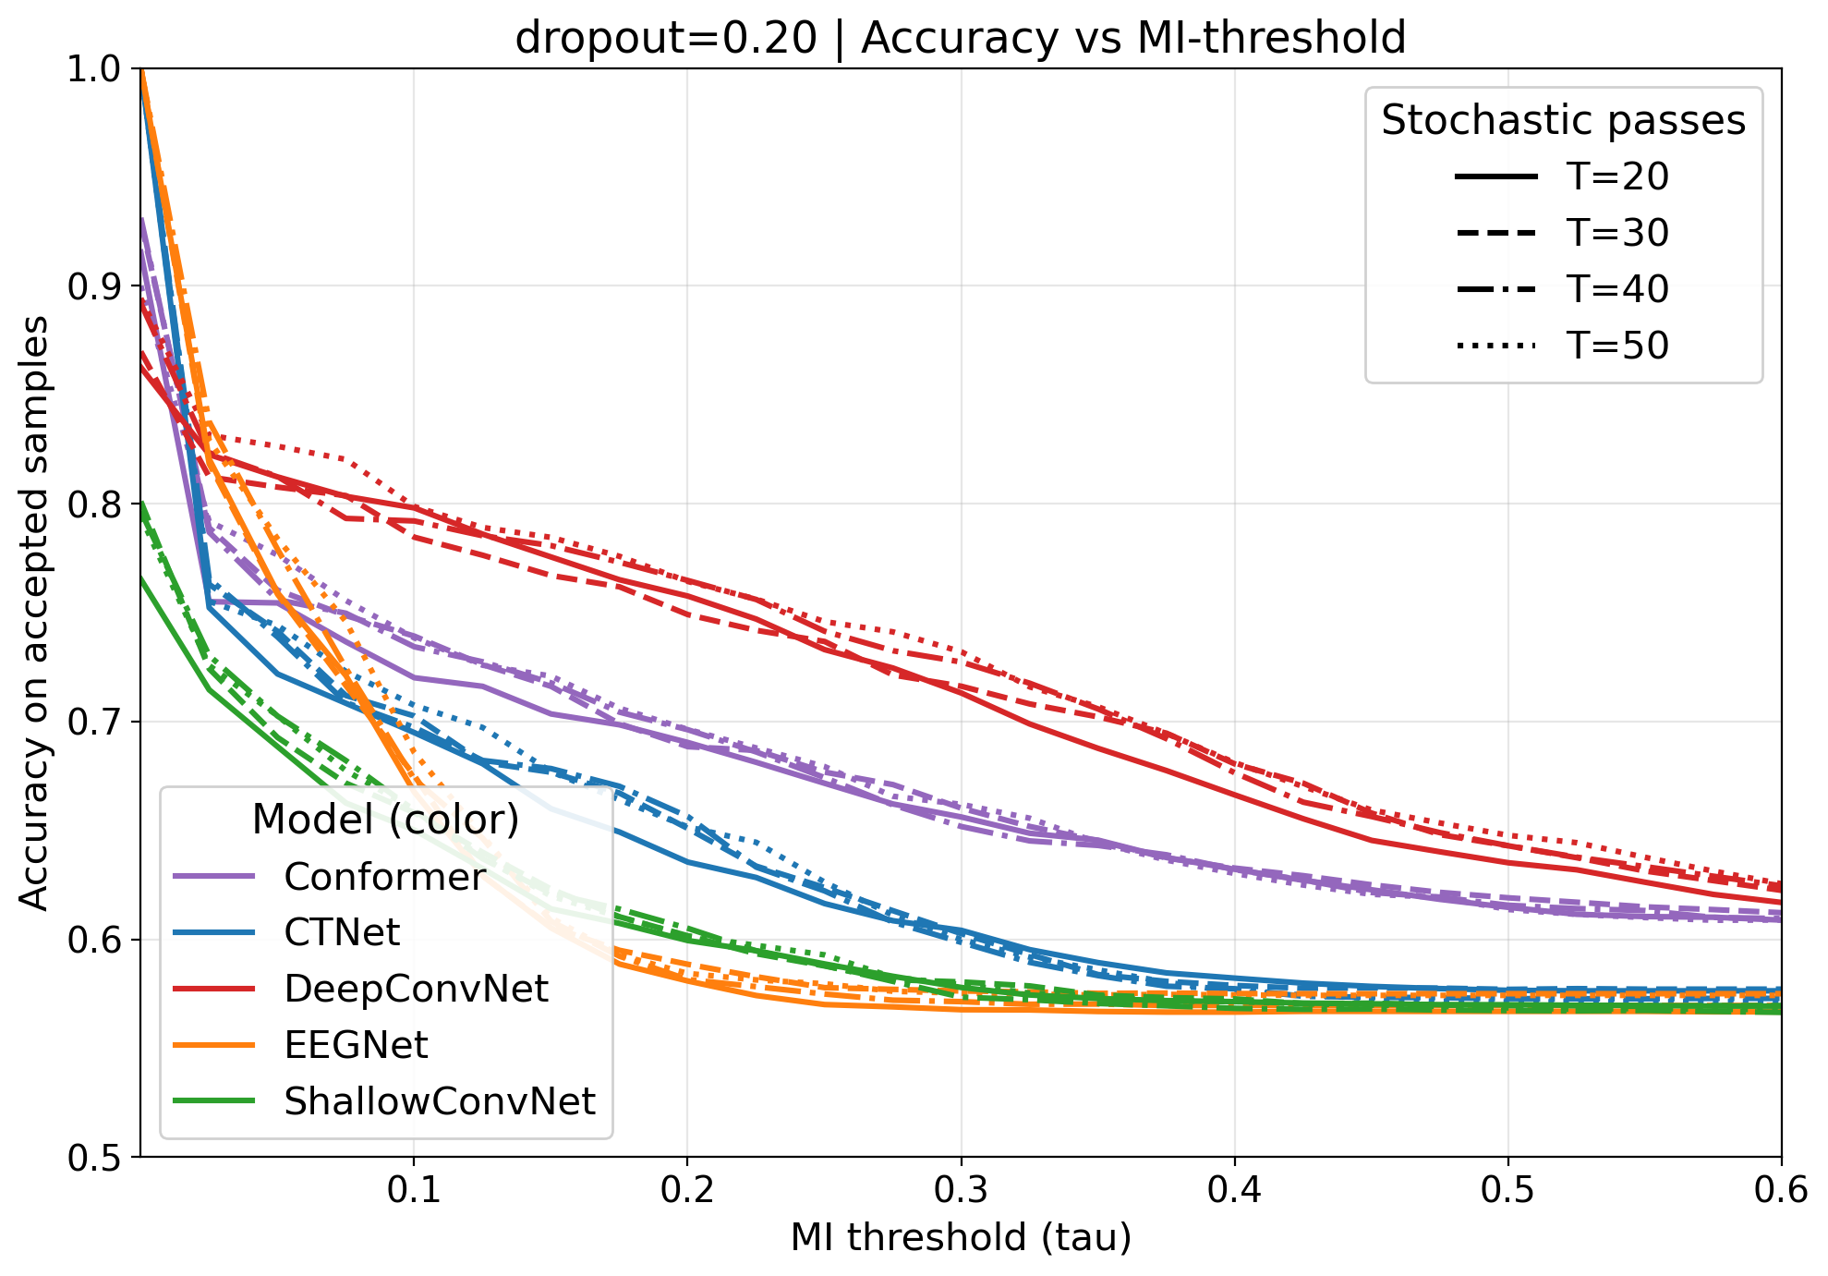
Epistemic Uncertainty Analysis of models on BCI-dataset
(a) Combined plot of accepted ratio and accuracy versus MI threshold. (b) Accuracy on accepted samples versus MI-threshold for different numbers of stochastic forward passes, T ∈ {20, 50}

Slide 15
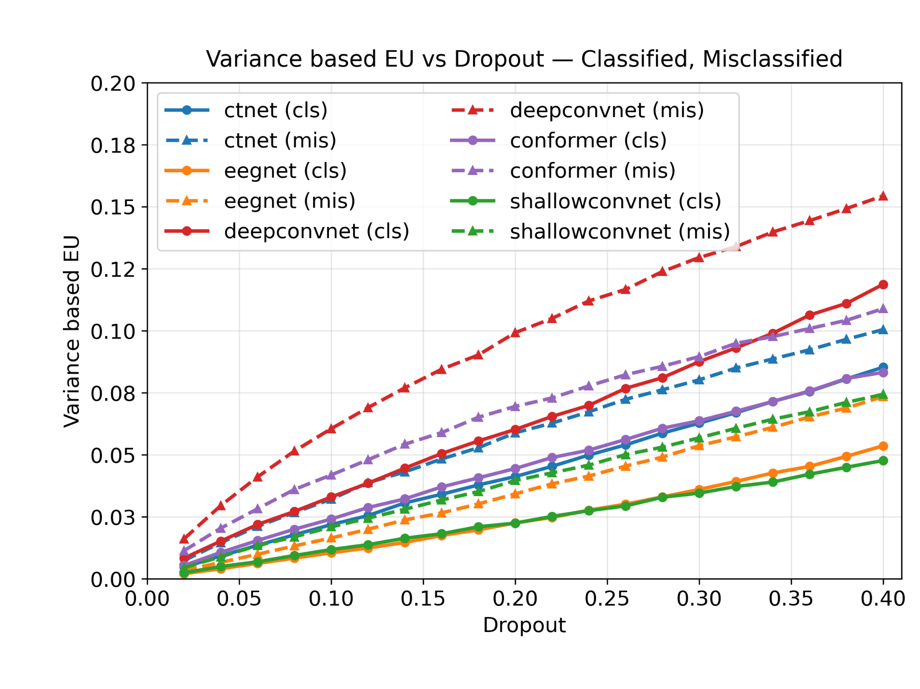
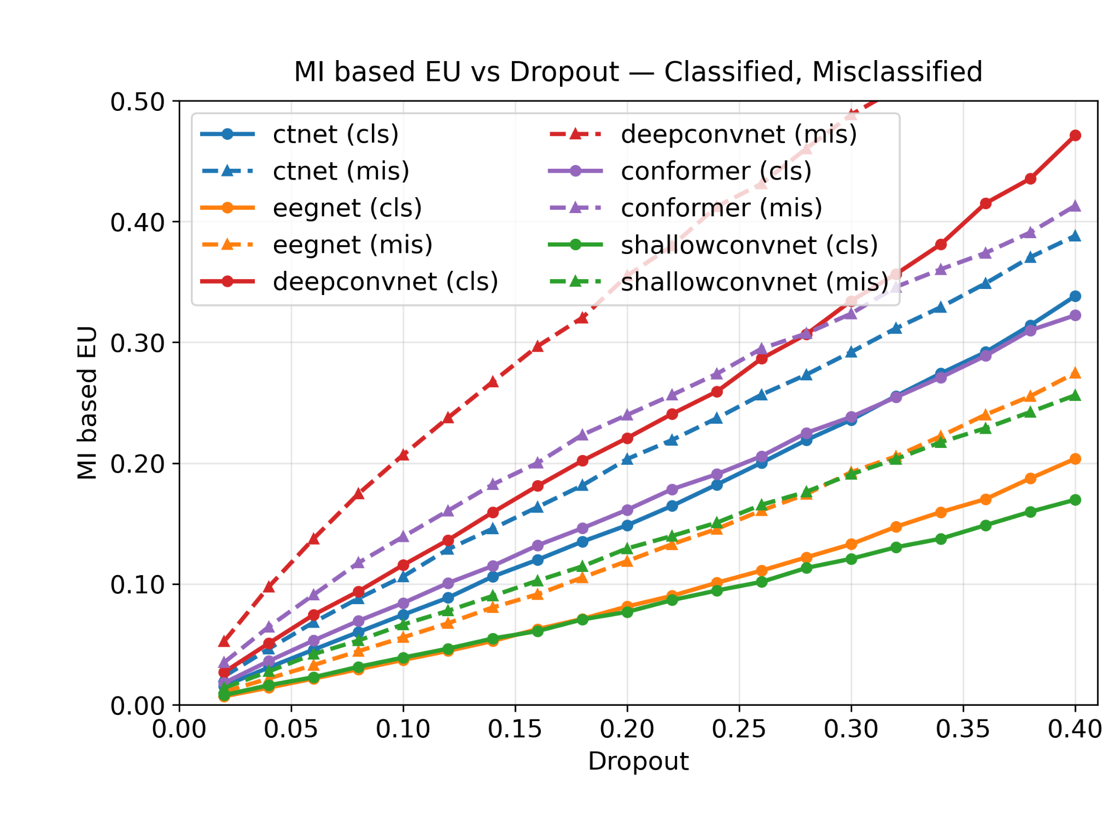
Epistemic Uncertainty Analysis of models on BCI-dataset
(a) Variance-based EU as a function of dropout
(b) MI-based EU as a function of dropout, separated into correctly classified and misclassified samples.

Slide 16
Conclusion
EU-TTR provides a test-time framework for assessing the reliability of EEG deep learning predictions using epistemic uncertainty.
Monte Carlo Dropout enables uncertainty estimation from multiple stochastic forward passes without modifying the trained network.
Misclassified EEG samples consistently show higher epistemic uncertainty than correctly classified samples.
Epistemic uncertainty (EU) provides a stronger separation between correct and incorrect predictions than variance-based uncertainty.
EU-based selective prediction rejects highly uncertain samples and improves the effective accuracy of the retained predictions, while controlling the accuracy–coverage trade-off.

Slide 17
V. J. Lawhern et al., “EEGNet: A compact convolutional neural network for EEG-based brain–computer interfaces,” Journal of Neural Engineering, vol. 15, no. 5, p. 056013, 2018.
R. T. Schirrmeister et al., “Deep learning with convolutional neural networks for EEG decoding and visualization,” Human Brain Mapping, vol. 38, no. 11, pp. 5391–5420, 2017.
Y. Song, Q. Zheng, B. Liu, and X. Gao, “EEG Conformer: Convolutional transformer for EEG decoding and visualization,” IEEE Transactions on Neural Systems and Rehabilitation Engineering, vol. 31, pp. 710–719, 2022.
W. Zhao, X. Jiang, B. Zhang, S. Xiao, and S. Weng, “CTNet: A convolutional transformer network for EEG-based motor imagery classification,” Scientific Reports, vol. 14, no. 1, p. 20237, 2024.
P. Manivannan, I. P. de Jong, M. Valdenegro-Toro, and A. I. Sburlea, “Uncertainty quantification for cross-subject motor imagery classification,” arXiv preprint arXiv:2403.09228, 2024.
D. M. Shama and A. Venkataraman, “BUNDL: Bayesian uncertainty-aware deep learning with noisy training labels for seizure detection in EEG,” arXiv preprint arXiv:2410.19815, 2024.
Q. Huang, H. Zhi, H. Zhang, and Z. Gu, “Regularization continual learning based on Bayesian uncertainty modeling for P300 brain-computer interface,” 2024 WRC Symposium on Advanced Robotics and Automation (WRC SARA), IEEE, pp. 380–385, 2024.
T. Duan, Z. Wang, S. Liu, Y. Yin, and S. N. Srihari, “UNCER: A framework for uncertainty estimation and reduction in neural decoding of EEG signals,” Neurocomputing, vol. 538, p. 126210, 2023.
References
S. Depeweg, J.-M. Hernandez-Lobato, F. Doshi-Velez, and S. Udluft, “Decomposition of uncertainty in Bayesian deep learning for efficient and risk-sensitive learning,” International Conference on Machine Learning (ICML), PMLR, pp. 1184–1193, 2018.
M. Abdar, F. Pourpanah, S. Hussain, D. Rezazadegan, L. Liu, M. Ghavamzadeh, P. Fieguth, X. Cao, A. Khosravi, U. R. Acharya, et al., “A review of uncertainty quantification in deep learning: Techniques, applications and challenges,” Information Fusion, vol. 76, pp. 243–297, 2021.
E. Hüllermeier and W. Waegeman, “Aleatoric and epistemic uncertainty in machine learning: An introduction to concepts and methods,” Machine Learning, vol. 110, no. 3, pp. 457–506, 2021.
H. Wang and Q. Ji, “Epistemic uncertainty quantification for pretrained neural networks,” Proceedings of the IEEE/CVF Conference on Computer Vision and Pattern Recognition (CVPR), pp. 11052–11061, 2024.
Y. Gal and Z. Ghahramani, “Dropout as a Bayesian approximation: Representing model uncertainty in deep learning,” International Conference on Machine Learning (ICML), PMLR, pp. 1050–1059, 2016.
C. Brunner, R. Leeb, G. Müller-Putz, A. Schlögl, and G. Pfurtscheller, “BCI Competition 2008–Graz data set A,” Institute for Knowledge Discovery, Graz University of Technology, vol. 16, no. 1–6, p. 1, 2008.

