Slide 1


WORKSHOP ON BRAIN-MACHINE INTERFACES
IEEE SMC 2026
October 4-7, 2026
Reliable Asynchronous Control in MI BCIs:
An Unsupervised Spatial Focalisation Gating for Intentional Non-Control
Paolo Forin · Stefano Tortora · Emanuele Menegatti · Luca Tonin
Department of Information Engineering, University of Padua, Italy · Padova Neuroscience Center
paolo.forin@phd.unipd.it

Slide 2

MOTIVATION
The INC Problem in MI-BCI
BCI system are based on trials, specially BCI-MI based system where the user has to perform an imagination task.
ONE TRIAL
Unintended command fires
IC
INC
IC
INC
IC
INC
Standard synchronous calibration assumes a stable Intentional Control (IC) state and assigns one static label to every time point of the trial.
time
IC — focused (informative)
But sustained attention is rarely constant: fatigue, mind-wandering and delayed initiation inject Intentional Non-Control (INC) / idling inside the “active” trial.
Integrator held at neutral
INC — idling / mind-wandering (mislabeled noise)
A noisy-labelling problem: the classifier learns boundaries from data where some samples are background noise, diluting separability and decoding accuracy.
IEEE SMC 2026 · Bellevue, WA, USA
2

Slide 3





materials and methods: OUR APPROACH
Spatial Focalisation Gating (SFG)
Hypothesis: genuine motor imagery produces a focal ERD of sensorimotor activity, compared with the diffuse power pattern of Rest/Intentional Non-Control (INC).
Training-set cleaning
Only gated, IC-consistent samples are used to fit the classifier.
Spatial focality
Unsupervised classifier
→
→
feature F(t)
P(IC | F(t))
Online reliability weighting
P(IC) continuously re-weights the integrator.
IEEE SMC 2026 · Bellevue, WA, USA
4

Slide 4
materials and methods: NEW FEATURE
Spatial Focality
Sensorimotor ROIs
Why this feature?
Select Region of Interests (ROIs) and compute the mean power Pᴿᴼᴵ
Genuine MI produces a focal, contralateral ERD; rest is diffuse, high-power synchronisation.
Left
Centre
Right
1) Spatial
C3, C1, CP1
Cz, FCz, CPz
C4, C2, CP2
F(t) compares power across the ROIs at one instant (not power now vs. Baseline). ERD lowers power only in the active ROI.
Focality feature:
median( Pᴿᴼᴵ )
F(t) = log( )
2) Class-agnostic
min( Pᴿᴼᴵ )
the min operator finds the active hemisphere automatically, without prior task knowledge.
Rest: median ≈ min → F(t) ≈ 0
3) Drift-robust
Tasks: median > min → F(t) high
normalising against global power resists fatigue or impedance changes.
IEEE SMC 2026 · Bellevue, WA, USA
7

Slide 5
materials and methods: UNSUPERVISED CLASSIFIER
The GMM Gate: Unsupervised Intent Detection
Spatial focality
GMM classifier
Gating Policy
→
P(IC) = 0.5
feature F(t)
P(IC | F(t))
• A Gaussian Mixture Model (K = 2) is fit to the normalised focality feature F(t) in two latent states: High Focus (IC) and Low Focus / Rest (INC).
• The cluster with the higher mean focality is automatically labelled IC.
• Offline, this posterior acts as a gate: only samples classified as IC are kept to train the classifier.
• Online, the posterior weighs how much to trust the BCI classifier's output at each instant.
INC
IC
focality feature F(t) →
discard
keep
Automatic. No manual pruning, no labels — the GMM removes non-informative idling from the training set on its own.
IEEE SMC 2026 · Bellevue, WA, USA
8

Slide 6
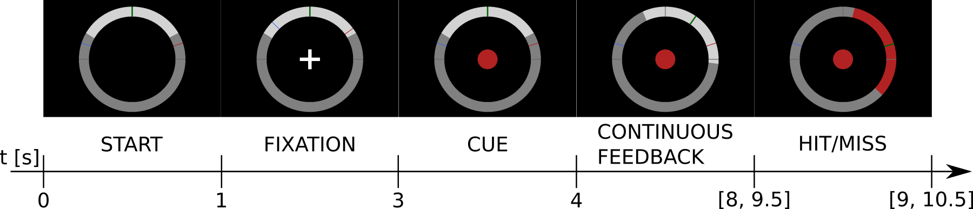
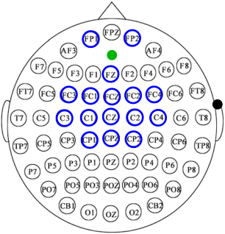
materials and methods: SETUP
Experimental Setup & Paradigm
ROIs:
[C3, C1, CP1], [Cz, FCz, CPz], [C4, C2, CP2]
TRIAL ORGANIZATION (cue-based synchronous paradigm)
Classifier: QDA
Classes: Both hands VS Both feet
Calibration: 3 runs, always-correct feedback
Evaluation: 2 runs, real feedback
16
Electrodes
5
512 Hz
healthy subjects
(age 26.5 ± 1.5)
System g.tec with
g.USBamp
reference: right earlobe
60
30
calibration trials
30 x 2 MI class
online trials
10×2 MI + 10 rest
ground: AFz
IEEE SMC 2026 · Bellevue, WA, USA
5

Slide 7



materials and methods: PIPELINE
Processing Pipeline
Identical chain offline (calibration) and online (closed-loop)
CAR filter
Band-pass
Hilbert
Smoothing
Classifiers
FP1, FP2 excluded
8–13 Hz & 18–24 Hz
4th-order Butterworth
Instantaneous power envelope
Moving average, 1-s buffer
QDA and GMM
Band-pass
Artifact rejection
8–13 Hz & 18–24 Hz
4th-order Butterworth
Threshold-based EOG (Fp1, Fp2) & EMG
Online: streamed at 16 Hz inside the ROS-Neuro middleware.
IEEE SMC 2026 · Bellevue, WA, USA
6

Slide 8




materials and methods: OFFLINE TRAINING
Offline Gated Control Architecture
Processing pipeline: CAR, μ/β band-pass, Hilbert power (xₜ)
Artifact Check
Compute Spatial Focality and classify it
F(t) and P(IC | F(t))
{
Filtered samples
gate( F(t) ) =
Accepted if P(IC | F(t)) ≥ 0.5
Rejected otherwise
Train the BCI classifier
IEEE SMC 2026 · Bellevue, WA, USA
9

Slide 9

materials and methods: ONLINE CONTROL
Online Gated Control Architecture
Processing pipeline: CAR, µ/β band-pass, Hilbert power (x_{t})
GMM Gate
Classifier Direction
Artifact Check
P(IC | F(t))
P(Classifier | xₜ)
Reliability-Weighted Soft-Increment Integrator
INC (P(IC)≈0):
P_{merged}≈ 0.5 → v(t) ≈ 0 → C(t+1) ≈ C(t)
P_{merged} = P(IC) · P(Classifier) + ( 1 − P(IC) ) · 0.5
v(t) = min( 1, |P_{merged}(t) − 0.5| · 2 · K_{gain} )
C(t+1) = C(t) + sign(P_{merged} − 0.5) · |v(t)| / b_{s}
Feedback Shown to the User
IEEE SMC 2026 · Bellevue, WA, USA
10

Slide 10
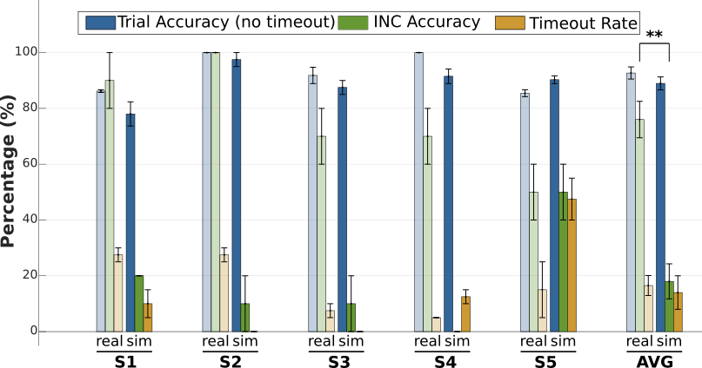
results: OFFLINE
Isolating the Gate's Effect
Baseline architecture simulated on the same neural traces recorded under SFG.
Trial Accuracy:
comparable (p = 0.1055): both equally accurate once triggered
Timeout Rate:
comparable (p = 0.5117): gate doesn't impede execution
INC Accuracy:
76.0% vs 18.0% (p = 0.0059): a significant difference
IEEE SMC 2026 · Bellevue, WA, USA
12

Slide 11
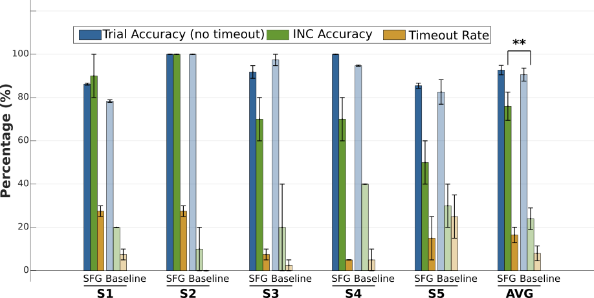
results: ONLINE
Closed-Loop Performance
TRIAL ACCURACY
> 90%
Without considering timeouts
TIMEOUT RATE
8% → 16.5%
deliberate safety trade-off
INC ACCURACY
24% → 76%
p = 0.0020 **
IEEE SMC 2026 · Bellevue, WA, USA
11

Slide 12
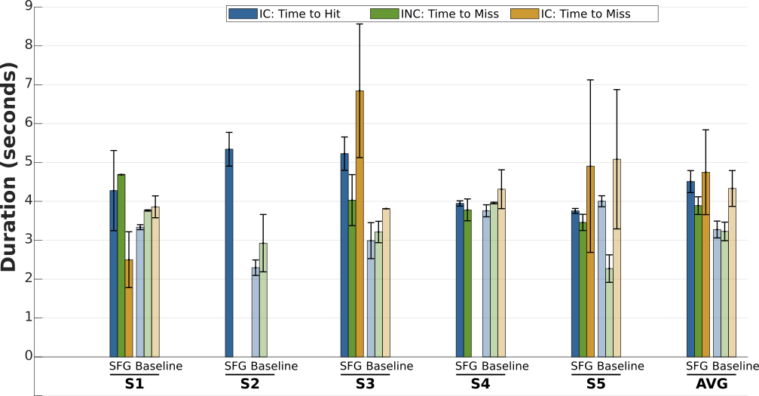
results: ONLINE
Command Latency
IC: Time to Hit
+1.3s (p = 0.0645, n.s. Wilcoxon signed-rank).
INC, IC: Time to Miss
SFG requires more time before an unintended command fires.
IEEE SMC 2026 · Bellevue, WA, USA
13

Slide 13
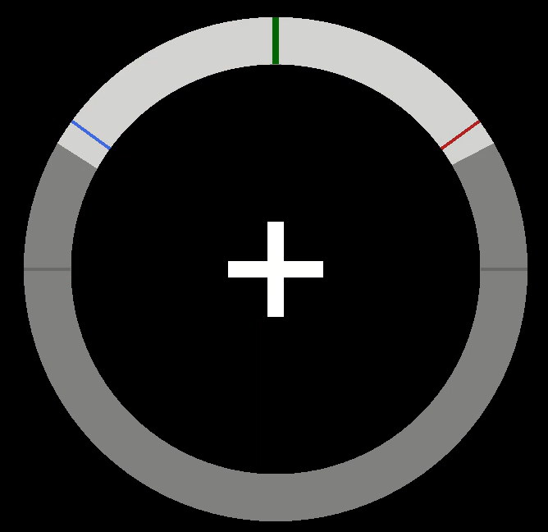
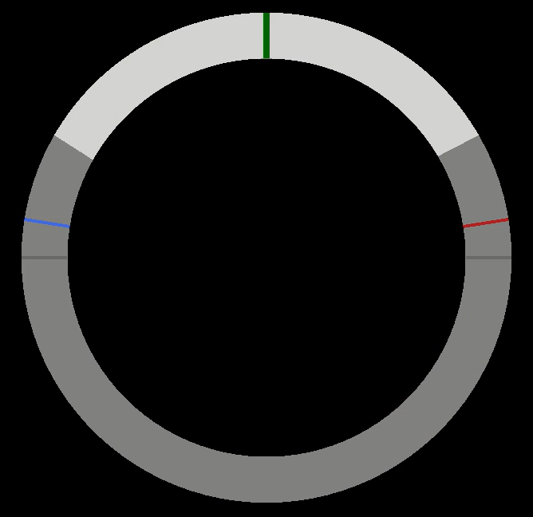
results: ONLINE
Online Closed-Loop Control Performance
OUR
TRAD
IEEE SMC 2026 · Bellevue, WA, USA
15

Slide 14
CONCLUSION and TAKE-HOME MESSAGE
When the brain isn't focused, the system should know it.
An unsupervised, GMM-based Spatial Focalisation Gate turns spatial EEG focality into a real-time trust signal that decides whether the command is trustworthy enough to drive the external device.
LIMITATIONS
OUTLOOK
Restricted to a two-class paradigm.
Validated on a small cohort (5 subjects).
Proof of concept: validated within a synchronous, cue-based paradigm, not yet asynchronous.
Validate on larger, more diverse cohorts to confirm the effect beyond N=5.
Extend beyond motor imagery to other paradigms, e.g. CVSA (covert visual spatial attention).
Move from the synchronous, cue-based setting to real asynchronous, self-paced control.
IEEE SMC 2026 · Bellevue, WA, USA
15

Slide 15

THANK YOU
Questions?
Reliable Asynchronous Control in MI BCIs: An Unsupervised Spatial Focalisation Gating for Intentional Non-Control
paolo.forin@phd.unipd.it
Paolo Forin · Stefano Tortora · Emanuele Menegatti · Luca Tonin
IEEE SMC 2026 · Bellevue, WA

