Slide 1


IEEE SMC 2026
Bellevue, WA, USA
October 4-7, 2026
EGPFNet: EEG-Guided Fusion for
Multi-Talker Speech Extraction
J. Zhang, H. Xie, Z. Yang, Y. Wang, and M. Qiao
Presenter: Hongyang Xie
School of Artificial Intelligence and Computer Science
North China University of Technology, Beijing, China

Slide 2
EEG provides the missing cue in a multi-talker mixture
Audio alone cannot identify intent
EEG supplies a neural attention cue
One microphone contains attended and interfering speakers
Audio-only separation does not know which output the listener wants
No enrollment utterance or speaker identity is available
Cortical activity tracks attended speech more strongly
EEG guides target selection without replacing acoustic evidence
Goal: estimate the attended waveform end to end
EEG answers the question that the mixture cannot: which voice is the target?
Task: x = attended speech + interferers; EEG is the only auxiliary cue; output is the attended waveform.

Slide 3
Three bottlenecks make EEG-guided extraction difficult
Weak and heterogeneous neural evidence
Unstructured cross-modal fusion
Low signal-to-noise ratio
Strong subject and session variability
A static encoder can learn artifacts instead of attention
Attention cues differ across EEG bands
Audio and EEG have mismatched time scales
Direct fusion can degrade fine acoustic detail
Design principle: preserve speech evidence, adapt EEG features, then inject neural cues progressively.
Low-frequency activity supports slower envelope tracking; beta and gamma can reflect faster auditory dynamics.

Slide 4
EGPFNet assigns one mechanism to each bottleneck
Adaptive dual encoders
Progressive neural guidance
Bidirectional Mamba models long acoustic context
Five DWT bands remain separate
Top-2 routing selects two of three KAN experts
Load balancing discourages expert collapse
Speech remains the fusion query
EEG bands enter from gamma to delta
KAN-FFN models nonlinear cross-modal relations
A soft mask selects the attended acoustic basis

Slide 5
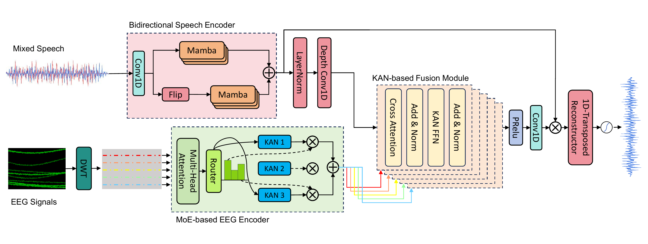
EGPFNet separates selection from acoustic reconstruction

Slide 6
Bidirectional Mamba preserves detail and long-range context
Preserve a waveform-compatible basis
Model context in both directions
Conv1D learns a time-domain analysis filterbank
Latent features retain phase-compatible detail
The original basis is saved for mask application
Reconstruction mirrors the analysis convolution
Forward Mamba: past-to-future context
Backward Mamba: future-to-past context
Concatenate, project, and normalize
Linear-time alternative to full self-attention

Slide 7
Sparse KAN experts adapt to heterogeneous EEG patterns
Keep physiological bands explicit
Route each time step to specialists
Resample EEG to 128 Hz
Four-level db4 DWT yields five subbands
Normalize each channel and align time lengths
Share one encoder while preserving band identity
Multi-head attention captures temporal and spatial context
Router keeps the top two of three KAN experts
Sparse evaluation supports specialization
Auxiliary loss balances expert utilization

Slide 8
Ordered fusion turns EEG bands into successive refinements
Speech remains the query
EEG bands refine it in order
Start with the bidirectional speech embedding
Align each EEG band to the acoustic frame length
Use each band as key and value
Preserve acoustic evidence through residual updates
gamma → beta → alpha → theta → delta
Cross-attention injects one band per depth
KAN-FFN captures nonlinear modulation
Final sigmoid mask selects the attended source

Slide 9
Evaluation spans different conditions
Complementary datasets
Training and evaluation
KUL
16 subjects, 64 EEG channels
Spatially separated competing speech
AVED
20 subjects, 32 EEG channels
Competing Mandarin narratives
In-ear headphone presentation
Audio and EEG: 44.1 kHz and 128 Hz
Trial-level 80/10/10 split per subject
Adam, batch 8, cosine schedule; 300/400 epochs; four metrics; subject averages

Slide 10
EGPFNet achieves the strongest point estimates on KUL
6.97
0.79
2.50
SI-SDR (dB)
ESTOI
PESQ
+0.12 vs IFENet
+0.02 vs IFENet
+0.06 vs IFENet

Slide 11
The gains persist on the more distinct AVED setting
9.02
0.80
1.99
SI-SDR (dB)
ESTOI
PESQ
+0.26 vs IFENet
+0.03 vs IFENet
+0.08 vs IFENet

Slide 12
The expert-routed EEG encoder contributes the largest gain
-1.49 dB
-1.13 dB
All three
KUL without MEE
AVED without MEE
modules contribute
Largest KUL drop
Largest AVED drop
MEE is most influential

Slide 13
Structured neural guidance improves target extraction
What EGPFNet changes
Long-context speech modeling + adaptive EEG experts + ordered neural fusion
The resulting mask guides selection while the original acoustic basis preserves reconstruction detail.
What the evidence shows
Best SI-SDR, ESTOI, and PESQ point estimates on KUL and AVED
MEE removal causes the largest tested degradation
Next: isolate routing, KAN, band order, and subject-independent generalization

Slide 14
Acknowledgments
Thank you for your attention
Supported by the NCUT Education Teaching Reform Research Project Fund,
the NCUT Graduate Educational Reform Research Project,
and the Undergraduate Training Program for Innovation and Entrepreneurship.
Corresponding author: myuqiao@ncut.edu.cn
Presenter: hongyang_xie@qq.com

