Slide 1
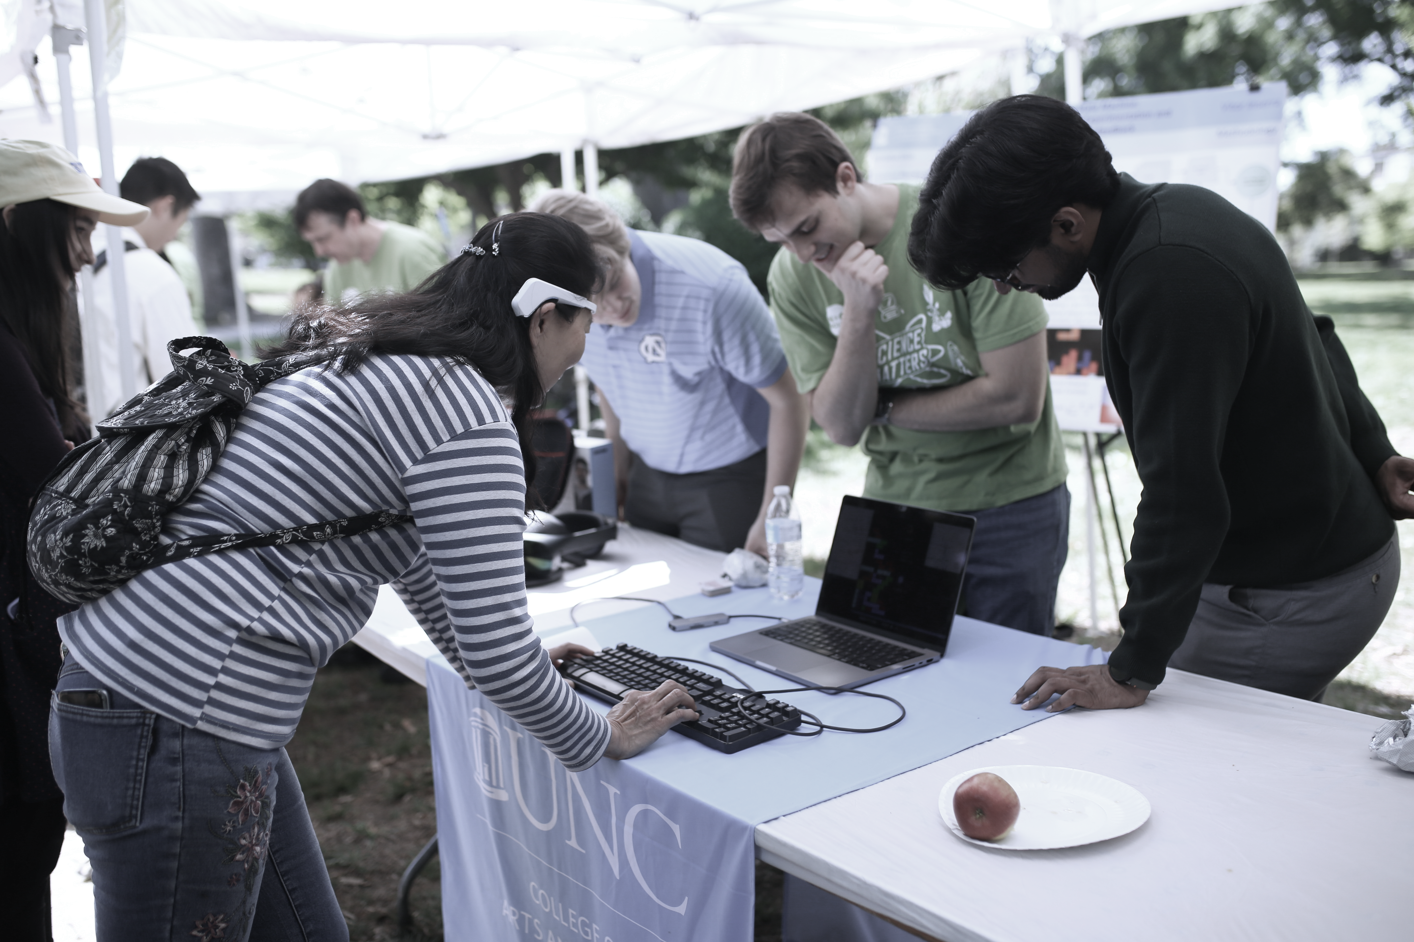




EEG Cognitive State Machine: A Modular Framework for Design-Time Experimentation and Run-Time Neurofeedback in Puzzle Games
Vitor Inserra & Richard Marks
UNC Chapel Hill · Department of Computer Science

Slide 2

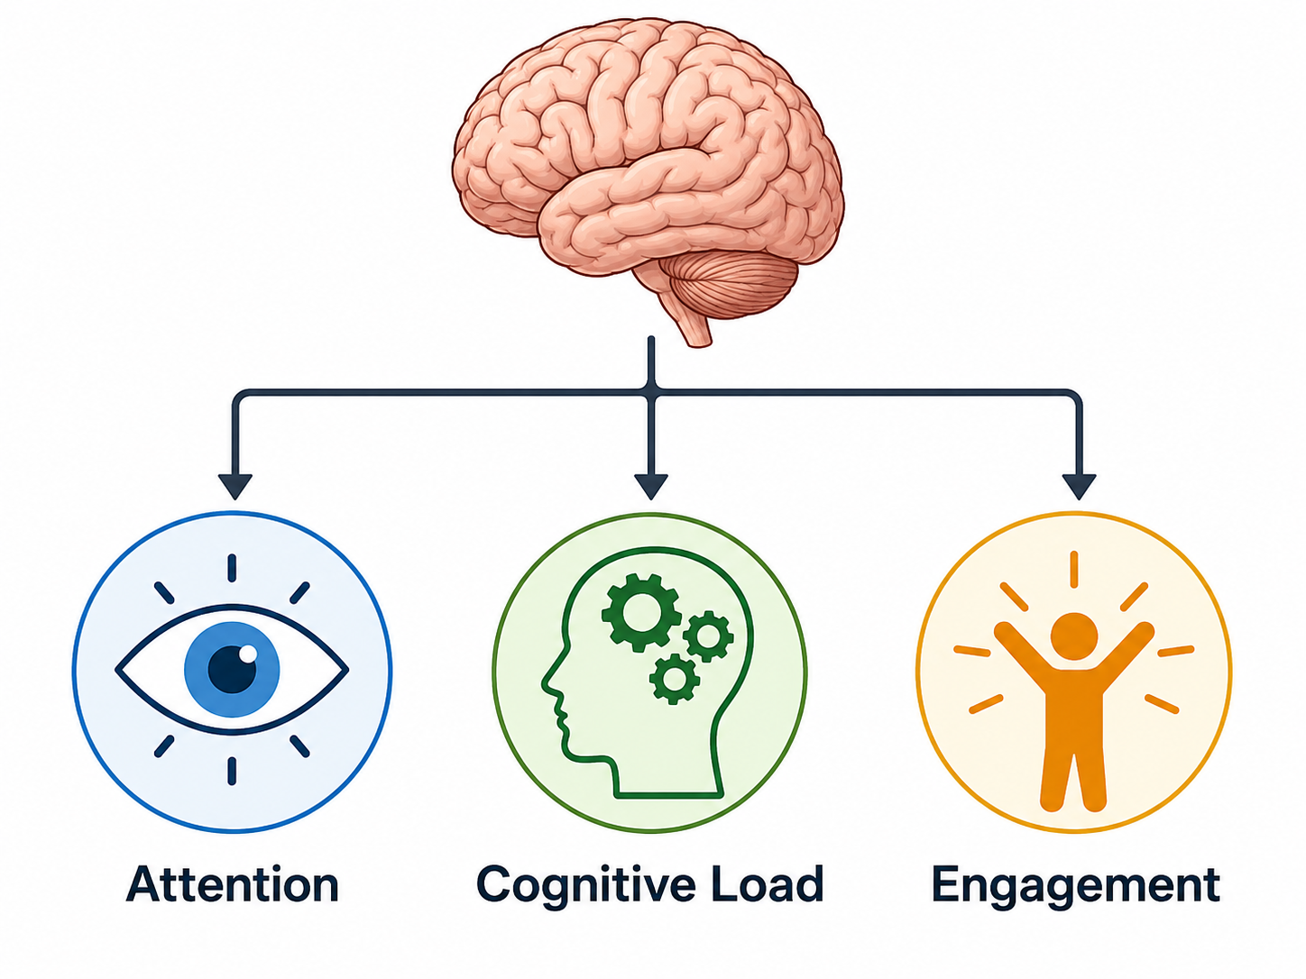
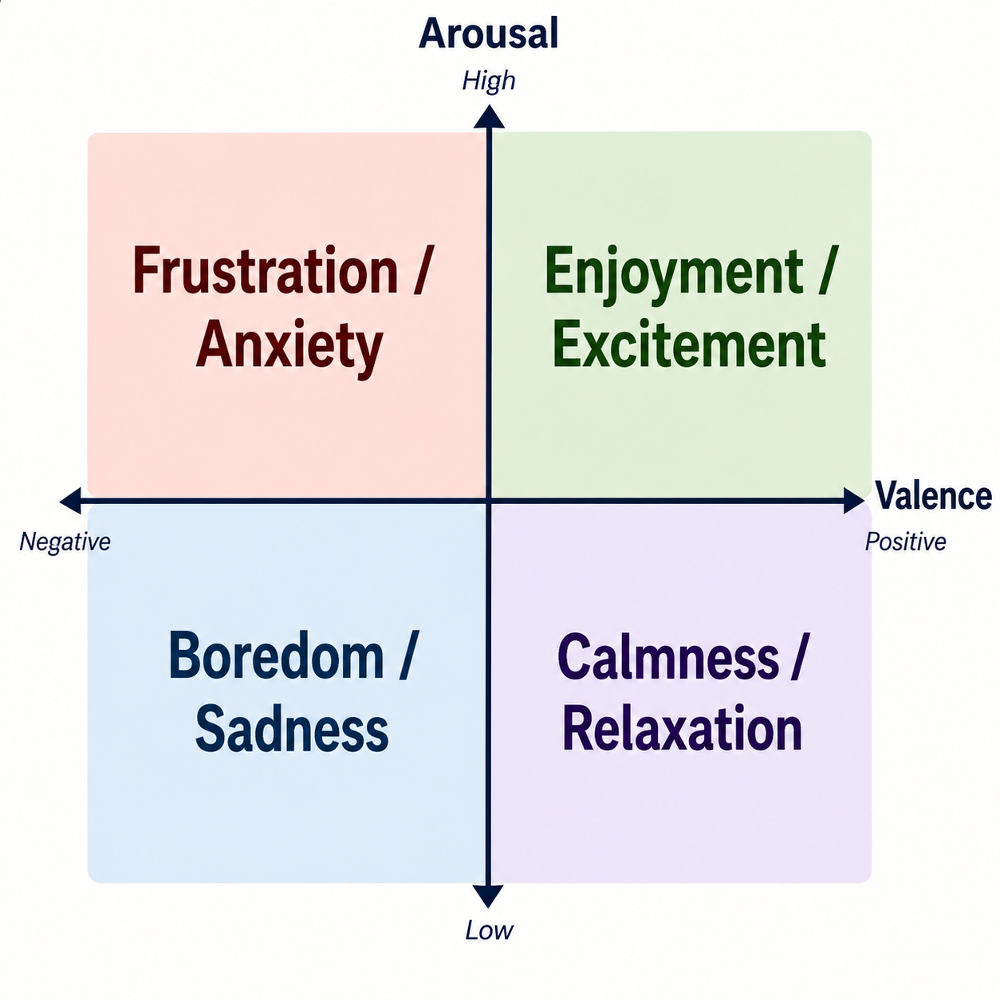
Introduction
XR and AI are converging into adaptive immersive apps.
  Using external awareness to adapt:
    Clicks, dwell time, completion times…
    Cameras, microphones, GPS…
    Questionnaires, chosen user preferences…
  Not using internal awareness:
    Latent cognitive states [1, 2] govern the success of complex user journeys.
    Abstract emotional states [3] responsible for pleasurable user experiences.

Slide 3
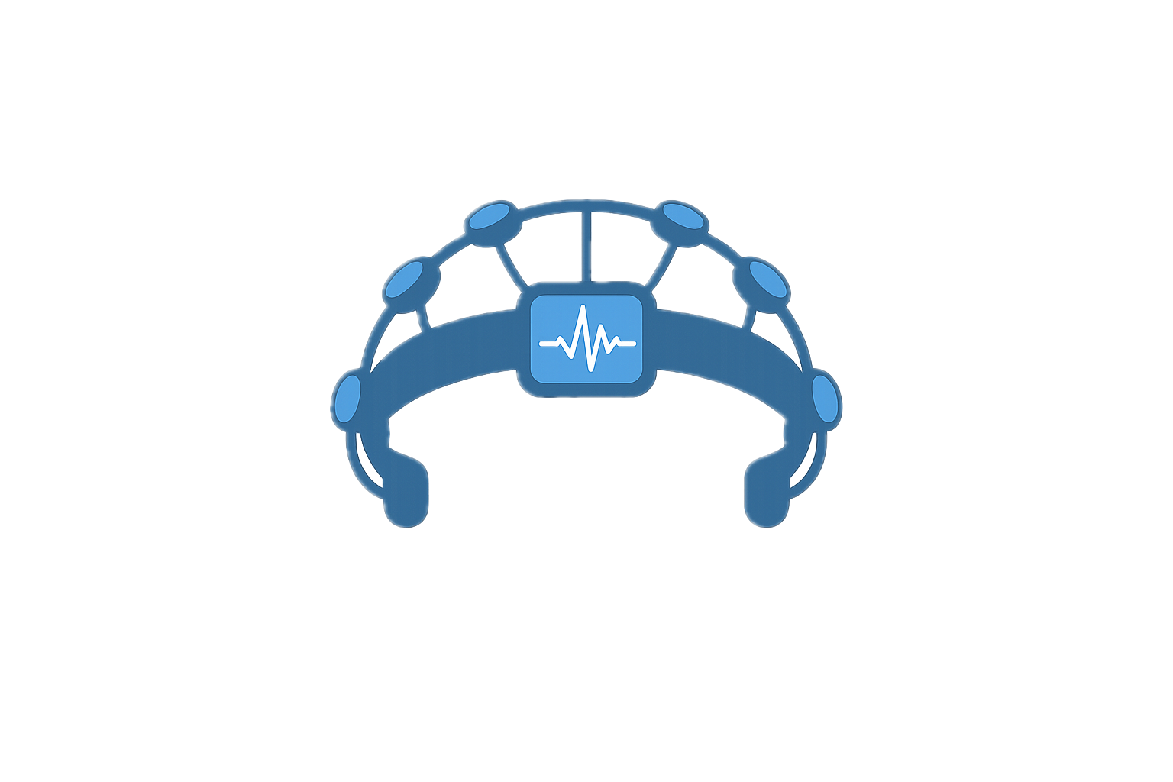
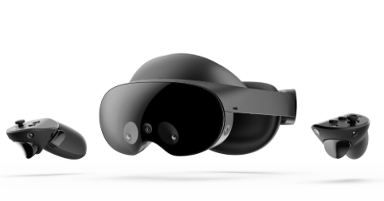
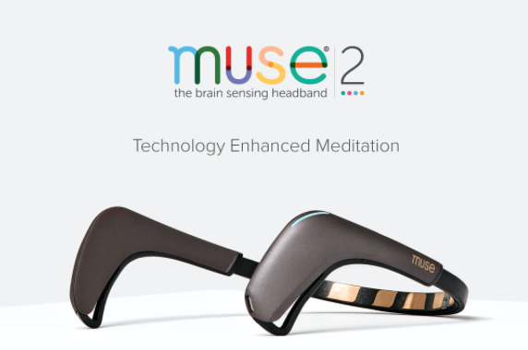
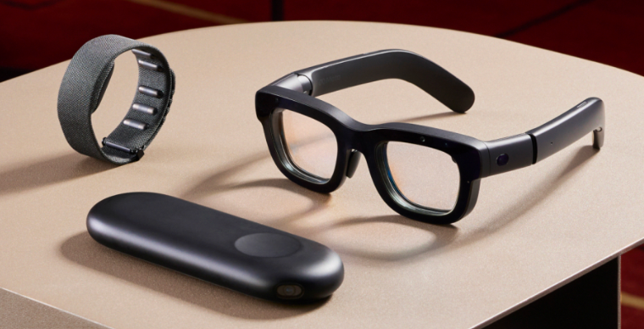
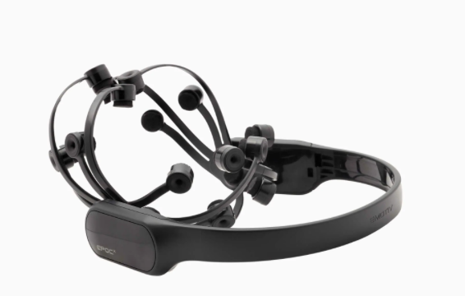
Introduction
Internal awareness from the brain can be paired with HMDs.
Recognize and quantify human emotions and cognition.
Provides informative context for adaptation.
Allows direct UX evaluation.
Non-Invasive BCI + Eye Tracking.

Slide 4
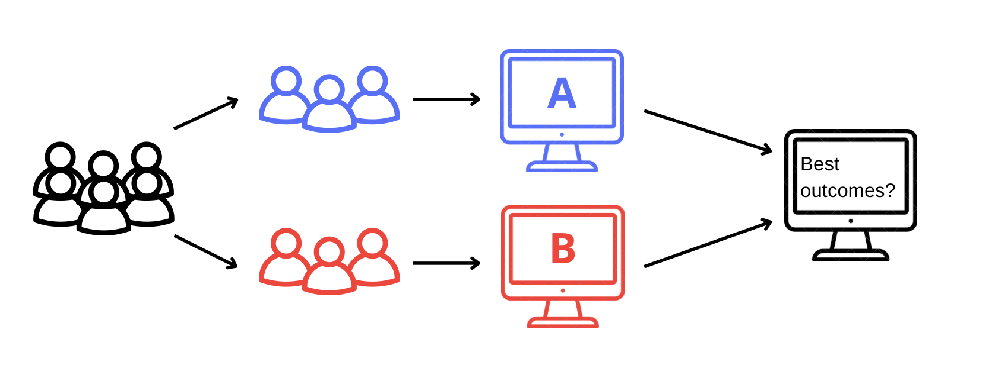
Introduction
Software companies run Online Controlled Experiments (OCE).
Behavioral telemetry is a strong signal with large sample sizes and simple user journeys [4].

Slide 5
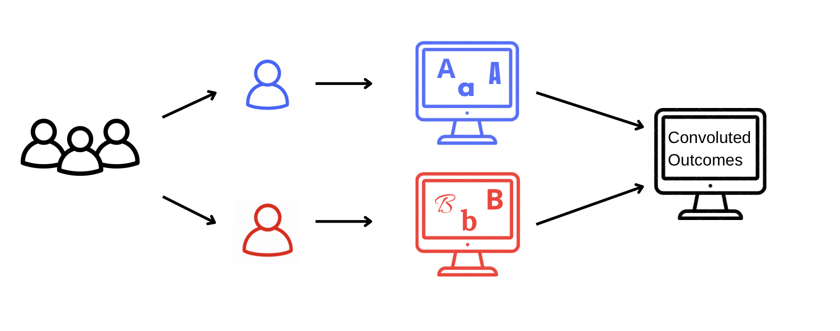
Problem
Games and educational software are challenged by small sample sizes, complex user journeys, and little behavioral information [5].
Finds the variant preferred by most.
Slow process for each new enhancement.

Slide 6
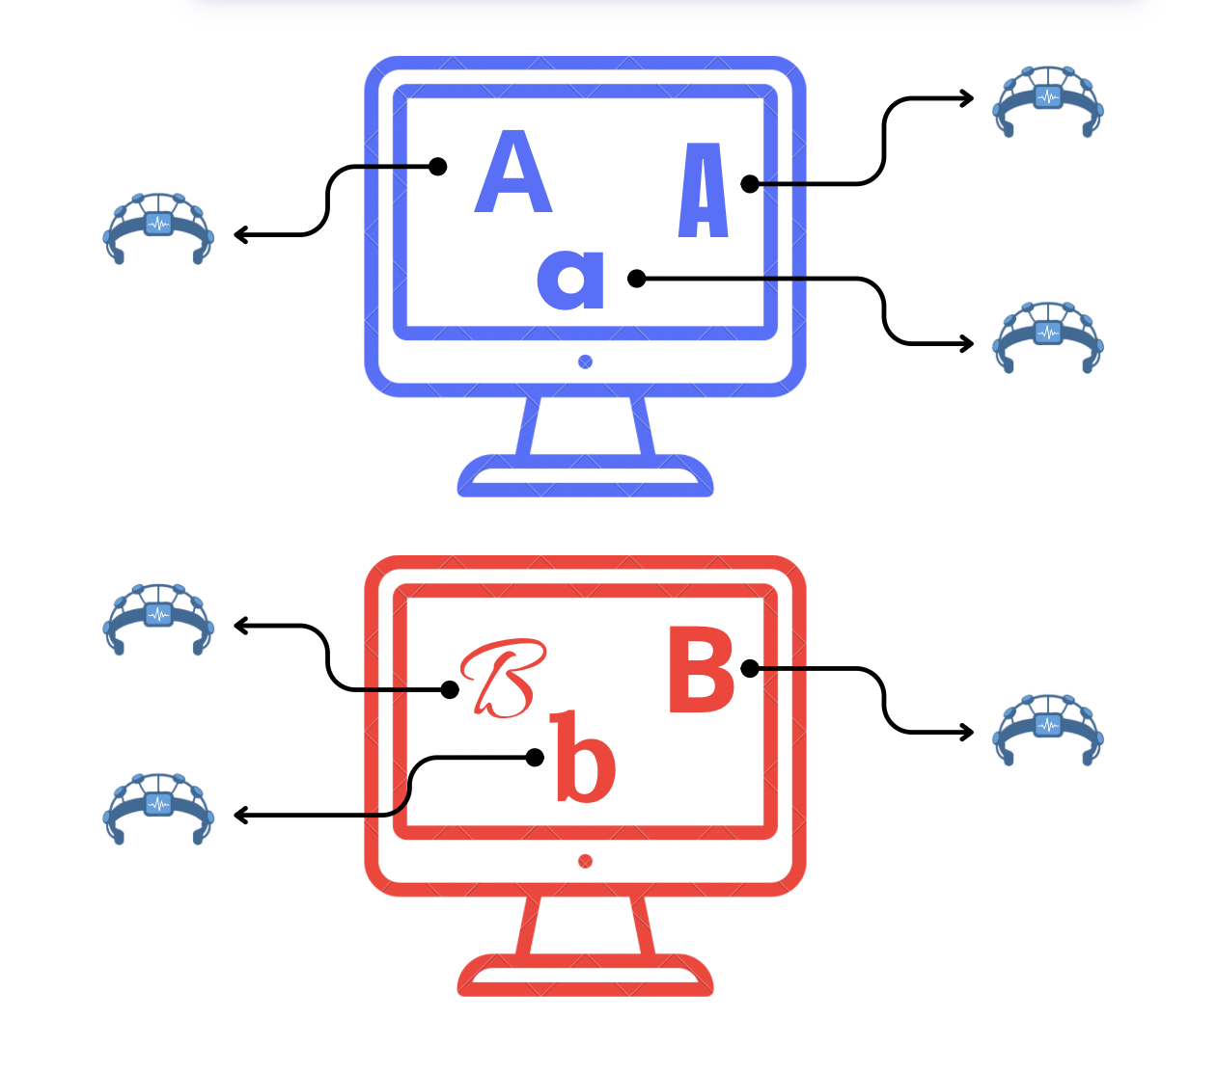
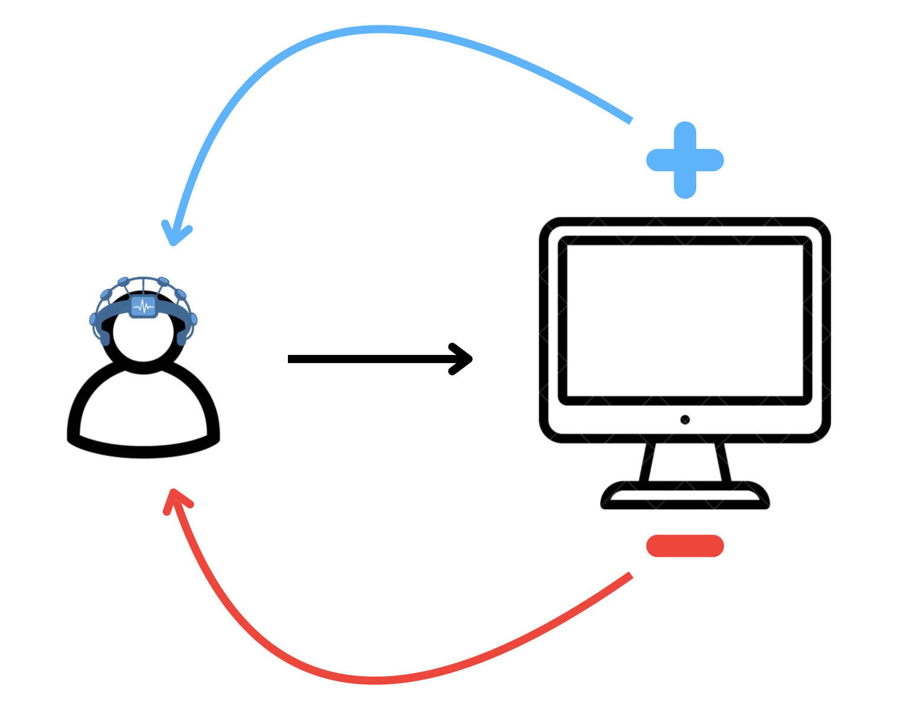
Solving with EEG-derived Estimates
Behavior is directly inferred from brain signals instead of behavioral telemetry.
Faster and personalized iterations through Neuroadaptation.

Slide 7
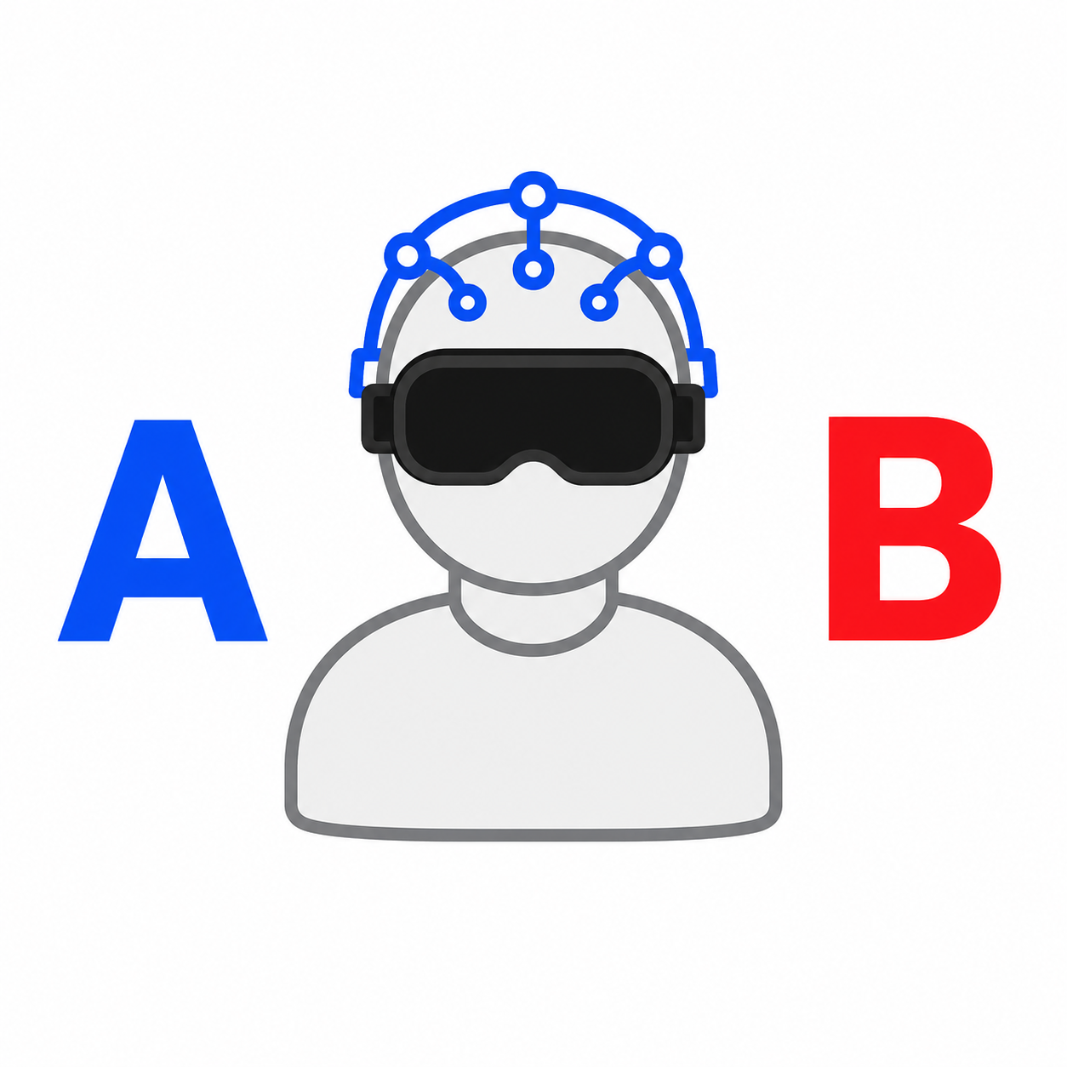
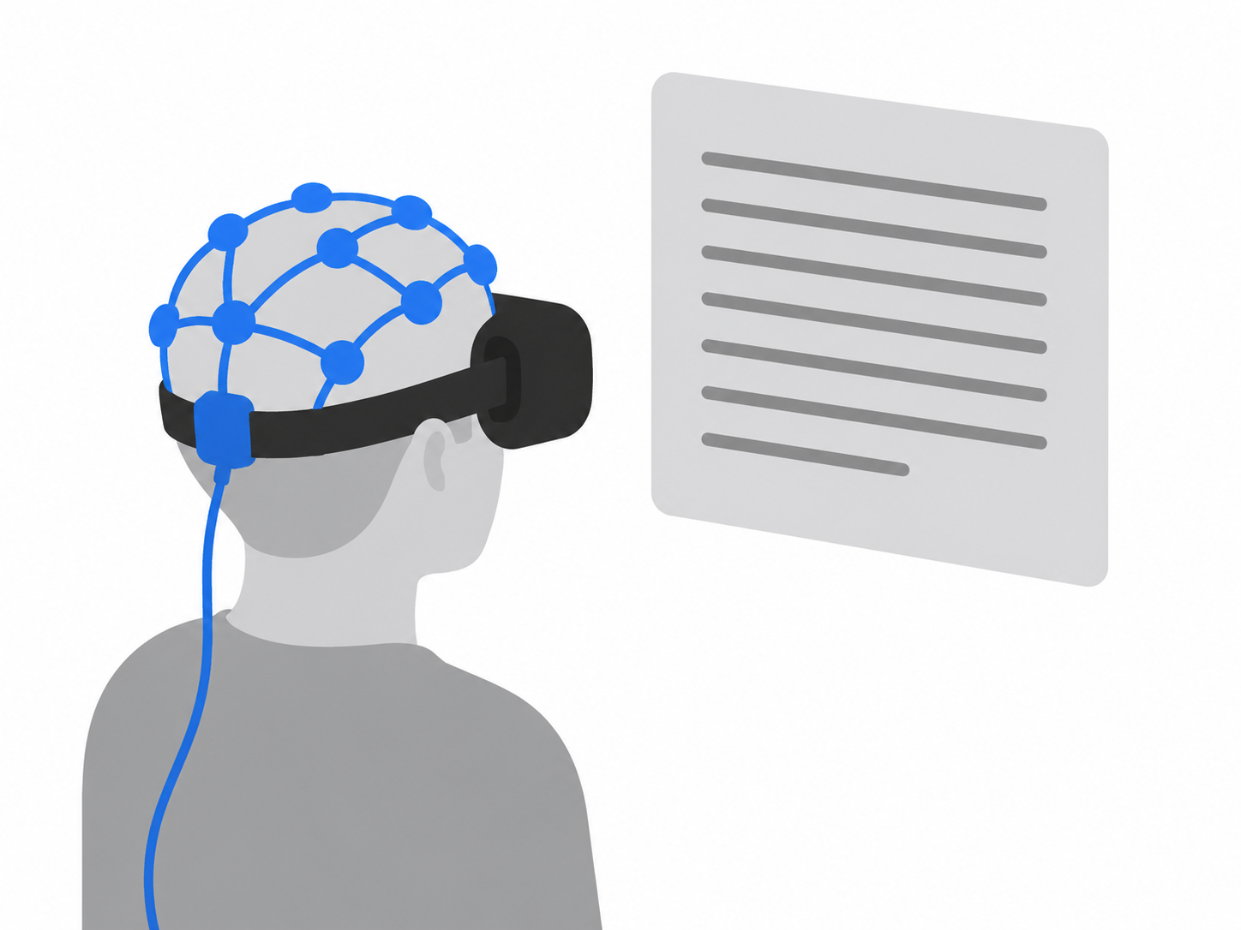
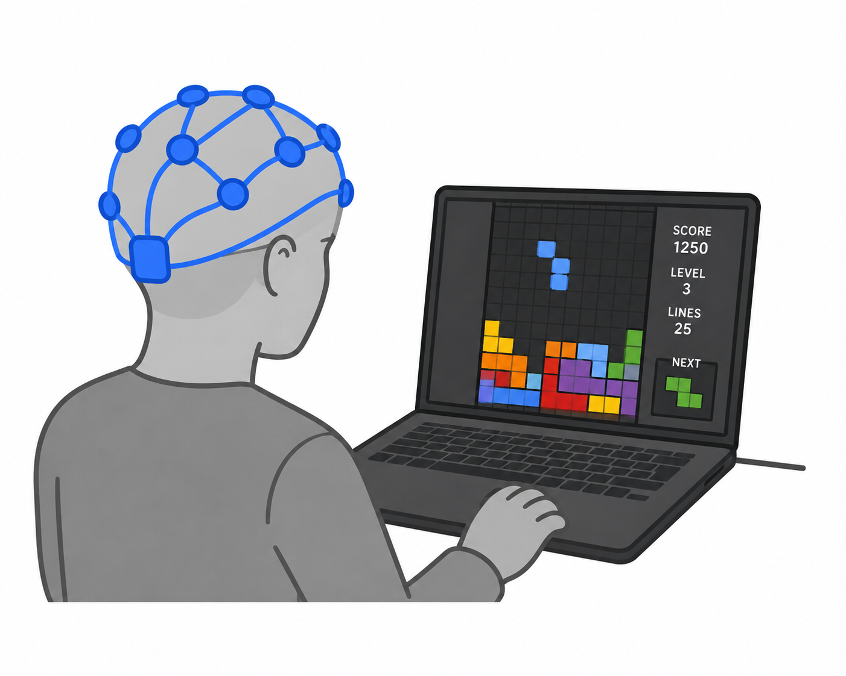
Feasibility Studies
End-to-end online controlled experiment on VR puzzle game.
Real-time Emotion Inference during VR Reading.
Neuroadaptive Puzzle Game with Real-Time Inference to control loop.
Notes:
With the goal of engineering a framework to do both of thsoe we ran three feasibility studies
We start by looking at a comparison of behavioral telemetry and EEG-based predictions in design time experimentation
Then I'll talk about a small project I made, classifying my own emotional arousal in real time synchronized with eye tracking
but what is most important about this is that we created a fast enough classifier to
create a neuroadaptive version of tetris with continuous emotion adaptation. This will show how we leverage modern machine learning and feed affective state predictions into a live control-loop rather than using band-ratio heuristics or threshold level predictors like in previous studies.

Slide 8

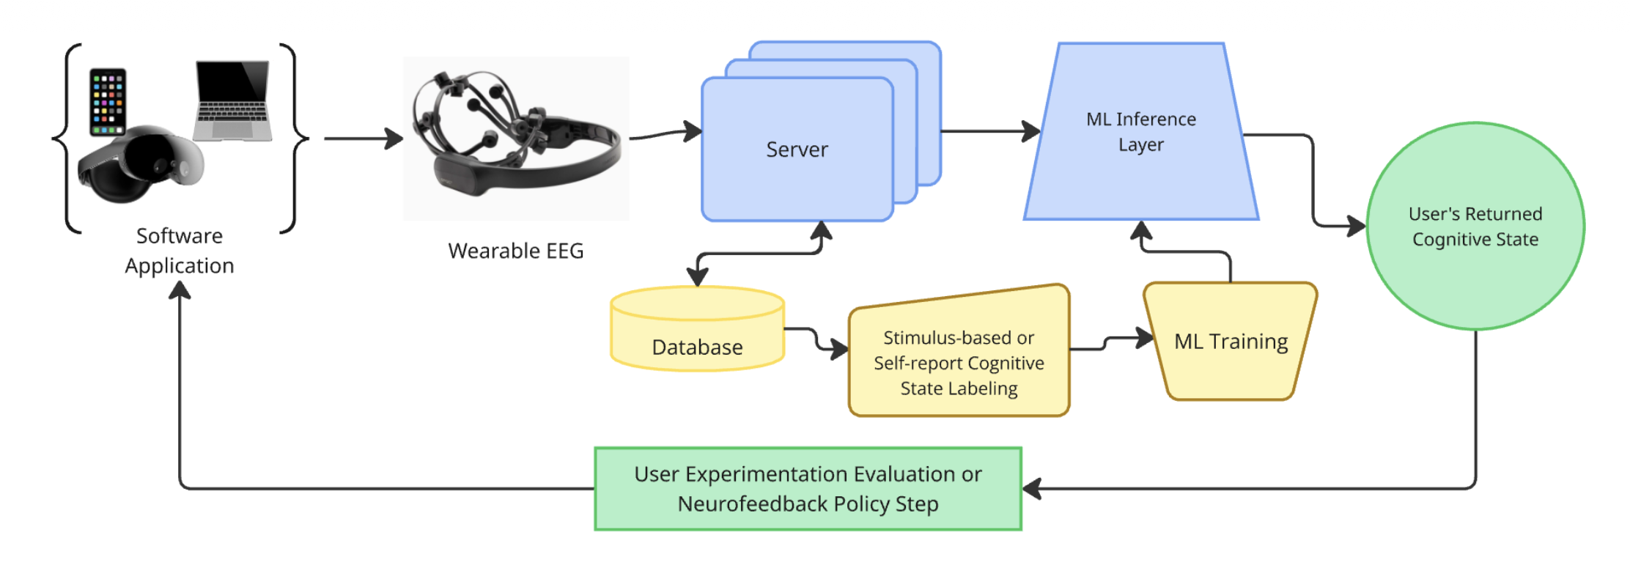

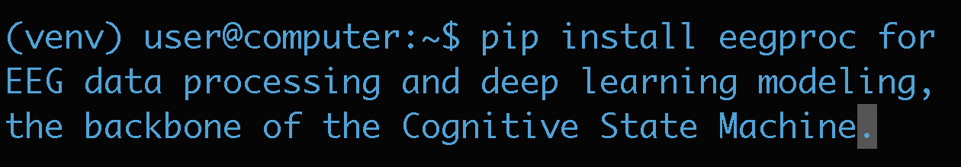
Shared Software Layer
github.com/EEGo-UNC/EEGProc

Slide 9
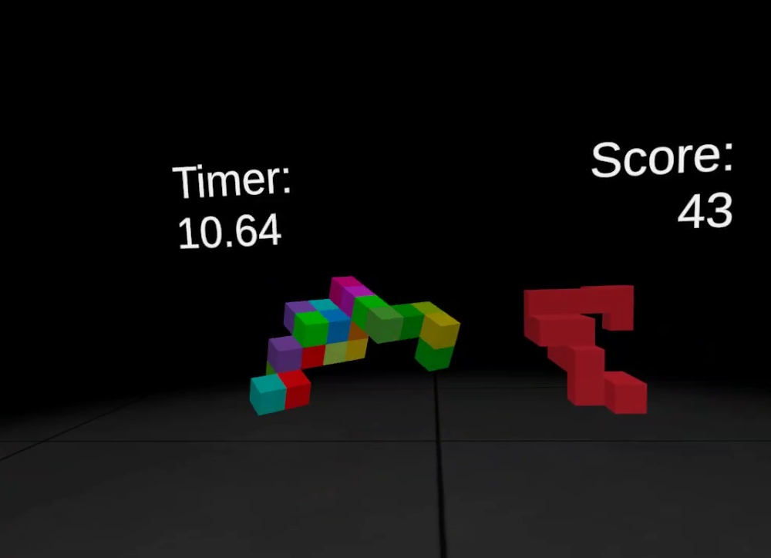
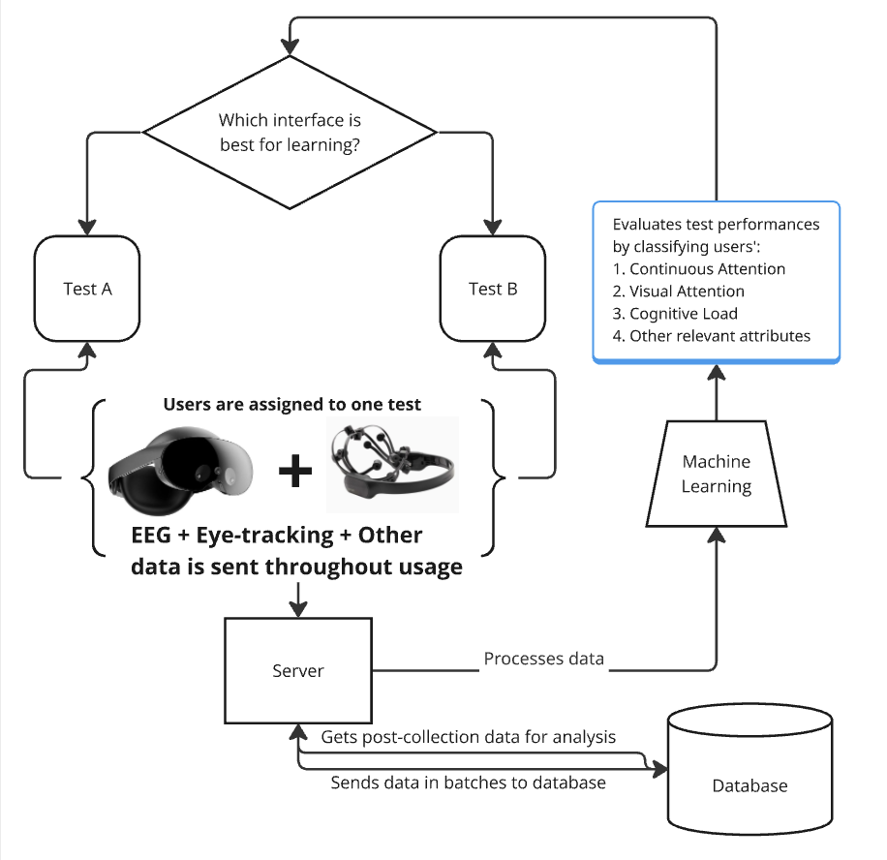
Brain-Enhanced Applications
A/B Testing in a VR Puzzle Game using EEG [6]
  Demonstrate the feasibility of an end-to-end EEG-VR OCE pipeline.
  Compare EEG-based vs. traditional OCE in within-subject variant analysis.

Slide 10
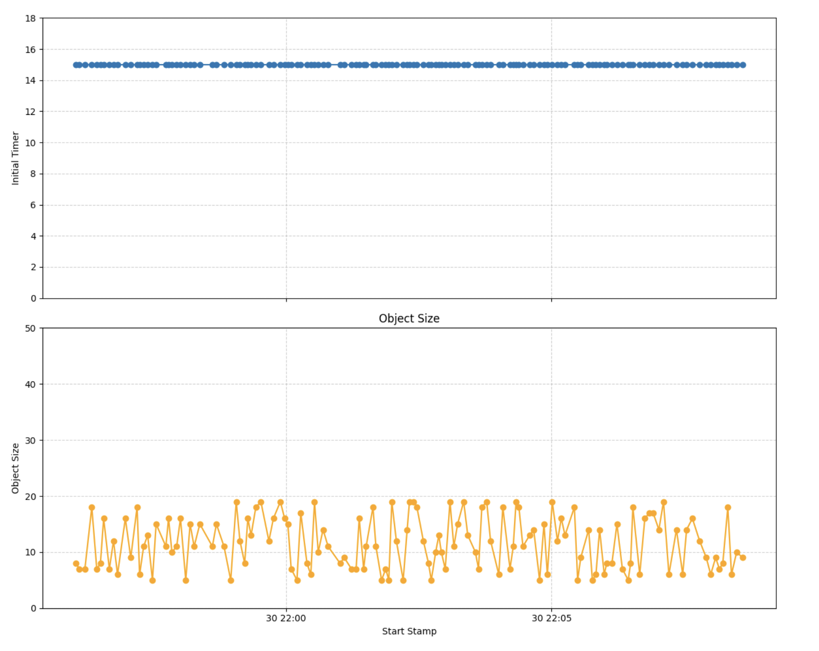
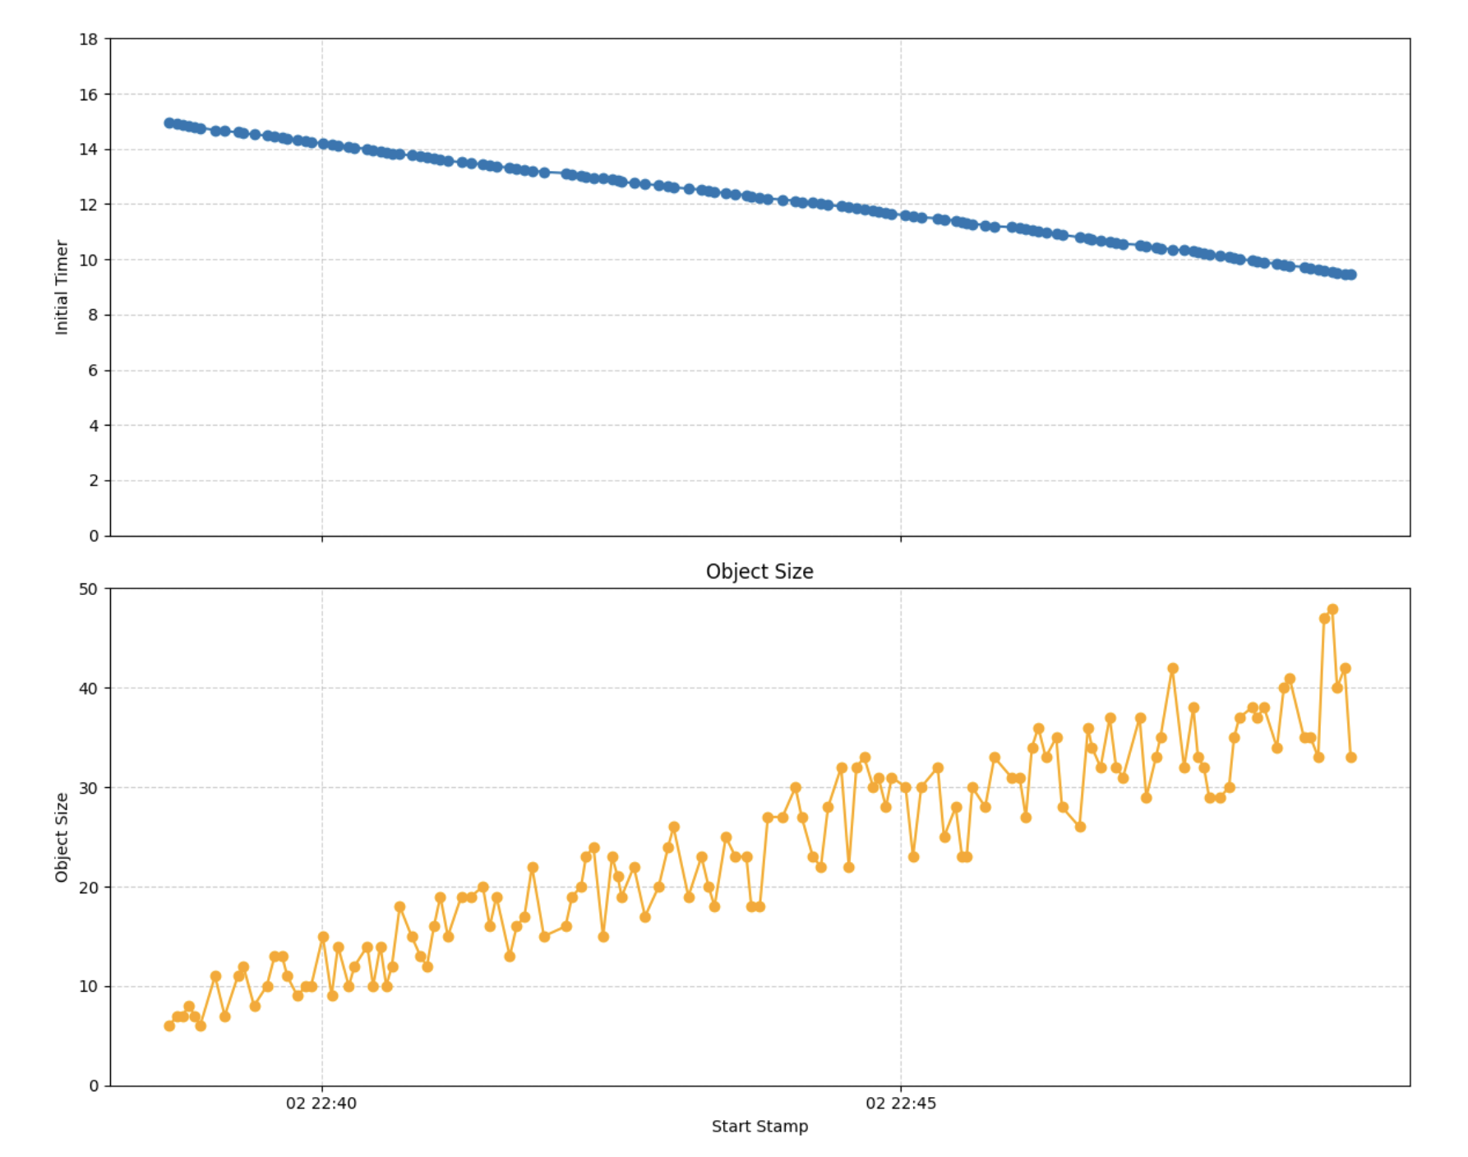
Brain-Enhanced Applications
Version A
Version B

Slide 11
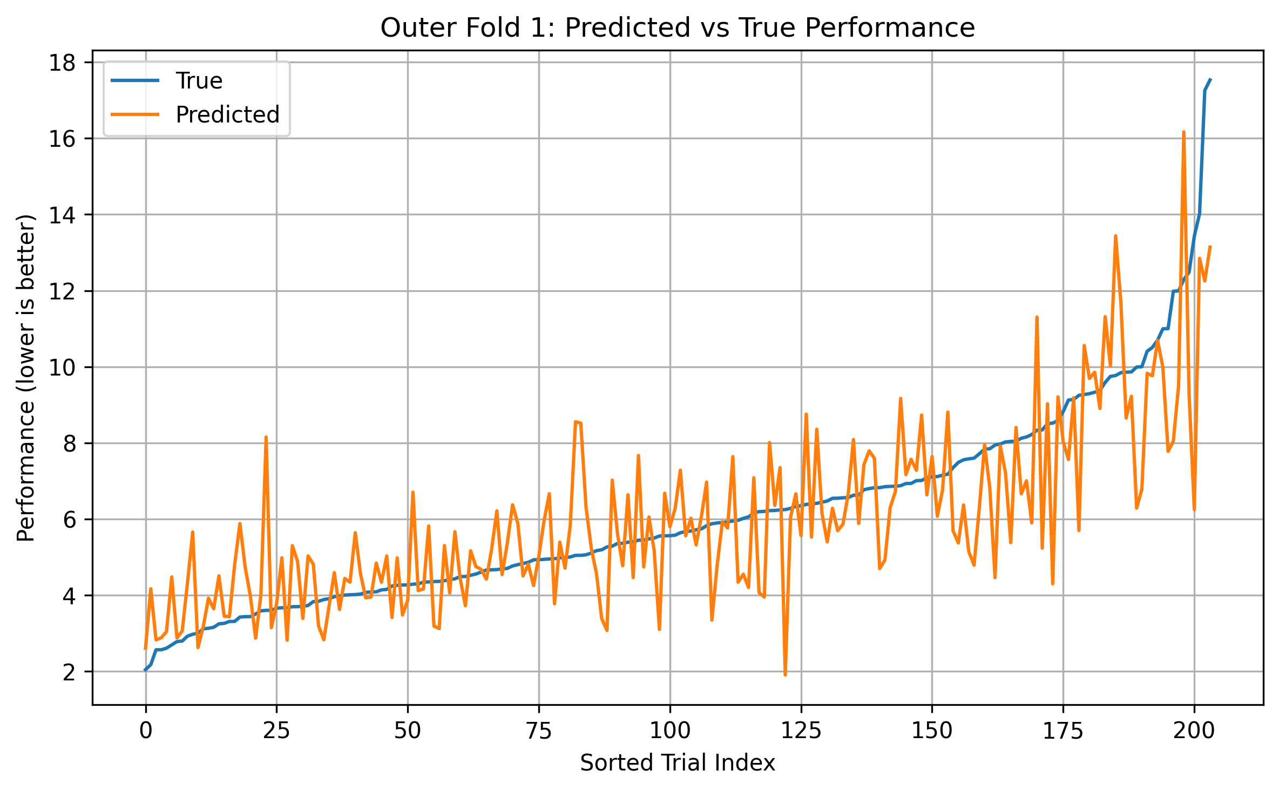
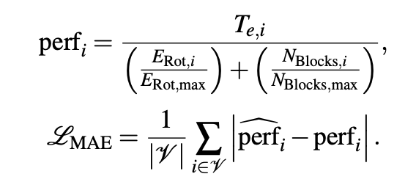
Brain-Enhanced Applications
MAE ≈ 1.3
  Ranges from 1.9 to 16.1
R² ≈ 0.6
  LKOCV (K=4)
  16 sessions

Slide 12
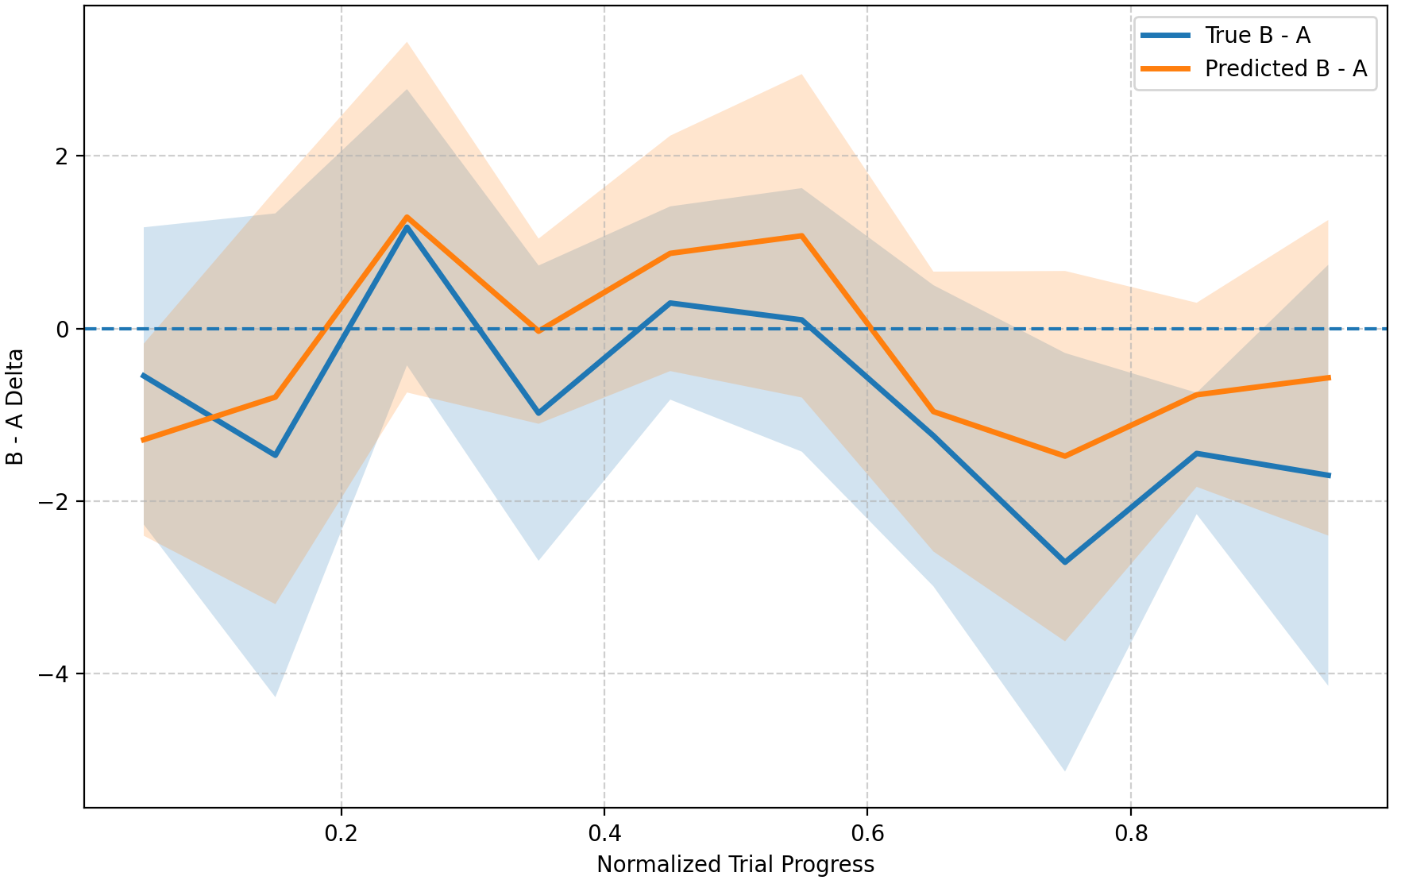
Brain-Enhanced Applications
Pearson r = 0.856 (p < 0.01)
Bland–Altman 0.588 mean bias

Slide 13
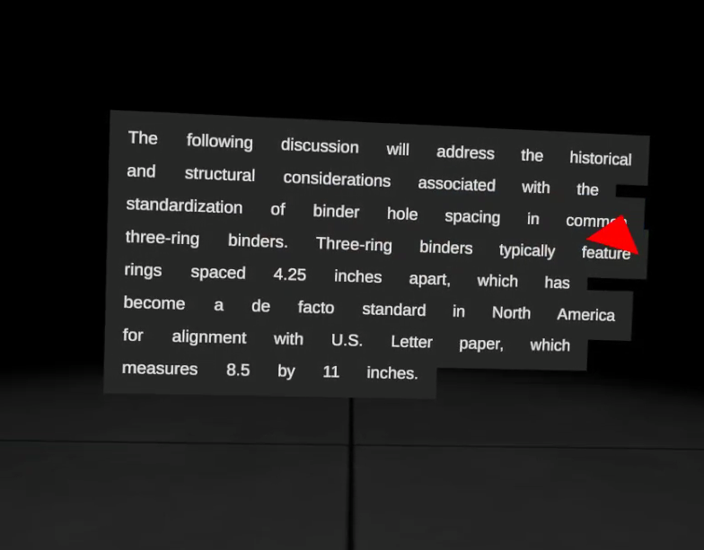
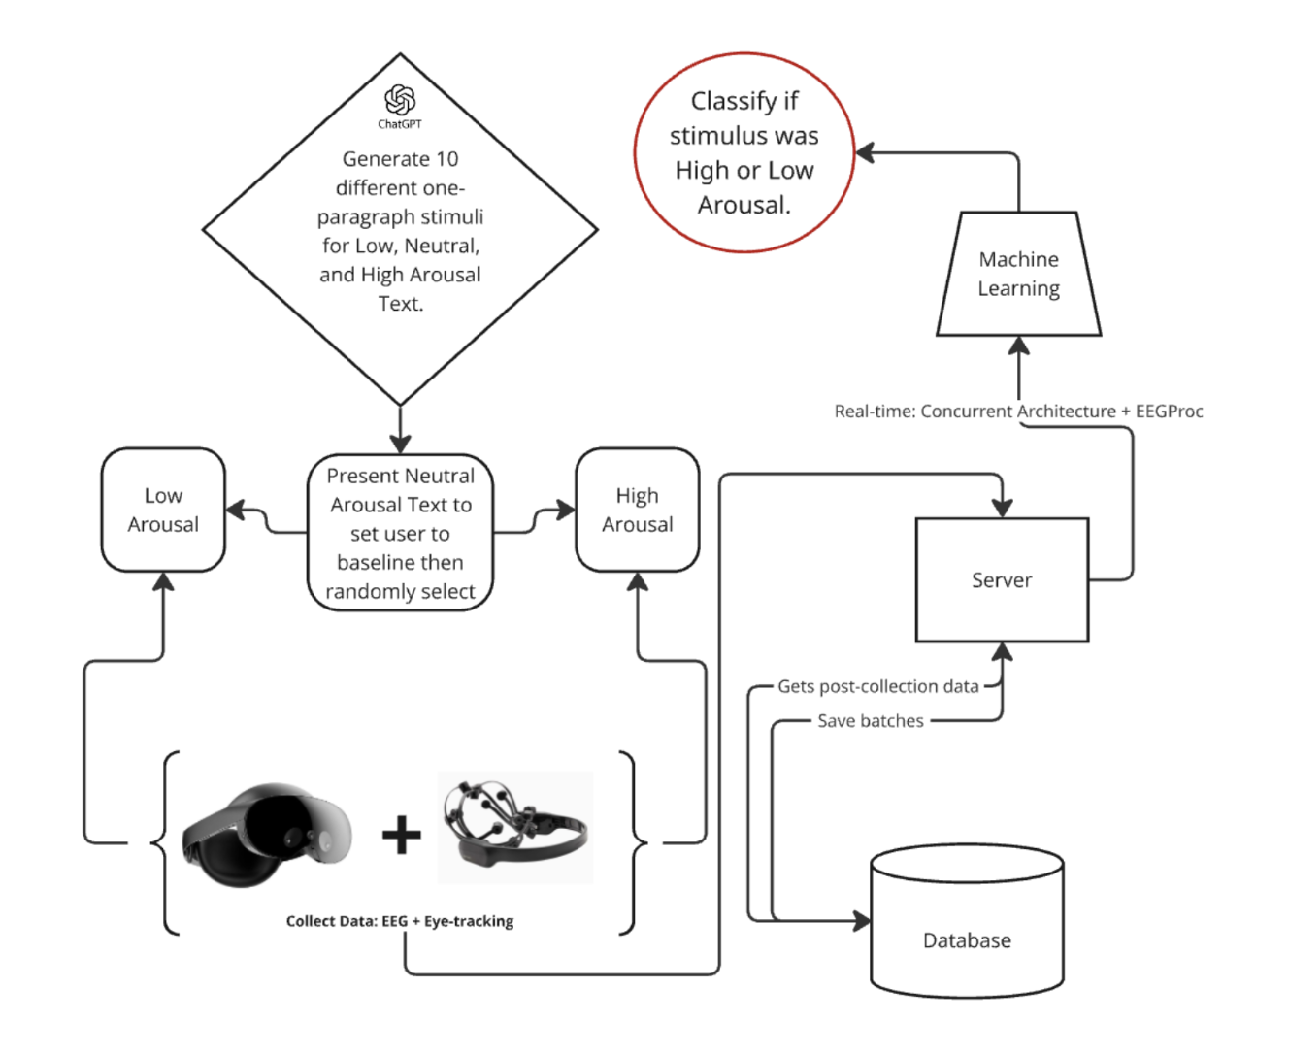
Emotions throughout VR Reading
Classifying emotional Arousal in Real-time during VR Reading
  Synchronize eye-tracking and EEG with emotional labelling.
  Model binary arousal through real-time BiLSTM.

Slide 14
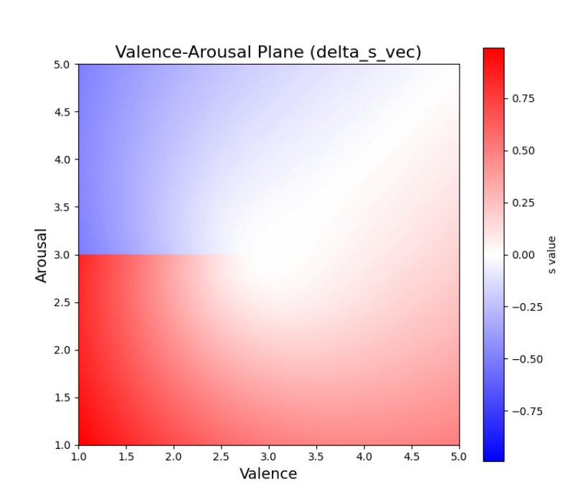
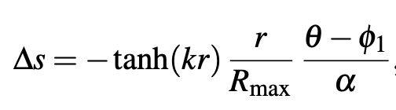
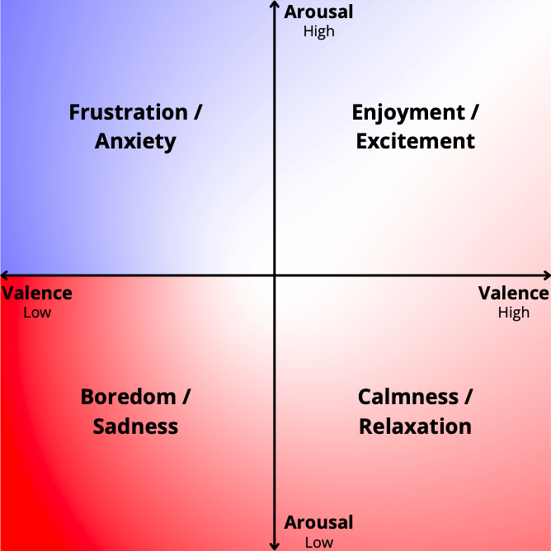


Neuroadaptive Tetris
Neuroadaptation through Real-time Inference (N=4)
  Minimizes “error” to emotional target—BiLSTM + System Control Function.
  Estimate emotions, not just EEG ratios, in real-time and continuously adapt the fall speed of blocks during Tetris gameplay.
  31% relative increase in enjoyment (underpowered for claims of significance).
Notes:
Previous work has attempted biocybernetic loops on Tetris [7, 8, 9] using EEG.
We differ by predicting emotion instead of cognitive workload or engagement, and by applying continuous adaptation throughout the entire session (no thresholds and no levels) by using a modern DL pipeline and feeding predictions to a system control loop.

Slide 15
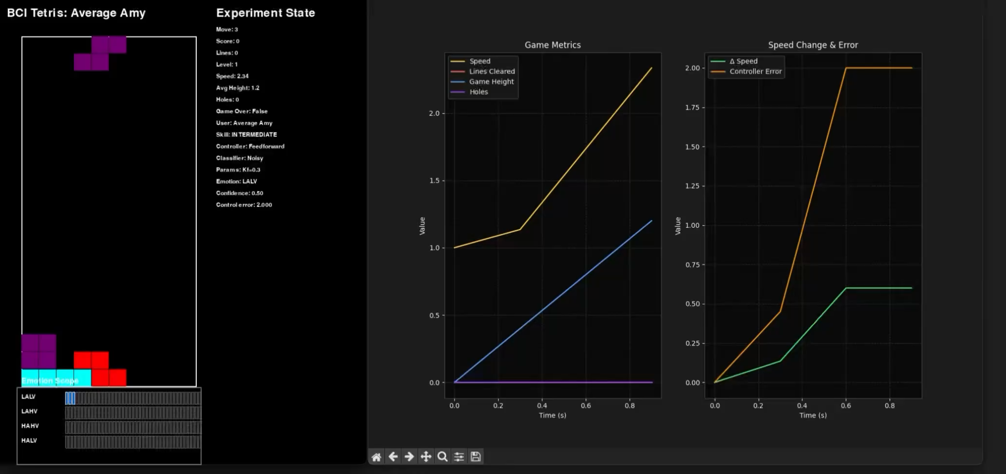
Neuroadaptive Tetris
Simulation of control loop through Emotional Distance Minimization (EDM).

Slide 16
Neuroadaptive Tetris
Further work on benchmarking and comparing advanced ML and featurization strategies across multiple datasets.
Work on interpretability and explainability methods for increasingly complex ML pipelines.
Neuroadaptive reading that matches user’s cognitive demands. (Subject study with N=20, looking for funding)

Slide 17
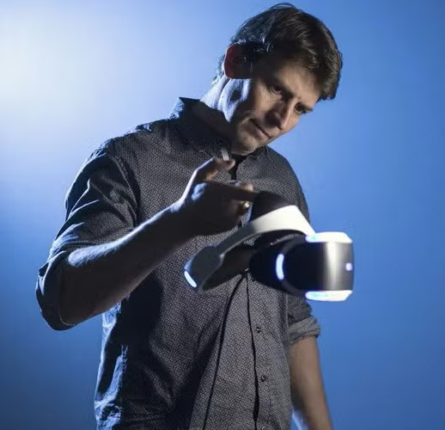
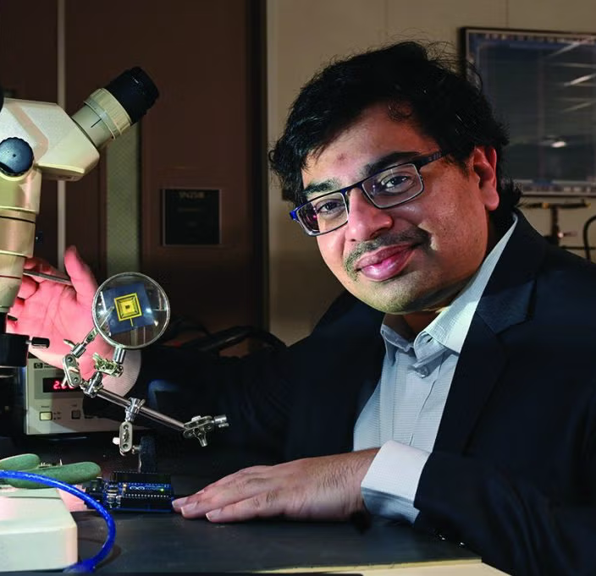
Acknowledgements
Group of 7 undergrads and 3 graduates that supports Wearable BCI + ML research.
Professor’s who advise and contribute to this research:
Dr. Richard Marks
Dr. Raghavendra Pothukuchi

Slide 18
References
[1] E. V. Kutafina, A. Heiligers, R. Popovic, A. Brenner, B. Hankammer, S. M. Jonas, K. Mathiak, and J. Zweerings, “Tracking of mental workload with a mobile EEG sensor,” Sensors, vol. 21, no. 15, p. 5205, 2021.
[2] A. Apicella, P. Arpaia, M. Frosolone, and N. Moccaldi, “High-wearable EEG-based distraction detection in motor rehabilitation,” Scientific Reports, vol. 11, p. 5297, 2021.
[3] S. Katsigiannis and N. Ramzan, “DREAMER: A database for emotion recognition through EEG and ECG signals from wireless low-cost off-the-shelf devices,” IEEE Journal of Biomedical and Health Informatics, vol. 22, no. 1, pp. 98–107, 2018.
[4] R. Kohavi, A. Deng, B. Frasca, T. Walker, Y. Xu, and N. Pohlmann, “Online controlled experiments at large scale,” in Proceedings of the 19th ACM SIGKDD International Conference on Knowledge Discovery and Data Mining, (Chicago, IL, USA), pp. 1168–1176, Association for Computing Machinery, 2013.
[5] R. Kimmons, “A/B testing on open textbooks: A feasibility study for continuously improving open educational resources,” The Journal of Applied Instructional Design, vol. 10, no. 2, pp. 1–9, 2021.
[6] V. Gasparetto Inserra, “Brain-enhanced applications: A/B testing in virtual reality education through EEG and machine learning,” honors thesis, University of North Carolina at Chapel Hill, Chapel Hill, NC, USA, 2025. College of Arts and Sciences, Department of Computer Science.
[7] A. T. Pope, E. H. Bogart, and D. S. Bartolome, “Biocybernetic system evaluates indices of operator engagement in automated task,” Biological Psychology, vol. 40, no. 1–2, pp. 187–195, 1995.
[8] S. H. Fairclough, “Fundamentals of physiological computing,” Interacting with Computers, vol. 21, no. 1–2, pp. 133–145, 2009.
[9] K. C. Ewing, S. H. Fairclough, and K. Gilleade, “Evaluation of an adaptive game that uses EEG measures validated during the design process as inputs to a biocybernetic loop,” Frontiers in Human Neuroscience, vol. 10, p. 223, 2016.

