Slide 1
IFANet: An Interactive Frequency Attention Network for EEG Motor Imagery Decoding
Author: Yuan Zhou,Cong Yi,and Weina Zhu
Conference: 2026 IEEE International Conference on Systems, Man, and Cybernetics (SMC)

Slide 2
CONTENTS
01
Motivation
02
Method
03
Experiment
04
Results
05
Conclusion

Slide 3
Motivation
Machine learning-based EEG decoding methods rely heavily on the expertise of domain experts and require the manual design of complex feature extraction processes. The emergence of deep learning technologies has reduced the need for manual feature extraction. However, traditional models that combine convolutional neural networks (CNNs) and Transformers to decode motor imagery EEG (MI-EEG) signals typically do not account for key interactions between different frequencies; conversely, traditional models that do account for these interactions struggle to effectively capture the key interrelationships between local and global features, resulting in poor performance in both cases.

Slide 4
Method
To address the above issues, this study employed a hybrid attention mechanism (global and local attention) and embedded a cross-frequency feature interaction module within the local attention. This is because hybrid attention effectively overcomes the limitation of CNNs in capturing long-range dependencies and can effectively capture fine-grained local features; Meanwhile, the cross-band interaction module effectively addresses the issue that Transformers generally overlook cross-band feature interactions, yielding more discriminative and robust fused features than those from a single band, thereby improving EEG decoding performance.

Slide 5
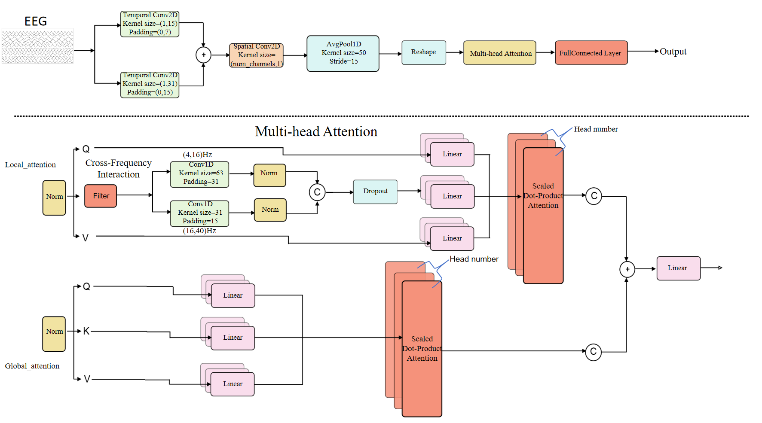
The proposed network architecture consists of three main components: a feature extraction module, a cross-frequency interaction self-attention module, and a classification module.The design is as follows:

Slide 6
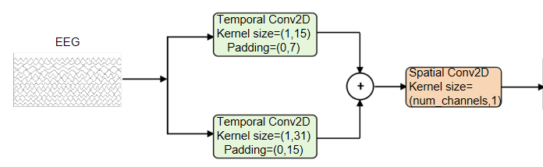
Feature extraction module
We designed a two-dimensional convolutional layer with two different kernel sizes to extract temporal information. The kernel sizes were set to (1, 15) and (1, 31). We performed element-wise addition on the feature maps obtained from the two convolutional layers. Subsequently, we used a spatial convolutional layer with a kernel size of C × 1 to extract features from different channels.

Slide 7
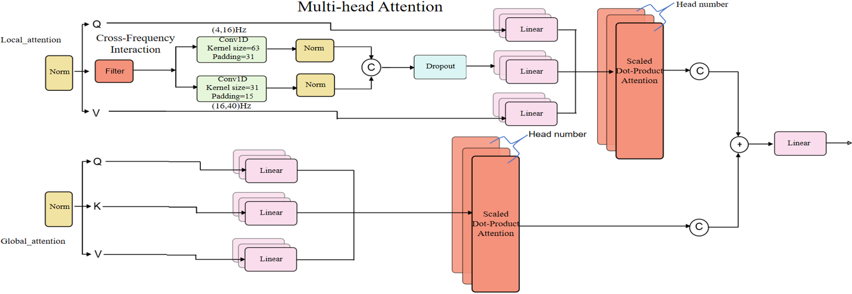
Cross-frequency interaction self-attention module
As a core innovation of IFANet, this module is designed to enhance EEG decoding performance by capturing the interrelationships between different frequency bands. The module utilizes cross-frequency interaction features and global features through a multi-head attention framework.

Slide 8
Experiment
Three widely-used public MI-EEG datasets were employed, covering varied classification difficulties and data scales:
BCIC-IV-2A: 9 subjects, 22 channels, 4-class movements, 250 Hz sampling;
BCIC-IV-2B: 9 subjects, 3 channels, 2-class movements, includes standard train/test splits;
HGD: 14 subjects, 44 channels (covering motor-related regions), 4-class movements, 250 Hz sampling.

Slide 9
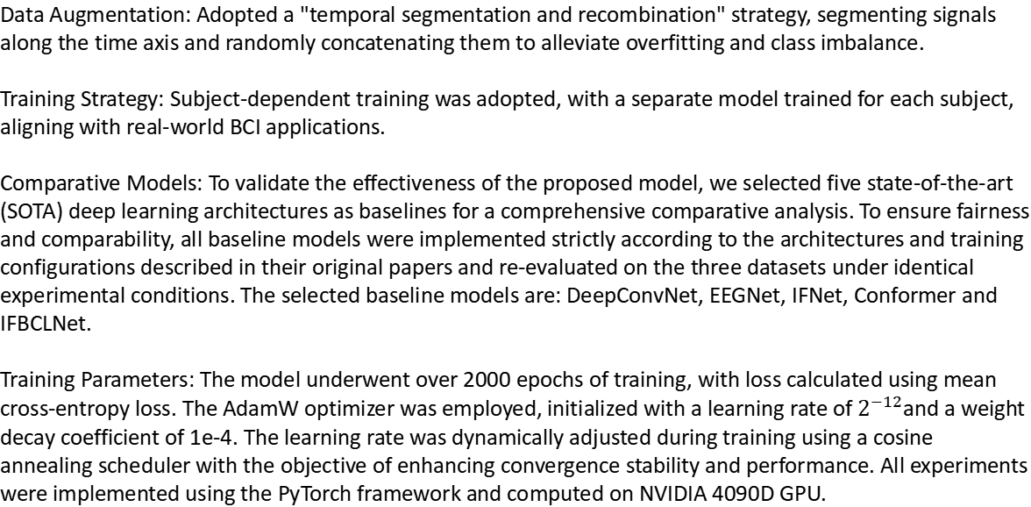
Data Augmentation: Adopted a "temporal segmentation and recombination" strategy, segmenting signals along the time axis and randomly concatenating them to alleviate overfitting and class imbalance.
Training Strategy​​: Subject-dependent training was adopted, with a separate model trained for each subject, aligning with real-world BCI applications.
​​Comparative Models​​: To validate the effectiveness of the proposed model, we selected five state-of-the-art (SOTA) deep learning architectures as baselines for a comprehensive comparative analysis. To ensure fairness and comparability, all baseline models were implemented strictly according to the architectures and training configurations described in their original papers and re-evaluated on the three datasets under identical experimental conditions. The selected baseline models are: DeepConvNet, EEGNet, IFNet, Conformer and IFBCLNet.
Training Parameters: The model underwent over 2000 epochs of training, with loss calculated using mean cross-entropy loss. The AdamW optimizer was employed, initialized with a learning rate of $2^{−12}$and a weight decay coefficient of 1e-4. The learning rate was dynamically adjusted during training using a cosine annealing scheduler with the objective of enhancing convergence stability and performance. All experiments were implemented using the PyTorch framework and computed on NVIDIA 4090D GPU.
Experimental Design

Slide 10
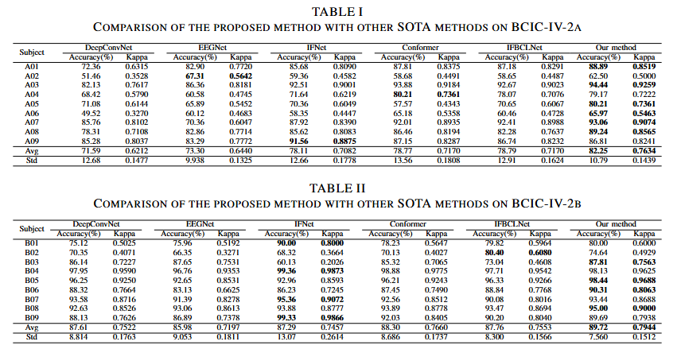
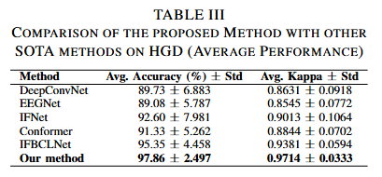
Results
Our model's classification performance on the three datasets is shown below:

Slide 11
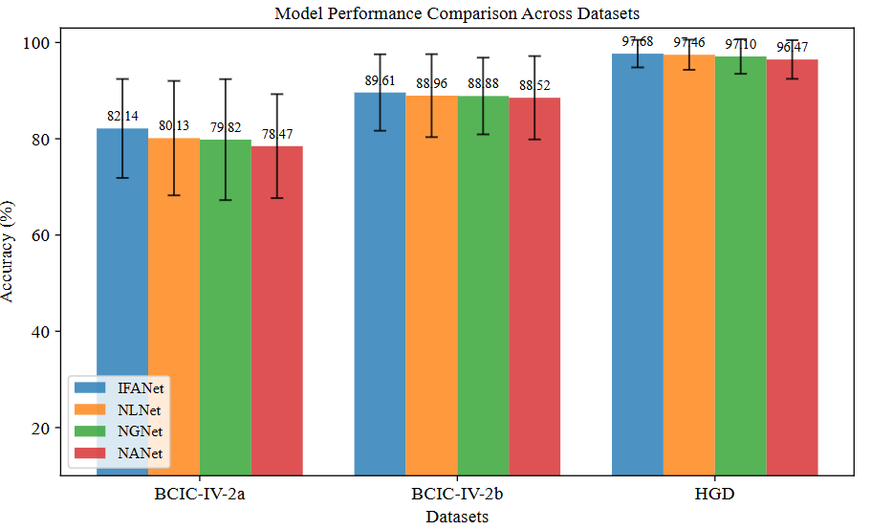
Ablation Studies
Three variant models were constructed in order to evaluate the impact of attention mechanisms and cross-frequency interactions. The first model (NLNet) did not include a local attention layer, the second model (NGNet) did not include a global attention layer, and the third model (NANet) did not include any attention mechanism. The elimination of the local attention layer facilitates the evaluation of the significance of cross-frequency interaction features in terms of overall model performance. In a similar manner, the removal of the global attention layer facilitates the evaluation of the contribution of global features. The elimination of all attention mechanisms provides an in-depth assessment of their cumulative impact on model performance.

Slide 12
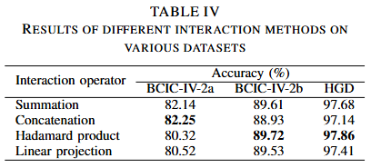
In order to evaluate the impact of cross-frequency interactions on model performance, experiments were conducted with different interaction operations. These experiments further illustrate the effect of cross-frequency interactions on model performance by employing various interaction operators. On the BCIC-IV-2a dataset, Concatenation achieved the best performance because it only performs channel stacking without mixing numerical values, thus preserving the most complete original discriminative information. Conversely, in the BCIC-IV-2b and HGD datasets, the Hadamard product outperforms other operations.

Slide 13
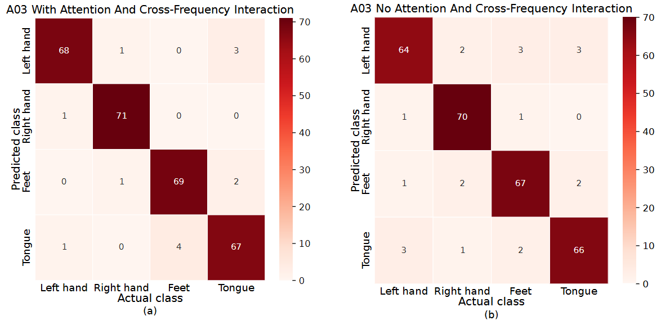
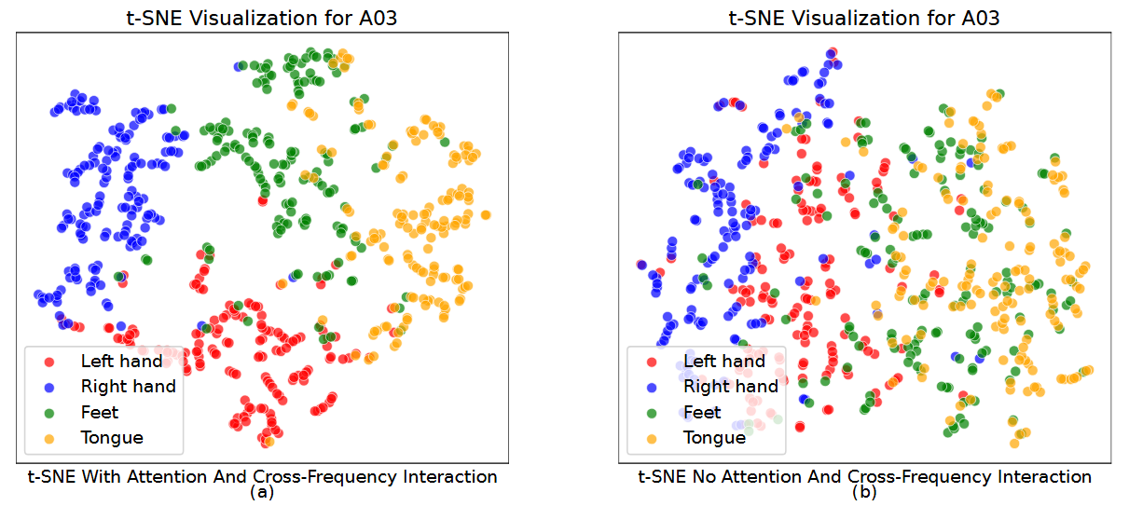
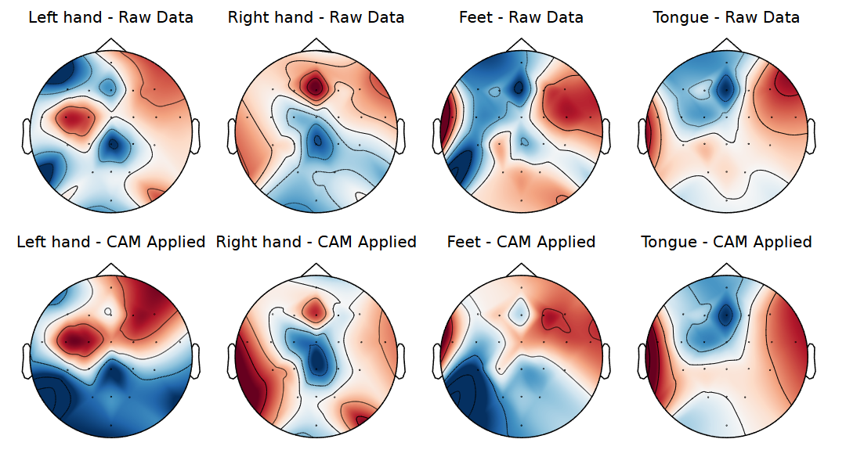
Visualization
We used confusion matrices, t-SNE, and Grad-CAM for visualization.

Slide 14
Conclusion
This research introduces IFANet, a novel network for MI-EEG decoding that combines cross-frequency interactions with attention mechanisms. Experiments on three public datasets demonstrate that IFANet significantly outperforms existing state-of-the-art models. The efficacy and interpretability of the core components of the model are validated by ablation studies and Grad-CAM visualisations, respectively, thus highlighting its potential for practical applications in brain-computer interfaces. Subsequent research will concentrate on optimising real-time performance and cross-subject generalisation.

Slide 15
That’s all for my sharing.
Thank you all for your listening!
I welcome your questions and discussions.

