Slide 1

Cognify: A Mobile-Optimized Edge Architecture for 4-Channel EEG Cognitive State Classification
Alessia Ioana Brinzarea Iamandi
Monta Vista High School
Cupertino, CA, USA

Slide 2
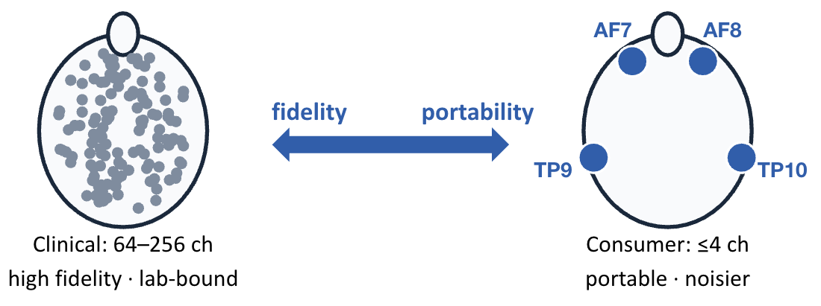
Motivation
The Problem
Obstacles
30-40% of high-school students report burnout, often undetected until performance declines
Cognitive lapses are safety-critical in aviation and driving
Mobile devices cannot sustain 128-channel compute, memory, or thermal load
Consumer-EEG studies are small (typically fewer than 30 subjects) which limits generalizability

Slide 3
Related Work, The Gap, and Objectives
High Density DL
LaBraM: state of the art
  >1 GB, 64+ channel attention
Sparse-channel
EEGNet: compact CNNs work
  Successors target 22-62 channels
Sparse LOSO is small
Romaniuk: 70% accuracy, N=123
ID3RSNet: 74.7% accuracy, N=11
Task taxonomy
Natalizio et al.: Active/Passive on 128-channel HBN
Sparse-channel LOSO evaluations remain small (largest tabulated: N=123) and none of the compared systems runs on a phone.
The Gap:
1,232-subject LOSO study at 4 channels
On-device mobile interference
Attention-based temporal visualization
1
2
3

Slide 4
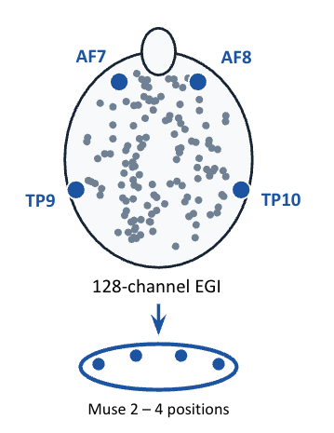
Approach and Classification
Data
11 public OpenNeuro datasets from Healthy Brain Network
Identical 128-channel EGI net, identical montage, 500 Hz
Training pool
  6 datasets (ds005505 – ds005510)
  1,232 subjects
  Ages 5-21
Channel restriction
Extract TP9, AF7, AF8, TP10 (Muse 2 positions) from clinical recordings
  Simulates consumer channel count
  Preserves wet-electrode signal equality
Labels
ACTIVE (42%)
PASSIVE (58%)
Labels reflect the external task condition → task-type classification
Contrast Change Detection
Sequence Learning
Symbol Search
Resting State
Movie Watching
Surround Suppression
!

Slide 5
The System
1
2
3
4
5
6
4-ch EEG
4 s segments
50% overlap
168 features
7-segment
window (16 s)
BiLSTM +
Transformer
prediction +
attention timeline
Preprocessing: FIR bandpass 1-50 Hz
Downsample 256 Hz
Reject > 150 µV
95% retained (1,734,491/1,825,656)
Per-subject z-score
168 features per 4 s segment
Input shape
7 * 168 = 1,176 values
116
42
10
116 per channel
Stats, Hjorth, entropy, band powers, ratios
42 connectivity (6 pairs)
Coherence, phase-locking,
PAC
10 bilateral
asymmetries
Mobile-compatible footprint

Slide 6
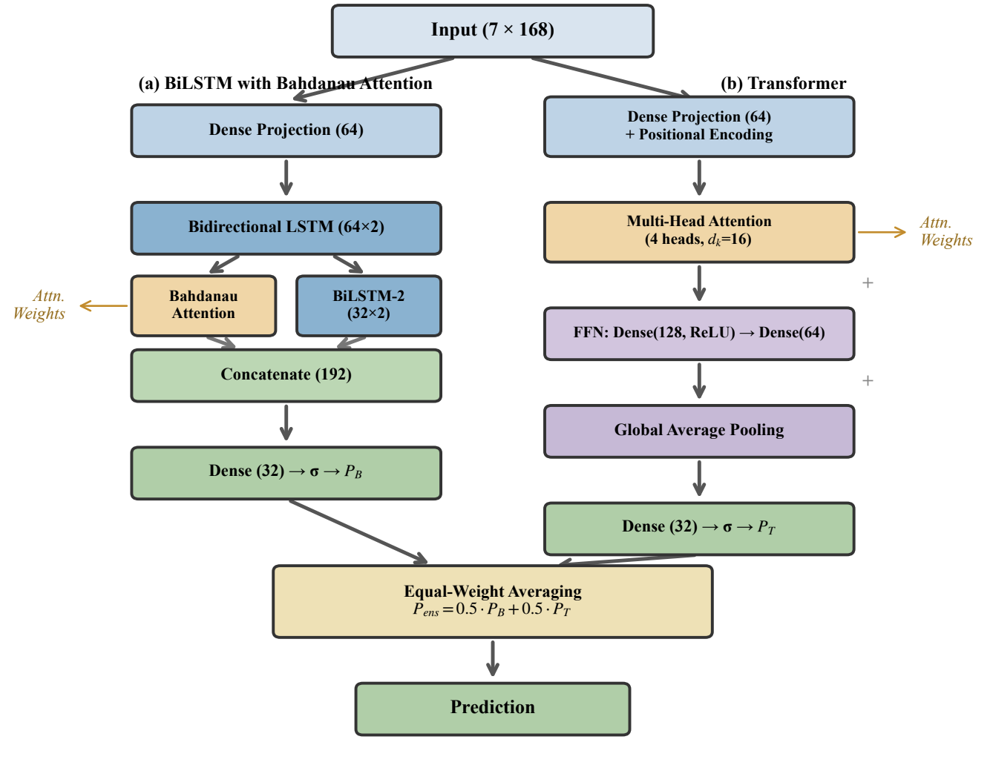
Ensemble Architecture
BiLSTM + Bahdanau attention
~148k parameters
616 KB TFLite order-sensitive temporal dependencies (recurrent gating)
Transformer, 4-head self-attention
~69k parameters
198 KB TFLite all-pairs interactions among segments
Ensemble (static, all inference steps)
Used for the held-out evaluation
The deployed app runs a ten-model production ensemble (5 BiLSTM + 5 Transformer) to reduce prediction variance
Fig. 1: (a) BiLSTM with Bahdanau attention. (b) Transformer with four-head self-attention.

Slide 7
Validation Protocol
Leave-One-Subject-Out
Metric: AUC
Ranks active above passive across all thresholds
… x1,232
0.5 = coin flip
1.0 = perfect
Train on remaining 1,231 → repeat x1,232
Every subject scored by models trained without that subject’s data
Exclusions
1,232
1,118
1,104
all subjects
~114 single-class
~14 outliers
Statistics
BCa bootstrap 95% Cls (10,000 iterations)
One-sided Wilcoxon signed-rank
Holm-Bonferroni correction
Sensitivity check: including the 14 outliers shifts the headline AUC by -0.005 (inside the reported CI)

Slide 8
Primary Results & Baselines
1
0.8400
FULL COHORT · 1,104 subjects
Ensemble (ours)
0.8400
Transformer
0.8252
Ensemble AUC = 95% CI [0.8343, 0.8453]
1,104 of 1,232 subjects (after fixed exclusion rules)
BiLSTM
0.8243
CNN baseline
0.7940
SAME 1,176 INPUTS, FLATTENED · ds005505 subset, N=121
matched Ensemble
0.8144
Ensemble > both base models (p<0.001)
Bases tie (Δ = -0.0009, p=0.717)
RF flattened
0.6913
MLP flattened
0.6875
−0.123 AUC vs best flattened
Same 1,176 flattened inputs
0.123 AUC lost on the matched cohort (0.8144 vs 0.6913)
Temporal, attentive modeling is the differentiator
0.70
0.75
0.80
0.85
AUC - chance = 0.50, off-scale
Table I: Comparing Cognify with previous models and baselines.

Slide 9
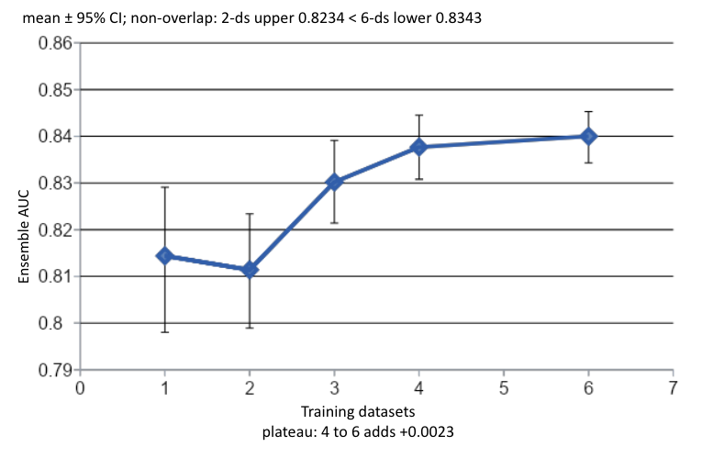
Dataset Scaling
6 datasets: AUC 0.8400 [0.8343, 0.8453]
N = 1,104
Identical hyperparameters at every scale
6-dataset lower CI bound (0.8343) > 2-dataset upper bound (0.8234)
  Non-overlapping
4 to 6 datasets
  +0.0023
  Suggests a plateau within this recording protocol
Table III: Ensemble AUC as a function of training dataset count, with
identical hyperparameters across all configurations.

Slide 10
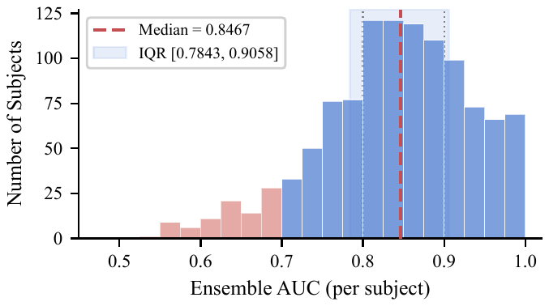
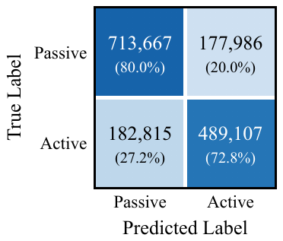
Per-Subject Variability & Confusion Matrix
Median 0.8467
IQR [0.7843, 0.9058]
70.5% of subjects > 0.80
27.8% > 0.90
Aggregated over 1,563,575 test sequences
Passive (majority class) 80.0%
Active 72.8%
Overall 76.9%
BUT
90 subjects (8.2%) < 0.70
Minimum 0.5355
Fig. 3: Per-subject ensemble AUC distribution across 1,104 subjects.
Fig. 4: Aggregated confusion matrix over 1,563,575 test segments.

Slide 11
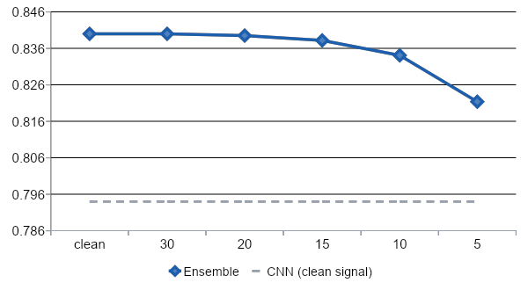
Noise Robustness
Ensemble AUC
SNR (dB): noise increases to the right
Table IV: Noise sensitivity across 1,104 subjects.

Slide 12
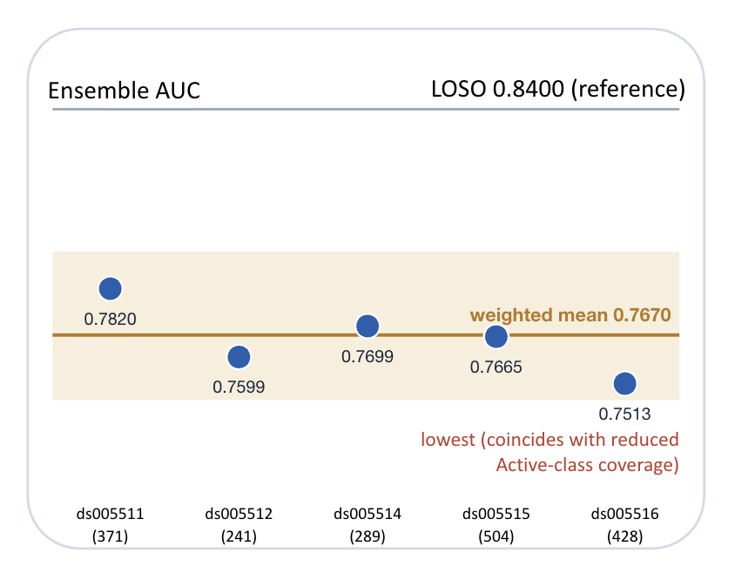
Held-Out Generalization
0.7670
Weighted mean AUC (1,833 subjects)
5 datasets never used for training, tuning, or any design decision (all within 0.7500-0.7900)
Per-subject mean: 0.7660 [0.7563, 0.7748]
1231 evaluable
602 single-class excluded (same rule as LOSO)
Same acquisition protocol
  Tests distribution shift
  Reduced task coverage
Table V: Held-out dataset evaluation on 5 unseen test datasets.

Slide 13
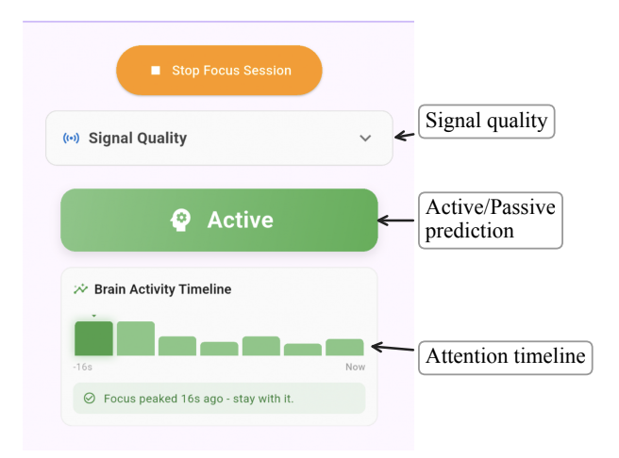
Mobile Deployment
2
Entire pipeline on Android phone
Offline
No account
No data leaves the device
Models on disk (4.1 MB)
10-model TFLite ensemble
5 Transformer, 5-fold production training
Deployed-model estimate
5-fold AUC = 0.7728; threshold = 0.40
  Consistent with the held-out band
Fig. 2: Cognify mobile application during a live focus session.
Runtime heap (63 MB)
the whole pipeline runs on the phone
Latency (Pixel 6 Pro, 369 cycles)
Median 87.3 ms; p95 100.3 ms
1
2
3
4
5
6
only ① differs: clinical setup vs consumer headband

Slide 14
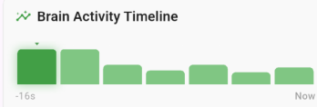
Attention Analysis
3
Averaged into the app’s 7-segment timeline (zero extra inference cost, dual-output models)
Transformer: distributed (>99.7% of maximum entropy)
BiLSTM: selective (29.6x the attention-weight variability)
Attention patterns describe model behavior. They are not validated neuropsychological markers.
!

Slide 15
Limitations & Future Work
Limitation
Planned remedy
Classifies task type (active/passive) but not graded internal fatigue
Collect recordings with appropriate fatigue labels; extend to continuous estimation
Clinical wet electrodes (95% segment retention) vs dry consumer reality (65% reported)
Muse 2 recordings under the same active/passive protocol to measure the transfer gap directly
Cohort aged 5-21, lab environment
Adult cohorts; naturalistic classroom and workplace validation
Mobile evaluation is computational (latency, memory) but not yet empirical on consumer EEG
On-device validation with consumer hardware (explicit next step)

Slide 16
Conclusion
Task-state classification is feasible at four channels
1
1
AUC 0.8400 [0.8343, 0.8453]; LOSO over 1,232 subjects, 1,104 evaluated after fixed exclusions
Fits on a phone
2
4.1 MB; 87.3 ms median latency; fully online
3
Attention weights give users a temporal view
At zero extra inference cost
Generalization
0.7670 on 1,833 subjects across 5 fully held-out datasets

Slide 17
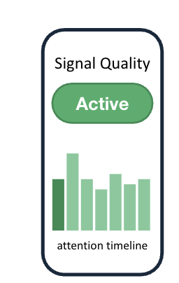
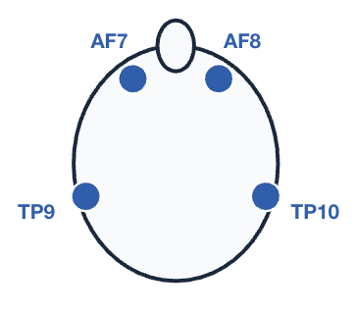
Thank you!
Alessia Ioana Brinzarea Iamandi
alessia.brinzarea@gmail.com
Monta Vista High School, Cupertino, CA, USA

Slide 18
References
JP. Koutsimani, A. Montgomery, and K. Georganta, “The relationship between burnout, depression, and anxiety: A systematic review and meta-analysis,” Front. Psychol., vol. 10, art. 284, 2019, doi: 10.3389/fpsyg.2019.00284.
D. J. Madigan and T. Curran, “Does burnout affect academic achievement? A meta-analysis of over 100,000 students,” Educ. Psychol. Rev., vol. 33, no. 2, pp. 387–405, 2021, doi: 10.1007/s10648-020-09533-1.
B. C. Tefft, “Drowsy driving in fatal crashes, United States, 2017–2021,” AAA Found. Traffic Safety, Washington, DC, USA, Res. Brief, 2024. [Online]. Available: https://aaafoundation.org/drowsy-driving-in-fatal-crashes-united-states-2017-2021/.
N. Bigdely-Shamlo, J. Touryan, A. Ojeda, C. Kothe, T. Mullen, and K. Robbins, “Automated EEG mega-analysis I: Spectral and amplitude characteristics across studies,” NeuroImage, vol. 207, art. 116361, 2020, doi: 10.1016/j.neuroimage.2019.116361.
W.-B. Jiang, L.-M. Zhao, and B.-L. Lu, “Large Brain Model for learning generic representations with tremendous EEG data in BCI,” in Proc. Int. Conf. Learn. Representations, 2024. [Online]. Available: https://arxiv.org/abs/2405.18765.
Y. Song, Q. Zheng, B. Liu, and X. Gao, “EEG Conformer: Convolutional Transformer for EEG decoding and visualization,” IEEE Trans. Neural Syst. Rehabil. Eng., vol. 31, pp. 710–719, 2023, doi: 10.1109/TNSRE.2022.3230250.
V. J. Lawhern et al., “EEGNet: A compact convolutional neural network for EEG-based brain–computer interfaces,” J. Neural Eng., vol. 15, no. 5, art. 056013, 2018, doi: 10.1088/1741-2552/aace8c.
V. Romaniuk and A. Kashevnik, “Cross-dataset emotion valence prediction approach from 4-channel EEG: CNN model and multi-modal evaluation,” Big Data Cognit. Comput., vol. 9, no. 11, art. 280, 2025, doi: 10.3390/bdcc9110280.
A. Natalizio et al., “Real-time estimation of EEG-based engagement in different tasks,” J. Neural Eng., vol. 21, no. 1, art. 016014, 2024, doi: 10.1088/1741-2552/ad200d.
X. Feng, Z. Guo, and S. Kwong, “ID3RSNet: cross-subject driver drowsiness detection from raw single-channel EEG with an interpretable residual shrinkage network,” Front. Neurosci., vol. 18, art. 1508747, 2024, doi: 10.3389/fnins.2024.1508747.

