Slide 1


WORKSHOP ON BRAIN-MACHINE INTERFACES
IEEE SMC 2026 | October 4–7, 2026
A Brain–Eye–Hand Multimodal Human–Robot Interface: Design and Validation
Hongxin Li, Pengmin Zhu, Yaru Liu*, Yimin Hu, Junhao Xiao, Zongtan Zhou
College of Intelligence Science and Technology,
National University of Defense Technology
Notes:
Good morning everyone. Today I will present our work, titled A Brain-Eye-Hand Multimodal Human-Robot Interface: Design and Validation. The motivation behind this work is simple: multimodal human-robot interaction has made impressive progress in decoding physiological signals, but many systems still stay at the level of offline paradigms or simulated demonstrations. Our goal is to connect brain, hand, and eye signals with a real multi-robot semi-physical platform, and to validate the entire loop from human intention to robot execution.

Slide 2
Motivation: multimodal HRI needs physical validation
Existing gaps
Physiological HRI research often focuses on paradigms and decoding algorithms.
Physical robot validation is difficult because it requires scene configuration, localization, communication and safety.
The gap slows down the transfer from laboratory intent decoding to real robotic applications.
EEG
EMG
Eye gaze
Robots
Validation
Key question: Can multimodal physiological intent decoding be validated in a practical multi-robot task loop?
Notes:
Let me first introduce the problem. Human-robot interaction based on physiological signals is attractive because it can interpret intention more naturally. However, many studies stop at designing signal paradigms or improving decoding accuracy. The robot side is often simplified, because building a reliable experimental robot environment is expensive and time-consuming. This creates a clear gap: we need a platform where EEG, EMG, and eye tracking can be tested together, with real robot execution and measurable task performance. This is the gap our work tries to address.

Slide 3
Research goal and contributions
Goal
Build a Brain–Eye–Hand multimodal interface that integrates EEG, EMG and eye tracking with a multi-robot semi-physical experimental platform.
1
Unified interaction
EEG selects targets, EMG switches modes, and eye gaze plans robot trajectories.
2
Versatile platform
Researchers can change scenarios and robot tasks without rebuilding the hardware/software environment.
Single-modal tests and a comprehensive multimodal multi-robot task verify end-to-end functionality.
3
Rigorous validation
End-to-end loop: physiological acquisition → intent decoding → robot execution → visual feedback
Notes:
The research goal is to build a complete Brain-Eye-Hand multimodal interface for robotic validation. The first contribution is unified interaction: different physiological signals are assigned to complementary roles. EEG is used for target selection, EMG for mode switching and discrete commands, and eye tracking for continuous trajectory planning. The second contribution is a versatile platform. It supports multiple experimental scenarios and reduces the engineering cost of robotic validation. The third contribution is rigorous validation, including both single-modality functional tests and a multi-stage robot formation task.

Slide 4
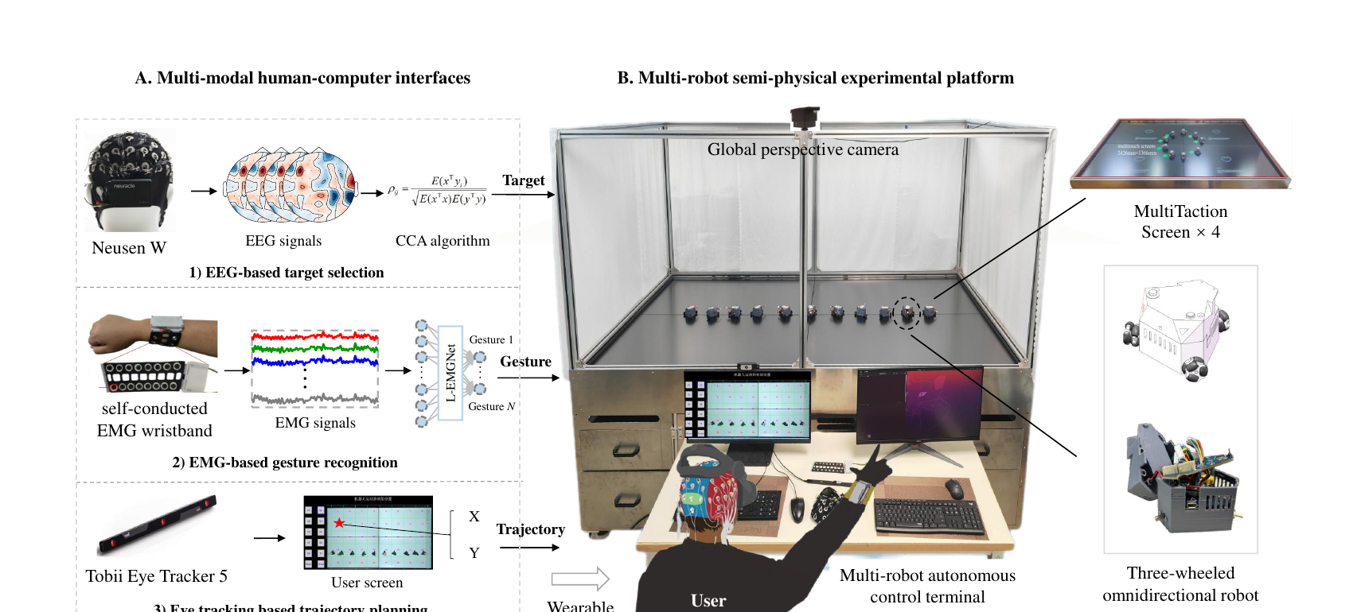
Overall architecture of BEH‑MMHRI
Human–Robot Interaction System:
acquisition + intent decoding
Multi‑Robot Semi‑Physical Experimental System: robot control + scene rendering
Notes:
This slide shows the overall architecture. The system is divided into two subsystems. On the left, the human-robot interaction system continuously monitors three modalities: EEG, EMG, and eye movement. Each modality is decoded into a different type of interactive command. On the right, the multi-robot semi-physical experimental system executes the commands with physical mobile robots on a large display surface. The important point is that the architecture is not just a collection of sensors. It forms a closed loop from physiological signal acquisition, to intent decoding, to robot control and visual feedback.

Slide 5
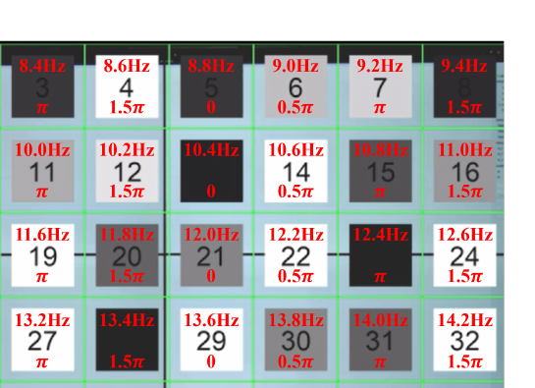
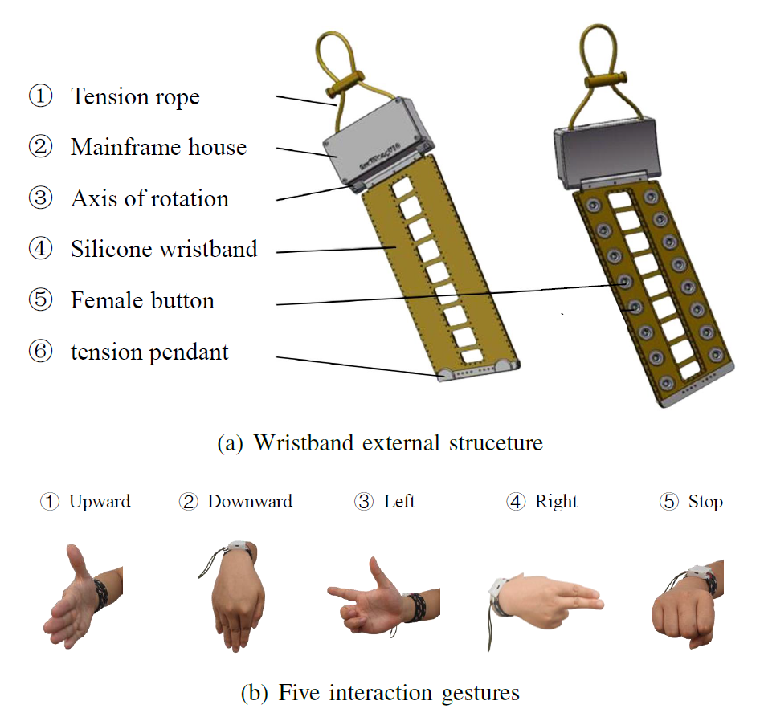
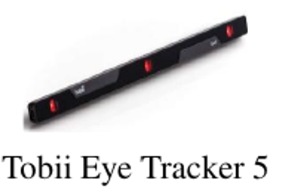
Brain–Eye–Hand interaction roles
Brain / EEG
Hand / EMG
Eye / Gaze
Target selection through SSVEP and CCA decoding
Gesture commands for mode switching and robot motion
Continuous trajectory planning through gaze points
Design principle: use each modality for the command type it expresses most naturally.
Notes:
The interaction design follows a decoupling principle. Instead of forcing one modality to handle every command, each modality is used for the task it is best suited to. EEG is used for selecting targets because SSVEP can support multiple discrete choices. EMG is used for gestures and mode switching because hand movements are fast and intuitive. Eye tracking is used for trajectory planning because gaze naturally provides continuous spatial information. This division is important because multi-robot tasks require both discrete decisions and continuous planning.

Slide 6
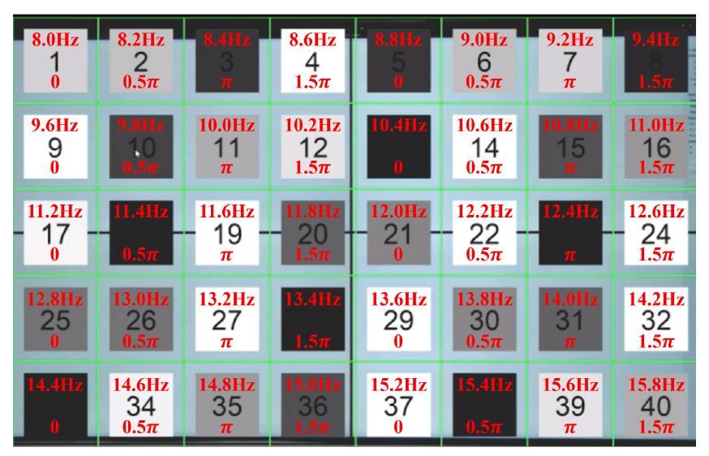
EEG-based target selection
Paradigm design
• 4×10 checkerboard stimulus grid for the single-modal target selection task.
• 40 blocks flicker from 8 to 15.8 Hz with 0.2 Hz increments.
• CCA decoding uses eight occipital channels from the 64-channel EEG amplifier.
Role in comprehensive task
• The target set is reduced from 40 regions to 12 robot-ID choices.
• The user selects formation members from 10 robots using SSVEP.
97.56%
average EEG target-selection accuracy
EEG provides reliable discrete selection for multi-robot decision points.
Notes:
For the EEG module, we use the steady-state visual evoked potential paradigm. In the single-modal test, the visual field is divided into a four-by-ten checkerboard grid, giving forty possible target locations. Each stimulus flickers at a unique frequency and phase. EEG data are collected with a 64-channel amplifier, but decoding uses the occipital channels, where SSVEP responses are strongest. Canonical correlation analysis is used for training-free frequency recognition. In the comprehensive task, the same idea is adapted to select robot IDs rather than regions.

Slide 7
EMG-based gesture recognition
Hardware and signals
• Self-conducted EMG wristband with eight electrode pairs.
• 500 Hz sampling rate; 20–150 Hz bandpass and 50 Hz notch filtering.
• 250 ms processing window with 125 ms step for real-time command output.
Interaction gestures
• Single-modal task: upward, downward, left, right and stop.
• Comprehensive task: Rock, Scissors, Paper, L-Shape and OK-Shape for state control.
93.84%
accuracy at 250 ms window
≈0.3 s
robot response after gesture
Gesture control replaces a remote controller with a natural command channel.
7
Notes:
The EMG module provides fast discrete commands. Instead of using a conventional remote controller, the user performs predefined hand gestures. The system uses a wrist-worn EMG device with eight electrode pairs, which is suitable for capturing fine-grained wrist and finger movements. After filtering, the signals are classified by a lightweight neural network, L-EMGNet. Although longer windows can slightly improve accuracy, we use the 250-millisecond window in the comprehensive experiment because it gives a better trade-off between accuracy and real-time response.

Slide 8
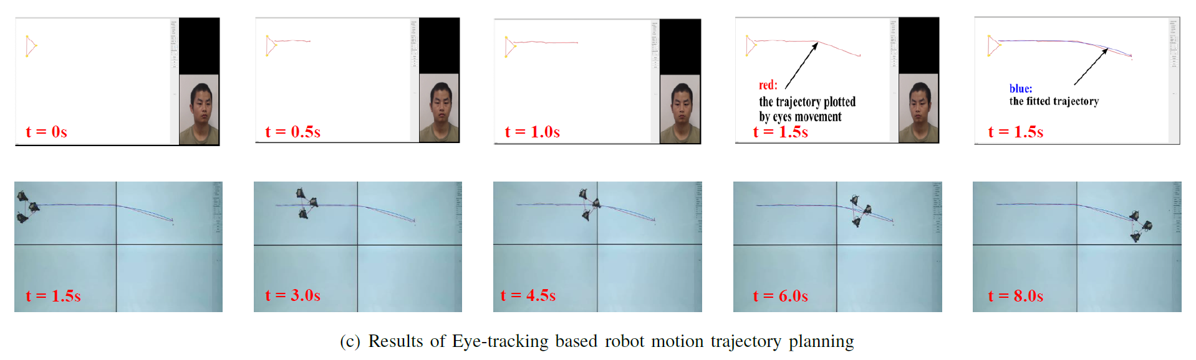
Eye-tracking based trajectory planning
Trajectory extraction
• Tobii Eye Tracker 5 captures gaze points in real time.
• The output gaze stream is converted into a raw trajectory.
• A fitted trajectory is generated for robot formation motion.
Why gaze works here
• It expresses spatial intention directly.
• It avoids discrete step-by-step path input.
• It supports intuitive formation-level motion planning.
In the full task, EMG starts and stops the gaze drawing process, replacing keyboard input.
Notes:
The eye-tracking module is responsible for continuous trajectory planning. The user looks at points on the interaction screen, and the system records the gaze stream over time. In the single-modal test, the red curve represents the raw gaze trajectory, and the blue curve represents the adjusted robot trajectory. This is a natural way to specify paths, especially for formation-level motion, because the user can draw an intended route with the eyes instead of selecting many discrete waypoints. In the comprehensive task, EMG gestures control when the gaze drawing begins and ends.

Slide 9
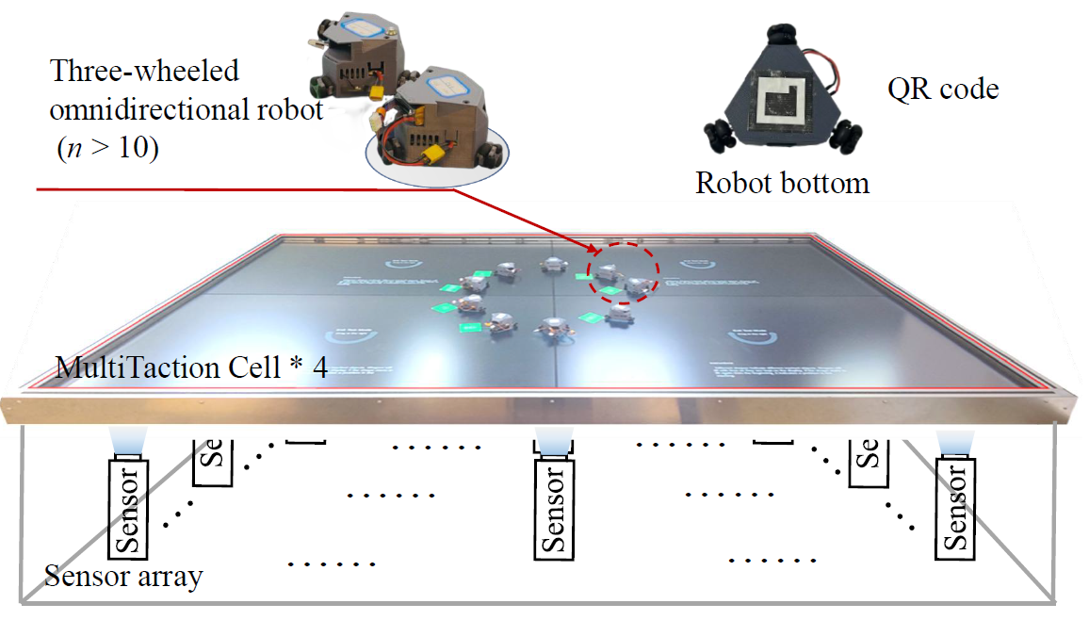
Multi-robot semi-physical experimental system
Platform components
• Four MultiTaction Cell screens form a large interactive display array.
• More than ten three-wheeled omnidirectional robots execute formation tasks.
• Screen tracking and QR code recognition provide position and state information.
Benefit
• No extra localization sensor is needed on each robot.
• Experimental scenes and robot states can be visualized dynamically.
• The platform lowers the cost of robotic validation.
MSES makes physical validation repeatable, visible and scalable.
Notes:
The robot-side system is the multi-robot semi-physical experimental system. It consists of four MultiTaction Cell screens, multiple three-wheeled omnidirectional robots, and an overhead camera. The screens do more than display the environment. They also support object tracking and can provide robot position and state information through markers or QR codes. This means that small robots do not need to carry expensive localization sensors. As a result, the system becomes easier to scale and easier to reconfigure for different human-robot interaction experiments.

Slide 10
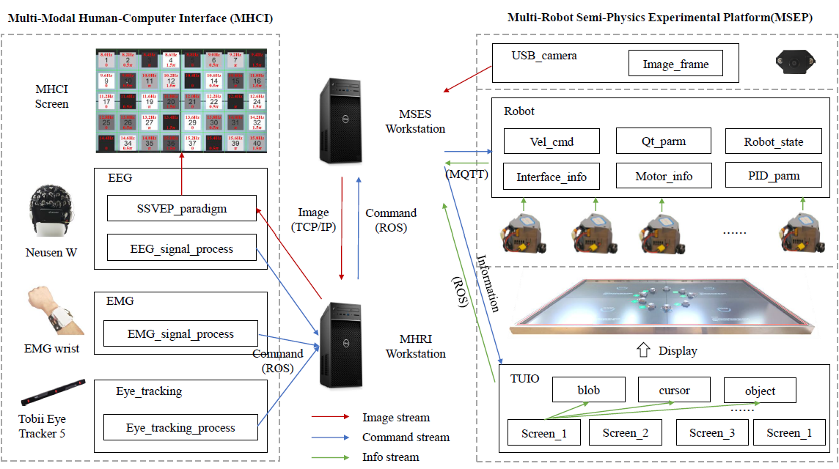
Software framework design
Data flow
• Image streams: camera and screen information.
• Command streams: decoded EEG, EMG and gaze commands.
• Information streams: robot states, interface status and parameters.
Implementation choice
• HRIS modules are encapsulated as ROS nodes.
• MQTT is used for communication with small robots where full ROS is costly.
• The design is lightweight, flexible and scalable.
The framework keeps multimodal sensing and robot control synchronized in real time.
Notes:
The software framework connects the human-side modules with the robot-side platform. On the workstation, the system uses ROS nodes for the interaction modules and the robot control logic. However, many small mobile robots cannot run a full ROS instance because of limited computing resources. Therefore, the authors use MQTT as a lightweight communication bridge. The framework organizes the transmitted information into image streams, command streams, and information streams. This structure improves scalability and makes it easier to add new modalities or new robot tasks later.

Slide 11
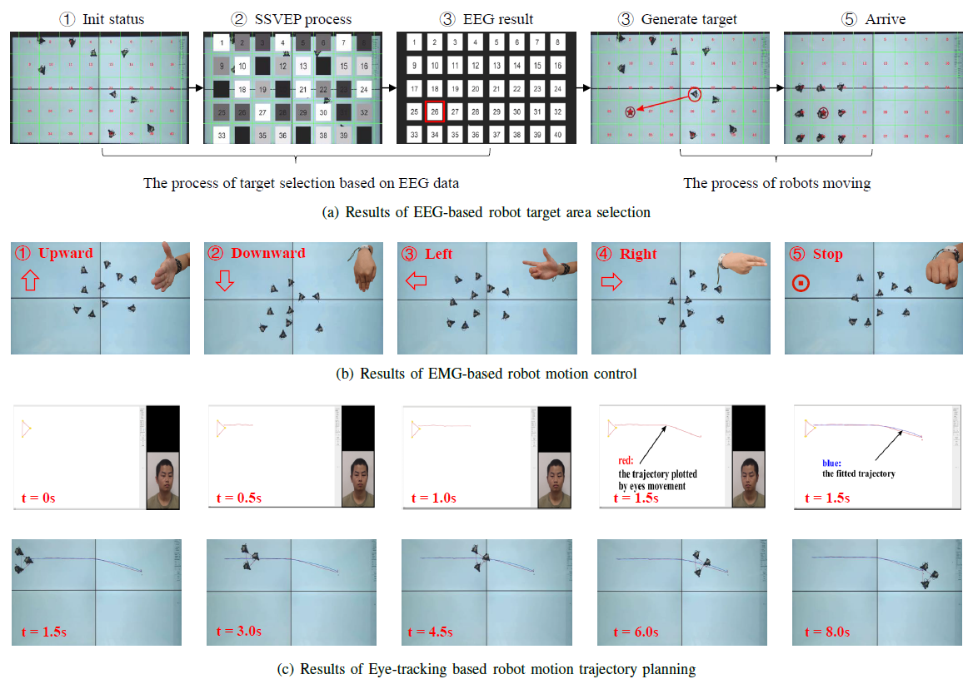
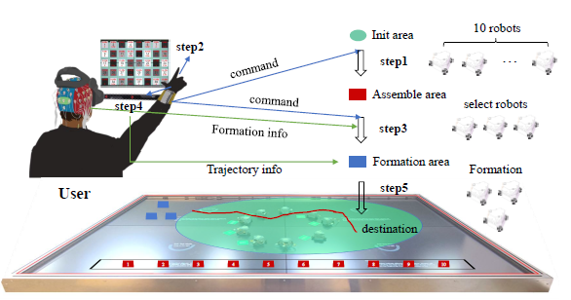
Experimental validation strategy
Phase 1: single-modal tests
Phase 2: comprehensive task
Verify EEG target selection, EMG robot motion and eye-gaze trajectory planning separately.
Integrate all modalities to assemble robots, select formation members and move along a gaze-planned path.
Notes:
The validation strategy has two phases. First, each modality is tested independently. The EEG module is tested in a robot target area selection task. The EMG module is tested by using gestures to control robot motion. The eye-tracking module is tested by drawing a trajectory and asking robots to follow the generated path. After these single-modal tests, the authors move to a comprehensive task where all modalities are integrated. This progressive strategy is important because it allows us to verify both the individual functions and the end-to-end multimodal workflow.

Slide 12
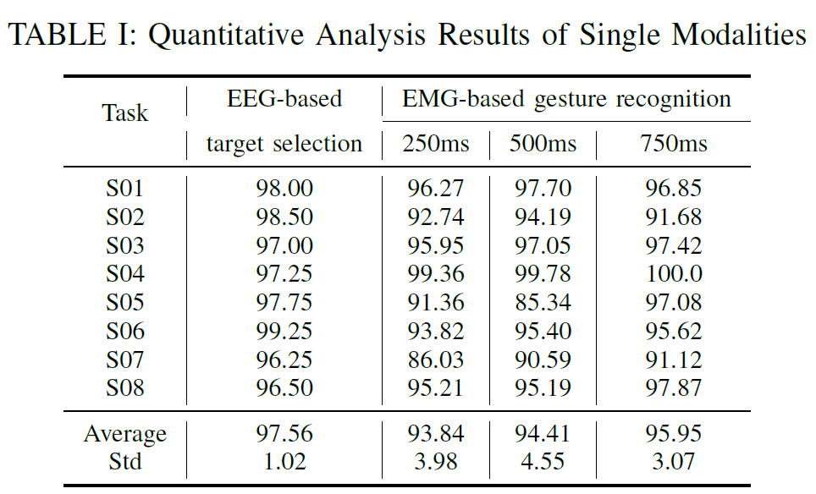
Single-modal quantitative results
Average accuracy (%)
97.56%
95.95%
93.84%
94.41%
EEG
target
EMG 250ms
EMG 500ms
EMG 750ms
97.56%
EEG average
93.84%
EMG @ 250 ms
95.95%
EMG @ 750 ms
The 250 ms EMG window is selected because it keeps accuracy high while preserving faster command output.
Notes:
The quantitative results show strong single-modal performance. The EEG-based target selection task reaches an average accuracy of 97.56 percent with a small standard deviation. For EMG gesture recognition, the average accuracy improves as the window length increases: 93.84 percent at 250 milliseconds, 94.41 percent at 500 milliseconds, and 95.95 percent at 750 milliseconds. However, the accuracy gain from a longer window is limited, while the response speed becomes slower. Therefore, the system uses the 250-millisecond window in the comprehensive task to maintain real-time interaction.

Slide 13
Comprehensive multimodal task design
1
Assemble all robots
2
Select 3 of 10 robots
3
Move to formation area
4
Draw trajectory by gaze
5
Move formation to destination
Modality mapping: EMG controls task states • EEG selects robot IDs • Eye tracking plans trajectory
Notes:
The comprehensive experiment is designed as a multi-stage collaboration task. Ten robots are randomly distributed on the screen. First, all robots move to an assembly area. Then the user selects three robots from the ten available robots to form a formation. After that, the selected robots move to a formation area. The user then plans a trajectory using eye tracking, and finally the formation moves to the destination along the generated path. This task requires coordination among all three modalities, so it is a strong validation of the complete BEH-MMHRI system.

Slide 14
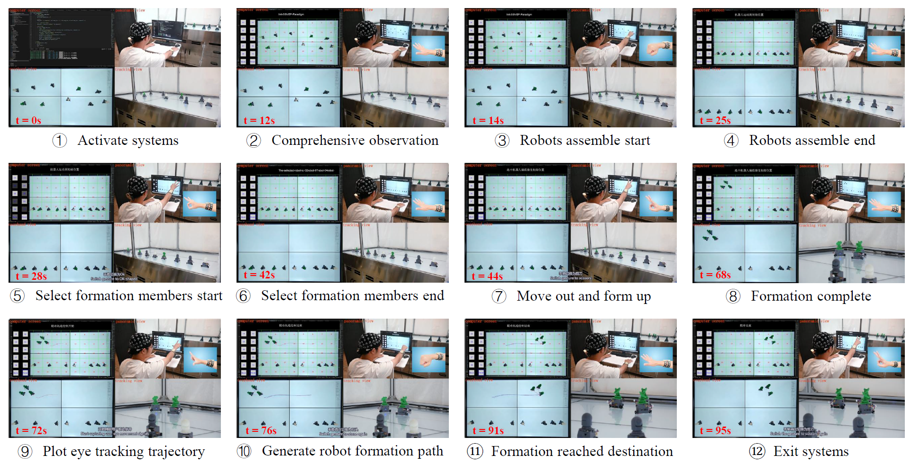
Comprehensive experiment results
12 s
system initialized
25 s
all robots assembled
68 s
formation complete
91 s
destination reached
95 s
session exit
Notes:
This slide shows the full experimental process. The system initialization finishes within 12 seconds, giving the user immediate feedback about robot positions. A Rock gesture triggers assembly, and all robots converge by 25 seconds. The user then activates the SSVEP selection process and selects robots 2, 4, and 7. After that, the selected robots move out and form the formation, which is complete at 68 seconds. At 72 seconds, gaze-based trajectory planning begins, and the formation reaches the destination at 91 seconds. This result demonstrates that the system can orchestrate a complex multi-stage HRI task.

Slide 15
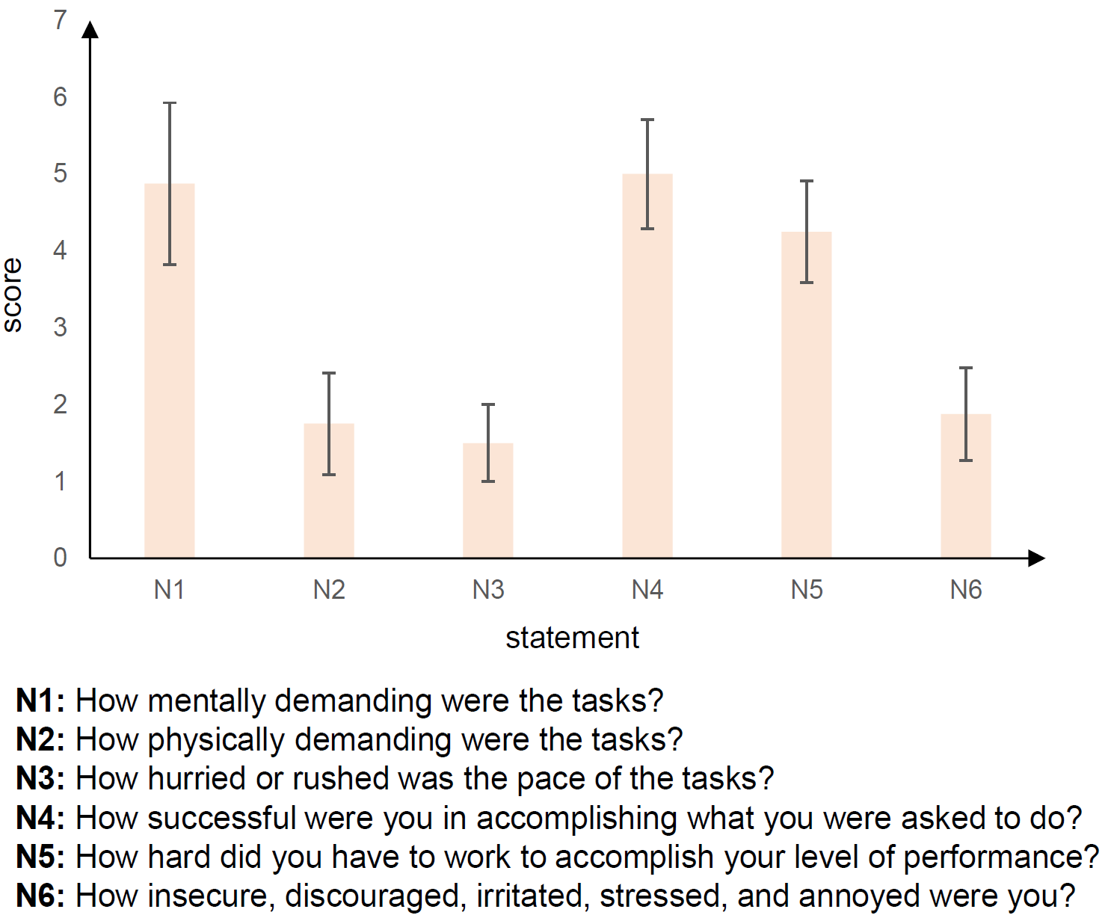
Usability, latency and remaining limitations
NASA‑TLX highlights
• Physical demand: 1.75±0.66; temporal demand: 1.50±0.50.
• Frustration: 1.88±0.60, suggesting the interaction framework is intuitive.
• Performance rating: 5.00±0.71, indicating high task-success confidence.
Latency and limitations
• EEG computation latency: 38.5 ms; EMG latency: 32.6 ms; communication latency: 12.3 ms.
• Current focus is system-level integration rather than new decoding algorithms.
• Future work: asynchronous fusion and closed-loop error monitoring.
Takeaway: low latency + low frustration support the platform as a practical benchmark for complex HRI.
Notes:
The discussion focuses on usability, latency, and limitations. The NASA-TLX assessment shows low physical demand, low temporal demand, and low frustration. This suggests that the multimodal decoupling strategy is intuitive and does not introduce unnecessary cognitive burden. The system is also responsive: the EEG module has an average computation latency of 38.5 milliseconds, the EMG module has 32.6 milliseconds, and the communication latency is about 12.3 milliseconds. However, there are still limitations. The current study focuses on system integration, and future work should add asynchronous fusion and closed-loop error correction.

Slide 16
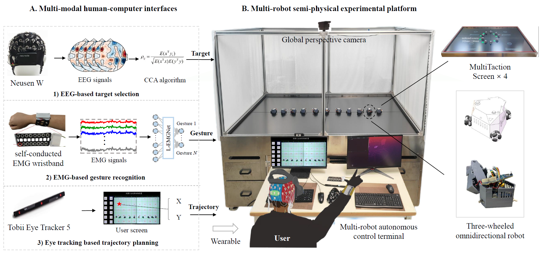
Conclusion
Key messages
• A unified Brain–Eye–Hand interface integrates EEG, EMG and gaze for complementary robot commands.
• The semi-physical multi-robot platform reduces the cost of physical HRI validation.
• Single-modal and comprehensive experiments demonstrate accuracy, usability and real-time responsiveness.
Thank you — Q & A
Notes:
To conclude, this work proposes BEH-MMHRI, a unified Brain-Eye-Hand multimodal human-robot interface. The core idea is to assign EEG, EMG, and eye tracking to complementary interaction roles, and to validate these signals in a real multi-robot semi-physical environment. The experiments show that the platform can support accurate single-modal interaction, real-time multimodal task execution, and usable human-robot collaboration. In future work, the platform can be extended with more advanced multimodal fusion and closed-loop error correction. Thank you for your attention, and I am happy to take questions.

