Slide 1


A Comparative Analysis of SVD-Enhanced FBCCA for High-Speed SSVEP-BCI Communication
Paper No: 358
Sofie Marie Møller Nielsen, Linn Marie Ploug, and Sadasivan Puthusserypady
Technical University of Denmark
Department of Health Technology
Biomedical Signal Processing Group
Notes:
Sofie
Hi everyone. We are Sofie and Linn from the Biomedical Signal Processing Group at the Technical University of Denmark.
Together with Professor Sadasivan Puthusserypady, we investigated whether Singular Value Decomposition can improve high-speed SSVEP-based BCI communication.

Slide 2
Motivation
Motivation
Methods
Results
Discussion
Conclusion
Can we make a SSVEP-based BCI faster without sacrificing reliability?
Short gaze time
Fast selection
Short gaze time
Less EEG data
Lower SNR
Harder frequency recognition
How can we maintain reliable frequency recognition while reducing the required gaze time?
Notes:
“Can we make an SSVEP-based BCI faster without sacrificing reliability?”
[PAUSE — eye contact]
“For a high-speed BCI, we want to recognize the target as quickly as possible.”
[CLICK 1]
“Shorter gaze times allow faster selections.”
[PAUSE]
“But this comes at a cost.”
[CLICK 2]
“Shorter gaze times also mean that we have less EEG data available for classification.”
“And with less data, the SSVEP response can be more difficult to distinguish from the background EEG, making frequency recognition more challenging.”’
[CLICK 3]
[brief pause — look back at audience]
“So the question we asked was: How can we maintain reliable frequency recognition while reducing the required gaze time?”

Slide 3
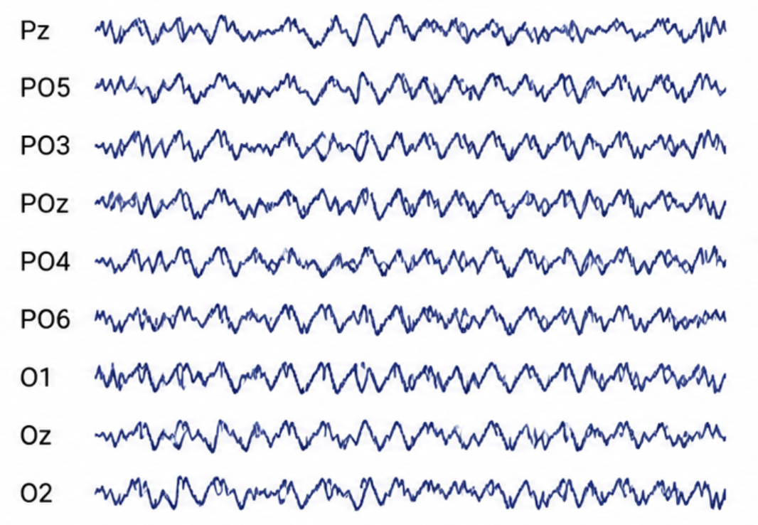
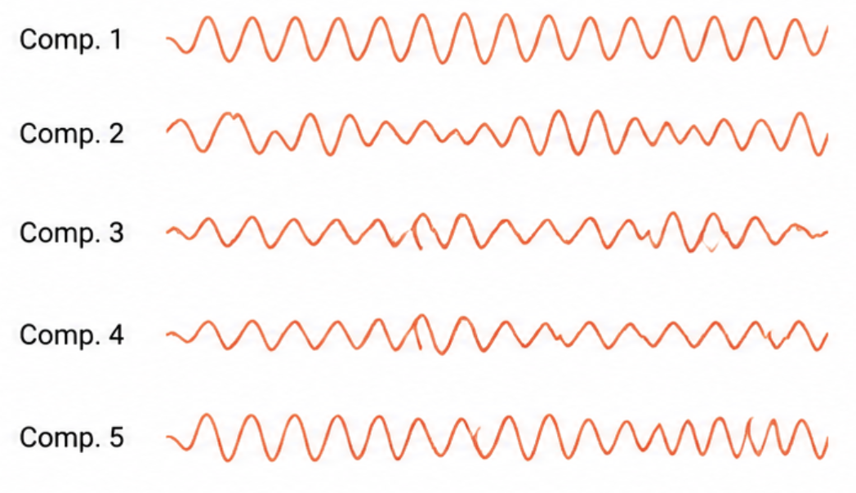
Why Singular Value Decomposition?
Motivation
Methods
Results
Discussion
Conclusion
9-channel EEG
Parietal and occipital channels
Dominant components
Reduced representation
SVD
Improve CCA and FBCCA performance, particularly at short gaze durations
Right-hand figure created with assistance from ChatGPT (OpenAI)
Notes:
So, if shorter gaze times give us less EEG data and make frequency recognition more difficult, the question becomes:
Can we make better use of the data we do have?”
[PAUSE]
This is where Singular Value Decomposition, or SVD, comes in.
[CLICK]
We start with EEG recorded from nine parietal and occipital channels. But not everything contained in these signals is equally informative.
[CLICK]
[CLICK]
SVD allows us to decompose the multichannel EEG into dominant components, while reducing components that contribute less information
[CLICK]
The idea is therefore simple: retain the most informative structure before performing frequency recognition, with the aim of improving CCA and FBCCA — particularly at short gaze durations.

Slide 4
Study Objective
Motivation
Methods
Results
Discussion
Conclusion
Can SVD improve correlation-based SSVEP frequency recognition by reducing redundant and less informative signal components?
Notes:
“And this leads us to the main objective of our study:”
[PAUSE — eye contact]
“Can SVD improve correlation-based SSVEP frequency recognition by reducing redundant and less informative signal components?”

Slide 5
Experimental Data
Introduction
Methods
Results
Discussion
Conclusion
35 Subjects 40 Visual targets 64 EEG channels recorded 6 Blocks per subjects
Benchmark dataset
250 Hz sampling rate after downsampling 8.0–15.8 Hz stimulation frequencies in 0.2-Hz increments
Data used in our
analysis
9 parietal/occipital channels Pz · PO5 · PO3 · POz · PO4 · PO6 · O1 · Oz · O2
140 ms latency correction | 0.5–5.6 s gaze windows
[7] Y. Wang, X. Chen, X. Gao, and S. Gao, “A benchmark dataset for ssvep-based brain-computer interfaces,” IEEE Transactions on Neural Systems and Rehabilitation Engineering, vol. 25, pp. 1746–1752, 10 2017.
Notes:
Sofie
“To evaluate this, we used a widely used public SSVEP benchmark dataset.”
“It contains recordings from 35 subjects responding to 40 visual targets, with stimulation frequencies ranging from 8 to 15.8 hertz.”
[CLICK]
For our analysis, we selected 9 parietal and occipital channels, where the SSVEP response is most prominent.
We evaluated gaze windows ranging from 0.5 to 5.6 seconds.

Slide 6
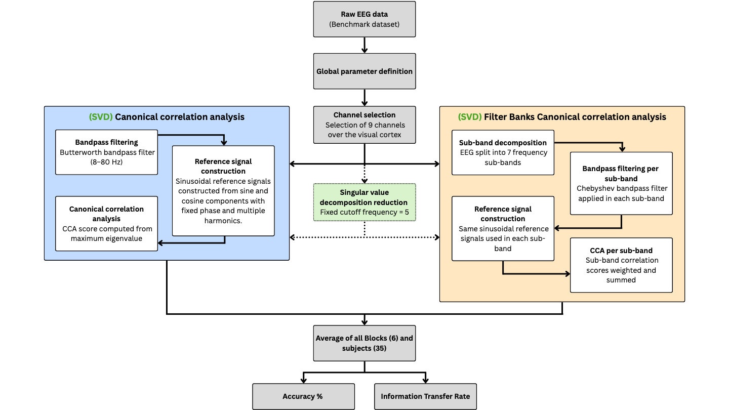
Analysis Pipeline
Introduction
Methods
Results
Discussion
Conclusion
Pipeline is created with Miro
Notes:
Linn
“So, how did we investigate this?”
[CLICK 1]
“We started with the raw EEG data and selected nine channels over the visual cortex, where the SSVEP response is most prominent.”
“We then used two correlation-based methods for frequency recognition:
[CLICK 2/3 — CCA side]
CCA and
[CLICK 2/3 — FBCCA side]
Filter Bank CCA.”
[CLICK — SVD]
“And this is where we introduced SVD.”
“We applied dimensionality reduction before frequency recognition, giving us two additional methods: SVD-CCA and SVD-FBCCA.”
[CLICK — bottom]
“Finally, we compared all four methods based on accuracy and information transfer rate.”

Slide 7
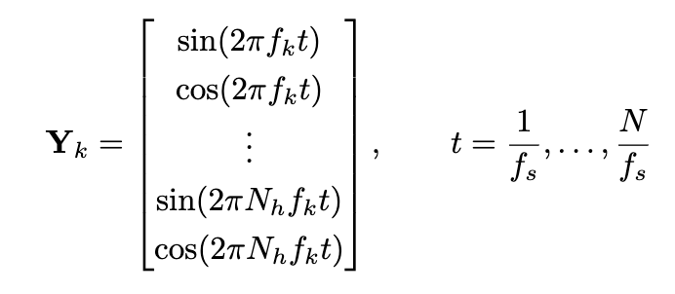
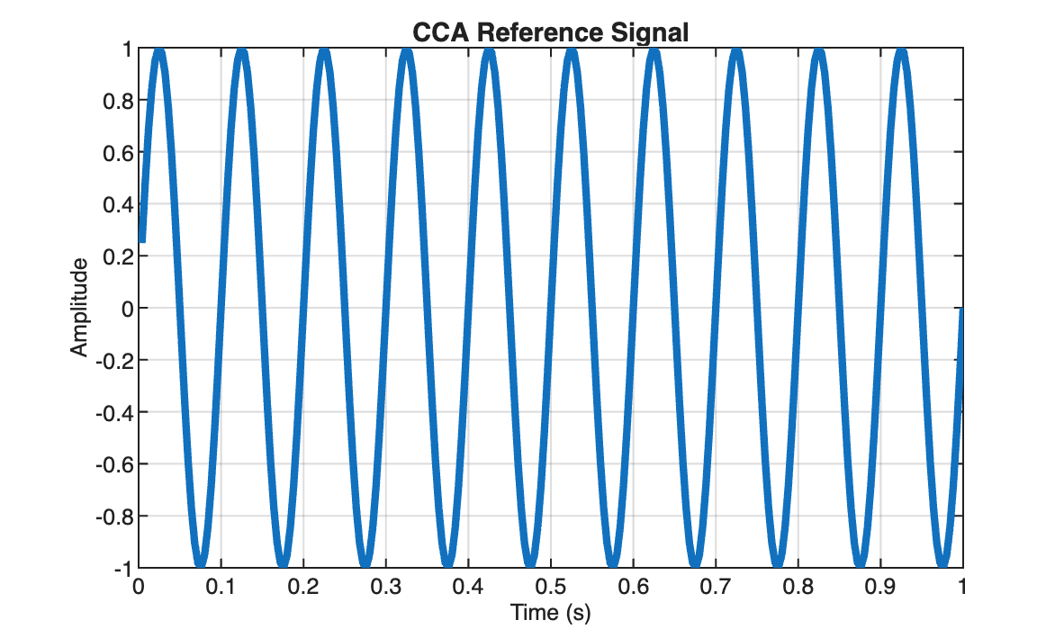
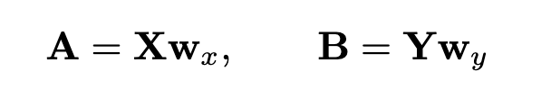
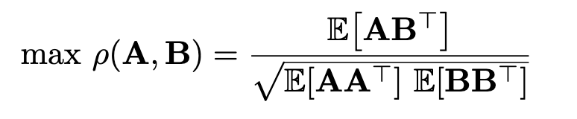
Canonical Correlation Analysis
Frequency Recognition
Introduction
Methods
Results
Discussion
Conclusion
Goal of CCA: Identify stimulus frequency
Reference signals constructed from sine and cosine waves at candidate frequencies:
Decision rule
Compute correlation for each candidate frequency
Recognized frequency = maximum correlation
[11] Z. Lin, C. Zhang, W. Wu, and X. Gao, “Frequency recognition based on canonical correlation analysis for ssvep-based bcis,” IEEE Transactions on Biomedical Engineering, vol. 53, pp. 2610–2614, 12 2006.
Notes:
Sofie
“For frequency recognition, we first use CCA as our baseline method.”
[CLICK]
“The goal is to identify which stimulus frequency best matches the recorded EEG.”
[CLICK]
“For each candidate frequency, we construct reference signals using sine and cosine waves at the fundamental frequency and five harmonics.”
[CLICK]
“CCA then finds the linear combinations of the EEG and reference signals that maximize their correlation.”
“The candidate with the highest correlation is selected as the recognized frequency.”

Slide 8
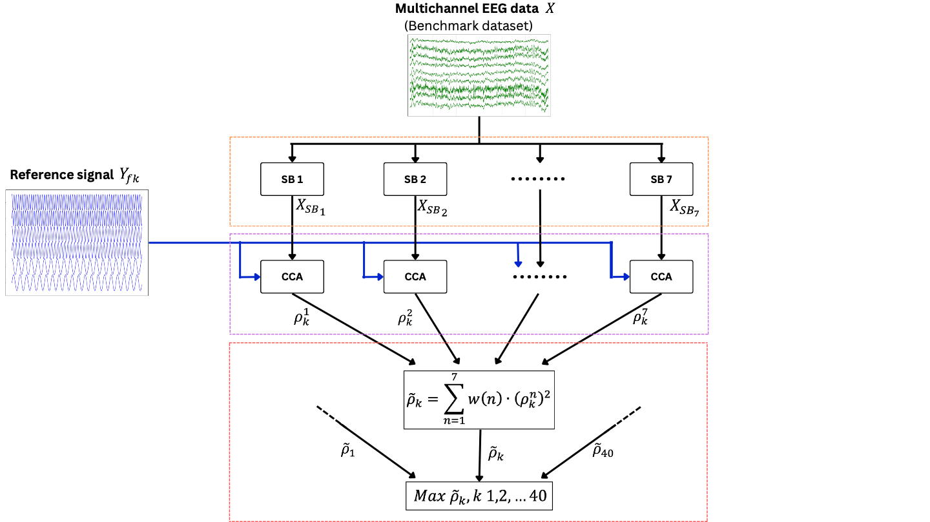
Introduction
Methods
Results
Discussion
Conclusion
Filter Bank Canonical Correlation Analysis
Sub Band Frequency Recognition
Figure adapted from [15] and modified in Miro to reflect the benchmark dataset and the processing pipeline used in this study.
[15] X. Chen, Y. Wang, S. Gao, T. P. Jung, and X. Gao, “Filter bank canoncal correlation analysis for implementing a high-speed ssvep-based brain-computer interface,” Journal of Neural Engineering, vol. 12, 8 2015.
Notes:
Linn
“The second frequency-recognition method we evaluated is Filter Bank CCA, or FBCCA.”
[CLICK 1 – filter bank]
“Instead of analysing the EEG as a single broadband signal, FBCCA first decomposes it into multiple overlapping frequency sub-bands. In our study, we used seven sub-bands.”
“This allows the SSVEP information — including the fundamental frequency and its harmonics — to be evaluated across different frequency ranges.”
[CLICK 2 – CCA]
“CCA is then applied separately within each sub-band, using reference signals representing each candidate frequency and its harmonics.”
[CLICK 3
“This gives us a correlation score for each candidate frequency within each sub-band.”
[CLICK 4 – weighted score]
“These correlation scores are then combined using a weighted sum, allowing the different sub-bands to contribute differently to the final score.”
[CLICK 5 – maximum]
“Finally, we obtain one combined score for each of the 40 candidate frequencies,
[CLICK 6
and the frequency with the highest score is selected as the predicted target.”

Slide 9
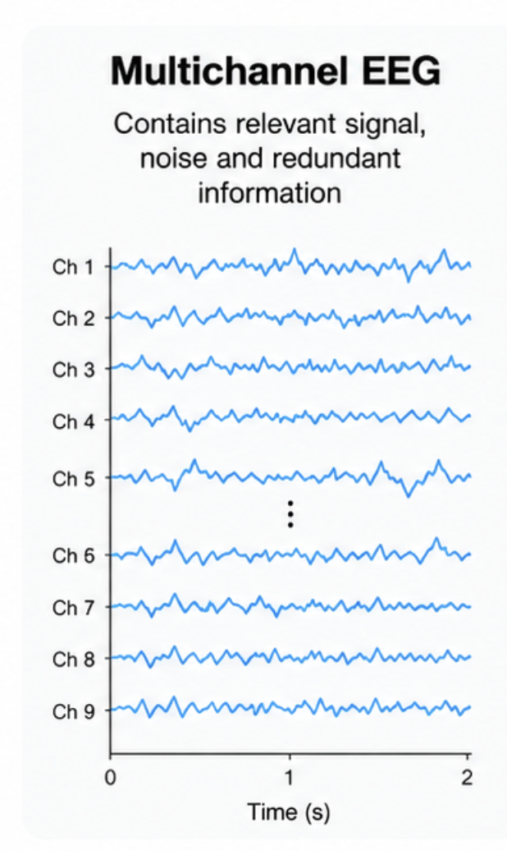
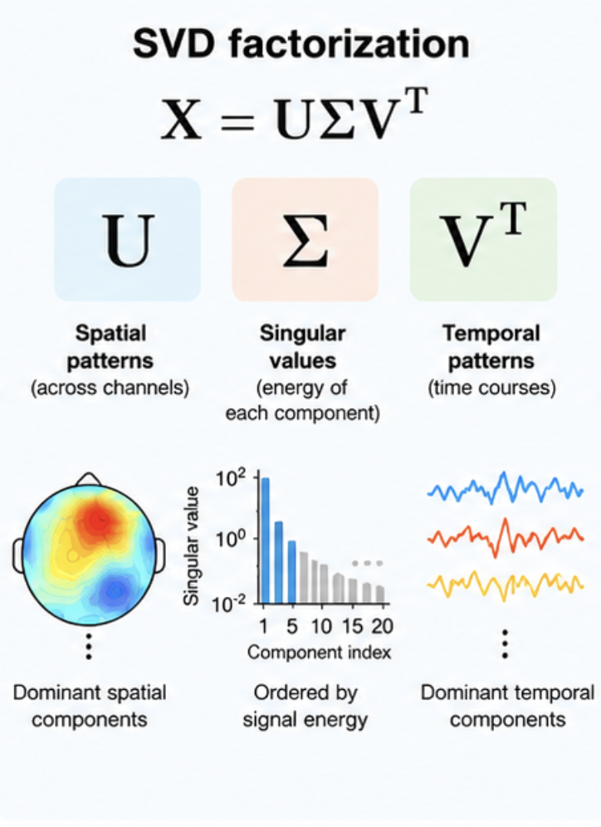
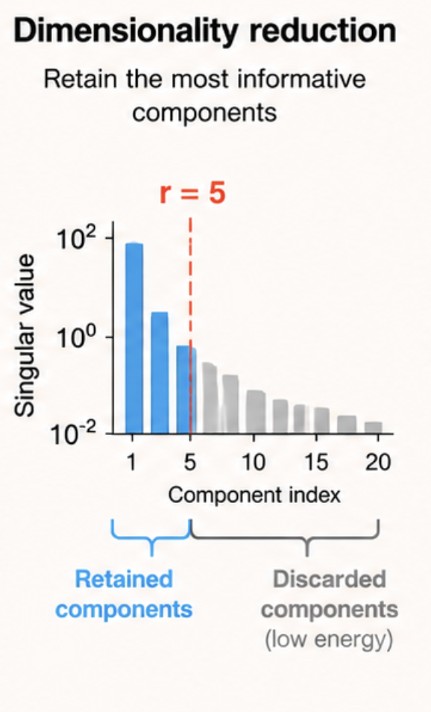
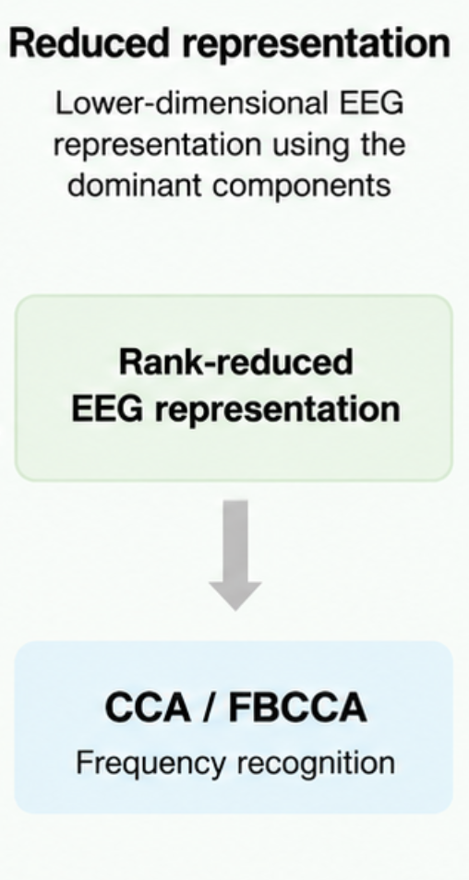
Introduction
Methods
Results
Discussion
Conclusion
Singular Value Decomposition
Enhancement of CCA & FBCCA
Notes:
[CLICK]
“Before applying CCA or FBCCA, we introduce SVD to reduce redundant and noisy information.”
[CLICK]
“SVD decomposes the multichannel EEG into spatial patterns, singular values, and temporal patterns.”
“The components are ordered by the size of their singular values, with larger singular values representing a greater contribution to the signal.”[CLICK]
“We then retain the dominant components and remove the lower-energy components.”
[CLICK]
“This gives us a lower-dimensional representation of the EEG, which is then used for CCA and FBCCA.”

Slide 10
Evaluation Framework
Introduction
Methods
Results
Discussion
Conclusion
Metrics
Classification Accuracy | ITR
F1 | Cohen’s 𝜿
Experimental Setup
Results averaged across subjects and blocks
Fixed latency at 140 ms
Methods
Baseline: CCA and FBCCA
SVD-enhanced: SVD-CCA and SVD-FBCCA
5] F. B. Vialatte, M. Maurice, J. Dauwels, and A. Cichocki, “Steady-state visually evoked potentials: Focus on essential paradigms and future perspectives,” pp. 418–438, 4 2010.
Notes:
CLICK 1 — Performance Metrics
“So, how do we actually determine whether SVD improves performance?”
[pause]
“We evaluated performance using classification accuracy, F1-score, information transfer rate, and Cohen’s kappa — with accuracy and ITR as our main performance measures.”
CLICK 2 — Evaluation Setup
“Results were averaged across all subjects and blocks, using a fixed latency of 140 milliseconds.”
CLICK 3 — Method Comparison
“And most importantly, we directly compared our two baseline methods — CCA and FBCCA — against their SVD-enhanced versions — SVD-CCA and SVD-FBCCA.”

Slide 11
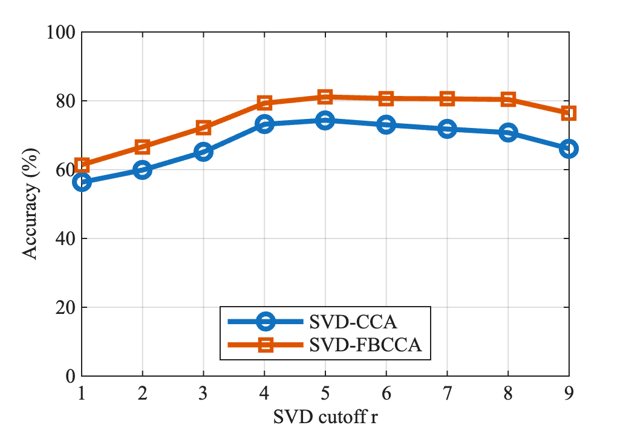
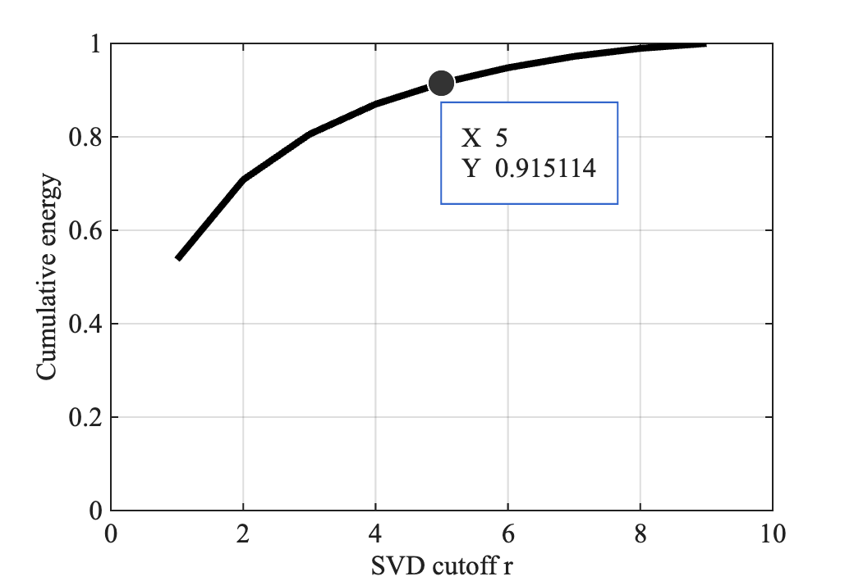

Sensitivity Analysis of SVD Cutoff Parameter
Introduction
Methods
Results
Discussion
Conclusion
Sensitivity Analysis of SVD Cutoff
Average Cumulative Energy of SVD Components
Peak performance occurs at $r=5$
~92% of the signal energy is retained at r=5
More information is not necessarily more useful information
Notes:
“But how much dimensionality reduction should we actually apply?”
[PAUSE — audience]
“To determine this, we performed a sensitivity analysis of the SVD cutoff, (r).”
[CLICK 1 – left plot]
“And what we see is that performance initially improves as we retain more components.”
[gesture along the rising curve]
“But only up to a point.”
[PAUSE]
“Peak performance occurs at a cutoff of five components.”
[CLICK 2 – right plot]
“At this cutoff, those five components retain approximately 92% of the cumulative signal energy.”
[PAUSE]
“Interestingly, retaining additional components increases the captured energy…”
[gesture toward the right end of the curve]
“…but it does not improve classification performance.”
[PAUSE — audience]
“So, more information is not necessarily more useful information.”

Slide 12
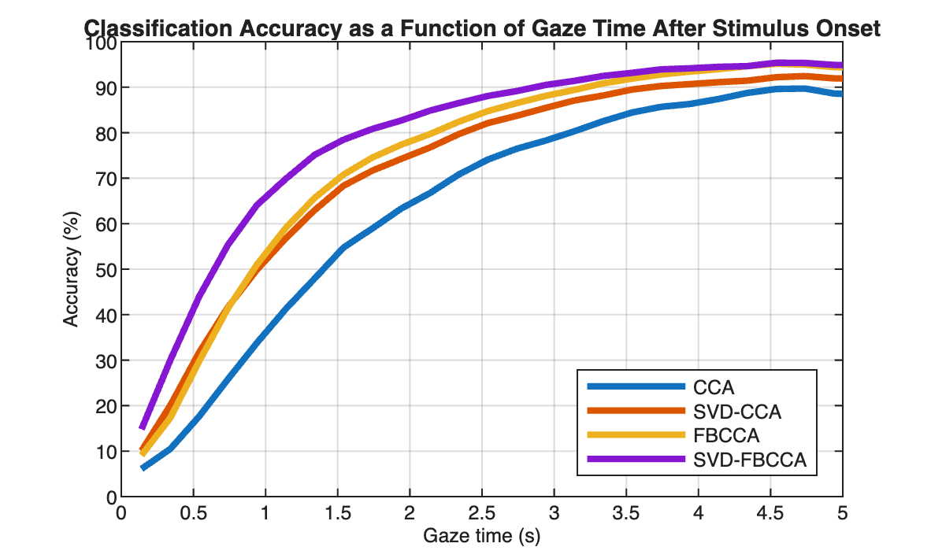
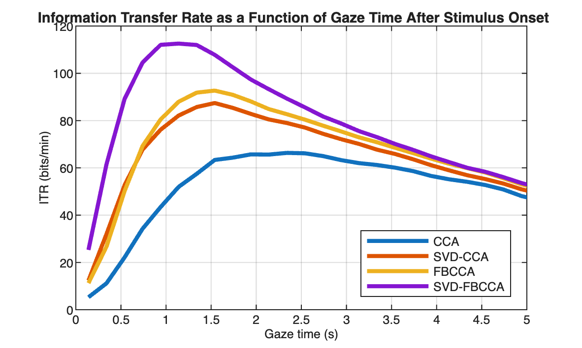
Classification Accuracy and ITR
Average of All Blocks & All subjects
Introduction
Methods
Results
Discussion
Conclusion
Notes:
Sofie
“So, does this dimensionality reduction actually translate into better BCI performance?”
[PAUSE]
“Here we se the classification accuracy for all four methods across gaze durations.”
[gesture to accuracy]
“For accuracy, all methods improve as more EEG data becomes available.”
“But the important difference appears at the shorter gaze durations, where the SVD-enhanced methods reach high performance earlier – especially the SVD enhanced FBCCA, which is the purple one”
[CLICK]
“And this becomes even clearer for information transfer rate.”
[CLICK]
“SVD-FBCCA produces the strongest peak, showing that reliable decisions can be made with less data.”

Slide 13
Classification Accuracy and ITR
Average of All Blocks & All subjects
Introduction
Methods
Results
Discussion
Conclusion
Peak Performance Metrics
Method | Time (s) | ITR (bits/min) | Max Accuracy (%)
CCA | 2.34 | 66.34 | 89.7
SVD-CCA | 1.54 | 87.43 | 92.4
FBCCA | 1.54 | 92.68 | 95.2
SVD-FBCCA | 1.14 | 112.57 | 95.4
Method F1 Score Cohen’s$κ$ Mean Accuracy (%)
SVD-FBCCA 0.795 0.789 79.4
The main benefit of SVD is therefore not higher final accuracy, but faster and more reliable decisions
Notes:
Sofie
SLIDE 14 — PEAK PERFORMANCE
“Looking at the peak performance values, we can see this more clearly.”
[table visible]
“Standard FBCCA reaches its peak ITR at 1.54 seconds”
[CLICK 1]
“But with SVD-enhanced FBCCA, peak ITR is reached after only 1.14 seconds, with an ITR of 112.57 bits per minute.”
“Importantly, the maximum accuracy remains almost identical to standard FBCCA — around 95 percent for both FBCCA methods.”
[CLICK 2]
[CLICK 3]
“And that leads to our main takeaway:
SVD does not primarily improve the final accuracy — it allows us to reach reliable performance faster.”

Slide 14
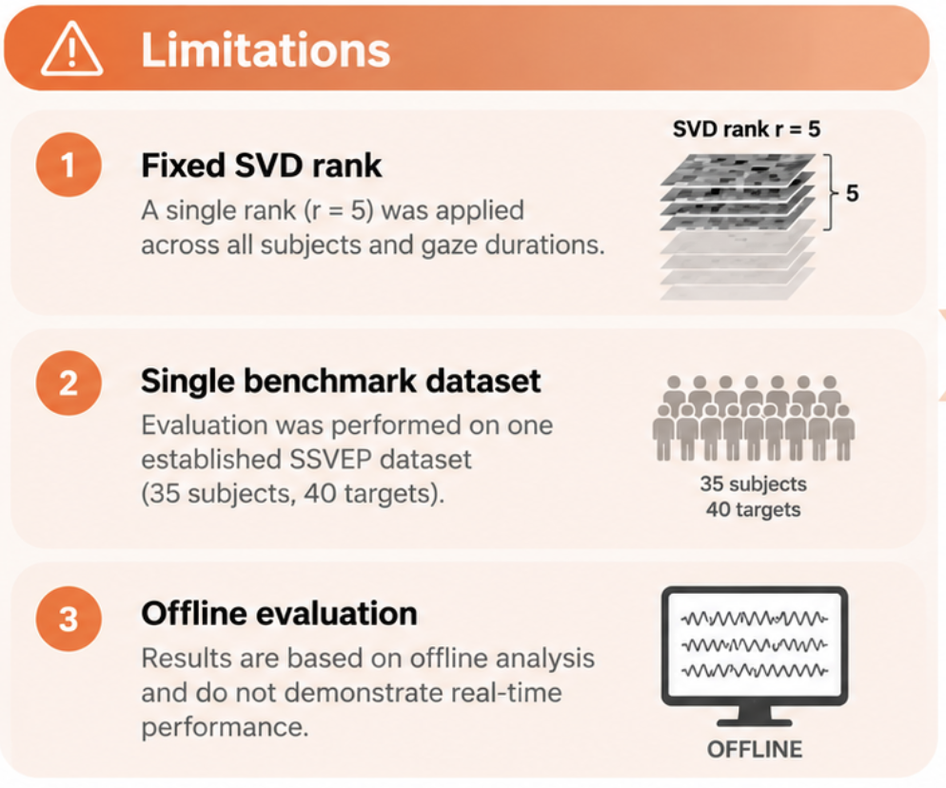
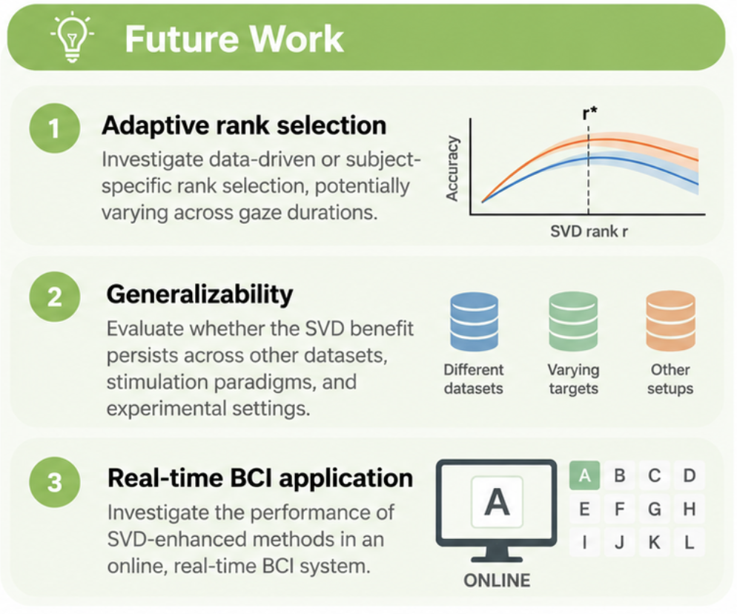

Limitations and Future Work
Introduction
Methods
Results
Discussion
Conclusion
Notes:
Linn
[CLICK 1
Of course, these results also come with some important limitations.”
[CLICK 2
“We used a fixed SVD rank of five across subjects
‘
[CLICK 3
and gaze durations, our evaluation was based on a single benchmark dataset,
[CLICK 4
and the analysis was performed offline.”
[Click 5 - PAUSE / shift toward Future Work]
“But these limitations also open up some interesting questions.”
[CLICK 6
“Can the optimal amount of dimensionality reduction be determined adaptively?”
[CLICK 7
“Does the benefit of SVD generalize across other datasets and experimental settings?”
[CLICK 8
[PAUSE]
“And ultimately — does this improvement translate into faster communication in a real-time BCI?”

Slide 15
Conclusion
Introduction
Methods
Results
Discussion
Conclusion
SVD-enhanced FBCCA improved performance, particularly at short stimulation windows
SVD-FBCCA achieved 95.5% accuracy and 112 bits/min at 1.14 s
SVD-based dimensionality reduction shows potential for high-speed SSVEP-BCIs
Notes:
Sofie
“So, to return to our original question: can we make an SSVEP-based BCI faster without sacrificing reliability?”
[PAUSE] [CLICK]
“Our results suggest that SVD-based dimensionality reduction can help us do exactly that.”
[CLICK]
“SVD-enhanced FBCCA performed particularly well at short stimulation windows, reaching 95.4 percent accuracy and 112.57 bits per minute at only 1.14 seconds.”
“So the main takeaway is not simply higher accuracy.”
[PAUSE] [CLICK}
“It is faster reliable decisions — which is exactly what we need for more practical high-speed SSVEP-based BCIs.”

Slide 16

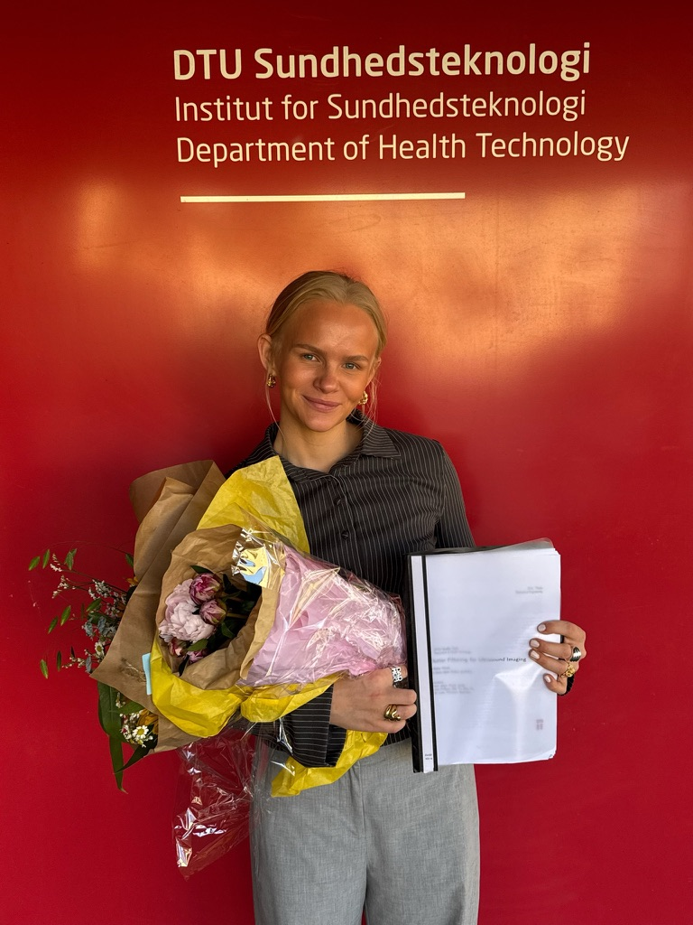



Thank You – Questions?
Technical
University of
Denmark
Sofie Marie Møller Nielsen​
MSc Biomedical Engineering
DTU
s224487@dtu.dk​
Linn Marie Ploug
MSc Biomedical Engineering
DTU
s224495@dtu.dk​
Sadasivan Puthusserypady
BSP Group Leader, Professor
DTU Health Tech
sapu@dtu.dk​
DTU Health Tech, BSP Group:
Notes:
Thank you very much for your time and attention. We’d be happy to take any questions.

Slide 17
References
[1] R. Mane, T. Chouhan, and C. Guan, “Bci for stroke rehabilitation: Motor and beyond,” Journal of Neural Engineering, vol. 17, no. 4, p. 041001, 2020.
[2] A. Rezeika, M. Benda, P. Stawicki, F. Gembler, A. Saboor, and I. Volosyak, “Brain–computer interface spellers: A review,” Brain Sciences, vol. 8, no. 4, p. 57, 2018.
[3] Y. Zhang, S. Q. Xie, H. Wang, and Z. Zhang, “Data analytics in steady-state visual evoked potential-based brain-computer interface: A review,” IEEE Sensors Journal, vol. 21, no. 2, pp. 1124–1138, 2021.
[4] S. Kundu and S. Ari, “Brain-computer interface speller system for alternative communication: A review,” pp. 317–324, 8 2022.
[5] F. B. Vialatte, M. Maurice, J. Dauwels, and A. Cichocki, “Steady-state visually evoked potentials: Focus on essential paradigms and future perspectives,” pp. 418–438, 4 2010.
[6] A. M. Norcia, L. G. Appelbaum, J. M. Ales, B. R. Cottereau, and B. Rossion, “The steady-state visual evoked potential in vision research: A review,” Journal of Vision, vol. 15, no. 6, p. 4, 2015.
[7] Y. Wang, X. Chen, X. Gao, and S. Gao, “A benchmark dataset for ssvep-based brain-computer interfaces,” IEEE Transactions on Neural Systems and Rehabilitation Engineering, vol. 25, pp. 1746–1752, 10 2017.
[8] N. Shi, Y. Miao, C. Huang, X. Li, Y. Song, X. Chen, Y. Wang, and X. Gao, “Estimating and approaching the maximum information rate of noninvasive visual brain-computer interface,” NeuroImage, vol. 289, 4 2024.
[9] M. Nakanishi, Y. Wang, Y. T. Wang, Y. Mitsukura, and T. P. Jung, “A high-speed brain speller using steady-state visual evoked potentials,” International Journal of Neural Systems, vol. 24, no. 6, p. 1450019, 2014.
[10] H. Cecotti, “Adaptive time segment analysis for steady-state visual evoked potential based brain-computer interfaces,” IEEE Transactions on Neural Systems and Rehabilitation Engineering, vol. 28, pp. 552– 560, 3 2020.
[11] Z. Lin, C. Zhang, W. Wu, and X. Gao, “Frequency recognition based on canonical correlation analysis for ssvep-based bcis,” IEEE Transactions on Biomedical Engineering, vol. 53, pp. 2610–2614, 12 2006.
12] G. Bin, X. Gao, Z. Yan, B. Hong, and S. Gao, “An online multi-channel ssvep-based brain-computer interface using a canonical correlation analysis method,” Journal of Neural Engineering, vol. 6, 2009.
[13] M. Nakanishi, Y. Wang, Y. T. Wang, and T. P. Jung, “A comparison study of canonical correlation analysis based methods for detecting steady-state visual evoked potentials,” PLoS ONE, vol. 10, 10 2015.
[14] Y. Zhang, D. Guo, F. Li, E. Yin, Y. Zhang, P. Li, Q. Zhao, T. Tanaka, D. Yao, and P. Xu, “Correlated component analysis for enhancing the performance of ssvep-based brain-computer interface,” IEEE Trans- actions on Neural Systems and Rehabilitation Engineering, vol. 26, no. 5, pp. 948–956, 2018.
[15] X. Chen, Y. Wang, S. Gao, T. P. Jung, and X. Gao, “Filter bank canoncal correlation analysis for implementing a high-speed ssvep-based brain-computer interface,” Journal of Neural Engineering, vol. 12, 8 2015.
[16] M. C. Bolanos, S. B. Ballestero, and S. Puthusserypady, “Filter bank approach for enhancement of supervised canonical correlation analysis methods for ssvep-based bci spellers,” in Proceedings of the Annual International Conference of the IEEE Engineering in Medicine and Biology Society, EMBS, vol. 2021-January, 2021, pp. 337–340.
[17] J. P. Dmochowski, A. S. Greaves, and A. M. Norcia, “Maximally reliable spatial filtering of steady state visual evoked potentials,” NeuroImage, vol. 109, pp. 63–72, 4 2015.
[18] M. Nakanishi, Y. Wang, X. Chen, Y. T. Wang, X. Gao, and T.-P. Jung, “Enhancing detection of ssveps for a high-speed brain speller using task-related component analysis,” IEEE Transactions on Biomedical Engineering, vol. 65, no. 1, pp. 104–112, 2018.
[19] A. Almurshedi, A. K. Ismail, and N. Sulaiman, “Feature extraction of visual evoked potentials using wavelet transform and singular value decomposition,” Iranian Journal of Medical Physics, vol. 15, pp. 206–214, 2018.
[20] D. M. W. Powers, “Evaluation: From precision, recall and f-measure to roc, informedness, markedness and correlation,” Journal of Machine Learning Technologies, vol. 2, no. 1, pp. 37–63, 2011.

