Slide 1



IEEE International Conference on
Systems, Man, and Cybernetics
2026
RAG-based EEG-to-Text Translation
Using Deep Learning and LLMs
Enrico Collautti¹, Xiaopeng Mao³, Luca Tonin¹˒², Stefano Tortora¹˒², Sadasivan Puthusserypady³
¹ IAS-LAB, Department of Information Engineering, University of Padova
² Padova Neuroscience Center, University of Padova
³ Department of Health Technology, Technical University of Denmark
University of Padova & Technical University of Denmark
RAG-based EEG-to-Text Translation Using Deep Learning and LLMs
Notes:
Timing: 0:00–0:20 (20 seconds)
Today I will present our RAG-based EEG-to-text pipeline, developed with colleagues at the University of Padova and the Technical University of Denmark. We study sentence-level semantic decoding from non-invasive EEG during silent reading.
Source: accepted LaTeX paper, Title and author affiliations

Slide 2

Motivation and Objectives
Target assistive communication for people with speech impairments.
Develop a modular EEG-to-text pipeline system, flexible and easily improvable.
Use non-invasive EEG to enable a portable BCI solution.
Decode full sentences to achieve more fluent and natural communication.
2
Notes:
Timing: 0:20–1:05 (45 seconds)
The motivation is assistive communication. We aim for a modular system that works with non-invasive EEG and recovers sentence-level meaning. A key deliverable is evidence beyond a randomized baseline. Across nine participants, the paper reports mean cosine similarity of 0.181 versus 0.139, with p = 0.0059. This measures semantic alignment, rather than exact transcription accuracy.
Source: accepted LaTeX paper, Introduction and Abstract

Slide 3
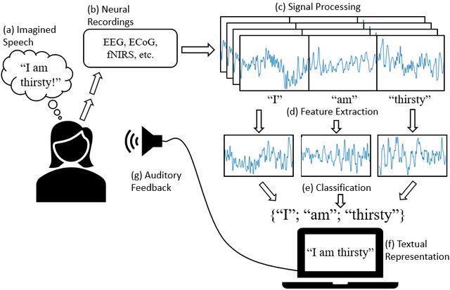
Introduction
A Brain-Computer-Interface (BCI) enables direct communication between the brain and an external device.
Speech decoding BCIs aim to reconstruct or interpret speech.
Current state-of-the-art systems rely mostly on invasive recordings.
Non-invasive approaches using EEG remain limited, often restricted to small vocabularies or character-by-character decoding¹.
Cooney, Ciaran & Folli, Raffaella & Coyle, Damien. (2022). Opportunities, pitfalls and trade-offs in designing protocols for measuring the neural correlates of speech. Neuroscience & Biobehavioral Reviews. 140. 104783. 10.1016/j.neubiorev.2022.104783.
¹S. A. Murad and N. Rahimi, "Unveiling Thoughts: A Review of Advancements in EEG Brain Signal Decoding Into Text," in IEEE Transactions on Cognitive and Developmental Systems
3
Notes:
Timing: 1:05–1:45 (40 seconds)
A brain-computer interface maps brain activity to an external output. Speech-decoding systems motivate natural communication, but the strongest results often use invasive recordings. EEG provides a non-invasive alternative with substantial noise and limited spatial resolution. The current work concerns silent reading, rather than demonstrated decoding of freely imagined speech.
Source: accepted LaTeX paper, Introduction; figure citations retained from supplied deck

Slide 4
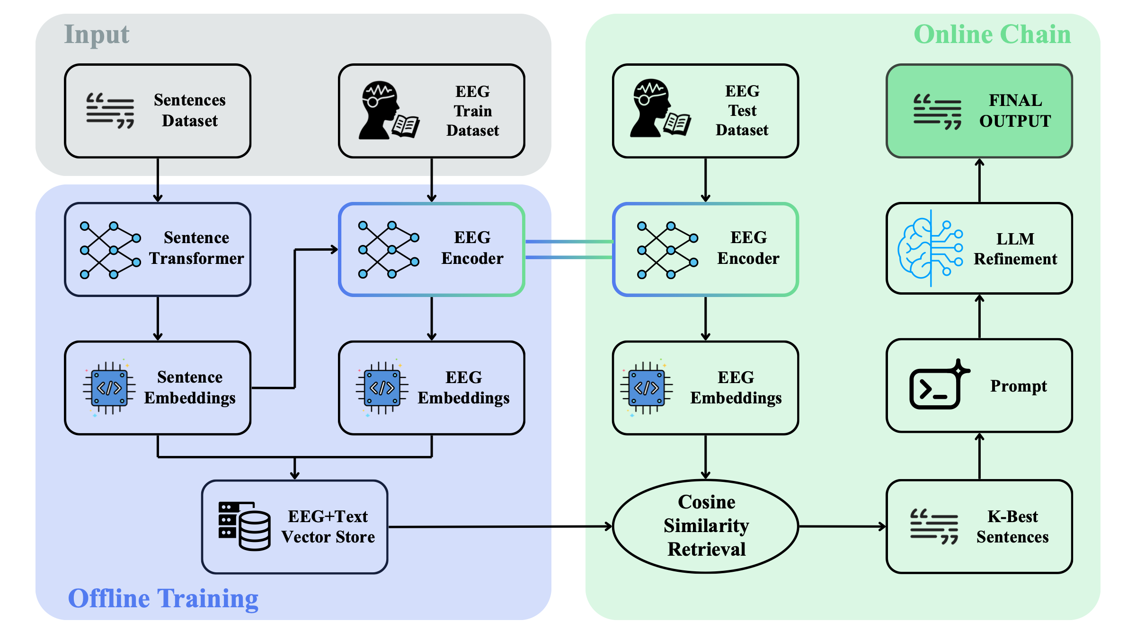
Methods: The Main Pipeline
4
Notes:
Timing: 1:45–2:45 (60 seconds)
On the left, the sentence transformer supplies target embeddings for EEG encoder training. Training EEG embeddings and their text form the vector store. On the right, a test EEG embedding retrieves three training sentences, and an LLM produces one refined sentence. Test sentences never enter the store. Online chain labels the inference stage here. The experiments use prerecorded trials.
Source: accepted LaTeX paper, Methods, Fig. 1

Slide 5


Data
Each trial pairs an EEG recording with the sentence being read.
+
EEG segment
Target sentence
One sentence-level EEG-text pair
5
Notes:
Timing: 2:45–3:05 (20 seconds)
Our basic training example is an EEG segment paired with the sentence read during that segment. Fixation timing identifies the sentence boundaries. Sentence duration varies, so the signals are zero-padded to a common temporal length within each subject.
Source: accepted LaTeX paper, Methods: Dataset and EEG Preprocessing

Slide 6


Sentence Embeddings
all-mpnet-base-v2 maps sentences to 768-dimensional semantic vectors.
Text
Sentence transformer
Sentence embedding
Pretrained model
768 dimensions
6
Notes:
Timing: 3:05–3:35 (30 seconds)
We use the pretrained all-mpnet-base-v2 sentence transformer. It maps each target sentence to a 768-dimensional semantic vector. Semantically related sentences should have similar representations. These vectors supervise the EEG encoder.
Source: accepted LaTeX paper, Methods: Sentence Embedding Targets

Slide 7
EEG Encoder
The encoder learns to predict the corresponding sentence embedding.
EEG segment
EEG encoder
EEG embedding
Training target: the 768-dimensional sentence embedding
Cosine similarity loss aligns the EEG and text representations.
7
Notes:
Timing: 3:35–4:10 (35 seconds)
The EEG encoder converts a multichannel EEG segment into a vector with the same dimension as the text representation. During training, cosine similarity aligns this prediction with the corresponding sentence embedding. At inference, the encoder receives only the EEG signal. The next slide describes the architecture and objective.
Source: accepted LaTeX paper, Methods: EEG Encoder and Embedding Alignment

Slide 8
EEG Encoder: Architecture and Loss
EEGChannelNet-inspired encoder
Temporal convolutions with multiple dilations,
spatial convolutions, and residual blocks.
Cosine similarity loss
$$ℒ_{cosine}=1−\cos{θ}=1−\frac{x⋅y}{|\left|x\right||⋅|\left|y\right||}$$
x: predicted EEG embedding
y: target sentence embedding
8
Notes:
Timing: 4:10–5:05 (55 seconds)
The EEGChannelNet-inspired encoder combines temporal convolutions with multiple dilation factors, spatial convolutions, and residual blocks. Global average pooling and a linear projection produce a 768-dimensional output. The cosine loss is one minus cosine similarity between predicted EEG embedding x and target text embedding y. Hyperparameter selection used three random seeds. Final models were retrained on the complete training portion.
Source: accepted LaTeX paper, Methods: EEG Encoder and Embedding Alignment

Slide 9
Retrieving Chain and LLM Refinement
Implemented a Retrieval Augmented Generation (RAG)-inspired pipeline:
Train EEG embeddings stored in a FAISS Vector Store.
Test EEG embedding is computed using the trained encoder.
Top-3 similar sentences retrieved from the Vector Store via cosine similarity computed on EEG embeddings.
A LLM (Meta-Llama-3-8B) combines them into a single, fluent output.
Final output sentence is generated, starting from EEG data.
9
Notes:
Timing: 5:05–6:00 (55 seconds)
FAISS indexes the EEG embeddings of training trials, linked to their text. We query this store with the test EEG embedding and retrieve the three nearest sentences by cosine similarity. Meta-Llama-3-8B receives this retrieved text and a prompt asking for one fluent sentence without adding or removing information. The model does not see the true test sentence. Prompt constraints do not guarantee factual correctness.
Source: accepted LaTeX paper, Methods: Vector Indexing and Retrieval-Augmented Generation

Slide 10
EEG Data: Database Choice
ZuCo 1.0¹ records EEG and eye tracking during silent reading of English sentences.
9 participants
Independent model per subject
3 excluded for incomplete recordings
Natural Reading and Sentiment Reading provide approximately 700 pairs per subject.
TRAIN | VALIDATION | TEST
600 sentences | 50 sentences | 50 sentences
128 channels at 500 Hz. The EEG data is already preprocessed.
Same test sentences across subjects.
¹ Hollenstein, N., Rotsztejn, J., Troendle, M. et al. ZuCo, a simultaneous EEG and eye-tracking resource for natural sentence reading. Sci Data 5, 180291 (2018). https://doi.org/10.1038/sdata.2018.291
10
Notes:
Timing: 6:00–6:55 (55 seconds)
The experiment uses nine ZuCo 1.0 participants. Three were excluded because incomplete recordings left substantially fewer usable trials. Natural Reading and Sentiment Reading yield approximately 700 sentence pairs per participant. The data were acquired with 128 channels at 500 Hz and supplied after artifact cleaning. We train independently per subject on 650 sentences, reserving the same 50 test sentences across people. Fifty training sentences support validation before retraining on all 650.
Source: accepted LaTeX paper, Methods: Dataset, EEG Preprocessing and Embedding Alignment

Slide 11
Results: Qualitative Examples
Subject ZMG | Subject ZJN
Target sentence: | Target sentence:
... by the time it's done with us, Mira Nair's new movie has its audience giddy with the delight of discovery, of having been immersed in a foreign culture only to find that human nature is pretty much the same all over. | Huxley was born in Godalming, Surrey, England.
Final output: | Final output:
A beautifully crafted, emotionally resonant film that should appeal to audiences looking for something original and thought-provoking. | He was born in Litchfield, England, where he attended school before moving on to study medicine at Edinburgh University, Scotland.
Cosine similarity: 0.560 | Cosine similarity: 0.551
11
Notes:
Timing: 6:55–8:05 (70 seconds)
These are the first two examples in Table I. Underlined red text reproduces the paper’s semantic correspondences. In the first, both sentences describe a film with positive sentiment, giving cosine similarity 0.560. In the second, the generated output retains the birth context and England, giving 0.551. However, the birthplace differs and the output adds a biography. Semantic overlap can coexist with factual errors. These are illustrative examples, not typical-case accuracy estimates.
Source: accepted LaTeX paper, Results: Table I, first two examples

Slide 12
Evaluation: Randomized EEG Control
Random baseline
Same downstream pipeline
Permute EEG samples in time, then randomly assign signals to test labels. Repeat with 10 seeds.
Keep the encoder, retrieval, and LLM refinement unchanged.
Semantic similarity
Paired statistical tests
Compare embeddings of the generated sentence and the target using cosine similarity.
One-sided Wilcoxon tests. Apply FDR correction to the nine subject-level comparisons.
No ground-truth text during generation
12
Notes:
Timing: 8:05–9:10 (65 seconds)
The control permutes EEG samples in time and randomly assigns shuffled signals to test labels. Ten random seeds account for variability. This preserves amplitude distributions while disrupting temporal structure. The downstream system remains the same. We score cosine similarity between output and target embeddings after generation. Across subjects, the test compares nine paired subject means. Within each subject, it compares fifty sentence scores with seed-averaged baselines. Subject-level p-values receive Benjamini–Hochberg FDR correction.
Source: accepted LaTeX paper, Methods: Random Baseline and Statistical Analysis

Slide 13
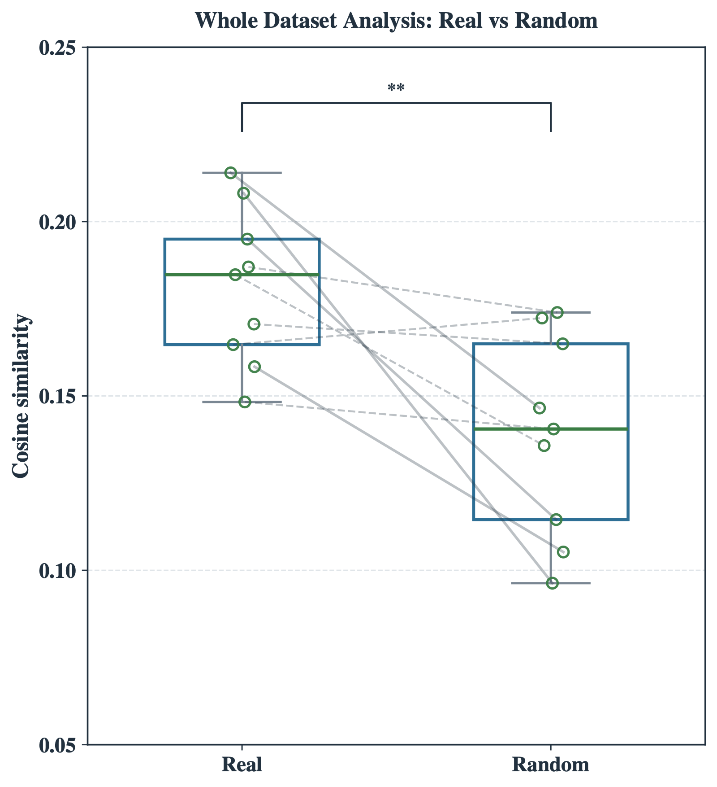
Results: Real EEG and Random Baseline
Mean cosine similarity
Mean ± SD across subjects
0.181 ± 0.022
Real EEG
0.139 ± 0.029
Random baseline
+30.45% relative improvement
p-value = 0.0059 (9 paired subject means)
13
Notes:
Timing: 9:10–10:05 (55 seconds)
The original paper figure compares the real and randomized subject means. The real mean is 0.181 with standard deviation 0.022 across subjects, versus 0.139 with standard deviation 0.029 for the baseline. The paper reports 30.45 percent relative improvement, with p = 0.0059 in the one-sided paired Wilcoxon test. This supports information beyond the control, while the absolute similarity remains modest.
Source: accepted LaTeX paper, Results: Fig. 2 and Table II

Slide 14
Results: Subject-Level Performance
Subject | Real cosine | Random cosine | p-value
ZAB | 0.214 | 0.147 | 0.012
ZDM | 0.148 | 0.141 | 0.417
ZGW | 0.195 | 0.115 | 0.009
ZJM | 0.187 | 0.174 | 0.417
ZJN | 0.158 | 0.105 | 0.030
ZKB | 0.165 | 0.172 | 0.594
ZKH | 0.208 | 0.096 | 0.009
ZKW | 0.171 | 0.165 | 0.417
ZMG | 0.185 | 0.136 | 0.056
8 of 9
subjects have a higher mean similarity with real EEG
4 of 9
statistically significant improvements after FDR correction
p-values include Benjamini–Hochberg FDR correction.
14
Notes:
Timing: 10:05–10:55 (50 seconds)
Eight of nine participants have higher real means. Four, ZAB, ZGW, ZJN and ZKH, show significant differences after FDR correction. ZMG has p = 0.056 and does not meet the threshold. ZKB has a slightly lower real mean. The across-subject result therefore coexists with substantial individual variability. The p-value column contains corrected subject-level values.
Source: accepted LaTeX paper, Results: Table II

Slide 15
Discussion and Future Work
Limited reconstruction quality
Outputs can capture broad meaning
but miss or introduce details.
Improve the EEG encoder
Use techniques such as contrastive learning to improve separation between sentence representations to support retrieval.
Limited embedding separation
Similar EEG embeddings make
sentence retrieval difficult.
Limited training data
Datasets for assistive communication
Single-trial recordings constrain
learning from noisy EEG.
Collect repeated trials of functional phrases.
15
Notes:
Timing: 10:55–11:25 (30 seconds)
The main evidence is improved semantic alignment beyond the randomized control without ground-truth text at inference. However, generated sentences can still be wrong. Single-trial data, EEG noise and the structure of learned representations constrain retrieval. We should interpret these results as evidence for coarse semantic recovery in this experimental setting.
Source: accepted LaTeX paper, Discussion

Slide 16
Conclusions and Future Work
A modular EEG-to-text pipeline
Generates sentences from non-invasive EEG, combining representation learning, sentence retrieval, and LLM refinement.
Real EEG outperforms the randomized control
Mean cosine similarity: 0.181 vs 0.139
+30.45% relative improvement
One-sided Wilcoxon tests p-value = 0.0059
Evidence of coarse semantic recovery
A proof of concept based on silent reading, with substantial improvements still needed for reliable assistive communication.
16
Notes:
Timing: 11:25–11:55 (30 seconds)
We presented a modular EEG-to-text pipeline with a statistically significant improvement over its randomized control. The result supports semantic information in the EEG, while reliable reconstruction remains a challenge. A next step described in the paper is contrastive learning to better separate sentence representations in the EEG embedding space.
Source: accepted LaTeX paper, Conclusion and Discussion

Slide 17
Thank you for your attention
17
Notes:
Timing: 11:55–12:00 (5 seconds)
Thank you for your attention. I welcome your questions.
Source: accepted LaTeX paper, Closing

