Slide 1

Temporal Generalization in fNIRS-Based Autism Classification:
A Cross-Time-Window Transfer Benchmark
Marios Petrov, Sahana Vinayak, Targol Bakhtiarvand, Moses Smith Guddah, Adham Atyabi,
Frederick Shic, Kevin A. Pelphrey
Department of Computer Science, University of Colorado Colorado Springs
Seattle Children's Research Institute · University of Washington School of Medicine
IEEE SMC 2026 · Bellevue, WA
1
Notes:
TIMING 0:00-0:30. Hi, I'm Marios Petrov from the University of Colorado Colorado Springs. This is joint work with Seattle Children's Research Institute and the University of Washington. I'll be talking about temporal generalization in fNIRS-based autism classification: what happens when the time window you evaluate on is not the one you trained on, and what actually fixes it.

Slide 2
Motivation
The Problem
Our Approach
The hemodynamic response function (HRF) varies across individuals in peak latency, shape, and amplitude
Existing fNIRS-ASD classifiers train and evaluate on a single fixed observation window
In heterogeneous pediatric cohorts, this fixed-window assumption fails and performance collapses
fNIRS is often assumed too temporally coarse for short-segment decoding
Formalize cross-time-window transfer: train on a source window, evaluate on a different target window
Convert fNIRS to topographic maps and classify with modern vision backbones
Benchmark 2 zero-shot baselines + 8 adaptation strategies under leave-one-subject-out CV (N=124)
First unified benchmark of temporal generalization for fNIRS classification
If discriminative information exists in short fNIRS segments but its temporal location varies per child, the limitation is the evaluation protocol, not the modality.
IEEE SMC 2026 · Bellevue, WA
2
Notes:
TIMING 0:30-1:20. The core issue: the hemodynamic response is not the same across people. Peak latency, shape, amplitude all vary with neurovascular coupling, anatomy, and age. Yet nearly every fNIRS classification study picks one time window and trains and tests inside it. We formalize the failure mode as cross-time-window transfer, and benchmark ten evaluation conditions on 124 children. The framing box at the bottom is the thesis: if the signal is there but moves around in time per child, the problem is the protocol, not fNIRS itself.

Slide 3
Background
Zhang et al. 2023 (ASGCN)
95.4% ASD classification from resting-state fNIRS using windows as short as 2.1 s: brief segments carry rich information
Cai et al. 2025 (EWE-GAT)
97.9% with graph attention on resting-state fNIRS, but trained and evaluated within the same time window
Yang et al. 2024 (HD-DOT)
Biological motion viewing produces robust, regionally specific activation differences between autistic and non-autistic children
Lin et al. 2024 (EEG-fNIRS)
Subject-specific HRF modeling significantly improves neurovascular coupling characterization: inter-individual variability is large
Jing 2023 · Lyu 2021 · Feng 2025
Cross-subject transfer in fNIRS degrades without adaptation; domain alignment recovers much of it, but temporal shift is untouched
Gap: prior fNIRS-ASD studies uniformly evaluate within one temporal window; cross-time-window generalization has never been tested.
IEEE SMC 2026 · Bellevue, WA
3
Notes:
TIMING 1:20-2:10. Quick context. Prior ASD work with graph networks reports 95 to 98 percent, including from 2-second segments, but always within one fixed window and often without strict subject holdout. Biological motion is one of the best established probes of social perception differences in autism, confirmed recently with high-density optical imaging. And the transfer literature shows cross-subject shift is a real problem in fNIRS. But nobody has tested the temporal axis: train on one part of the trial, test on another. That's the gap.

Slide 4
Dataset and Biological Motion Paradigm
Participants
N = 124 children (63 ASD / 61 TD), ages 4-16; matched on age; differ in sex and IQ
Why point-light walkers?
Site
Seattle Children's Hospital, IRB-approved, guardian informed consent
Preserve biological motion, remove faces and background semantics
Reliably elicit differential ASD/TD responses in prefrontal and temporal cortex
Short, repeatable trials → dense temporal sampling per session
Stimuli
15 s point-light walker (PLW) clips: happy, angry, fearful, neutral, rotation control
Quality control
Trials with >35% invalid behavioral monitoring samples excluded (~15% of trials)
Windowing
2.5 / 5 / 7.5 / 10 s windows on a common 2.5 s lattice; 10 s spans the canonical HRF, 2.5 s is the stress test
Representation
Window-mean ΔHb per channel → scalp interpolation → 2D topographic map
IEEE SMC 2026 · Bellevue, WA
4
Notes:
TIMING 2:10-2:55. The data: 124 children, 63 with ASD and 61 typically developing, ages 4 to 16, collected at Seattle Children's. Groups are matched on age but differ in sex composition and IQ, which we report transparently and return to in limitations. Each trial is a 15-second point-light walker across five emotion conditions. Point-light walkers are ideal here: pure biological motion, no faces or scene content, and short repeatable trials that let us sample the hemodynamic response densely. We slice each trial into windows from 2.5 to 10 seconds at 2.5-second offsets, average the response per channel within a window, and interpolate onto the scalp to get a topographic image.

Slide 5
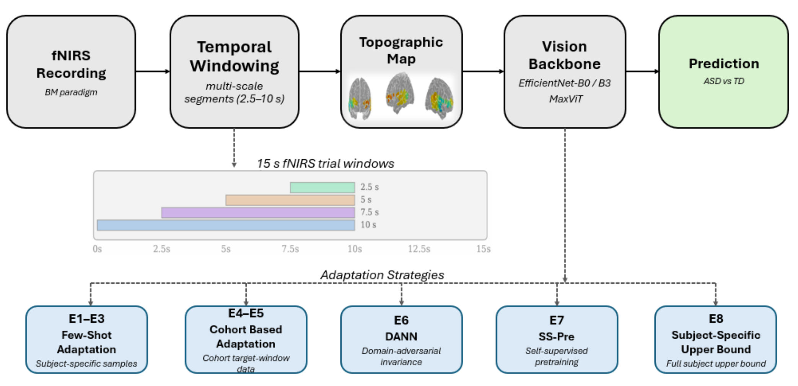
Pipeline: fNIRS as Images, Windows as Domains
IEEE SMC 2026 · Bellevue, WA
5
Notes:
TIMING 2:55-3:35. The full pipeline. Recordings from the biological motion paradigm are sliced into multi-scale windows, each window becomes a topographic map, and the maps are classified by one of three ImageNet-pretrained vision backbones: EfficientNet-b0, b3, and MaxViT. The key conceptual move is at the bottom: we treat each time window as a domain. A source window generates training data, a different target window is used for evaluation, and the eight adaptation strategies E1 through E8 modify training or fine-tuning to cope with that shift.

Slide 6
Evaluation Protocol
Cross-Time-Window Transfer
Design Choices
Source window wₛ generates training data; target window wₜ ≠ wₛ is used for evaluation
Train on one window from N-1 subjects, evaluate on a different window from the held-out subject
Gap between same-window and cross-window accuracy = marginal cost of temporal shift
Leave-one-subject-out CV across all 124 subjects: strict, no subject leakage
All few-shot conditions use ≈5% of the relevant sample pool
18 window configurations × 3 architectures × 10 conditions
Central question
Given a classifier trained on source-window data from a subset of subjects, how well does it generalize to a different time window from a subject it has never seen?
IEEE SMC 2026 · Bellevue, WA
6
Notes:
TIMING 3:35-4:10. The protocol in one slide. A source window trains, a different target window evaluates, and everything runs under leave-one-subject-out cross-validation, so the model has never seen the held-out child or the target window. Few-shot conditions get about 5 percent of samples. Altogether it's 18 window configurations, three architectures, and ten evaluation conditions. The central question in the box: train here, on these people; does it work there, on that child?

Slide 7
Ten Evaluation Conditions: A Ladder of Privileged Information
Zₛ, Zₜ
Zero-shot
E1-E3
Few-shot
No held-out subject or target-window data; measures raw cross-subject and cross-window transfer
Fine-tune on ≈5% of the held-out subject's samples: source window, target window, or both sequentially
E4-E5
Cohort
E6
DANN
Adapt on full target-window data from all other subjects, optionally + few-shot personalization
Domain-adversarial training with gradient reversal removes window-discriminative cues; zero target-subject data
E7
SS-Pre
E8
Upper bound
Self-supervised temporal pretraining (next-step embedding prediction) across both windows; zero target-subject data
All of the subject's source-window data, zero target-window exposure; isolates subject shift vs temporal shift
IEEE SMC 2026 · Bellevue, WA
7
Notes:
TIMING 4:10-4:50. The conditions form a ladder of increasing privileged information. Zero-shot gets nothing. E1 to E3 get a 5-percent few-shot sample from the held-out child. E4 and E5 see everyone else's target-window data. E6 and E7 are the deployable, calibration-free options: adversarial window invariance and self-supervised temporal pretraining, with zero data from the target child. E8 is the diagnostic upper bound: it knows the child completely but has never seen the target window, so it tells us which shift, subject or temporal, actually hurts.

Slide 8
Results: Zero-Shot Transfer Is Near Chance
54.0-65.1%
55.4-69.5%
≈ chance
Zero-shot source (Zₛ): same window, unseen subject
Zero-shot target (Zₜ): different window, unseen subject
Binary task, chance = 50%; both baselines cluster near it
What this tells us
Uniformly poor across all 18 window configurations and all three architectures
Neither window length nor offset produces a consistent advantage
The Zₛ - Zₜ gap is small and inconsistent in sign: temporal shift compounds an already severe cross-subject degradation
Cross-time-window transfer is a first-order challenge requiring explicit adaptation
IEEE SMC 2026 · Bellevue, WA
8
Notes:
TIMING 4:50-5:25. First result: without adaptation, everything fails. Same-window cross-subject accuracy is 54 to 65 percent; cross-window is 55 to 69. On a binary task with chance at 50, that is barely signal. No window length or offset is consistently better, and the gap between the two baselines is small and flips sign, which tells us temporal shift stacks on top of an already severe cross-subject problem rather than replacing it. Adaptation is not optional here.

Slide 9
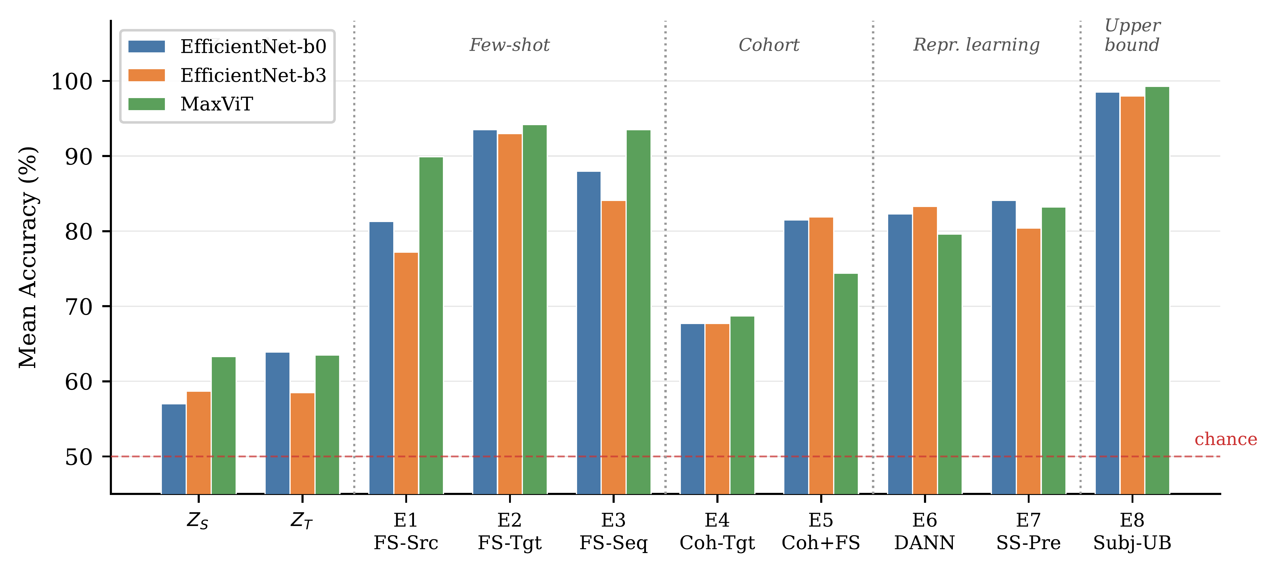
Results: Adaptation Strategies (E1-E8)
94.2%
E2: ≈5% target-window labels (MaxViT), best practical result
97-100%
E8: knows the subject, never saw the window
78-90%
E6/E7: zero target-subject data
Mean accuracy across completed window configurations, LOSO, N=124.
IEEE SMC 2026 · Bellevue, WA
9
Notes:
TIMING 5:25-6:30. This is the main figure; four things to see. One: the zero-shot cluster at the left, near chance. Two: E2, fine-tuning on just 5 percent of target-window labels, jumps to 93-94 percent, best practical result 94.2 with MaxViT. That's a single short calibration block per child. Three: cohort-level adaptation, E4, barely moves: around 68 percent. Pooling more of other people's data is not a substitute for subject-specific data; in fact E5 shows cohort adaptation can be a worse starting point for personalization, a mild negative transfer. Four, the headline: E8 hits 97 to 100 percent while never seeing the target window. So once the model knows a child's hemodynamic profile, it transfers across time almost perfectly. Inter-subject variability, not temporal shift, is the dominant barrier. And when calibration is impossible, DANN and self-supervised pretraining still deliver 78 to 90 with zero target-subject data; neither dominates, they appear complementary.

Slide 10
Comparison with Prior Work
Method | Task | N | Protocol | Cross-Subj | Cross-Win | Acc (%)
Zhang 2023 (ASGCN) | Rest | 47 | k-fold | ✗ | ✗ | 95.4
Cai 2025 (EWE-GAT) | Rest | 47 | LOOCV | ✗ | ✗ | 97.9
Feng 2025 (CHTLM) | MI | 8 | LOSO | ✓ | ✗ | 83.1-91.3
Ours: E6 (DANN, b3) | BM | 124 | LOSO | ✓ | ✓ | 83.3
Ours: E7 (SS-Pre, b0) | BM | 124 | LOSO | ✓ | ✓ | 84.1
Ours: E2 (FS-Tgt, MaxViT) † | BM | 124 | LOSO | ✓ | ✓ | 94.2
Prior high accuracies come from same-window evaluation, often without strict subject holdout: direct comparison is misleading
Our protocol is strictly harder: LOSO + cross-time-window on a 2.6× larger cohort
† uses ≈5% labeled target-window data from the held-out subject
IEEE SMC 2026 · Bellevue, WA
10
Notes:
TIMING 6:30-7:10. Contextualizing against the literature. The 95-98 percent numbers from prior ASD work are same-window and often without subject holdout, so they answer an easier question. Our setting is strictly harder: strict leave-one-subject-out, cross-window transfer, and a cohort 2.6 times larger. Under those conditions, calibration-free strategies reach 83-84, and 5-percent personalization reaches 94.2.

Slide 11
Discussion
Findings
Limitations & Future Work
Temporal shift is real but almost fully recoverable once subject physiology is known
Invest calibration time in subject-specific data, not in matching the training window
2.5 s windows perform comparably to 10 s with adaptation: shorter sessions, more trials, better child compliance
Sliding windows double as ecologically valid augmentation: every sample is a real hemodynamic segment, no synthetic interpolation
Single paradigm, single site; no age stratification or control for group sex and IQ differences: age may contribute to the variability E8 recovers
Topographic maps discard intra-window dynamics, so zero-shot loss cannot be cleanly attributed to window shift alone
fNIRS samples only superficial cortex; deeper modalities would clarify the residual gap
Combine E6 + E7 in a unified pipeline; extend to multi-session; fuse with concurrently recorded eye tracking
IEEE SMC 2026 · Bellevue, WA
11
Notes:
TIMING 7:10-7:50. Two discussion points worth emphasizing. Practically: calibrate to the child, not the clock. A short calibration block beats any amount of window matching. And short windows work, which matters enormously in pediatric screening where session length and compliance are the binding constraints; it also means time windowing is a free, physiologically grounded augmentation strategy. Limitations: one paradigm at one site, no age stratification or control for the group differences in sex and IQ, and the map representation throws away within-window dynamics, so we can't cleanly separate window shift from lost temporal information. Next steps include unifying the adversarial and self-supervised strategies and fusing with the eye tracking we collected concurrently.

Slide 12
Conclusion
We formalized cross-time-window transfer for fNIRS-based ASD classification and benchmarked ten evaluation conditions across three vision architectures under leave-one-subject-out cross-validation (N=124).
1
Temporal distribution shift is a first-order challenge: zero-shot accuracy 54-69%, near chance
2
The shift is almost entirely recoverable with subject-specific adaptation: E8 reaches 97-100%, E2 recovers 90-96% from ≈5% of labels
3
Without any target-subject data, domain-adversarial and self-supervised strategies (78-90%) far exceed cohort adaptation (≈68%)
4
Discriminative ASD/TD information is recoverable from windows as short as 2.5 s
A practical roadmap for deploying fNIRS-based ASD classifiers under realistic temporal variability.
IEEE SMC 2026 · Bellevue, WA
12
Notes:
TIMING 7:50-8:25. To conclude, four takeaways. Temporal shift is first-order: zero-shot is near chance. It is almost entirely recoverable through subject-specific adaptation: the upper bound hits 97 to 100, and 5 percent of labels recovers 90 to 96. When calibration is impossible, adversarial and self-supervised strategies at 78 to 90 far exceed cohort pooling. And 2.5-second windows carry the signal. Together this is a practical roadmap for deploying fNIRS classifiers under realistic temporal variability.

Slide 13
Thank You – Q & A
Calibrate to the child, not the clock.
Marios Petrov · NeuroCognition Lab, University of Colorado Colorado Springs
Collaboration: Seattle Children's Research Institute · University of Washington School of Medicine
This study was funded by NIMH award K01MH104739
IEEE SMC 2026 · Bellevue, WA
13
Notes:
TIMING 8:25-8:45. One line to remember: calibrate to the child, not the clock. Once a model knows a subject's hemodynamic profile, it transfers across time windows almost perfectly. Thanks to my collaborators at Seattle Children's and UW, and to NIMH for funding. Happy to take questions. (Buffer to 10:00 for Q&A within slot if applicable.)

