Slide 1

WORKSHOP ON BRAIN-MACHINE INTERFACES
IEEE SMC 2026
October 4-7, 2026
Subject-Specific Analysis of Self-Initiated Attention Shifts from EEG with Controlled Internal and External Attention Conditions
Yuwen Zeng, Dengzhe Hou, Zhang Zhang, Sai Sun, Yongsong Huang, Chia-huei Tseng, and Satoshi Shioiri
Advanced Institute of Convergence Knowledge Informatics
Tohoku University, Japan
Notes:
Hello everyone. My name is Yuwen Zeng from Tohoku University. Today I will present our work, Subject-Specific Analysis of Self-Initiated Attention Shifts from EEG with Controlled Internal and External Attention Conditions. The main question is simple: before a person voluntarily shifts attention, can we detect a distinguishable EEG pattern?

Slide 2
Background: self-initiated attention
(1) Right side turns red
(2) Shift to right
Bottom-up
Involuntary
Exogenous
Stimulus-driven
(1) Arrow
(2) Right arrow
(3) Shift to right
Top-down
Voluntary
Endogenous
Goal-directed / instructed
belong
(1)~(n-1) Self-initiation
(n) Shift to right
Internal decision
Self-initiated attention [2]
Same selection but
different process: [2]
Gap: Does distinct brain activities precede self-initiated shifts of attention?
[1] Hopfinger, J. B., Camblin, C. C., & Parks, E. L. (2010). Isolating the internal in endogenous attention. Psychophysiology, 47(4), 739-747.
[2] Katsuki, F. and Constantinidis, C., 2014. Bottom-up and top-down attention: different processes and overlapping neural systems. The Neuroscientist, 20(5), pp.509-521.
Notes:
Attention shifts can be driven in different ways. In bottom-up attention, a stimulus captures us, for example when something suddenly turns red. In top-down attention, we follow a goal or an instruction, such as an arrow telling us where to attend. But in daily life, we often decide by ourselves when and where to shift attention. We call this self-initiated attention. The difficulty is that there is no external trigger, so the timing of the internal decision is hard to measure. This leads to our gap: do distinct brain activities precede self-initiated shifts of attention?

Slide 3
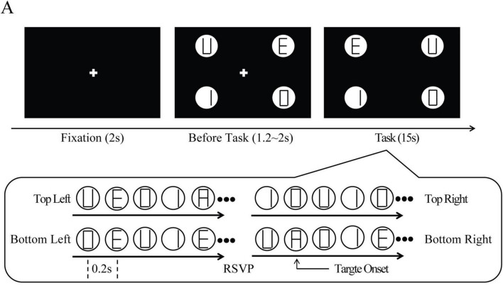
Background
Multiple sequential choices Rapid serial visual presentation (RSVP) paradigm [3]
Each trial:
2 s fixation
+ 1.2-2.0 s preparation
+ 15 s task
Four streams update every 0.2 s
Each stream has 0-2 target
Approximately 4.66 targets per trial on average
Task: Report how many of the four locations contained at least one “A”
[3] Hou, D., Sun, S., Hatori, Y., Tseng, C. H., & Shioiri, S. (2025). Task-constrained self-initiated attention shifts are indexed by frontal-midline theta ramping. Frontiers in Human Neuroscience.
Notes:
To study this question, we used a multi-sequential-choice RSVP paradigm from our previous work. Each trial started with fixation and preparation, followed by a 15-second task. Four streams of letters were shown at the same time, and each stream updated every 0.2 seconds. Participants had to report which of the four locations contained at least one target letter A. This design is useful because participants have several possible locations and multiple opportunities to shift attention during one trial.

Slide 4
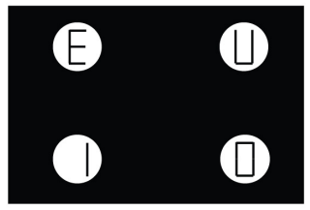
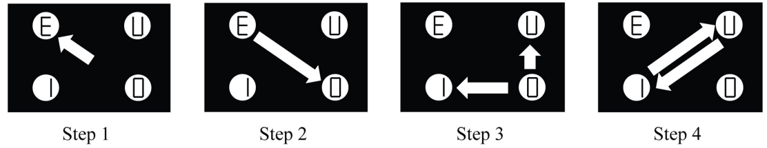
Background
Multiple sequential choices Rapid serial visual presentation (RSVP) paradigm [3]
The same RSVP display supports different sources of control:
Task-constrained self-initiated (TCSI)
Externally instructed (EI)
Search for the target letter A among four streams.
Choose when and where to shift attention.
No external cue determines the shift time.
Detect a target under the same visual stimulation.
Follow a fixed rule and shift to the diagonal stream.
An external event determines when to shift.
?
* Besides TCSI and EI, an additional free viewing (FV, no rule no task) was also collected.
[3] Hou, D., Sun, S., Hatori, Y., Tseng, C. H., & Shioiri, S. (2025). Task-constrained self-initiated attention shifts are indexed by frontal-midline theta ramping. Frontiers in Human Neuroscience.
Notes:
The key point is that the visual display was the same, but the source of control was different. In the task-constrained self-initiated condition, or TCSI, participants searched for A and decided when and where to shift. No external cue specified the shift time. In the externally instructed condition, or EI, participants followed a fixed rule and shifted to the diagonal stream after a target event. So both conditions involve a task, but TCSI is internally initiated and EI is externally instructed. This contrast lets us ask whether the pre-shift EEG signal contains information about the source of control.

Slide 5
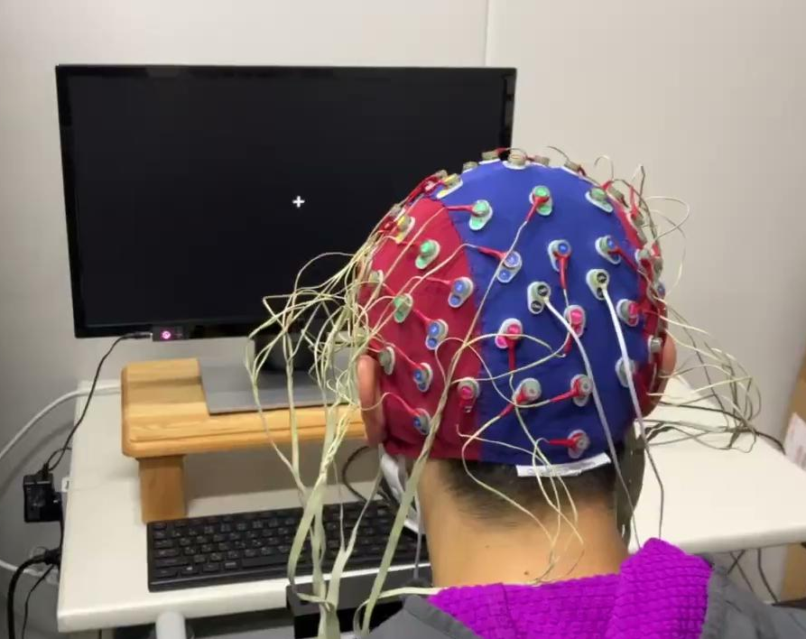
Background
Multiple sequential choices Rapid serial visual presentation (RSVP) paradigm [3]
EEG
Biosemi 64-channel system 2048 Hz
Dynamic brain activity
17 participants (15 for final analysis)
Eye tracking
Tobii Pro Fusion 250 Hz
Two dimensions gaze
Saccade time is used to estimate attention shift time
Notes:
During the experiment, EEG was recorded with a 64-channel BioSemi system, and eye movements were recorded with a Tobii eye tracker. The eye-tracking data are important because saccade onset gives us an estimate of when the overt attention shift occurred. We then used EEG activity before that shift as the analysis window.

Slide 6
Background
Previous studies
Identifying the neural mechanisms underlying voluntary attention:
  frontal theta associated with internally generated decisions and alpha dynamics preceding voluntary shifts
  primarily describe how the brain produces voluntary orienting
Purpose: From a data-science perspective, determine whether voluntary attention shifts, i.e., Task-constrained self-initiated (TCSI) vs Externally instructed (EI), exhibit distinct and decodable neural patterns
Method
Classify EEG signals with machine-learning classifier
Identify neural patterns that distinguish types of voluntary attention shifts
Notes:
Previous analyses mainly asked how voluntary attention is produced, for example through frontal theta or alpha dynamics. Here, we take a data-science perspective. We ask whether EEG before the shift can classify TCSI versus EI, and which signal features the model uses for this classification. In other words, we are not claiming a causal neural mechanism from the classifier. We use machine learning to identify discriminative neural patterns under controlled visual stimulation.

Slide 7
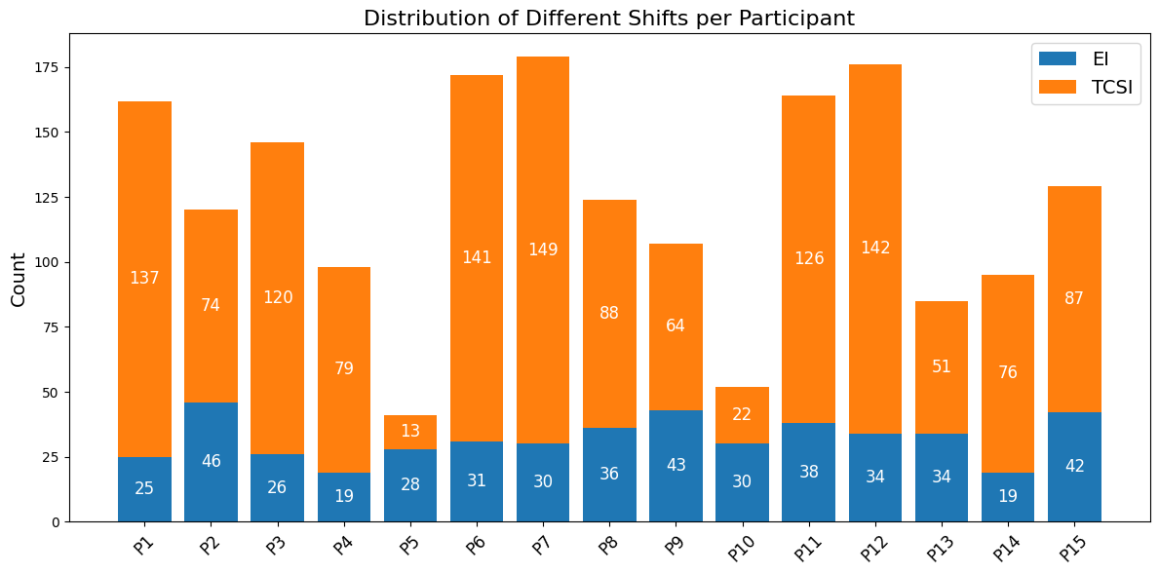
Method
Dataset
15 participants (8 males, 7 females; age 20-30 years)
Time-frequency representations
Focused on epochs surrounding each attention shift (gaze shift)
Pre-shift time window of -2.0 s to -0.5 s relative to the shift onset (0 s)
Notes:
The final analysis included 15 participants, eight male and seven female, aged 20 to 30 years. For each attention shift, we built time-frequency representations around the gaze shift. The main analysis focused on the pre-shift window from minus 2.0 seconds to minus 0.5 seconds. We chose this window to capture preparatory activity while reducing direct contamination from the eye movement itself.

Slide 8
Method
Setups
Experimental settings
Input: single-band vs. multiband
Within-subject: 3-fold stratified cross-validation for each subject
Cross-subject: leave-one-subject-out (LOSO) validation across subjects (classification only)
Evaluation metrics: Accuracy, Receiver Operating Characteristic curves (ROC) curves, and Area Under the Curve (AUC)
Theta: 4~7 Hz
Alpha: 8~12 Hz
Low Beta: 13~20 Hz
High Beta: 20~30 Hz
Gamma: 30~40 Hz
Multiband input
(5 sequences)
Single-band input
(1 sequence)
Model: Random forest
Pipeline: input → feature extraction → model training → importance analysis (score-based importance analysis & SHAP analysis)
Notes:
We compared single-band and multi-band inputs. The five bands were theta, alpha, low beta, high beta, and gamma. For each subject, we used three-fold stratified cross-validation. We also tested cross-subject generalization with leave-one-subject-out validation. The classifier was a random forest, followed by feature-importance and SHAP analyses. Performance was evaluated by accuracy, ROC curves, and AUC.

Slide 9
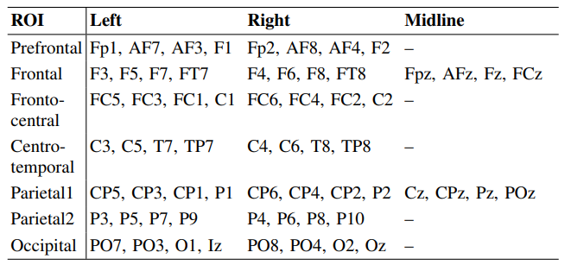
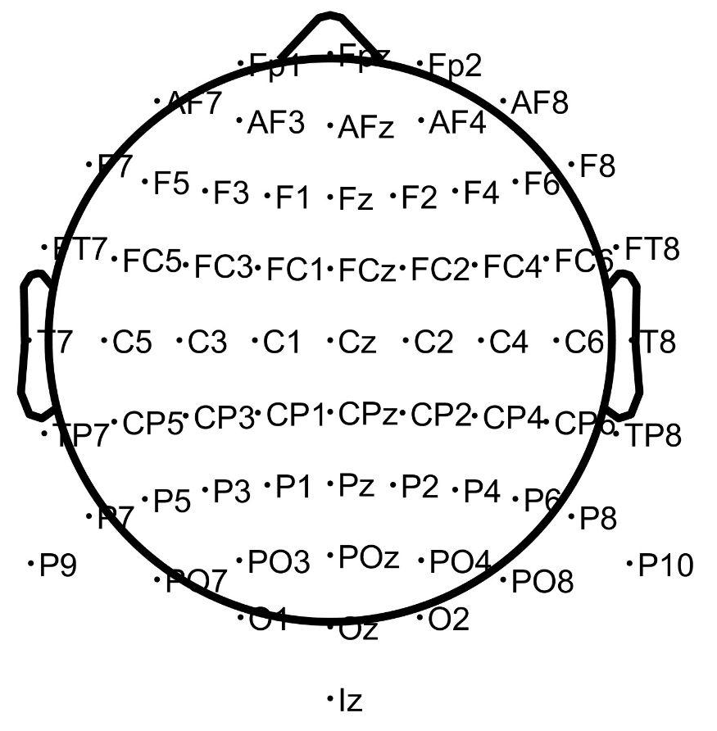
Method
Feature Extraction: Trial-wise features
Global features
Whole-brain summary of (mean, std, energy)
Temporal variability (std of global activity over time)
Spatial variability (std across channels)
Region-of-interest (ROI) features
First/second-order features (mean, std, median, power magnitude..)
Higher-order features (skewness, kurtosis)
Intra-ROI spatial variability (mean channel std & peak-to-peak range)
Window-based ROI dynamics (with a 0.2 s window and 0.1 s step)
Sliding-window (mean, std, integrated power)
Across-window variability (std, range, change rate)
Connectivity & asymmetry features
ROI-to-ROI correlations
Hemispheric and anterior–posterior asymmetry
Prefrontal
Frontal
Fronto-central
Parietal
Parietal 2
Centro-temporal
Occipital
Midline-frontal
Midline-parietal
Notes:
The feature set was designed to capture several aspects of EEG activity. Global features summarized whole-brain statistics such as mean activity, variability, and energy. ROI features described activity in prefrontal, frontal, parietal, occipital, midline, and centro-temporal regions. We also included window-based dynamics, connectivity between ROIs, and asymmetry features. So the classifier could use spectral, spatial, temporal, and inter-regional information.

Slide 10
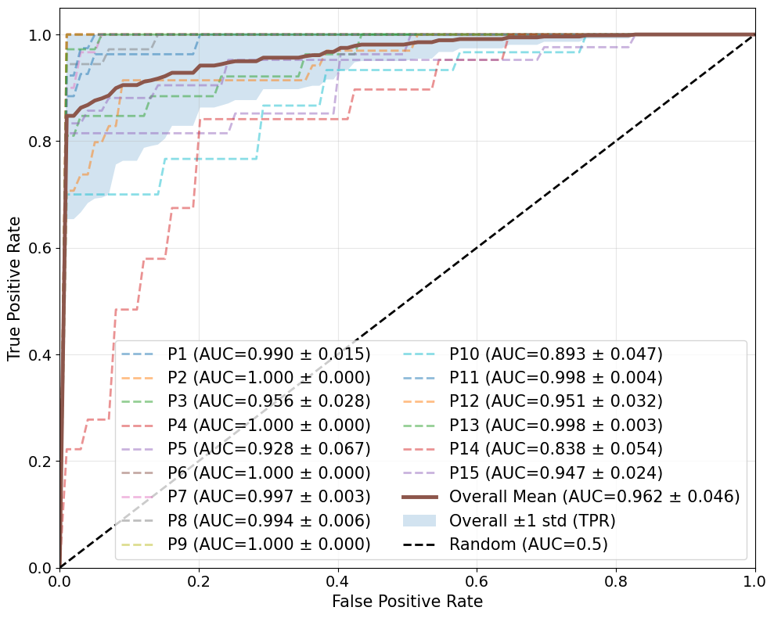
Result
within-subject classification
Table I. within-subject classification accuracy and AUC
 | Multi-band | Theta | Alpha | Low Beta | High Beta | Gamma
Acc. | 0.936 ± 0.046 | 0.782 ± 0.161 | 0.803 ± 0.107 | 0.886 ± 0.077 | 0.923 ± 0.054 | 0.929 ± 0.058
AUC | 0.974 ± 0.032 | 0.780 ± 0.160 | 0.805 ± 0.134 | 0.916 ± 0.077 | 0.956 ± 0.035 | 0.965 ± 0.037
In contrast:
cross-subject classification remained at chance level, highlighting substantial inter-individual variability.
Notes:
The first main result is that within-subject classification worked well. The multi-band model achieved an average accuracy of 0.936 and an AUC of 0.974. Among single bands, gamma and high beta also showed strong performance, with AUC values around 0.965 and 0.956. Lower-frequency bands were still above chance, but weaker. Importantly, when we moved to cross-subject classification, performance remained around chance level. This means the discriminative information is reliable within individuals, but it does not transfer easily across people. For BMI applications, this points to the need for personalized models.

Slide 11
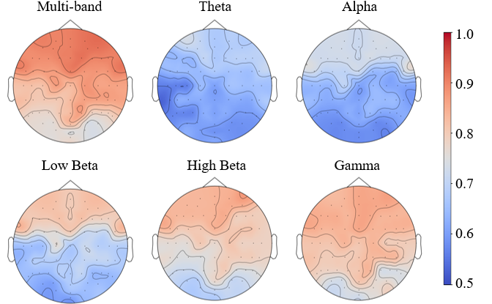
Result
within-subject classification
Band-Specific Topographic Importance Analysis: a performance-oriented analysis (AUC) based on spatial patterns
For each frequency band, EEG power was averaged over the pre-shift time window and projected onto the scalp to obtain time-averaged topographic maps
Suggesting that different bands provide complementary information for the classification model under the current feature representation
Notes:
Next, we examined where the discriminative information appeared on the scalp. For each frequency band, EEG power was averaged over the pre-shift window and projected onto topographic maps. The maps suggest that different frequency bands contribute different spatial patterns. High-frequency bands showed stronger discriminative structure, while other bands provided complementary information. I want to emphasize that this is a performance-oriented analysis: it shows which spatial patterns help classification, not a direct causal map of the brain.

Slide 12
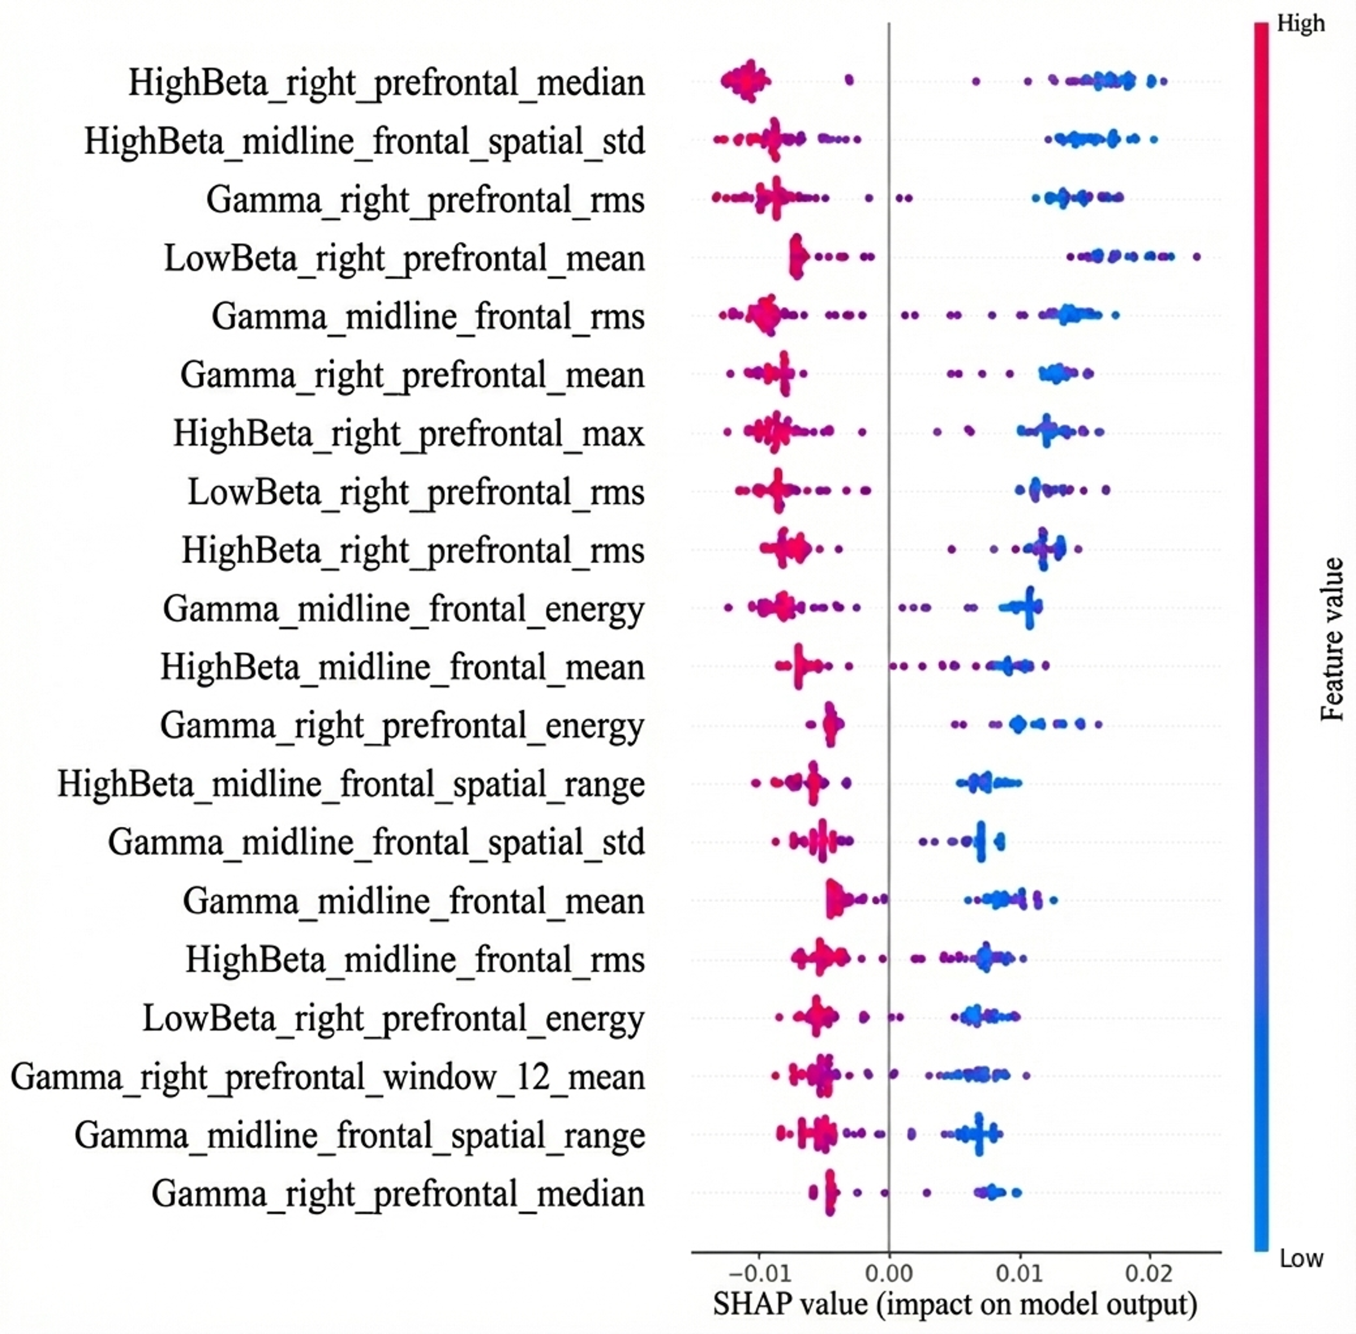
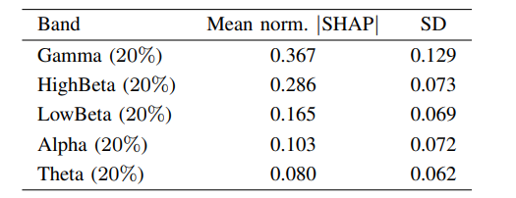
Result
within-subject SHAP-Based Explanation
SHAP-based Explanation
Table II. band-level normalized SHAP contributions
(standard deviation)
Notes:
To interpret the multi-band model, we used SHAP. At the band level, gamma had the largest normalized contribution, followed by high beta, then low beta, alpha, and theta. This agrees with the classification result: high-frequency features were especially useful for the model. At the same time, this does not mean gamma is the neural mechanism of self-initiated attention. High-frequency EEG can include muscle or oculomotor / ˌɑːkjəloʊˈmoʊtər / components, so we interpret these features as discriminative signals recorded by EEG.

Slide 13
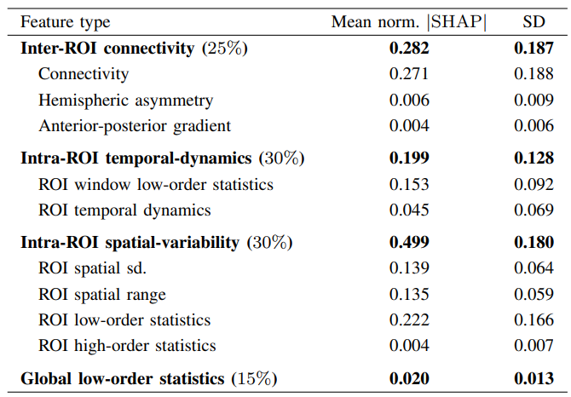
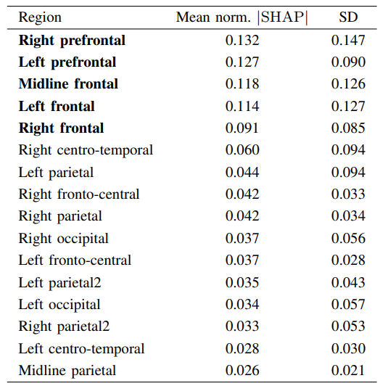
Result
within-subject SHAP-Based Explanation
Table III. Feature-level normalized SHAP contributions
Table IV. ROI-level normalized SHAP contributions
Notes:
At the feature-type level, intra-ROI spatial variability made the largest contribution, followed by connectivity and temporal-dynamic features. This suggests that the model did not rely only on absolute power in one region. It also used how activity varied within regions and how regions related to each other. At the ROI level, prefrontal and frontal regions had the largest contributions, especially right prefrontal, left prefrontal, and midline frontal areas. This is consistent with the idea that preparatory control processes are important, but again the SHAP result describes model behavior.

Slide 14
Discussion
Discriminative does not automatically mean neural
What the analysis supports
What remains uncertain
The pre-shift EEG-recorded signal contains subject-specific information.
Spatial patterns and inter-regional relationships both contribute.
Personalization is essential; cross-subject transfer remains unsolved.
Interpret SHAP as model behavior,
not a causal map of brain mechanisms.
Gamma and high-beta activity may include EMG or oculomotor components.
Shift onset is defined using eye tracking.
Feature design and model structure affect attributions.
Notes:
The central message is that discriminative does not automatically mean neural. What our analysis supports is that the pre-shift EEG-recorded signal contains subject-specific information that distinguishes TCSI from EI. Spatial patterns, feature variability, and inter-regional relationships all contributed to the model. The failed cross-subject result also shows that personalization is essential. What remains uncertain is the exact origin of some discriminative signals. Gamma and high-beta activity may include EMG or oculomotor components. Shift onset was defined using eye tracking, and feature design can affect SHAP attributions. So the safest interpretation is that this framework reveals subject-specific discriminative structure, not a complete causal explanation of voluntary attention.

Slide 15
Conclusion
Purpose and result:
Whether preparatory EEG activity can distinguish internally initiated attention shifts from externally instructed shifts under matched visual stimulation?
strong within-subject decoding performance, but weak cross-subject transfer
SHAP and topographic analyses suggest that high-frequency features, frontal regions, spatial variability, and connectivity all contributed to model decision
Future Goals:
Artifact control, cross-subject generalization, and personalized asynchronous BMI.
Notes:
To conclude, we asked whether preparatory EEG activity can distinguish internally initiated attention shifts from externally instructed shifts under matched visual stimulation. Using subject-specific random-forest models, we found strong within-subject decoding performance, but weak cross-subject transfer. SHAP and topographic analyses suggest that high-frequency features, frontal regions, spatial variability, and connectivity all contributed to model decisions. Future work should improve artifact control, test more generalizable models, and move toward personalized asynchronous BMI systems.

Slide 16
WORKSHOP ON BRAIN-MACHINE INTERFACES
IEEE SMC 2026
October 4-7, 2026
Thank You – Q & A
Yuwen Zeng, Dengzhe Hou, Zhang Zhang, Sai Sun, Yongsong Huang, Chia-huei Tseng, and Satoshi Shioiri
Advanced Institute of Convergence Knowledge Informatics
Tohoku University, Japan
Notes:
Thank you for your attention. I would be happy to take any questions.

