Slide 1

SA-HGNN: Sample-Adaptive Hyperbolic Graph Neural Network for EEG-Based Depression Recognition
Huazhong University of Science and Technology, 430074 Wuhan, China
Presenter: Pan Hu
Notes:
Hello everyone, I am Pan Hu from Huazhong University of Science and Technology. Today I will present SA-HGNN, a sample-adaptive hyperbolic graph neural network for EEG-based depression recognition. In this talk, I will explain why we did this work, how the method is designed, and what the experiments show. The talk is organized as follows. We start with the background and the challenges, then explain our motivation for using hyperbolic geometry. Next, I will walk through the three core modules of the method, followed by the experimental setup and results on public datasets. Finally, I will summarize the work and discuss future directions.

Slide 2
Outline
Introduction
Motivation
Method
Experiments and Results
Conclusion and Future Work
Notes:
The talk has five parts. First, the introduction, which covers the background of depression and EEG, and the challenges of modeling brain networks with existing graph models. Second, the motivation, which explains why we adopt hyperbolic geometry and summarizes our three contributions. Third, the method, which consists of three core modules: sample-adaptive graph construction, hyperbolic graph convolution, and attention pooling. Fourth, the experimental setup and results on public datasets, including comparisons with seven baselines, ablation studies, and sensitivity analysis. Finally, the conclusion and future work. I will keep each part focused, with the key message on every page.

Slide 3
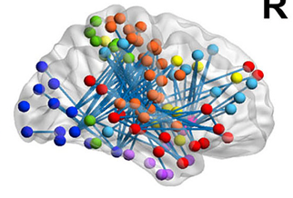
Introduction
Background
Depression affects over 332 million people worldwide, yet early symptoms are subtle. EEG is non-invasive, low-cost, and offers high temporal resolution. Depression disrupts whole-brain functional connectivity, whose hierarchical "rich-club" hubs are severely damaged in patients.
EEG Recording
​
Challenges
Existing GNNs compute in Euclidean space, which distorts exponentially growing hierarchies; static graphs miss individual differences, and noise channels mask the true topology.
Brain Functional Connectivity
WHO, 2025; Kaiser et al., 2015 (JAMA Psychiatry); van den Heuvel & Sporns, 2011 (J. Neurosci.); Wang et al., 2016 (Sci. Rep.); Fries, 2015 (Neuron); Nickel & Kiela, 2017 (NeurIPS)
Notes:
Depression is a global health crisis. According to the World Health Organization, more than three hundred thirty two million people are affected worldwide, and the economic loss is enormous, while early symptoms are subtle, so timely and objective diagnosis is critical. EEG is non-invasive, low-cost, and offers high temporal resolution, which is why it is widely used to study brain activity in depression. Neurophysiological studies show that depression is not a localized lesion but a disorder of whole-brain functional connectivity. Brain networks form a hierarchical rich-club structure: a small set of highly connected hub nodes links many peripheral nodes, and these hubs are severely disrupted in patients with depression. The images on this page show the two foundations of our work: an EEG recording session, which gives us the non-invasive signals, and a whole-brain functional connectivity network, where regions are nodes and connections are edges.
However, this hierarchy creates serious difficulties for existing methods. Most graph neural networks operate in Euclidean space, which cannot faithfully represent structures that grow exponentially with depth, so the hierarchy becomes distorted. In addition, static graph topologies are too rigid to capture connectivity differences between individuals, and redundant noise channels in EEG tend to mask the authentic topology. These are the three gaps that our work aims to close: the representation bottleneck of Euclidean space, the rigidity of static graphs, and the interference of noise channels. The references at the bottom support these claims, covering the global burden of depression, large-scale network dysfunction, the rich-club organization of the connectome, and early hyperbolic embeddings.

Slide 4
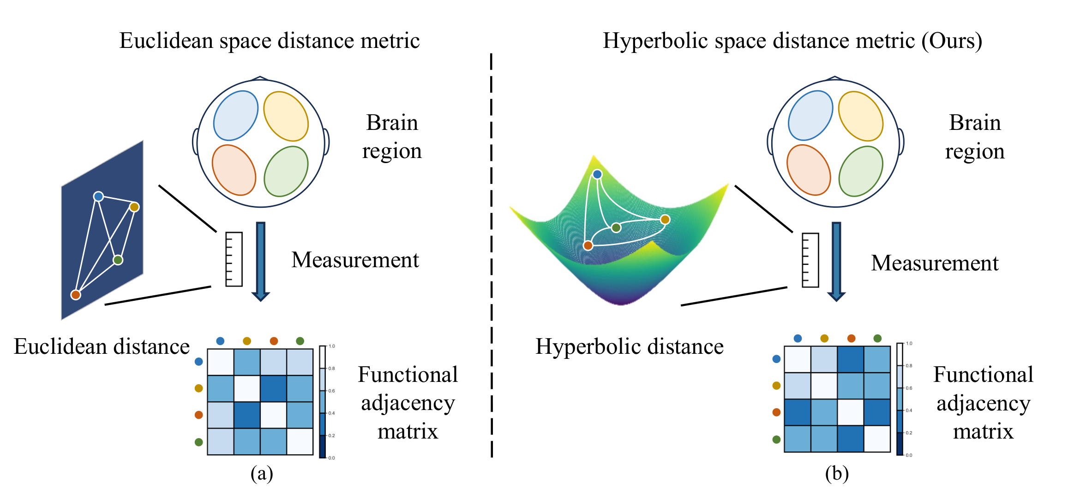
Motivation
Motivation
Brain hierarchies grow exponentially, so hyperbolic space represents them with low distortion, unlike Euclidean space. As the schematic shows, the same connectivity unfolds naturally in hyperbolic space; topologies must also be sample-adaptive and noise-filtered.
Contributions
First hyperbolic GNN for MDD brain networks: SAGC builds personalized topologies; HGC + AP capture hierarchy and filter noise; experiments achieve state-of-the-art on resting and task EEG.
(a) Euclidean metric (b) Hyperbolic metric (Ours)
Nickel & Kiela, 2017 (NeurIPS); Chami et al., 2019 (NeurIPS); Ganea et al., 2018 (NeurIPS); Bessadok et al., 2022 (IEEE TPAMI); Lee et al., 2019 (ICML); Kipf & Welling, 2017 (ICLR)
Notes:
These gaps directly shape our motivation. Because brain hierarchies grow exponentially, we turn to hyperbolic space, whose constant negative curvature lets tree-like structures unfold with low distortion. The schematic on this page makes the point visually: panel a shows the Euclidean metric, where the same connectivity pattern is compressed and the hierarchy is squeezed; panel b shows the hyperbolic metric we adopt, where the pattern unfolds naturally and each level keeps its separation. Since connectivity differs across individuals, the graph topology should also adapt to each sample rather than staying fixed. And because noise channels can hide informative connections, we need an attention mechanism to keep the core subgraph.
Based on this motivation, we make three contributions. First, we design a sample-adaptive graph construction module that builds a personalized topology for every sample, overcoming the rigidity of static graphs. Second, we combine hyperbolic graph convolution with attention pooling, so the model captures hierarchy in hyperbolic space while filtering noisy channels. Third, experiments on public EEG datasets show that our method achieves state-of-the-art performance on both resting-state and task-related paradigms, outperforming existing Euclidean-space graph models. The references below cover the foundations we build on: hyperbolic embeddings, hyperbolic graph convolution, graph pooling, and graph neural networks in network neuroscience.

Slide 5
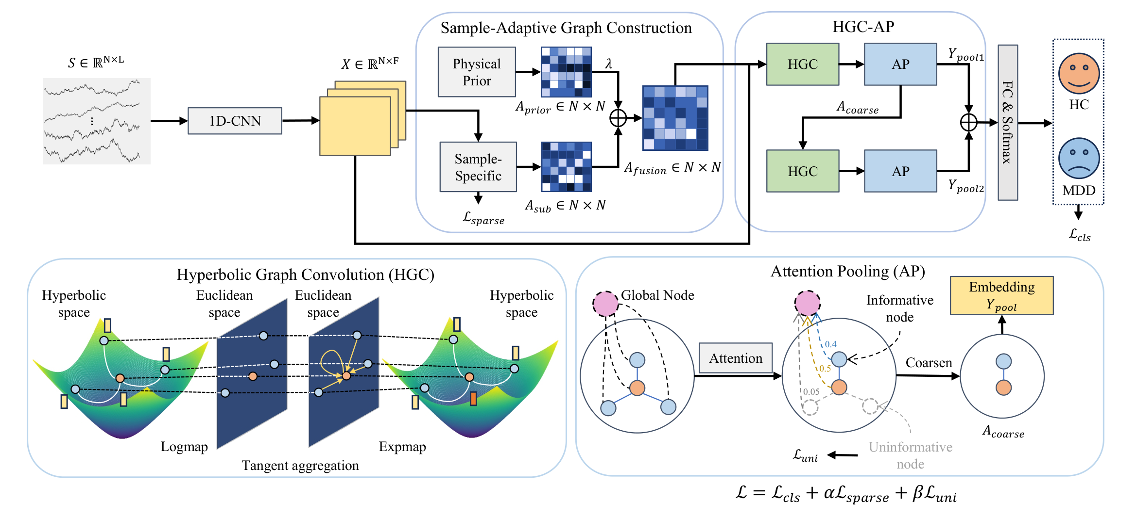
Method
​
SAGC graph construction
HGC hyperbolic convolution
AP attention pooling
Notes:
Here is the overall pipeline of SA-HGNN. First, raw EEG signals are organized as a matrix with channels and time points. A one-dimensional CNN extracts per-channel temporal features, giving a node feature matrix, where each electrode becomes a node. Then the sample-adaptive graph construction module generates a personalized adjacency matrix for each sample, instead of using one fixed graph for everyone. Next, stacked hyperbolic convolution and attention pooling layers work together: hyperbolic graph convolution aggregates information and captures the hierarchy in hyperbolic space, while attention pooling selects the important nodes and removes noise. After several layers, the global embeddings from all layers are summed to form a fused graph embedding, which is passed to a linear classifier for depression classification. This figure shows the complete chain from EEG features, adaptive graph construction, hyperbolic convolution and attention pooling, to the final classification. You can see the three module names on the figure: graph construction, hyperbolic convolution, and attention pooling. I will explain each module in detail next.

Slide 6
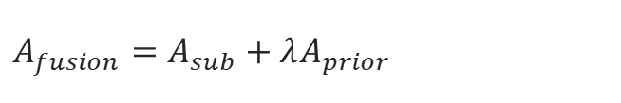
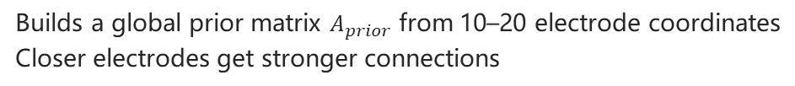
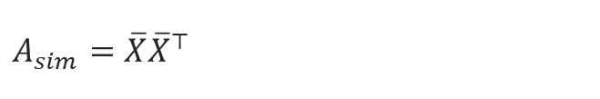
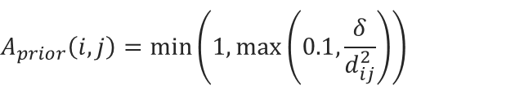
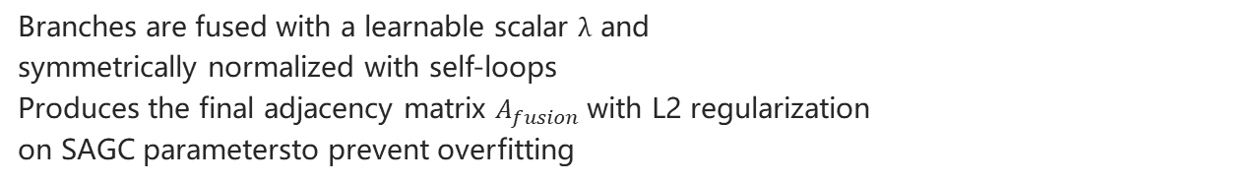
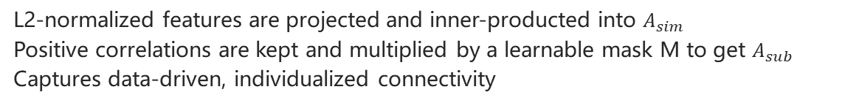
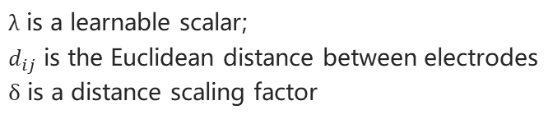
Module 1: Sample-Adaptive Graph Construction (SAGC)
1
Physical prior branch
Physical prior
Builds a global prior matrix $A_{prior}$ from 10–20 electrode coordinates
Closer electrodes get stronger connections
$$A_{prior}\left(i,j\right)=\min\left(1,\max\left(0.1,\frac{δ}{d_{ij}^{2}}\right)\right)$$
Sample correlation
2
Sample-specific correlation branch
$$A_{sim}=\overline{X}{\overline{X}}^{⊤}$$
L2-normalized features are projected and inner-producted into $A_{sim}$
Positive correlations are kept and multiplied by a learnable mask M to get $A_{sub}$
Captures data-driven, individualized connectivity
​
Fusion
$$A_{fusion}=A_{sub}+λA_{prior}$$
3
Fusion and normalization
Branches are fused with a learnable scalar $λ$ and
symmetrically normalized with self-loops
Produces the final adjacency matrix $A_{fusion}$ with L2 regularization
on SAGC parametersto prevent overfitting
$λ$ is a learnable scalar;
$d_{ij}$ is the Euclidean distance between electrodes
$δ$ is a distance scaling factor
Notes:
The first module is sample-adaptive graph construction. It fuses two branches. The physical prior branch builds a global prior matrix from the international ten-twenty electrode coordinates. Closer electrodes get stronger connections, the formula uses the inverse squared distance, the values are clipped into a fixed range, and the diagonal is set to zero, so no electrode is connected to itself. The sample-specific correlation branch is data-driven: it L2-normalizes the features, projects them through a linear layer, and computes a similarity matrix by inner product. It keeps only positive correlations, then multiplies them by a learnable mask to obtain individual connections. The two branches are fused with a learnable scalar lambda, so the model can balance the physical layout and the data-driven correlations. Finally, self-loops are added and the matrix is symmetrically normalized to give the final adjacency matrix. To prevent overfitting, we also apply L2 regularization to the parameters of this module. The resulting graph keeps both the physical prior and each sample's unique connectivity, so it is much more flexible than a static graph.

Slide 7
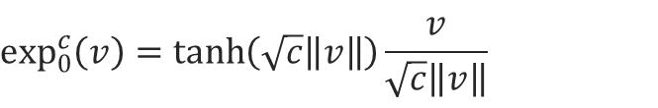
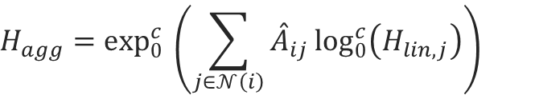
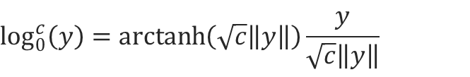
Module 2: Hyperbolic Graph Convolution (HGC)
1
Mapping to hyperbolic space
Exponential map (Euclidean → hyperbolic)
Euclidean features are projected to the tangent space and
mapped by exp into the Poincaré ball; curvature c is learnable
$$\exp_{0}^{c}\left(v\right)=\tanh\left(\sqrt{c}\left\|v\right\|\right)\frac{v}{\sqrt{c}\left\|v\right\|}$$
Logarithmic map (hyperbolic → Euclidean)
Transformation and aggregation
$$\log_{0}^{c}\left(y\right)=\operatorname{arctanh}\left(\sqrt{c}\left\|y\right\|\right)\frac{y}{\sqrt{c}\left\|y\right\|}$$
2
Linear transformation and neighbor aggregation run in the
tangent space with weights from the adaptive adjacency matrix Â
Neighbor aggregation in the tangent space
​
$$H_{agg}=\exp_{0}^{c}{​\left(\sum_{j∈𝒩\left(i\right)}{{\overset{ˆ}{A}}_{ij}\log_{0}^{c}\left(H_{lin,j}\right)}\right)}$$
3
Mapping back to Euclidean space
After activation, aggregated features return via log
to Euclidean space, matching the brain network hierarchy
𝒩(i): neighbor set of node i;
Â: normalized adjacency matrix
Notes:
The second module is hyperbolic graph convolution, which adds hyperbolic geometry to graph convolution. First, Euclidean features are projected to the tangent space, then mapped into the Poincare ball through the exponential map, with the curvature learned as a parameter. Linear transformation and neighbor aggregation both run in the tangent space. The linear transformation applies a learnable weight matrix and bias, and the neighbor aggregation uses the weights from the adaptive adjacency matrix, summing the information of neighboring nodes for each node. After activation, the aggregated features are mapped back to Euclidean space through the logarithmic map for the next layer. The exponential and logarithmic maps are inverse to each other, which makes the transformation between Euclidean and hyperbolic space reversible, so the whole layer fits into a standard neural network. The benefit is that hierarchical brain structures can be represented with low distortion in hyperbolic space, because the space expands exponentially with distance, matching the exponentially growing hierarchy of the brain network. Therefore, the hierarchy is no longer distorted by Euclidean distance.

Slide 8
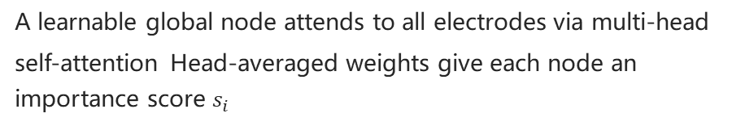
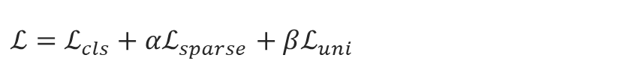
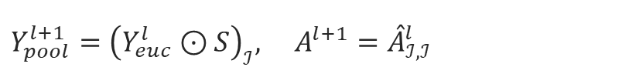
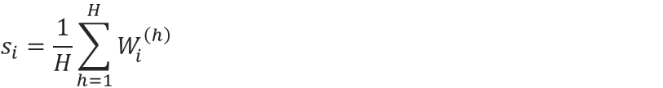
Module 3: Attention Pooling (AP) and Loss
1
Global node scoring
Node importance score (averaged over H heads)
A learnable global node attends to all electrodes via multi-head self-attention Head-averaged weights give each node an importance score $s_{i}$
$$s_{i}=\frac{1}{H}\sum_{h=1}^{H}{W_{i}^{\left(h\right)}}$$
Pooled features and coarsened adjacency
Top-K selection forms a coarsened graph
$$Y_{pool}^{l+1}={\left(Y_{euc}^{l}⊙S\right)}_{ℐ}, A^{l+1}={\overset{ˆ}{A}}_{ℐ,ℐ}^{l}$$
2
Each layer keeps the K highest-scoring nodes
to obtain pooled features and a coarsened adjacency matrix
Total loss
​
$$ℒ=ℒ_{cls}+αℒ_{sparse}+βℒ_{uni}$$
3
Uniformity constraint
An AP uniformity loss constrains discarded nodes
to mitigate over-smoothing and keep representation diversity
Global embeddings are summed across layers
and fed to a linear classifier
Notes:
The third module is attention pooling and loss design. We introduce a learnable global node that attends to all electrode nodes with multi-head self-attention, and we average the attention weights over the heads to get an importance score for each node. Each layer keeps only the top K nodes with the highest scores to form a coarsened graph, which removes noise and redundant channels. The pooled features are weighted by the importance scores before selection. To reduce over-smoothing and keep representation diversity, we constrain the features of the discarded nodes to be close to a uniform distribution, which is the attention pooling uniformity loss. The total loss has three parts: the cross-entropy classification loss, a sparsity regularizer that encourages simple graph topologies, and the uniformity loss, balanced by the coefficients alpha and beta. This design lets the model focus on the most informative nodes while keeping the learned features diverse.

Slide 9
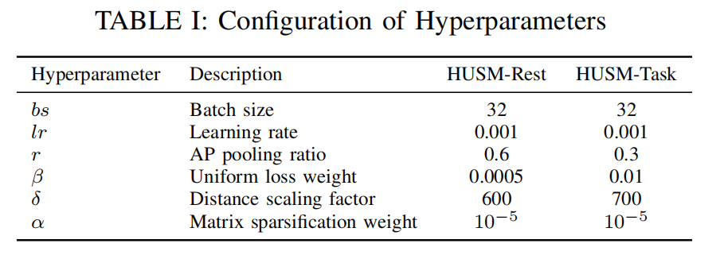
Experiments and Results
Public HUSM dataset
34 MDD patients + 30 healthy controls; 256 Hz
19 electrodes (international 10–20 system)
Includes resting-state (Rest) and task-related (Task) EEG
Data split
HUSM-Rest: 3,726 MDD + 3,588 HC segments
HUSM-Task: 13,200 MDD + 11,200 HC samples
Segmented after standard preprocessing and artifact rejection
​
Evaluation protocol
Subject-wise 10-fold cross-validation prevents information leakage
Metrics: ACC / REC / PRE / F1; hardware: NVIDIA RTX 4090
Mumtaz et al., 2017 (PLoS ONE); Seal et al., 2021 (IEEE TIM); Song et al., 2018 (IEEE TAC); Acharya et al., 2018 (Comput. Methods Programs Biomed.)
Notes:
We evaluate our method on the public HUSM dataset, which contains EEG recordings from thirty four MDD patients and thirty healthy controls, sampled at two hundred fifty six hertz with nineteen electrodes following the international ten-twenty system. The dataset includes two paradigms. The resting-state set reflects spontaneous brain activity without external tasks, and it contains three thousand seven hundred twenty six MDD segments and three thousand five hundred eighty eight control segments. The task-related set captures stimulus-evoked responses during task execution, with thirteen thousand two hundred MDD samples and eleven thousand two hundred control samples. We use subject-wise ten fold cross-validation, so data from the same subject never appears in both training and test sets, preventing information leakage. The metrics are accuracy, recall, precision, and F1, and the hardware is an NVIDIA RTX 4090. The hyperparameters were tuned on these datasets, for example the pooling ratio is zero point six for the resting state and zero point three for the task state.

Slide 10
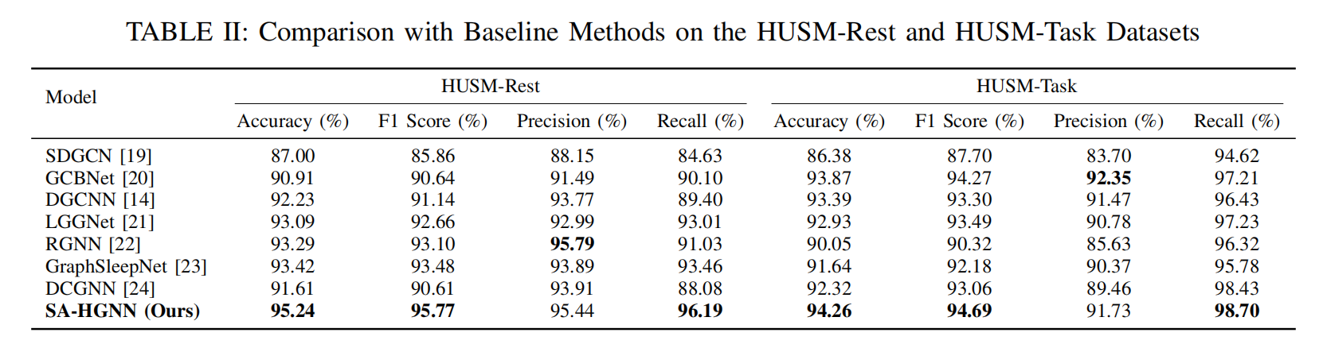
Main Results: Comparison with 7 Baselines
​
Rest: ACC 95.24% (+1.82) · F1 95.77% (+2.29) · REC 96.19% (+2.73) vs. GraphSleepNet
Task: ACC 94.26% (+0.39) · F1 94.69% (+0.42) · REC 98.70% vs. GCBNet
Notes:
We compare SA-HGNN with seven graph-based baselines. The main results show that SA-HGNN achieves the best performance on most metrics on both datasets. On the resting-state set, accuracy is ninety five point two four percent, F1 is ninety five point seven seven, and recall is ninety six point one nine. Compared with the second-best method GraphSleepNet, the gains are about one point eight two percentage points in accuracy, two point two nine in F1, and two point seven three in recall. On the task set, accuracy is ninety four point two six, F1 is ninety four point six nine, and recall reaches ninety eight point seven, again beating all baselines, with GCB Net as the second best. Notably, our recall is the highest on both paradigms, and on the task set it exceeds the second-best method DCGNN by a clear margin. High recall means fewer missed patients, which is valuable for clinical screening. These results also validate that the graph construction and hyperbolic convolution capture latent hierarchical brain networks, while attention pooling filters out noise.

Slide 11
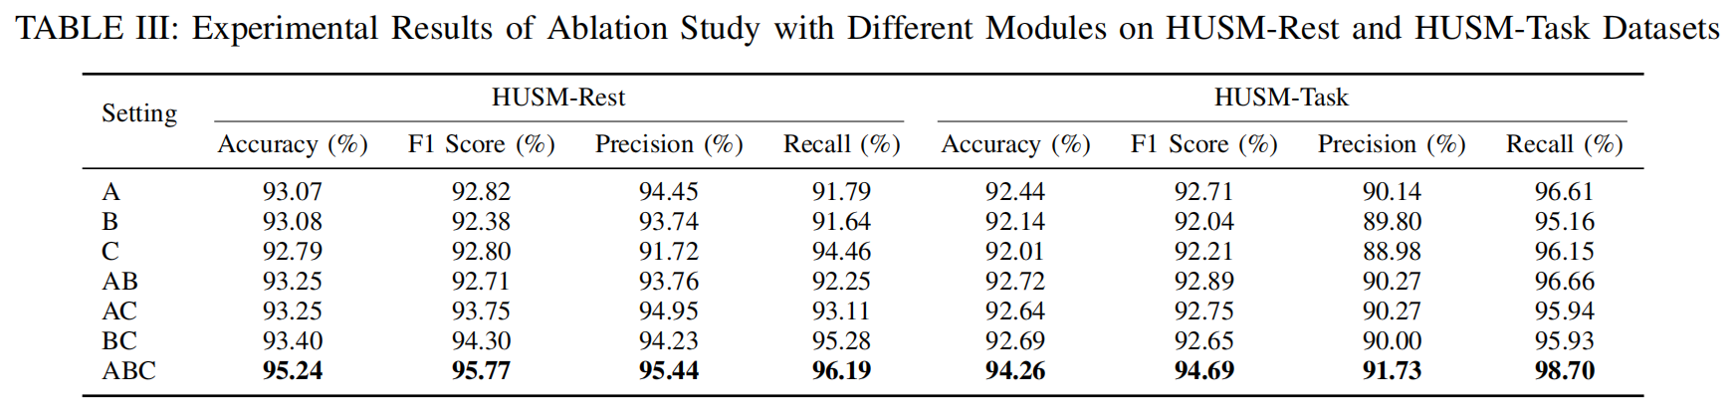
Ablation Study: Synergy of the Three Modules
Single modules A / B / C
Full model ABC is best
Each reaches a stable baseline (ACC ≈ 92–93%) and works alone
Rest：95.24 / 95.77；Task：94.26 / 94.69
Pairwise combinations AB / AC / BC
The three modules reinforce each other to form
a complete framework
Consistent gains show synergy between modules
Notes:
In the ablation study, we denote the three modules as A, B, and C, where A is hyperbolic graph convolution, B is sample-adaptive graph construction, and C is attention pooling. The results verify the contribution of each module. Any single module alone keeps accuracy stable around ninety two to ninety three percent, which shows each module works as a solid baseline. Pairwise combinations bring consistent gains, which shows synergy between the modules. The full model with all three modules performs best, with ninety five point two four accuracy and ninety five point seven seven F1 on the resting state, and ninety four point two six and ninety four point six nine on the task state. This confirms that graph construction, hyperbolic convolution, and attention pooling reinforce each other and are all necessary.

Slide 12
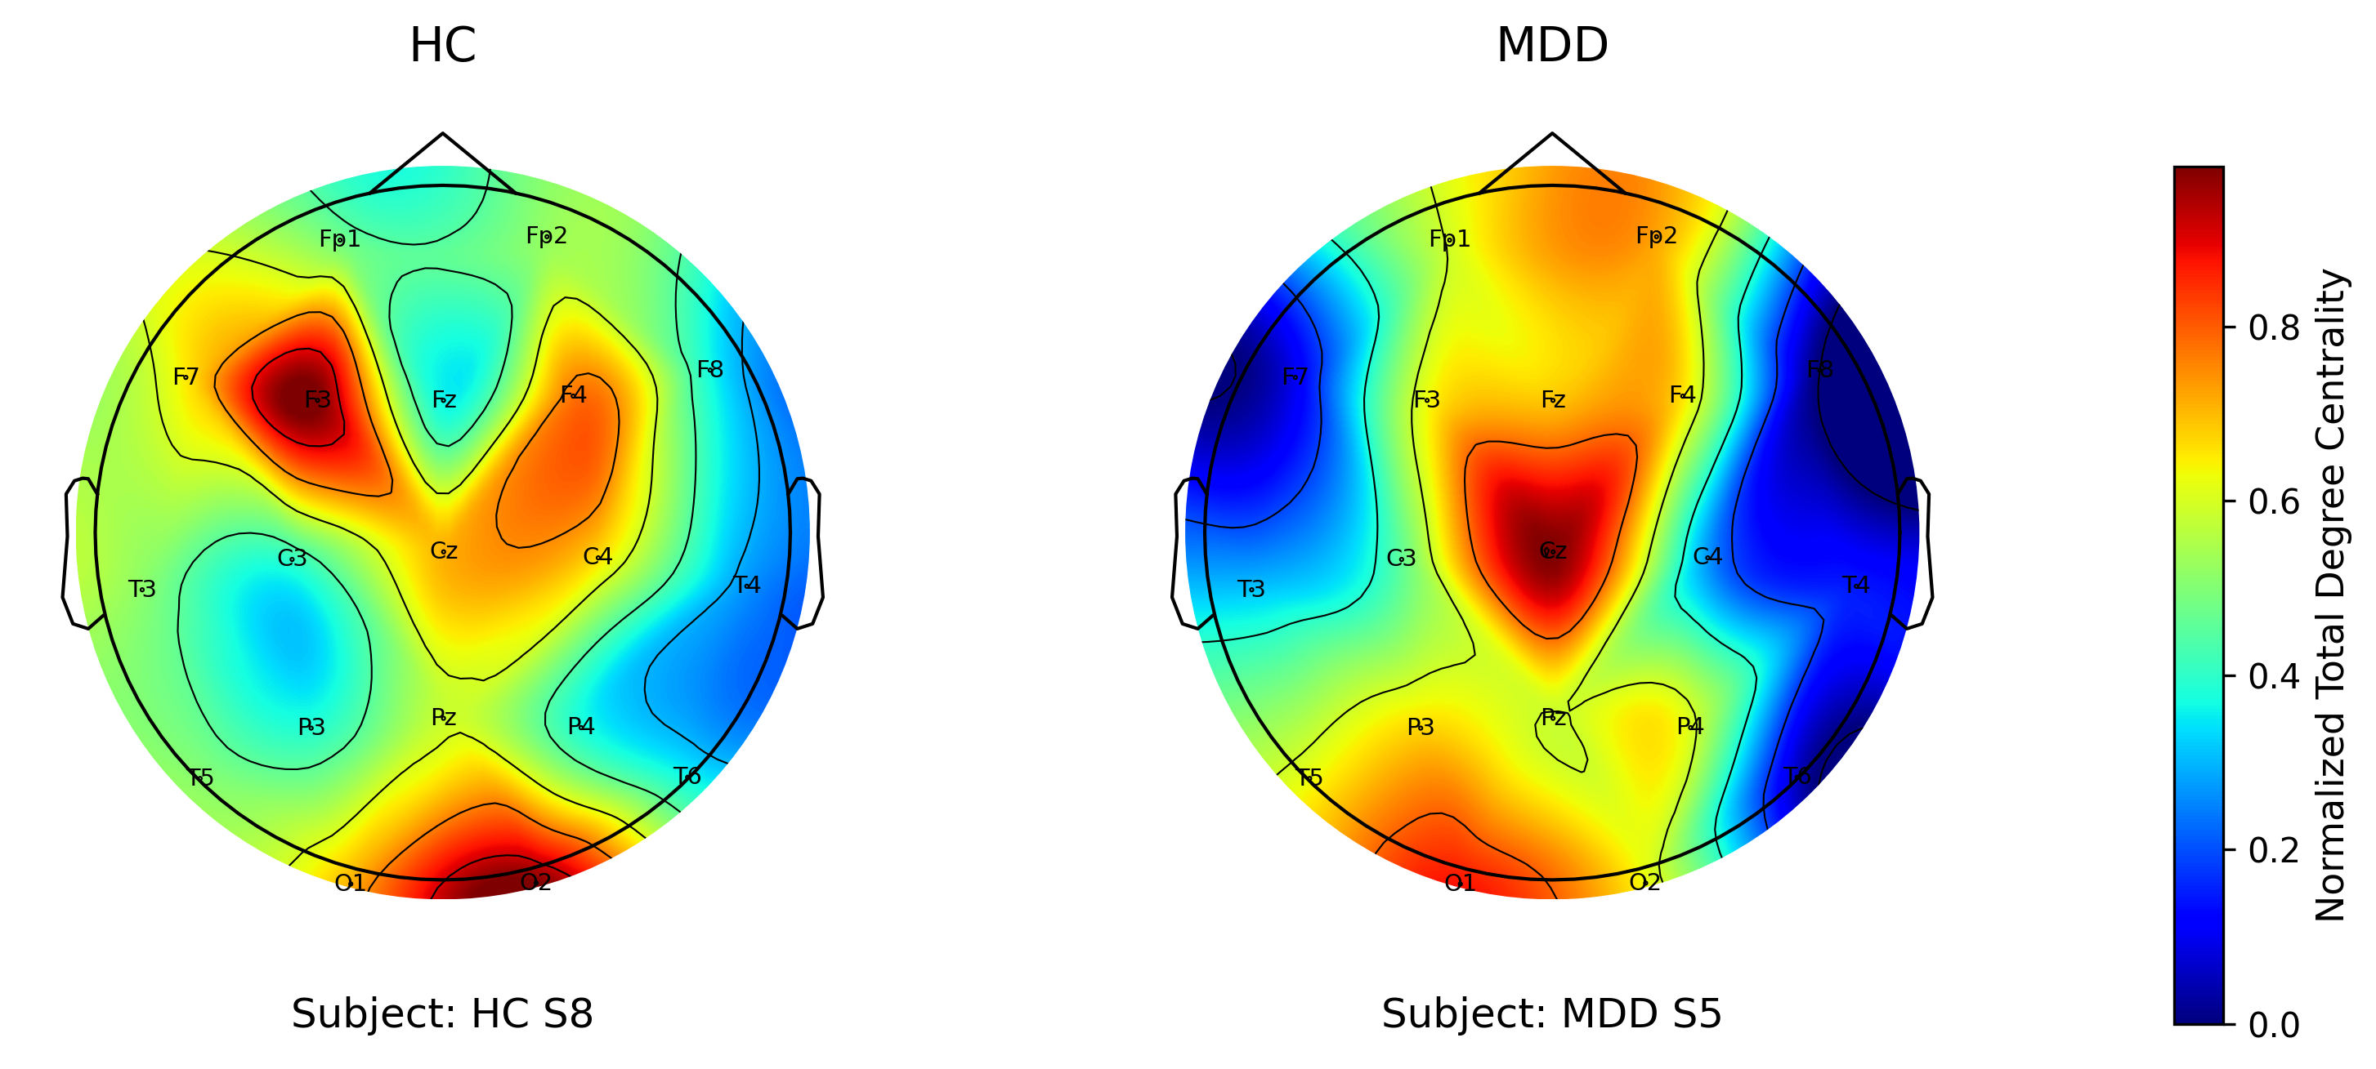
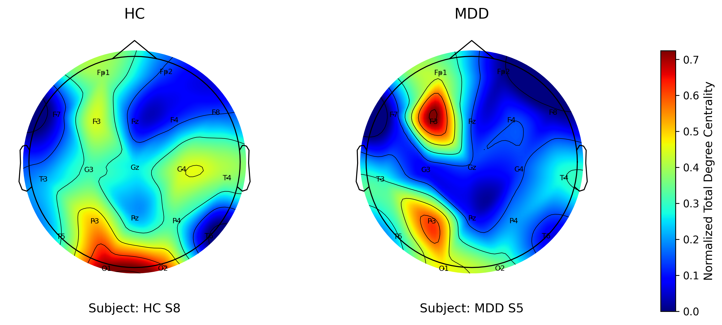
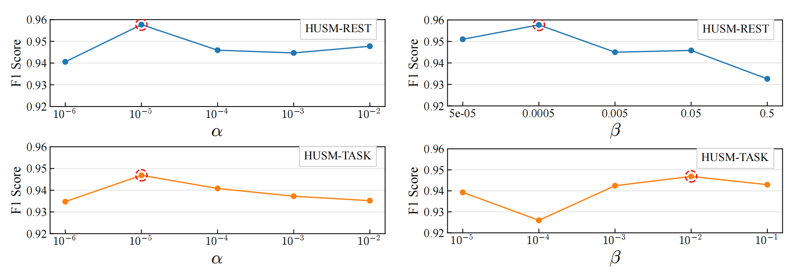
Parameter Sensitivity and Brain Connectivity Visualization
HUSM-Rest topomap
​
HUSM-Task topomap
$α$: 1e-5 gives the best F1 on both datasets, stable from 1e-6 to 1e-2
$β$: 0.0005 (Rest) / 0.01 (Task) is best and stable within range → robust
Resting state: hyperconnectivity in midline central regions
(default-mode overactivation)
Task state: significant left frontoparietal alterations
(emotional–cognitive deficits)
Notes:
We also analyze parameter sensitivity and interpretability. The four plots on this page show sensitivity to the sparsity weight alpha and the uniformity weight beta. Alpha equal to ten to the minus five is optimal on both datasets, and performance stays stable from ten to the minus six to ten to the minus two, which shows strong robustness. Beta is optimal at zero point zero zero zero five for the resting state and zero point zero one for the task state, and performance remains stable across a reasonable range. The two topomaps are computed from the learned adjacency matrix using normalized total degree centrality. In the resting state, MDD patients show hyperconnectivity in midline central regions, consistent with default-mode network overactivation. In the task state, left frontoparietal regions show significant changes, related to emotional and cognitive deficits. These patterns indicate that the connectivity captured by our model has neurobiological meaning.

Slide 13
Conclusion and Future Work
Summary
Future work
In summary, SA-HGNN combines sample-adaptive graph construction, hyperbolic graph convolution, and attention pooling to model the hierarchical brain networks of depression, achieving state-of-the-art results on both resting-state and task-related EEG.
1
In future work, we will validate generalization on more datasets, integrate multimodal biomarkers for clinical utility, and deepen interpretability to support clinical decision-making and neuroscience research.
2
​
3
Rest：ACC 95.24% · F1 95.77%
Task：ACC 94.26% · F1 94.69%
Best performance on both paradigms
Outperforms all Euclidean-space GNN baselines
Notes:
In summary, SA-HGNN combines three modules. Sample-adaptive graph construction fuses physical priors with individual correlations to build personalized topologies. Hyperbolic graph convolution embeds the hierarchy in hyperbolic space with low distortion. Attention pooling filters noisy channels and keeps the core subgraph. With these modules, the model achieves the best performance on both resting-state and task-related paradigms, outperforming all Euclidean-space graph baselines. Together, these results show that modeling the hierarchical nature of brain networks is both feasible and beneficial. In future work, we plan to validate generalization on more datasets and cross-center scenarios, integrate multimodal biomarkers such as imaging and scale-based measures to improve clinical utility, and deepen the interpretability of the learned connectivity patterns to support clinical decisions and neuroscience research.

Slide 14
References
World Health Organization. Depressive disorder (depression). WHO, 2025.
Kaiser R H, Andrews-Hanna J R, Wager T D, et al. Large-scale network dysfunction in major depressive disorder: a meta-analysis of resting-state functional connectivity. JAMA Psychiatry, 2015.
van den Heuvel M P, Sporns O. Rich-club organization of the human connectome. Journal of Neuroscience, 2011.
Wang T, et al. Disorganized cortical thickness covariance network in major depressive disorder implicated by aberrant hubs. Scientific Reports, 2016.
Fries P. Rhythms for cognition: communication through coherence. Neuron, 2015.
Nickel M, Kiela D. Poincaré embeddings for learning hierarchical representations. NeurIPS, 2017.
Chami I, Ying R, Ré C, Leskovec J. Hyperbolic graph convolutional neural networks. NeurIPS, 2019.[8] Ganea O E, Bécigneul G, Hofmann T. Hyperbolic neural networks. NeurIPS, 2018.
Bessadok A, Mahjoub M A, Rekik I. Graph neural networks in network neuroscience. IEEE TPAMI, 2022.
Lee J, Lee I, Kang J. Self-attention graph pooling. ICML, 2019.
Kipf T N, Welling M. Semi-supervised classification with graph convolutional networks. ICLR, 2017.
Mumtaz W, et al. A wavelet-based technique to predict treatment outcome for major depressive disorder. PLoS ONE, 2017.
Seal A, et al. DeprNet: A deep convolution neural network framework for detecting depression using EEG. IEEE Transactions on Instrumentation and Measurement, 2021.
Song T, et al. EEG emotion recognition using dynamical graph convolutional neural networks. IEEE Transactions on Affective Computing, 2018.
Acharya U R, et al. Automated EEG-based screening of depression using deep convolutional neural network. Computer Methods and Programs in Biomedicine, 2018.
14
Notes:
This page lists the key references cited in this talk.

Slide 15
Thank you!
Notes:
That is all for my presentation. Thank you for listening. I hope this work can contribute to automatic and objective depression screening. Thank you again for your attention.

