Slide 1




MWC-GAN: A Hybrid Multiscale Wavelet-Domain Conditional GAN for EOG Artefact Removal from EEG Signals
Aswin Sekhar C S^{1,2}, Jijomon Chettuthara Moncy¹, A. P. Vinod¹
¹ Singapore Institute of Technology (SIT)
² KK Women’s and Children’s Hospital (KKH)
Session: BMI Workshop VIII - Signal Processing, Reliability, and Computational Methods
Aswin Sekhar C S
IEEE SMC BMI Workshop 2026
7th October 2026
1 / 21
Notes:
Good afternoon ladies and gentlemen.
My name is Aswin Sekhar C S, I am a Research Officer and a Doctorate Student from the Singapore Institute of Technology and KK Women's and Children's Hospital.
Today, I will present our work titled “MWC-GAN: A Hybrid Multiscale Wavelet-Domain Conditional GAN for EOG Artefact Removal from EEG Signals.”
Let me begin with a simple question:
When an EEG recording is contaminated by an eye blink, how do we remove the artefact without also removing the brain activity that happens to occupy the same frequency range?
This is the central problem we address in this work.

Slide 2

Outline
Introduction
Motivation
Dataset
Proposed Method
Results
Conclusion
Outline
1.
Introduction
2.
Motivation
3.
Dataset
4.
Proposed Method
5.
Results and Discussion
6.
Conclusion
Aswin Sekhar C S
IEEE SMC BMI Workshop 2026
7th October 2026
2 / 21
Notes:
This is the outline of the presentation….I start with Introduction, then I will explain the motivation for our approach….Then the dataset used…Later I will talk about the proposed architecture and end the presentation with results and discussion along with conclusion

Slide 3
Introduction
Motivation
Dataset
Proposed Method
Results
Conclusion
Section 1
Introduction
Aswin Sekhar C S
IEEE SMC BMI Workshop 2026
7th October 2026
3 / 21
Notes:
Section one: introduction…Let me first establish why artefact removal is important in EEG..

Slide 4
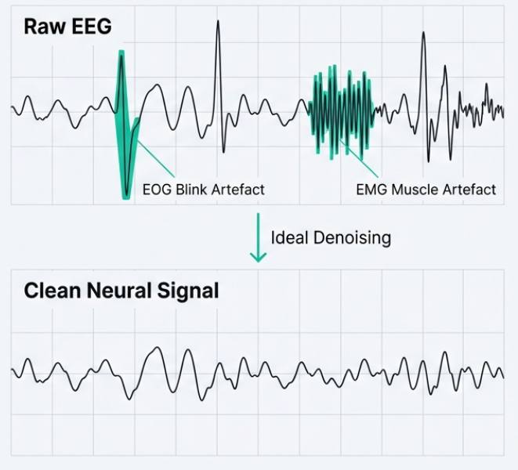
Introduction
Motivation
Dataset
Proposed Method
Results
Conclusion
Electroencephalogram and its Signal Quality
▸
Electroencephalography (EEG) records brain activity non-invasively using scalp electrodes, with high temporal resolution.
▸
EEG recordings are inherently non-stationary and susceptible to contamination from physiological and non-physiological artefacts, including ocular, muscular, cardiac activity and power-line interferences [1].
▸
These artefacts contaminate the recorded EEG, altering its observed temporal and spectral characteristics and potentially affecting downstream analyses.
▸
Clean EEG is a prerequisite for any brain-computer interface (BCI) tasks and clinical EEG assessments.
* Illustration created using AI
[1] A. Chaddad, Y. Wu, R. Kateb and A. Bouridane, “Electroencephalography signal processing: a comprehensive review and analysis of methods and techniques,” Sensors, vol. 23, no. 14, p. 6434, 2023.
Aswin Sekhar C S
IEEE SMC BMI Workshop 2026
7th October 2026
4 / 21
Notes:
Electroencephalography provides a non-invasive way of recording brain activity with high temporal resolution.
However, what we measure at the scalp is not purely neural activity.
The recorded signal can contain contributions from physiological sources such as eye movements, muscle activity and cardiac activity, as well as non-physiological interference such as power-line noise.
For this work, we focus specifically on ocular or EOG artefacts.
The important point is that these artefacts don't simply add noise that is completely separate from the EEG.
They can alter both the temporal waveform and the spectral characteristics of the observed signal.
Therefore, if denoising removes too aggressively, we may suppress not only the artefact but also information that is actually part of the neural signal.
This makes artefact removal a signal-preservation problem, not simply a noise-suppression problem.
And this becomes particularly challenging for EOG artefacts.

Slide 5
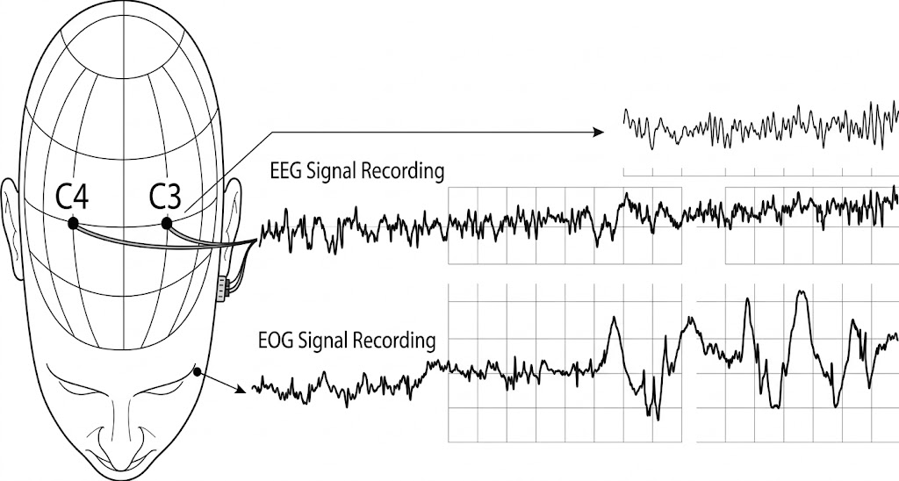
Introduction
Motivation
Dataset
Proposed Method
Results
Conclusion
Why Electrooculogram Artefacts?
▸
Electrooculogram (EOG) artefacts are involuntary, low in frequency, and harder to discriminate from EEG [2].
▸
They carry higher amplitude than the underlying EEG and predominantly occupy 0.5-12 Hz [2].
▸
They are non-stationary and share overlapping frequency bands with neural activity, so notch and band-pass filtering are insufficient [3].
▸
The contaminated band can be the band carrying task-relevant low-frequency information in the EEG.
* Illustration created using AI
[2] J. Yedukondalu, K. Sunkara, V. K. K. Rejeti, Y. M. Krishna and M. K. Chaitanya, “Single-channel EOG artifact removal using fixed frequency EWT and GMETV filter,” Sci. Rep. , vol. 15, no. 1, 2025.
[3] R. Jiang et al. , “A novel EEG artifact removal algorithm based on an advanced attention mechanism,” Sci. Rep., vol. 15, no. 1, 2025.
Aswin Sekhar C S
IEEE SMC BMI Workshop 2026
7th October 2026
5 / 21
Notes:
So, why specifically focus on EOG?
There are three important reasons.
First, EOG artefacts can have substantially larger amplitudes than the underlying EEG.
Second, they are predominantly concentrated in the low-frequency range, approximately 0.5 to 12 hertz.
And third—and most importantly—they are not spectrally isolated from EEG.
The delta, theta and alpha bands occupy approximately the same low-frequency region.
So if I simply apply an aggressive low-pass or band-pass filtering strategy to remove the ocular component, I risk removing physiologically meaningful EEG activity at the same time.
In other words, the challenge is not:
“Where is the noise?”
The challenge is:
“How do we separate the ocular component from neural activity when both occupy overlapping temporal and spectral regions?”
This is where conventional filtering becomes insufficient, and it motivates a learned denoising approach.

Slide 6
Introduction
Motivation
Dataset
Proposed Method
Results
Conclusion
Conventional EEG Artefact Removal Methods
TABLE I - CONVENTIONAL EEG ARTEFACT REMOVAL METHODS
Family
Representative Methods
Principal Limitations
Regression [4]
Reference-channel subtraction
Performance reduces significantly in the absence of a reference signal.
Blind source separation [4], [5]
PCA, ICA, CCA, IVA
Effective, but requires many EEG channels, prior knowledge of signal and artefact characteristics, and manual component rejection.
Decomposition [4]
Wavelet, EMD, variational mode, adaptive chirp mode
Rely on assumptions about artefact bandwidth and amplitude levels.
Hybrid [4], [6]
EMD-ICA, EMD-CCA
Improve suppression, but still hard to remove artefacts without reference channels or manual inspection.
Common Limitation
All of the above need a reference channel or manual inspection or assumptions about the artefact.
[4] X. Jiang, G. B. Bian and Z. Tian, “Removal of artifacts from EEG signals: a review,” Sensors, vol. 19, no. 5, p. 987, 2019.
.
[5] C. Stergiadis, V. D. Kostaridou and M. A. Klados, “Which BSS method separates better the EEG signals? A comparison of five different algorithms,” Biomed. Signal Process. Control , vol. 72, p. 103292, 2022.
.
[6] M. H. Soomro, N. Badruddin, M. Z. Yusoff and M. A. Jatoi, “Automatic eye-blink artifact removal method based on EMD-CCA,” ICME Int. Conf. Complex Medical Engineering , pp. 186–190, 2013.
Aswin Sekhar C S
IEEE SMC BMI Workshop 2026
7th October 2026
6 / 21
Notes:
Traditionally, several families of methods have been used for EEG artefact removal.
Regression methods can use a reference EOG channel, but their effectiveness depends strongly on having an appropriate reference.
Blind source separation methods such as PCA, ICA and CCA can separate components, but they typically require multiple channels and often involve assumptions about the signal or manual component selection.
Decomposition-based approaches, including wavelet and EMD-based methods, provide useful multiscale representations, but their performance can depend on assumptions about artefact bandwidth and amplitude.
So there is a common practical issue across many of these approaches:
reference dependence, manual intervention, or hand-crafted assumptions about the artefact.
This naturally motivates automated deep-learning approaches.

Slide 7
Introduction
Motivation
Dataset
Proposed Method
Results
Conclusion
Section 2
Motivation
Aswin Sekhar C S
IEEE SMC BMI Workshop 2026
7th October 2026
7 / 21
Notes:
Section two: motivation.

Slide 8
Introduction
Motivation
Dataset
Proposed Method
Results
Conclusion
Motivation
What has Deep Learning already solved?
Deep learning models need no reference channel and no manual inspection, enabling automated end-to-end artefact removal [7], [8].
RNNs and GANs further improve fidelity by capturing temporal dependencies and are tailored to a specific artefact [7].
Limitations of the State-of-the-Art
Limited exploitation of the multiscale structure of EEG: Most deep learning methods process contaminated EEG directly in the time domain, without an explicit joint time-frequency representation.
Insufficient temporal context for slowly varying artifacts: Most architectures are convolution-only or convolution-dominated, thereby limiting the ability to model slowly varying artefacts.
No explicit constraint on low-frequency spectral fidelity: Transformer-based or hybrid CNN-Transformer architectures are optimized with time-domain reconstruction losses, thereby the network does not enforce preservation of spectral features of the signal.
[7] X. Y. Liu et al. , “Recent applications of EEG-based brain-computer interface in the medical field,” Mil. Med. Res., vol. 12, no. 1, p. 14, 2025.
[8] W. Sun, Y. Su, X. Wu and X. Wu, “A novel end-to-end 1D-ResCNN model to remove artifact from EEG signals,” Neurocomputing, vol. 404, pp. 108–121, 2020.
Aswin Sekhar C S
IEEE SMC BMI Workshop 2026
7th October 2026
8 / 21
Notes:
So what has deep learning already solved?
One important advantage is that a neural network can learn the mapping from contaminated EEG to clean EEG directly.
This removes the need for a manually selected ICA component or an explicit reference channel during inference.
However, we identified three important limitations.
First: representation.
Many existing networks operate directly on the raw time-domain signal.
But EEG is inherently multiscale. Different physiological rhythms occupy different frequency ranges, and ocular artefacts also have characteristic low-frequency behaviour.
Second: temporal context.
Convolutional architectures are excellent at extracting local patterns, but their receptive field is fundamentally constrained by the architecture.
Slowly varying ocular artefacts can therefore require broader temporal context.
Third: spectral preservation.
A model trained primarily using a time-domain reconstruction objective is not explicitly told that the spectral distribution of the reconstructed EEG should remain faithful to the clean signal.
So our question became:
Can we design a denoiser that explicitly works with the multiscale structure of EEG, while simultaneously modelling local morphology and long-range temporal dependencies?
This is the motivation behind MWC-GAN.

Slide 9
Introduction
Motivation
Dataset
Proposed Method
Results
Conclusion
Section 3
Dataset
Aswin Sekhar C S
IEEE SMC BMI Workshop 2026
7th October 2026
9 / 21
Notes:
Section three: dataset.

Slide 10
Introduction
Motivation
Dataset
Proposed Method
Results
Conclusion
EEGdenoiseNet Benchmark Dataset
▸
Standardised, well-structured benchmark dataset for training and testing deep-learning denoising models [9].
▸
Permits synthesis of contaminated EEG segments with ground-truth clean EEG.
▸
Each segment: single-channel, 2 s, sampled at 256 Hz → 512 samples.
▸
Following the protocol of [9] gives 3400 EEG-EOG segment pairs.
Artefact Mixing Model
$$xi {=y}_{i}+ μ · a_{i}$$
(1)
4514
3400
5598
where y_{i} is the clean EEG segment, a_{i} the EOG artefact, and μ is varied to obtain different SNR values, ranging from −7 dB to 2 dB.
clean EEG segments
EOG segments
EMG segments (unused)
Input SNR Definition
$$SNR = 10 log⁡( ∑y_{i}2 ⁄ ∑ {(μ ×a_{i})}^{2} )$$
(2)
[9] J. Yan et al. , “EEGdenoiseNet: a benchmark dataset for deep learning solutions of EEG denoising,” J. Neural Eng., vol. 18, no. 5, p. 056057, 2021.
Aswin Sekhar C S
IEEE SMC BMI Workshop 2026
7th October 2026
10 / 21
Notes:
We use EEGdenoiseNet, the standard benchmark for deep-learning EEG denoising. It provides 4514 clean EEG, 3400 EOG and 5598 EMG segments. Every segment is single-channel, two seconds long, resampled at 256 hertz, giving 512 samples. It lets us synthesise contaminated EEG with a known ground-truth clean signal, sweeping SNR from minus seven to plus two decibels.

Slide 11
Introduction
Motivation
Dataset
Proposed Method
Results
Conclusion
Section 4
Proposed Method
Aswin Sekhar C S
IEEE SMC BMI Workshop 2026
7th October 2026
11 / 21
Notes:
Section four: the proposed method.

Slide 12
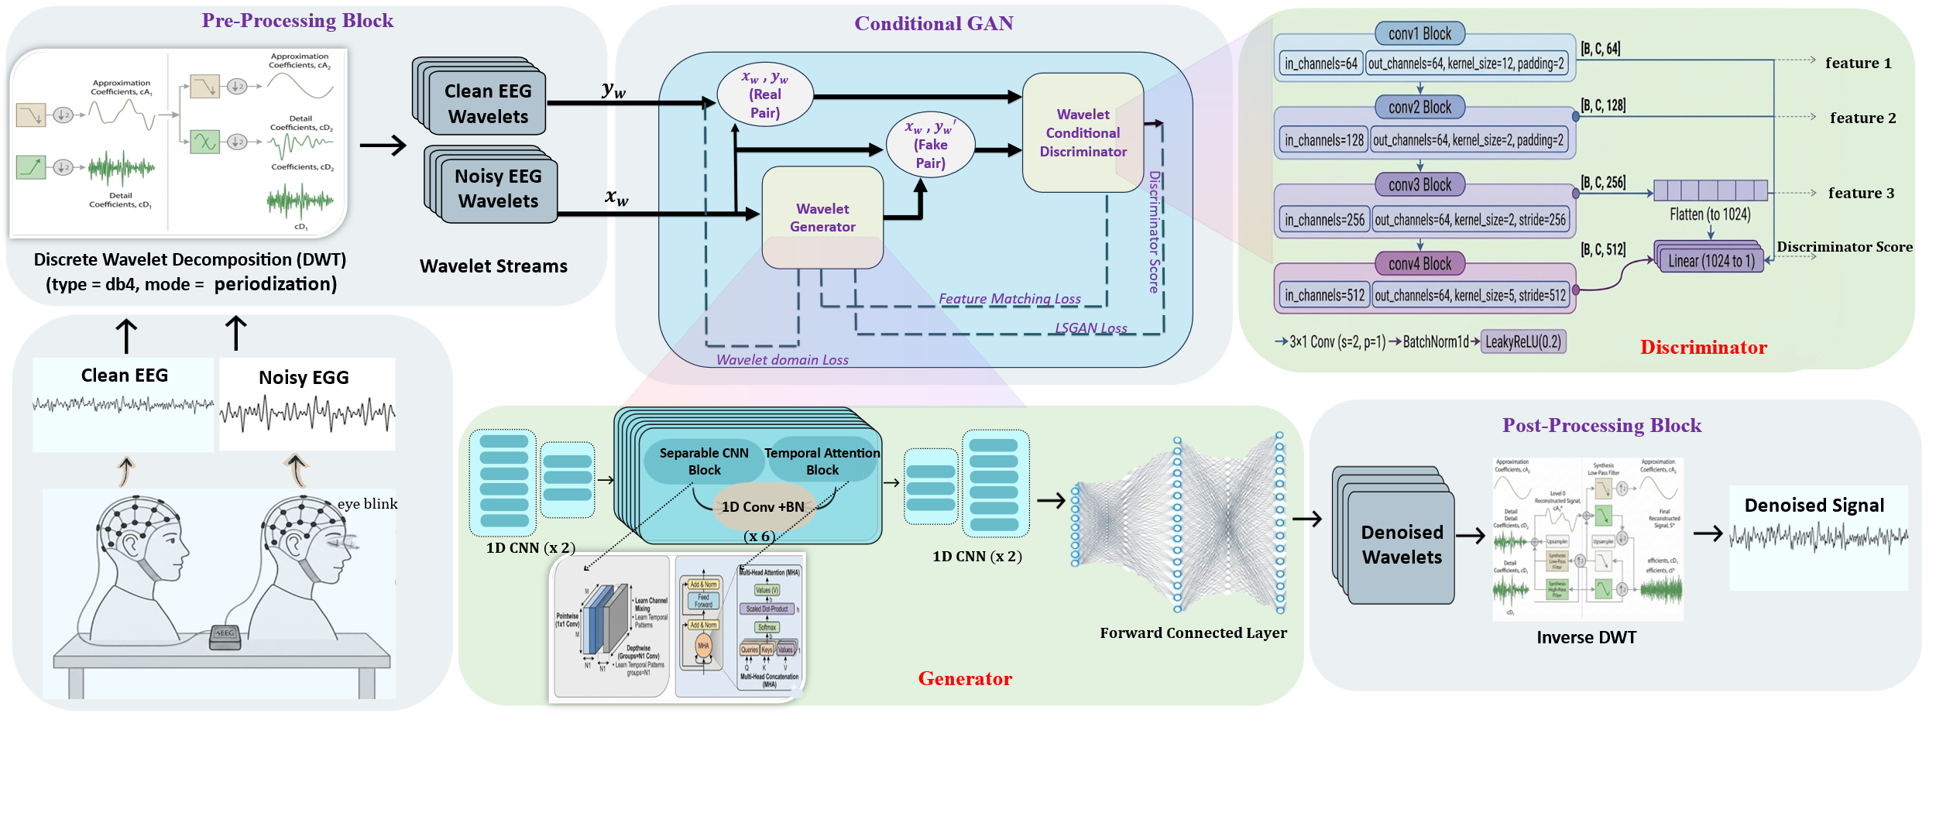
Introduction
Motivation
Dataset
Proposed Method
Results
Conclusion
Multiscale Wavelet-Domain Conditional GAN Architecture
Fig. 1. Signal processing and deep learning architecture of the proposed MWC-GAN model.
1. Preprocessing: DWT into 3 sub-bands; mother wavelet db4, mode periodization.
2. Conditional GAN: Estimates artefact-free wavelet coefficients from the noisy ones.
3. Postprocessing: Inverse DWT reconstructs the artefact-suppressed EEG.
Aswin Sekhar C S
IEEE SMC BMI Workshop 2026
7th October 2026
12/ 21
Notes:
The key idea behind MWC-GAN is actually quite simple.
Instead of asking a neural network to learn everything directly from raw EEG, we first expose the multiscale structure of the signal using a wavelet transform.
The network then operates on these wavelet coefficients.
Within the generator, we use two complementary mechanisms:
depthwise separable convolution for local morphology,
and multi-head self-attention for long-range temporal relationships.
Finally, a conditional discriminator evaluates whether the reconstructed wavelet representation is consistent with a clean EEG signal given the original noisy observation.
So there are really three ideas working together:
multiscale representation, local-plus-global modelling, and conditional adversarial learning.
Let me now walk through the architecture from left to right.

Slide 13

Introduction
Motivation
Dataset
Proposed Method
Results
Conclusion
Training Strategy, Loss Function and Evaluation Metrics
Discriminator loss - LSGAN
$$\begin{aligned}L_{D}=\frac{1}{2} E_{x,y}\left[{\left(D\left(x_{w},y_{w}\right)−1\right)}^{2}\right]+\frac{1}{2} E_{x,y}\left[{\left(D\left(x_{w},y_{w}′\right)\right)}^{2}\right] \end{aligned}$$
(3)
Real pairs map to 1, fake pairs to 0, conditioned on the noisy input.
Total Generator loss
Wavelet coefficient L₁ loss - accuracy in the wavelet domain
$$\begin{aligned}L_{\text{coeff}} = E_{x,y}\left[{\left\|y_{w}^{′}− y_{w}\right\|}_{1}\right] \#\end{aligned}$$
$$\begin{aligned}L_{G}= {γ_{1}L}_{coeff}+{γ_{2}L}_{sig}+ {γ_{3}L}_{adv}+γ_{4}L_{feature} \end{aligned}$$
(4)
(8)
Signal-domain L₁ loss - coefficient gains reach the waveform
γ₁ = 1, γ₂ = 1, γ₃ = 0.5, γ₄ = 0.5
$$\begin{aligned}L_{\text{sig}}= E_{x,y}\left[{\left\|y^{′}− y\right\|}_{1}\right] \#\end{aligned}$$
(5)
Weights set empirically.
Conditional adversarial loss - realism given the noisy input
$$L_{adv}= E_{x,y}\left[{\left(D\left(x_{w},y_{w}′\right)−1\right)}^{2}\right]$$
(6)
Evaluation Metrics
Feature-matching loss - higher-order statistics, not pointwise error
$$\begin{aligned}L_{feature}= E_{x,y}\left[{\left\|f_{2}− f_{2}′\right\|}_{1}\right] \end{aligned}$$
${SNR}_{out}$ ↑ : denoised signal power vs residual noise power
(7)
$RRMSEt$↓ : change in temporal information after denoising
where f₂ and f₂′ are second-stage discriminator features of the real and fake pairs.
$RRMSEf$↓ : change in spectral energy distribution (on PSD) after denoising
$CC$ ↑ : linear dependence on the clean ground truth
Aswin Sekhar C S
IEEE SMC BMI Workshop 2026
7th October 2026
13/ 21
Notes:
Now, the architecture alone is not sufficient.
We also need to define what we want the generator to preserve.
This is why our generator uses a combination of four objectives.
We empirically set the weights as 1, 1, 0.5 and 0.5 respectively.

Slide 14
Introduction
Motivation
Dataset
Proposed Method
Results
Conclusion
Section 5
Results and Discussion
Aswin Sekhar C S
IEEE SMC BMI Workshop 2026
7th October 2026
14 / 21
Notes:
Section five: results and discussion.

Slide 15
Introduction
Motivation
Dataset
Proposed Method
Results
Conclusion
Quantitative Results: Performance comparison on EEGdenoiseNet
TABLE II - EOG ARTEFACT REMOVAL METHODS
Method
SNR (dB)
RRMSE_{t}
RRMSE_{f}
CC
EMD–CCA [6]
0.6312
0.7790
0.8132
0.7941
NovelCNN [12]
11.4271
0.3411
0.3825
0.9102
FCNN [10]
10.3473
0.3515
0.3972
0.9120
GCTNet [11]
13.6922
0.2621
0.3076
0.9480
RESULTS ON EEGDENOISENET
13.97
0.2599
ResCNN [8]
12.0256
0.3001
0.3518
0.9261
dB SNR - best overall
RRMSE_{t} - lowest
DuoCL [13]
12.1101
0.3162
0.3272
0.9092
0.2832
0.9434
EEGDnet [9]
11.1535
0.3017
0.3145
0.9433
RRMSE_{f} - lowest
CC - competitive
SimpleCNN [10]
11.9341
0.2976
0.3045
0.9341
MWC-GAN (proposed)
13.9652
0.2599
0.2832
0.9434
Aswin Sekhar C S
IEEE SMC BMI Workshop 2026
7th October 2026
15 / 21
Notes:
Now let's look at the quantitative results.
MWC-GAN achieves an average SNR of 13.97 dB.
It also achieves the lowest time-domain RRMSE of 0.2599 and the lowest frequency-domain RRMSE of 0.2832 among the compared methods.
The correlation coefficient is 0.9434, which is competitive with the strongest baselines. One important observation is that GCTNet actually has a slightly higher correlation coefficient of 0.9480.
So we should not interpret the results as MWC-GAN winning every individual metric. Rather, the result is that MWC-GAN provides a strong overall balance between noise suppression, temporal reconstruction, and spectral preservation.

Slide 16
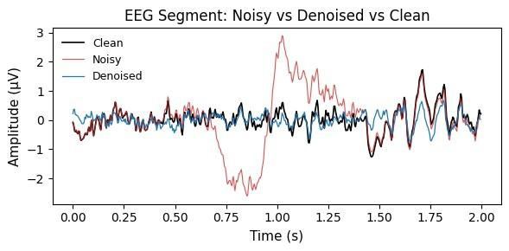
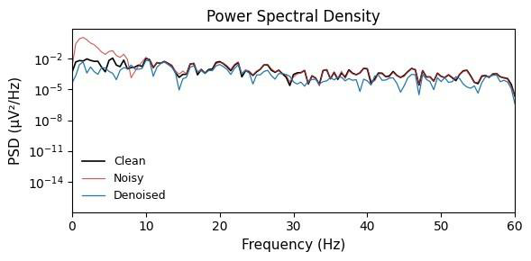
Introduction
Motivation
Dataset
Proposed Method
Results
Conclusion
Qualitative Results: Waveforms and Spectra
Fig. 2. Time-domain comparison of denoised, clean and noisy EEG.
Fig. 3. Frequency-domain comparison of denoised, clean and noisy EEG.
The large low-frequency ocular excursion in the noisy trace (red) is suppressed; the denoised trace (blue) tracks the clean reference (black).
Excess low-frequency energy is removed and the denoised PSD follows the clean spectrum across frequency bands.
Aswin Sekhar C S
IEEE SMC BMI Workshop 2026
7th October 2026
16 / 21
Notes:
The quantitative results tell us how close the reconstruction is numerically.
But it is also useful to see what the model is actually doing.
In the time domain, we can see the large low-frequency ocular excursion in the contaminated signal.
After denoising, this excursion is substantially suppressed, while the reconstructed waveform follows the clean reference.
We can also examine this in the frequency domain.
The contaminated signal contains excess low-frequency energy associated with the EOG artefact.
After denoising, the PSD moves much closer to the clean reference.
This is particularly important because our objective is not simply to produce a visually smoother EEG.
We want the reconstructed signal to remain consistent with the temporal and spectral structure of the clean reference.

Slide 17
Introduction
Motivation
Dataset
Proposed Method
Results
Conclusion
Key Results of Ablation study on MWC-GAN components
TABLE II - ABLATION OF MWC-GAN COMPONENTS
Configuration
SNR (dB)
RRMSE_{t}
RRMSE_{f}
CC
Raw EEG + cGAN
12.5150
0.2754
0.3026
0.9459
no wavelet front-end
Wavelet + SeparableCNN generator
11.4346
0.3278
0.3180
0.9146
no temporal multi-head attention
▸
Raw EEG input still reaches 12.52 dB, but with higher reconstruction error and lower SNR than the proposed model.
Wavelet + temporal MHA generator
13.5492
0.2636
0.3013
0.9457
no separable CNN branch
▸
Wavelet + SeparableCNN alone degrades performance - multiscale convolution without temporal modelling is insufficient and can even be detrimental.
MWC-GAN (full)
13.9652
0.2599
0.2832
0.9434
▸
Temporal attention is the significant component: adding it alone lifts SNR to 13.549 dB and lowers both RRMSE values.
▸
The full configuration achieves the best balance across metrics, with the lowest time- and frequency-domain error.
Aswin Sekhar C S
IEEE SMC BMI Workshop 2026
7th October 2026
17 / 21
Notes:
We tested four configurations.
First, we removed the wavelet front-end and fed raw EEG to the cGAN.
Interestingly, even this configuration performs reasonably well, achieving 12.52 dB SNR.
So the network itself clearly provides a strong denoising capability.
Next, we introduced the wavelet representation together with the SeparableCNN generator, but without temporal multi-head attention.
Interestingly, performance actually decreased to 11.43 dB.
This is important because it tells us that simply adding a multiscale representation and convolution is not sufficient.
Then we added the temporal multi-head attention branch to the wavelet representation.
Now the SNR increases substantially to 13.55 dB, and both reconstruction errors decrease.
Finally, when we combine the complete wavelet-domain architecture, SeparableCNN, temporal attention and conditional GAN framework, we obtain 13.97 dB SNR, with the lowest temporal and frequency-domain errors.
So the ablation gives us a useful architectural interpretation:
Wavelets provide the representation, but temporal modelling is critical for exploiting that representation effectively.
And the full architecture provides the best overall balance.

Slide 18
Introduction
Motivation
Dataset
Proposed Method
Results
Conclusion
Conclusion
▸
A hybrid conditional GAN denoising pipeline operating in the wavelet domain for EOG artefact removal from EEG.
▸
Conditioning on noisy wavelet coefficients makes the network learn a direct noisy-to-clean mapping rather than unconditional synthesis.
▸
Depthwise separable convolutions capture local morphology across scales; multi-head self-attention aggregates long-range temporal dependencies.
▸
Adversarial and feature-matching losses constrain reconstructions to preserve temporal and spectral structure.
▸
Ablations confirm the importance of the temporal attention module and of the full conditional GAN configuration.
RESULTS ON EEGDENOISENET
13.97
0.2599
dB SNR - best overall
RRMSE_{t} - lowest
0.2832
0.9434
RRMSE_{f} - lowest
CC - competitive
Aswin Sekhar C S
IEEE SMC BMI Workshop 2026
7th October 2026
18 / 21
Notes:
We proposed MWC-GAN, a hybrid conditional GAN for EOG artefact removal that operates in the wavelet domain rather than directly in the raw time domain.
The central architectural idea is to combine complementary capabilities:
wavelet decomposition for multiscale representation,
depthwise separable convolution for local morphology,
multi-head self-attention for long-range temporal dependencies,
and conditional adversarial and feature-matching objectives for realistic reconstruction
Overall, the results suggest that treating EEG denoising as a multiscale representation-learning problem, rather than purely as a time-domain reconstruction problem, can be beneficial for EOG artefact suppression.

Slide 19
Introduction
Motivation
Dataset
Proposed Method
Results
Conclusion
Limitations and Future work
LIMITATIONS
Single-Channel scope
The framework addresses single-channel EOG artefact removal only.
Semi-Synthetic evaluation
FUTURE WORK
Assessed on data with artificially added artefacts rather than natively contaminated recordings.
Multi-Channel, Multi-Artefact
Extend the wavelet-domain cGAN to spatial context and to EMG and ECG contamination.
Training Complexity
Adversarial learning adds complexity relative to purely supervised denoisers.
Stable, lightweight Adversarial design
Investigate more stable and lightweight alternatives to the current adversarial objective.
Task-integrated Denoising
Integrate denoising with downstream EEG tasks to better support practical BCI and clinical applications.
Aswin Sekhar C S
IEEE SMC BMI Workshop 2026
7th October 2026
19 / 21
Notes:
There are, however, several limitations that are important to acknowledge.
First, the current framework operates on single-channel EEG.
Second, the evaluation uses semi-synthetic contamination, where EOG artefacts are added to clean EEG, rather than relying exclusively on naturally contaminated recordings.
And third, GAN-based training introduces additional optimization complexity compared with a purely supervised denoising network.
Our next step is therefore to move toward multi-channel and multi-artefact denoising, including EMG and ECG contamination.
We also want to investigate more stable and lightweight alternatives to the current adversarial objective.
Finally, rather than evaluating denoising only through signal-level metrics, we want to investigate task-integrated denoising

Slide 20
Introduction
Motivation
Dataset
Proposed Method
Results
Conclusion
References
[1]
A. Chaddad, Y. Wu, R. Kateb and A. Bouridane, “Electroencephalography signal processing: a comprehensive review and analysis of methods and techniques,” Sensors, vol. 23, no. 14, p. 6434, 2023.
[2]
J. Yedukondalu, K. Sunkara, V. K. K. Rejeti, Y. M. Krishna and M. K. Chaitanya, “Single-channel EOG artifact removal using fixed frequency EWT and GMETV filter,” Sci. Rep. , vol. 15, no. 1, 2025.
[3]
R. Jiang et al. , “A novel EEG artifact removal algorithm based on an advanced attention mechanism,” Sci. Rep., vol. 15, no. 1, 2025.
[4]
X. Jiang, G. B. Bian and Z. Tian, “Removal of artifacts from EEG signals: a review,” Sensors, vol. 19, no. 5, p. 987, 2019.
[5]
C. Stergiadis, V. D. Kostaridou and M. A. Klados, “Which BSS method separates better the EEG signals? A comparison of five different algorithms,” Biomed. Signal Process. Control , vol. 72, p. 103292, 2022.
[6]
M. H. Soomro, N. Badruddin, M. Z. Yusoff and M. A. Jatoi, “Automatic eye-blink artifact removal method based on EMD-CCA,” ICME Int. Conf. Complex Medical Engineering , pp. 186–190, 2013.
[7]
X. Y. Liu et al. , “Recent applications of EEG-based brain-computer interface in the medical field,” Mil. Med. Res., vol. 12, no. 1, p. 14, 2025.
[8]
W. Sun, Y. Su, X. Wu and X. Wu, “A novel end-to-end 1D-ResCNN model to remove artifact from EEG signals,” Neurocomputing, vol. 404, pp. 108–121, 2020.
[9]
J. Yan et al. , “EEGdenoiseNet: a benchmark dataset for deep learning solutions of EEG denoising,” J. Neural Eng., vol. 18, no. 5, p. 056057, 2021.
[10]
X. Pu, P. Yi, K. Chen, Z. Ma, D. Zhao and Y. Ren, “EEGDnet: fusing non-local and local self-similarity for EEG signal denoising with transformer,” Comput. Biol. Med. , vol. 151, p. 106248, 2022.
[11]
J. Yin, A. Liu, C. Li, R. Qian and X. Chen, “A GAN guided parallel CNN and Transformer network for EEG denoising,” IEEE J. Biomed. Health Inform. , vol. 29, no. 6, pp. 3930–3941, 2025.
[12]
H. Zhang, C. Wei, M. Zhao, Q. Liu and H. Wu, “A novel convolutional neural network model to remove muscle artifacts from EEG,” ICASSP, pp. 1265–1269, 2021.
[13]
T. Gao, D. Chen, Y. Tang, Z. Ming and X. Li, “EEG reconstruction with a dual-scale CNN-LSTM model for deep artifact removal,” IEEE J. Biomed. Health Inform. , vol. 27, no. 3, pp. 1283–1294, 2023.
[14]
P. Sawangjai et al. , “EEGANet: removal of ocular artifacts from the EEG signal using generative adversarial networks,” IEEE J. Biomed. Health Inform. , vol. 26, no. 10, pp. 4913–4924, 2022.
Aswin Sekhar C S
IEEE SMC BMI Workshop 2026
7th October 2026
20 / 21

Slide 21


Introduction
Motivation
Dataset
Proposed Method
Results
Conclusion
Thank you
Questions and Discussion
Aswin Sekhar C S
Research Officer and Industrial Doctorate Student
Singapore Institute of Technology (SIT) & KK Women’s and Children’s Hospital (KKH)
MWC-GAN: A Hybrid Multiscale Wavelet-Domain Conditional GAN for EOG Artefact Removal from EEG Signals
Scan to Connect
Scan to Connect
Aswin Sekhar C S
IEEE SMC BMI Workshop 2026
7th October 2026
21 / 21
Notes:
Thank you very much for your attention.

