Slide 1

WORKSHOP ON BRAIN-MACHINE INTERFACES
IEEE SMC 2026
October 4-7, 2026
GRADUATION THESIS DEFENSE
fNIRS-based Deep Learning Classification
for Parkinson's Disease
Task-Guided Multi-Scale Spatiotemporal Modeling Approach
Candidate: Jiang Jingyi
Supervisor: Prof. Kuang Lidan
Changsha University of Science & Technology
Notes:
Good morning, respected committee members. I am Jiang Jingyi, and today I will present my graduation thesis on fNIRS-based deep learning classification for Parkinson's disease. This work proposes a task-guided multi-scale spatiotemporal modeling approach to improve objective auxiliary diagnosis.

Slide 2
Research Background and Significance
01 / Background
Clinical Need for Objective Auxiliary Diagnosis
Research Approach
Parkinson's disease (PD) is a common neurodegenerative disorder characterized by insidious onset, slow progression, and significant individual variability.
Current diagnosis relies primarily on clinical symptom observation and scale-based assessment; early identification and dynamic evaluation remain subjective and lagging.
Methods such as DAT-SPECT, PET, and MRI provide diagnostic support but are limited by cost, continuous monitoring constraints, and dynamic task scenarios.
Therefore, there is a need for a non-invasive, portable, reproducible, and intelligent classification method that reflects brain functional activity.
Combine fNIRS cerebral oxygenation signals with deep learning models to establish an objective auxiliary recognition framework for PD/HC binary classification.
Key Advantages:
Non-invasive and portable
Suitable for dynamic tasks
Reflects brain functional activity
Notes:
Parkinson's disease is a common neurodegenerative disorder. Current diagnostic methods have limitations in terms of objectivity and early detection. Our research approach combines fNIRS signals with deep learning to create an objective classification framework for PD versus healthy controls.

Slide 3
Current Progress and Research Gap
02 / Literature Gap
Current Progress
Problems Addressed in This Work
fNIRS offers advantages in neurological disease recognition: portable, low-cost, and suitable for dynamic tasks.
CNN, BiLSTM, Transformer and other models have been applied to brain signal classification.
In the small-sample PD-fNIRS scenario, this work aims to uniformly model:
Local spatiotemporal features
Cross-region global dependencies
Task condition priors
Multi-scale temporal dynamics
Key Limitations
Limitation 1: General brain signal models lack specialized design for PD-fNIRS hemodynamic features, resulting in insufficient disease-specific feature expression.
Limitation 2: Most studies focus on single tasks, lacking explicit utilization of task differences such as finger tapping, walking, and resting state.
Notes:
While fNIRS and deep learning models show promise, current approaches have two key limitations: lack of disease-specific design and insufficient utilization of multi-task information. Our work addresses these gaps by jointly modeling local features, global dependencies, task priors, and multi-scale temporal dynamics.

Slide 4
Significance and Key Innovation
03 / Contributions
Research Significance
Theoretical Significance
Methodological Significance
Application Significance
Explore discriminative patterns of PD-related brain dysfunction from three levels: fine motor, gross motor control, and basal brain functional state.
Construct a PD-fNIRS deep learning classification framework with local-global collaborative modeling architecture.
Provide methodological reference for PD early screening, objective auxiliary diagnosis, and intelligent brain-computer interface applications.
Key Innovation
fNIRS-CTPDNet: Local-Global Collaborative Framework
Propose a local-global collaborative framework for PD-fNIRS signals: convolutional local feature extraction combined with channel-preserving Transformer global dependency modeling, specifically designed for PD-fNIRS hemodynamic characteristics.
Notes:
This work has three-fold significance: theoretical, methodological, and application. The key innovation is fNIRS-CTPDNet, a local-global collaborative framework that combines convolutional local feature extraction with channel-preserving Transformer global dependency modeling, specifically designed for PD-fNIRS hemodynamic characteristics.

Slide 5
Research Methodology and Framework
04 / Methodology
Overall Research Pipeline
Data Acquisition
Preprocessing
fNIRS-CTPDNet
Experimental Evaluation
Public PD-fNIRS dataset
Three task paradigms
20 PD + 20 HC subjects
SCI quality assessment
MBLL conversion
Filtering & baseline correction
Local-global collaborative model
CNN frontend + Transformer
Channel-preserving encoding
LOSO-CV
Repeated 5-fold CV
Ablation studies
Visualization
Design Philosophy: The fNIRS-CTPDNet model combines convolutional local feature extraction with channel-preserving Transformer global dependency modeling, specifically designed to capture PD-related spatiotemporal patterns in fNIRS signals under small-sample constraints.
Notes:
Our research framework consists of four stages: data acquisition from public PD-fNIRS dataset with three task paradigms, preprocessing including SCI assessment and MBLL conversion, the fNIRS-CTPDNet model with local-global collaborative architecture, and comprehensive experimental evaluation including LOSO-CV, repeated 5-fold CV, ablation studies, and visualization analysis.

Slide 6
Dataset and Experimental Tasks
05 / Dataset
Dataset Overview
Three Experimental Task Paradigms
Data Source: Public PD-fNIRS dataset
Subjects: 20 PD patients + 20 healthy controls
Device: Brite MKII fNIRS system, 25 Hz sampling rate
Channels: 20 long-distance channels retained
Signals: HbO and HbR hemoglobin concentrations
Task | Paradigm | Functional Impairment Reflected
A | Finger Tapping | Fine motor control and action rhythm abnormalities
B | Walking | Motor automation impairment and frontal compensation
C | Resting State | Basal brain network and low-frequency spontaneous activity
Multi-Task Scenario Clarification
The term "multi-task" in this work refers to conditional modeling across three experimental task paradigms. The primary task remains PD/HC disease classification throughout, with task conditions serving as auxiliary contextual information to enhance feature discriminability.
Notes:
We use a public PD-fNIRS dataset with 20 PD patients and 20 healthy controls. Three task paradigms are employed: finger tapping for fine motor control, walking for motor automation, and resting state for basal brain function. The primary classification task is PD versus HC, with task conditions as contextual information.

Slide 7
fNIRS Data Preprocessing Pipeline
06 / Preprocessing
Five-Step Preprocessing Workflow
01
02
03
04
Channel Quality
Concentration
Filtering & Seg.
Baseline & Clean
SCI threshold = 0.5
Remove low-quality
channels
MBLL algorithm
Convert optical density
to HbO/HbR
Bandpass filter
Task-specific bands
Epoch extraction
Baseline correction
Artifact removal
Signal cleanup
05 Standardized Tensor
Form unified tensor input
for subsequent modeling
Notes:
The preprocessing pipeline consists of five steps: channel quality assessment using SCI threshold 0.5, concentration conversion via MBLL, bandpass filtering with task-specific frequency ranges, baseline correction with abnormal segment removal, and standardized tensor construction. This ensures high-quality input for subsequent deep learning modeling.

Slide 8
Input Representation and Training Setup
07 / Configuration
Single-Sample Tensor Representation
Training Configuration
Item | Setting
Epochs | 120
Optimizer | AdamW
Loss Function | Label Smoothing CE
Transformer Dim | 64, 6 layers, 8 heads
Validation Strategy | LOSO-CV + Repeated 5-fold
X ∈ R^(H × W × C)
H = 20: Number of long-distance channels
W: Number of temporal sampling points
C = 2: HbO and HbR signal types
Statistical Evaluation Protocol
All evaluation metrics are computed based on predictions from the test set of each fold. Mean and standard deviation are then calculated across all folds to ensure robust and reproducible performance estimation.
Notes:
Each sample is represented as a 3D tensor with dimensions H×W×C, where H is the number of channels, W is temporal length, and C is signal type. We use AdamW optimizer with label smoothing cross-entropy loss for 120 epochs. Validation employs both LOSO-CV and repeated 5-fold CV for robust evaluation.

Slide 9
Base Model fNIRS-CTPDNet: Design Rationale
08 / Model Design
Characteristics of PD-fNIRS Signals
Overall Design Philosophy
Local Abnormalities
Local Modeling First, Then Global Modeling
Hemodynamic delay, local waveform changes, short-term collaborative patterns
Temporal Convolution: Capture hemodynamic delay and local temporal dynamics
Channel-wise Depthwise Conv: Preserve region/channel-specific cortical responses
Local Fusion Conv: Extract cross-channel collaborative patterns within short time windows
Channel-preserving Transformer: Model long-range dependencies across brain regions and time
Global Coupling
Cross-region relationships, cross-temporal dependencies, task-induced functional differences
Small-Sample Constraint
Control model complexity, leverage structural inductive bias to enhance generalization
Notes:
The design of fNIRS-CTPDNet is motivated by three key characteristics of PD-fNIRS signals: local abnormalities, global coupling, and small-sample constraints. Our overall philosophy is local modeling first, then global modeling. This involves temporal convolution, channel-wise depthwise convolution, local fusion convolution, and a channel-preserving Transformer for long-range dependency modeling.

Slide 10
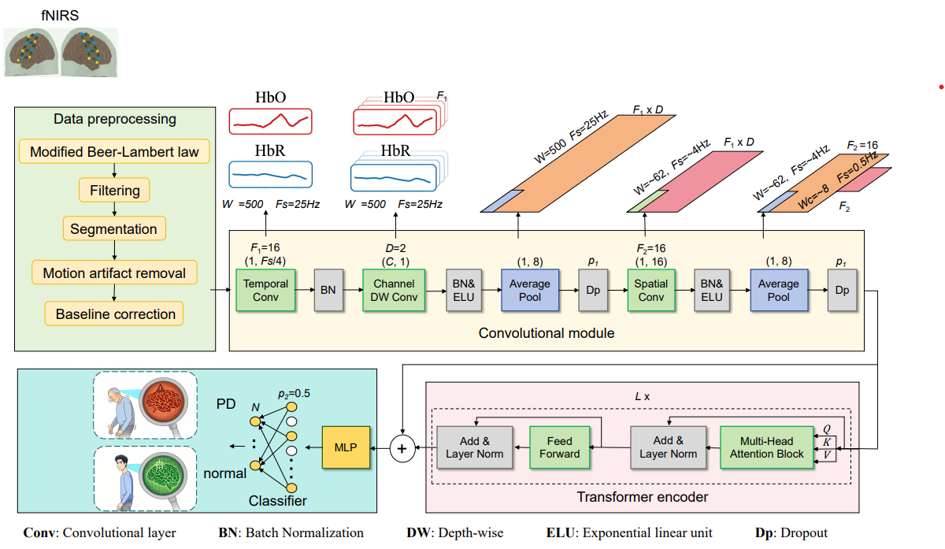
fNIRS-CTPDNet Overall Architecture
09 / Architecture
Design Advantage: CNN provides local inductive bias, Transformer provides global relationship modeling.
The two are complementary for PD-fNIRS small-sample spatiotemporal signal classification.
Notes:
The overall architecture follows a five-stage pipeline: input tensor, CNN frontend for local feature extraction, channel-preserving tokenization, Transformer encoder for global dependency modeling, and MLP classifier for PD/HC prediction. The key advantage is the complementarity between CNN local bias and Transformer global modeling.

Slide 11
Key Modules of Base Model
10 / Key Modules
CNN Frontend
Transformer Encoder
MLP Classifier
Consists of three convolution types:
Temporal Conv: capture hemodynamic delay
Depthwise Conv: preserve channel-specific responses
Local Fusion: extract cross-channel patterns
Convert features to sequences:
Self-Attention: model global dependencies
Channel Preservation: maintain semantics
Feed-forward: capture non-linear relations
Lightweight classification head:
Global Aggregation: extract token features
Lightweight MLP: simple perceptron layers
Binary Output: PD/HC probabilities
Design Advantage
CNN structure provides local inductive bias, while Transformer provides global relationship modeling capability. The two are complementary to adapt to PD-fNIRS small-sample spatiotemporal signal classification.
Notes:
The base model consists of three key modules: CNN frontend for local feature extraction with three convolution types, Transformer encoder for global dependency modeling with channel preservation, and MLP classifier for binary PD/HC prediction. The design advantage lies in the complementarity between CNN local inductive bias and Transformer global modeling.

Slide 12
Base Model Experimental Results
11 / Results
Effectiveness and Preliminary Results
Key Findings
LOSO-CV Accuracy by Task
PD and HC show separable HbO differences under finger tapping
CNN and Transformer are complementary; full model outperforms either alone
Local-global design effectively captures PD-related patterns
Task Paradigm | Accuracy
Task A: Finger Tapping | 86.90%
Task B: Walking | 89.58%
Task C: Resting State | 80.00%

Slide 13
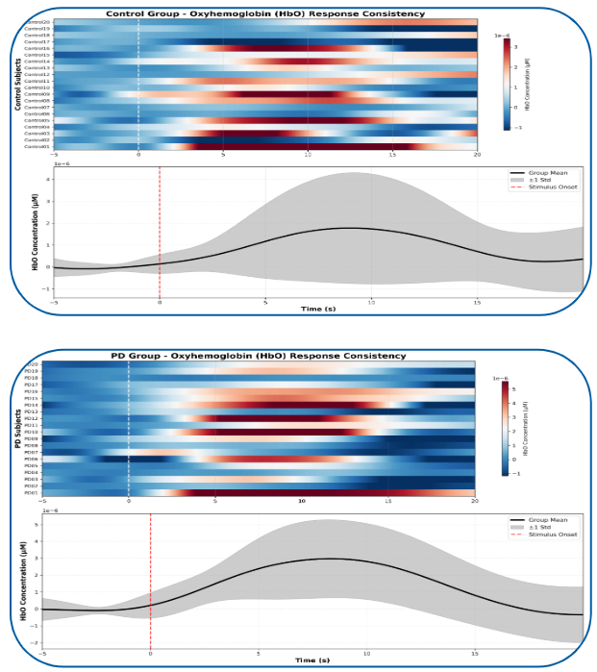
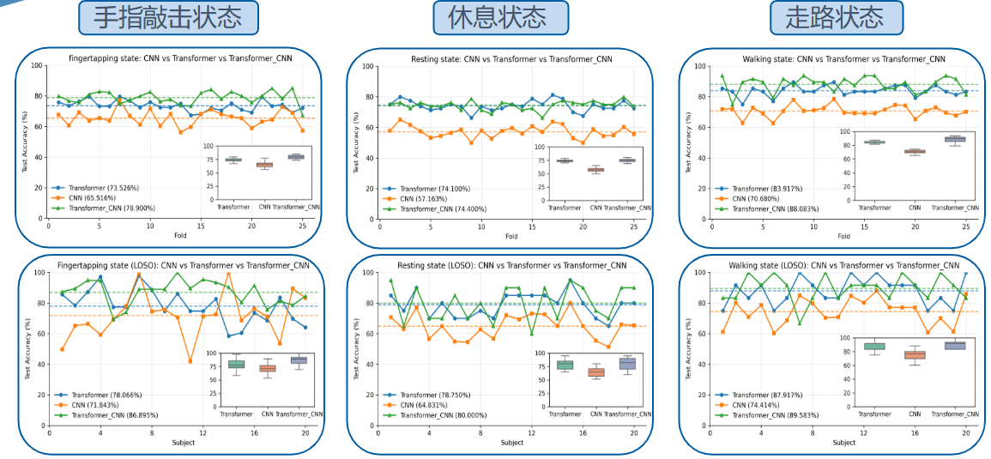
Base Model Experimental Results
12 / Results
• Under the finger tapping task, PD patients and healthy controls exhibit separable differences in HbO responses.
• The convolutional module and Transformer module are complementary; the full model outperforms either CNN alone or Transformer alone.
• Under LOSO-CV, fNIRS-CTPDNet achieves accuracies of 86.90%, 89.58%, and 80.00% on Tasks A, B, and C, respectively.
Finger-tapping
Resting
Walking

Slide 14
Comparison with Mainstream Models
13 / Comparison
Performance Comparison
Key Observations
Model | LOSO-CV Avg | 5-fold CV Avg
fNIRS-CTPDNet | 85.49% | 80.46%
fNIRS-T | 83.05% | 78.33%
fNIRSNet | 80.47% | 76.50%
CT-Net | 77.60% | 74.17%
BiLSTM | 74.57% | 71.63%
ViT | 71.27% | 69.13%
fNIRS-CTPDNet outperforms all baselines under both validation strategies
Local-global design for PD-fNIRS is more effective than general models
Walking task performs best, resting state is most challenging
Conclusion: The base model effectively captures discriminative differences between PD and HC in multi-task fNIRS signals.

Slide 15
Summary and Future Work
14 / Conclusion
Thesis Summary
Future Work
Work 1: Data Foundation
Expand data scale with multi-center validation
Incorporate brain topology using Graph Neural Networks
Reduce dependency on explicit task labels
Combine clinical scales for interpretability
Systematically organized fNIRS technical principles, public PD-fNIRS dataset, three experimental task settings, and unified preprocessing pipeline, providing a solid data foundation for model construction.
Work 2: fNIRS-CTPDNet Model
Proposed fNIRS-CTPDNet with CNN frontend and channel-preserving Transformer encoder, achieving local-global collaborative modeling for PD-fNIRS hemodynamic signals.

Slide 16
THANK YOU
15 / References
Jiang Jingyi | Supervisor: Prof. Kuang Lidan | Changsha University of Science & Technology
References
[1] B. R. Bloem, M. S. Okun, and C. Klein, "Parkinson's disease," The Lancet, vol. 397, no. 10291, pp. 2284-2303, 2021, doi: 10.1016/S0140-6736(21)00218-X.
[2] E. Tolosa, A. Garrido, S. W. Scholz, and W. Poewe, "Challenges in the diagnosis of Parkinson's disease," The Lancet Neurology, vol. 20, no. 5, pp. 385-397, 2021, doi: 10.1016/S1474-4422(21)00030-2.
[3] P. Pinti, I. Tachtsidis, A. Hamilton, J. Hirsch, C. Aichelburg, S. Gilbert, and P. W. Burgess, "The present and future use of functional near-infrared spectroscopy (fNIRS) for cognitive neuroscience," Annals of the New York Academy of Sciences, vol. 1464, no. 1, pp. 5-29, 2020, doi: 10.1111/nyas.13948.
[4] C. Eastmond, A. Subedi, S. De, and X. Intes, "Deep learning in fNIRS: a review," Neurophotonics, vol. 9, no. 4, p. 041411, 2022, doi: 10.1117/1.NPh.9.4.041411.
[5] J. Kwon and C.-H. Im, "Subject-Independent Functional Near-Infrared Spectroscopy-Based Brain-Computer Interfaces Based on Convolutional Neural Networks," Frontiers in Human Neuroscience, vol. 15, p. 646915, 2021, doi: 10.3389/fnhum.2021.646915.
[6] Z. Wang, J. Fang, and J. Zhang, "Rethinking Delayed Hemodynamic Responses for fNIRS Classification," IEEE Transactions on Neural Systems and Rehabilitation Engineering, vol. 31, pp. 4528-4538, 2023, doi: 10.1109/TNSRE.2023.3330911.
[7] U. Asgher, K. Khalil, M. J. Khan, R. Ahmad, S. I. Butt, Y. Ayaz, N. Naseer, and S. Nazir, "Enhanced Accuracy for Multiclass Mental Workload Detection Using Long Short-Term Memory for Brain-Computer Interface," Frontiers in Neuroscience, vol. 14, p. 584, 2020, doi: 10.3389/fnins.2020.00584.
[8] Q. Yu, R. Wang, J. Liu, L. Hu, M. Chen, and Z. Liu, "GNN-Based Depression Recognition Using Spatio-Temporal Information: A fNIRS Study," IEEE Journal of Biomedical and Health Informatics, vol. 26, no. 10, pp. 4925-4935, 2022, doi: 10.1109/JBHI.2022.3195066.
[9] Z. Wang, J. Zhang, X. Zhang, P. Chen, and B. Wang, "Transformer Model for Functional Near-Infrared Spectroscopy Classification," IEEE Journal of Biomedical and Health Informatics, vol. 26, no. 6, pp. 2559-2569, 2022, doi: 10.1109/JBHI.2022.3140531.
[10] L. Liao, J. Lu, L. Wang, Y. Zhang, D. Gao, and M. Wang, "CTNet: an interpretable CNN-Transformer fusion network for fNIRS classification," Medical & Biological Engineering & Computing, vol. 62, no. 10, pp. 3233-3247, 2024, doi: 10.1007/s11517-024-03138-4.
[11] E. Guevara, F. J. Rivas-Ruvalcaba, E. S. Kolosovas-Machuca, M. Ramirez-Elias, R. D. de Leon-Zapata, J. L. Ramirez-GarLuna, and I. Rodriguez-Leyva, "Parkinson's disease patients show delayed hemodynamic changes in primary motor cortex in fine motor tasks and decreased resting-state interhemispheric functional connectivity: a functional near-infrared spectroscopy study," Neurophotonics, vol. 11, no. 2, p. 025004, 2024, doi: 10.1117/1.NPh.11.2.025004.
[12] L. Pollonini, C. Olds, H. Abaya, H. Bortfeld, M. S. Beauchamp, and J. S. Oghalai, "Auditory cortex activation during speech perception in infants measured with functional near-infrared spectroscopy," Developmental Cognitive Neuroscience, vol. 8, pp. 110-121, 2014, doi: 10.1016/j.dcn.2014.05.003.
[13] M. Cope and D. T. Delpy, "System for long-term measurement of cerebral blood and tissue oxygenation on newborn infants by near infra-red transillumination," Medical & Biological Engineering & Computing, vol. 26, no. 3, pp. 289-294, 1988, doi: 10.1007/BF02443189.
[14] A. Vaswani, N. M. Shazeer, N. Parmar, J. Uszkoreit, L. Jones, A. N. Gomez, L. Kaiser, and I. Polosukhin, "Attention is all you need," in Advances in Neural Information Processing Systems, vol. 30, 2017, pp. 5998-6008.
[15] J. Devlin, M.-W. Chang, K. Lee, and K. Toutanova, "BERT: Pre-training of deep bidirectional transformers for language understanding," arXiv preprint arXiv:1810.04805, 2018.
[16] T. Miyato, S.-I. Maeda, M. Koyama, and S. Ishii, "Virtual adversarial training: a regularization method for supervised and semi-supervised learning," IEEE Transactions on Pattern Analysis and Machine Intelligence, vol. 41, no. 8, pp. 1979-1993, 2018, doi: 10.1109/TPAMI.2018.2858821.
Notes:
Thank you for your attention. This page lists the 16 key references cited in this thesis, covering Parkinson's disease clinical research, fNIRS methodology, deep learning models for brain signal classification, and foundational transformer architecture papers.

