Slide 1



WORKSHOP ON BRAIN-MACHINE INTERFACES
IEEE SMC 2026
Temporal and Spatial EEG Data Augmentation for
Single-Trial Detection During a Rapid Serial Visual
Presentation Task
Midhun Puthiyelath and Hubert Cecotti
Department of Computer Science, College of Science and Mathematics
California State University, Fresno | Fresno, CA, USA
IEEE SMC 2026 · October 4-7, 2026 · Bellevue, Washington
FRESNO STATE · IEEE SMC 2026 · BRAIN-MACHINE INTERFACES WORKSHOP

Slide 2


Why single-trial ERP detection remains difficult
WORKSHOP ON BRAIN-MACHINE INTERFACES
IEEE SMC 2026
A classifier sees only one noisy response at a time
Signal limitation
Deployment shift
EEG has a low signal-to-noise ratio
P300 timing and shape vary from trial to trial
Labeled target trials are limited
Small cap-placement differences change spatial sampling
Neural response latency changes across trials
Deep models can overfit the recording conditions
Training should reflect variability expected during testing
FRESNO STATE
IEEE SMC 2026 · Workshop on Brain-Machine Interfaces

Slide 3
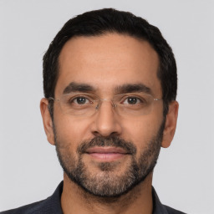
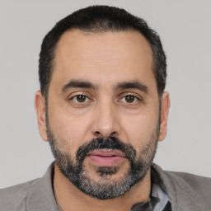
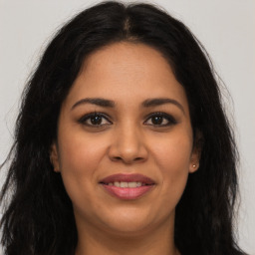
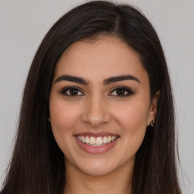
RSVP target-detection task
WORKSHOP ON BRAIN-MACHINE INTERFACES
IEEE SMC 2026
19 recruited
17 analyzed
267 ms per image
Silent target count
TARGET: adult male
NON-TARGET: young adult female
The classification target was the single-trial EEG response, not the image itself
Two participants were excluded because of a data-collection error
FRESNO STATE
IEEE SMC 2026 · Workshop on Brain-Machine Interfaces

Slide 4
EEG preprocessing and trial representation
WORKSHOP ON BRAIN-MACHINE INTERFACES
IEEE SMC 2026
32
electrodes
512 Hz
0.1-30 Hz
1 second
64
samples
BioSemi ActiveTwo
original sampling
band-pass filter
stimulus-locked epoch
downsampled signal
Each epoch
label
N trials per
participant
X in R^(32 x 64)
target / non-target
subject-specific models
FRESNO STATE
IEEE SMC 2026 · Workshop on Brain-Machine Interfaces

Slide 5
Four training conditions
WORKSHOP ON BRAIN-MACHINE INTERFACES
IEEE SMC 2026
NoAug
Temporal
Spatial
Spatial + Temporal
Original epochs only
Original + two shifted copies
Original + eight spatial copies
Original + both augmentation sets
Augmentation was applied only to each training fold
FRESNO STATE
IEEE SMC 2026 · Workshop on Brain-Machine Interfaces

Slide 6
Temporal augmentation
WORKSHOP ON BRAIN-MACHINE INTERFACES
IEEE SMC 2026
A one-sample shift models small ERP latency changes
Original
[ x1 x2 x3 ... x63 x64 ]
Shift left
[ x2 x3 x4 ... x64 0 ]
Shift right
[ 0 x1 x2 ... x62 x63 ]
1 sample at 64 Hz = 15.6 ms
Zero padding preserves 64 samples
FRESNO STATE
IEEE SMC 2026 · Workshop on Brain-Machine Interfaces

Slide 7
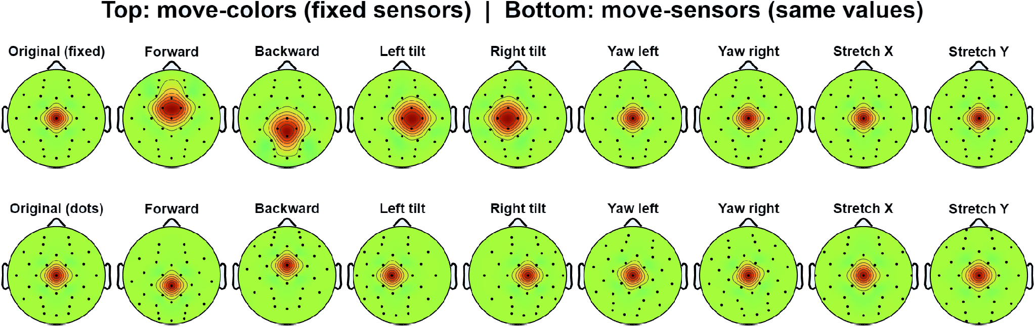
Spatial augmentation
WORKSHOP ON BRAIN-MACHINE INTERFACES
IEEE SMC 2026
Xaug = W X
W re-estimates channel values after a virtual cap perturbation
Tilts and rotations: 3 degrees
Stretch: 5-6% from the scalp center
FRESNO STATE
IEEE SMC 2026 · Workshop on Brain-Machine Interfaces

Slide 8
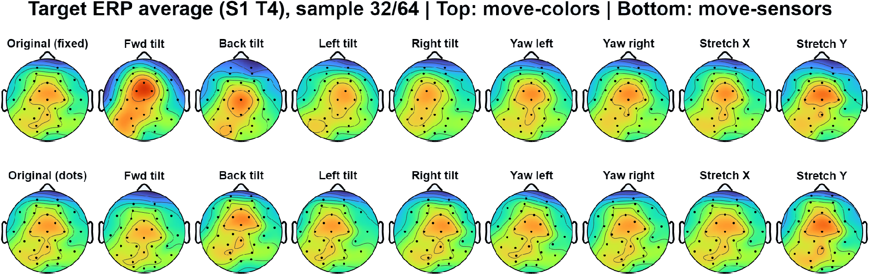
Spatial perturbations preserve a real ERP pattern
WORKSHOP ON BRAIN-MACHINE INTERFACES
IEEE SMC 2026
Target-evoked scalp topography from participant S1, sample 32 of 64
The class-related field remains recognizable while its sampled spatial distribution changes
FRESNO STATE
IEEE SMC 2026 · Workshop on Brain-Machine Interfaces

Slide 9
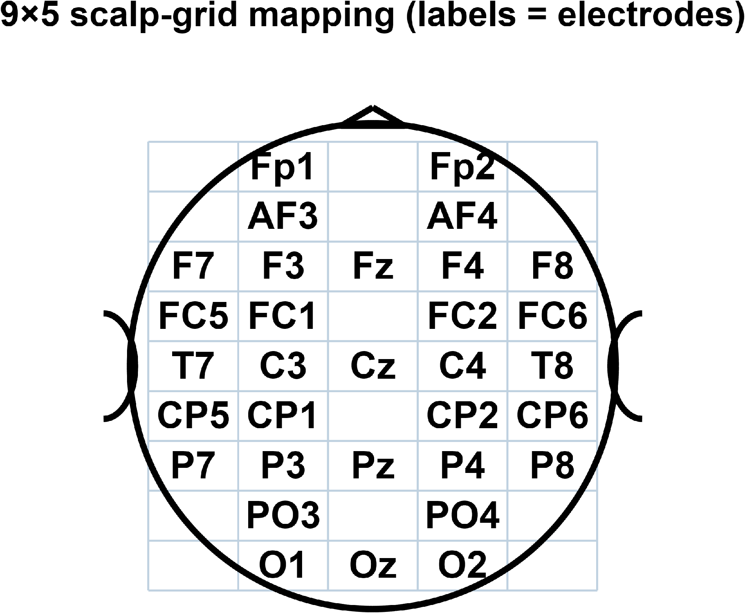
Two CNN representations
WORKSHOP ON BRAIN-MACHINE INTERFACES
IEEE SMC 2026
3D spatiotemporal CNN
2D space-time CNN
32 x 64 x 1
channel-time input
32 x 1
16 spatial filters
1 x 9
temporal block 1
1 x 9
temporal block 2
Input: 9 x 5 x 64 x 1
128 -> 2
FC + softmax
3D spatial filters, then temporal convolution
FRESNO STATE
IEEE SMC 2026 · Workshop on Brain-Machine Interfaces

Slide 10
Evaluation protocol
WORKSHOP ON BRAIN-MACHINE INTERFACES
IEEE SMC 2026
17
5
15
64
0.01
participants
stratified folds
training epochs
mini-batch size
initial learning rate
Primary metric
Repeated-measures statistics
Area under the ROC curve (AUC)
Friedman omnibus test
Mean across five folds for each participant
Wilcoxon vs NoAug, Bonferroni alpha = 0.0167
Validation epochs were never augmented
FRESNO STATE
IEEE SMC 2026 · Workshop on Brain-Machine Interfaces

Slide 11
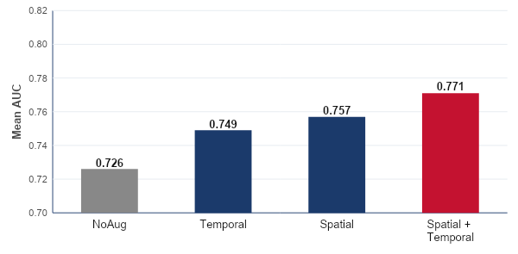
3D CNN results
WORKSHOP ON BRAIN-MACHINE INTERFACES
IEEE SMC 2026
+0.045 AUC
largest mean gain
vs NoAug
Combined reached
the highest mean AUC
Spatial + Temporal: 0.771 mean AUC
FRESNO STATE
IEEE SMC 2026 · Workshop on Brain-Machine Interfaces

Slide 12
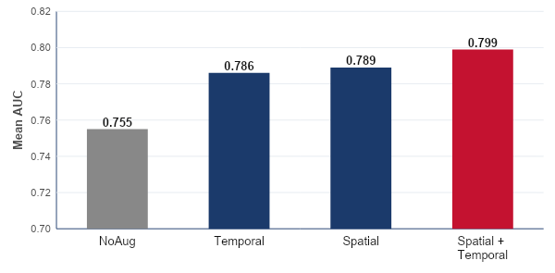
2D space-time CNN results
WORKSHOP ON BRAIN-MACHINE INTERFACES
IEEE SMC 2026
+0.043 AUC
largest mean gain
vs NoAug
Combined reached
the highest mean AUC
Spatial + Temporal: 0.799 mean AUC
FRESNO STATE
IEEE SMC 2026 · Workshop on Brain-Machine Interfaces

Slide 13
All planned comparisons were significant
WORKSHOP ON BRAIN-MACHINE INTERFACES
IEEE SMC 2026
Friedman omnibus tests
3D: p = 9.98 x 10^-4
2D: p = 2.80 x 10^-4
Comparison vs NoAug | 3D CNN p | 2D CNN p
Temporal | 0.0113 | 0.0023
Spatial | 0.0042 | 0.0031
Spatial + Temporal | 0.0005 | 0.0003
Bonferroni-corrected alpha = 0.0167
Every p-value remains below the corrected threshold
FRESNO STATE
IEEE SMC 2026 · Workshop on Brain-Machine Interfaces

Slide 14
Interpretation and limitations
WORKSHOP ON BRAIN-MACHINE INTERFACES
IEEE SMC 2026
What the results suggest
Limits on generalization
Spatial and temporal variability provide complementary training signals
Electrode-placement variability may dominate latency variability here
The 2D CNN may retain more information by avoiding scalp-grid projection
One RSVP face task with visually different target and non-target groups
Within-subject cross-validation only
Fixed rotations and stretches do not capture complex cap deformation
Optimal perturbation sizes may depend on montage and protocol
Both models benefit from
augmentation
Cross-session validation is the
next critical test
FRESNO STATE
IEEE SMC 2026 · Workshop on Brain-Machine Interfaces

Slide 15

Conclusion and questions
WORKSHOP ON BRAIN-MACHINE INTERFACES
IEEE SMC 2026
Domain-informed EEG augmentation improved single-trial detection
1
All augmentation strategies significantly improved AUC over NoAug
2
Spatial + Temporal produced the highest mean AUC for both CNNs
3
Spatial augmentation alone slightly outperformed temporal augmentation
Thank you
Questions?
midhun2412@mail.fresnostate.edu
FRESNO STATE
IEEE SMC 2026 · Workshop on Brain-Machine Interfaces

